Slide 1
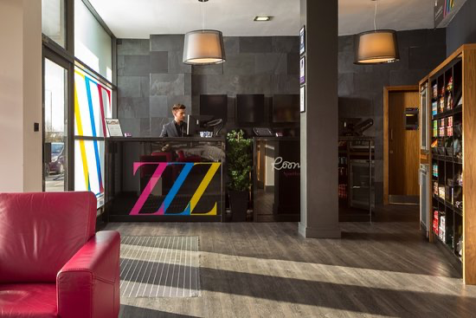
Roomzzz Aparthotel

Slide 2

Welcome to a flexible service apartment.
This hotel has a lot to offer to guests.
1. Most of the branches are around Leeds, York and Manchester etc.
2. The prices are at a good rate from low to high depending on your budget.
3. They offer the best service to the customers are always there 24/7 at your needs.
4. the hotel itself makes you feel at home with the rooms not cramped or tight space its like being at the comfort of your own home.

Slide 3
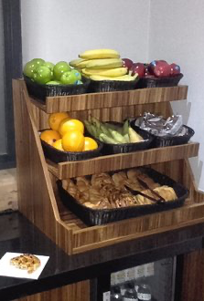
Why roomzzz is the perfect hotel to stay.
In my personal opinion I would definitely recommend this hotel to friends and family because I have stayed here numerous times In the past. The service is 10/0 from breakfast included when stay & the staff are there 24/7 to help you with your problems or needs. You get a beautiful room with WiFi, shower and tv with different channels also the cleaning is spot on. The hotel offers free tooth paste and tooth brush, shampoo conditioner and shower gel along with fresh towels in every bedroom, you get free coffee and tea too which is excellent if you forget to bring these things with you.

Slide 4
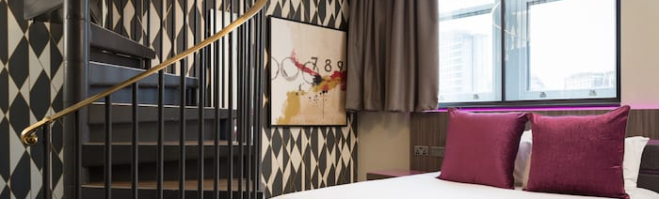
What does this hotel offer to customers
Free breakfast included.
Loyalty card for returning customers this is a bonus for better wifi and discounts.
Enough space not tight spaced like a cramped room
Earning rewards the more you stay
Room service (cleaning)
Everyone is there to help you at all times
Treats on arrival
From bath towels to hair dryers they offer a lot
The nicest and 10/10 cleaned rooms.

Slide 5
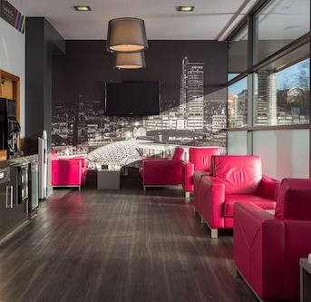
My personal experience
In my own opinion I can say this hotel has been the best for, the staff have treated me and my friends well every time we stayed. The hotel is like an apartment which is good for bigger space and privacy they had a separate building for the bigger rooms in Leeds. The reception is like a 5 minute drive away. I would recommend this hotel to a lot of people as I have a loyalty
card with them the more I visted the hotel give me discount and rewards like faster wifi or I can book a bigger room before anyone else can. This place is perfect for a night or two away with family and friends.

Slide 6
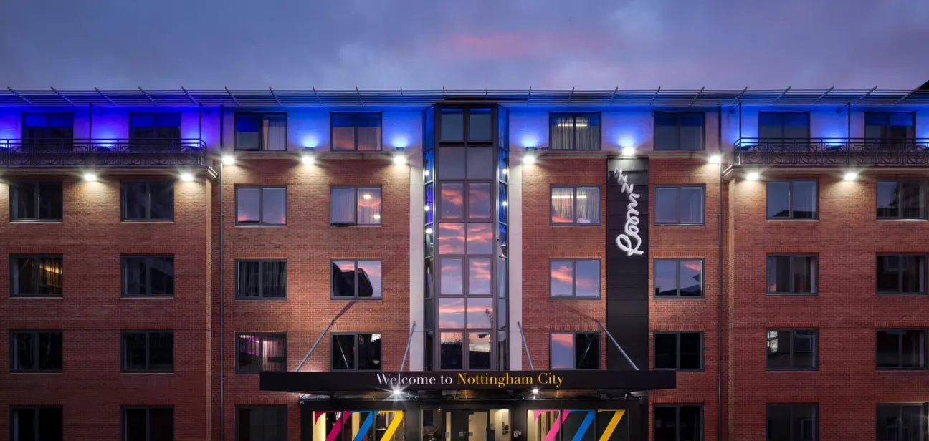
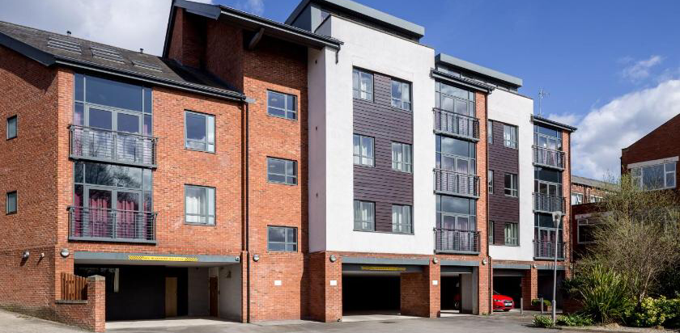
Roomzzz is a good popular hotel there is a few branches in the UK.
Chesterfied
York
Leeds
London
Manchester
Newcastle
Nottingham

Slide 7
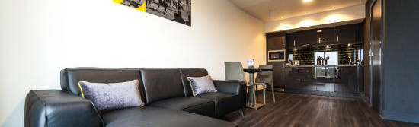
Award winning hotel
Based in 5 different areas in the uk, roomzz is a stylish aparthotel with flexible service and amazing rates even more when you join the perkzzz reward. This is a excellent hotel for the perfect visit.
During COVID they are extra safe and no need to worry about a thing. You meet to get your key from the reception and go to your room which is cleaned to a amazing standard fresh bedding, towels and dishes are sparkling clean too.

Slide 8


Every hotel is unique in there own way perosnally to me I think that for this certain hotel it’s the polite and lovely staff always there to help when needed, you can call from your room any point of your stay. I love the fact the bedrooms are fully furnished and spotless, the best part is you don’t even need to bring much with you.
They provide
Free towels
Free shampoo, conditioner and shower gel
Free coffee, tea , sugar and milk
Free tooth brush and tooth paste
Hair dyer and iron you can use
Tv with different channels
Ironing board

Slide 9
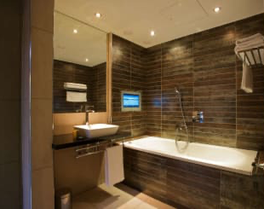
If you are ever in these areas and need a place to stay definitely come to roomzzz for affordable rooms from different prices.
The staff can help you with places to visit during your stay or finding a good food place to stay from room service is also there but I prefer to eat outside its much better.

Slide 10
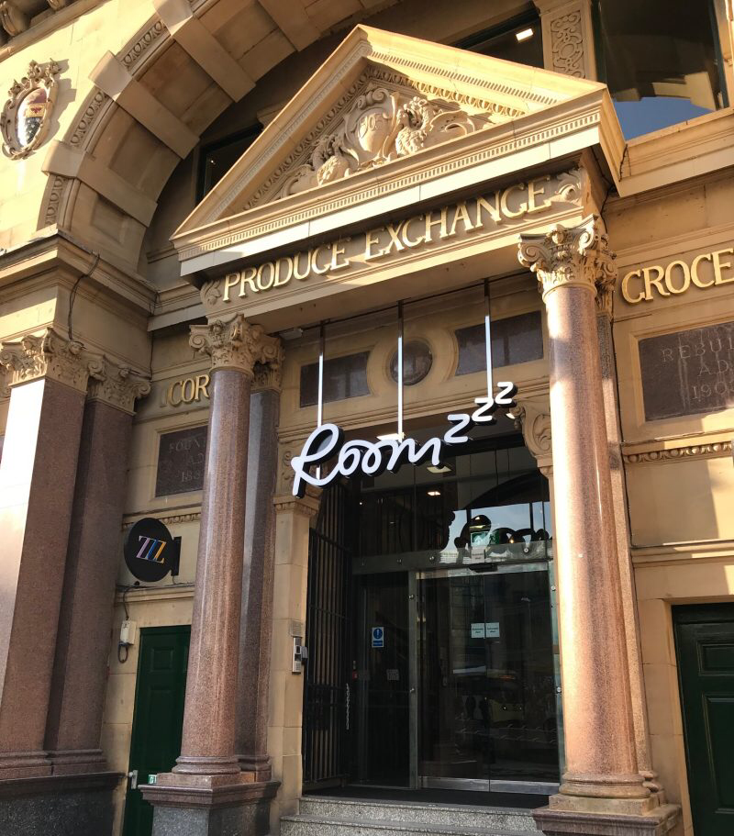
My overall review is that I am definitely going to book these hotel more often and continue t recommend to my family and friends. I am happy with the staff and the hotel rooms which are up to my standards and the rewards system is a bonus too.

