Slide 1

Stress in the UK
Fozia Kiani (2026354)
BMSW-4004
Problem solving and decision making
UWTSD
Task-1
Lecturer-Jonthan Wyatt.
Stress in the UK

Slide 2
Introduction
In this presentation to explaining about stress in the UK, also nature, scope and impacts.
Explain the Effects of the stress .in work-places.
An Evaluate through the analysis of Grid and pestle analysis.
An Evaluation to causes of stress on the organization .

Slide 3

What is stress?
Stress is termed as an unpleasant emotion state capable of affecting human function.
It is accompanied by emotional, physical and biochemical changes in the body.
Your body responds to change by changing its biochemical reactions in the brain corresponding to the phenomenon of stress (Edwards et al.).
The common response to attack (Selye, 1936);
Any influence that disturbs the natural equilibrium of the living body
Notes:
Stress affects a person’s ability to work efficiently. In today’s world of increasing physical illnesses, stress is also a major illness that is found in people of all ages. It has become very common for people to be affected by stress; therefore, stress in the workplace is increasing as well. In the UK, work related stress is taking up 80% of the employed sector. In this way, stress has become an alarming issue for the country which is affecting employees of all ages. Last year, these figures increased since the vast majority of people lost their jobs, and the financial difficulties they are experiencing are a major factor. People, in order to treat this illness, have resorted to spending huge amounts from their savings; last year, over 5.5 million people were hospitalized due to stress difficulties and spent millions of pounds on treatment. According to statistics, mental illness is a rising condition that affects people of all ages. It may have a significant impact on the proper functioning of the body, and it may be the cause of brain abnormalities, heart difficulties, and blood pressure problems. In almost every workplace, employees are found facing stress related issues which are compromising their productivity and ability to work efficiently.

Slide 4

Stress in Workers
Stress has severely started to impact organizations and its effects can be seen on employee productivity and mental health.
Psychological strain, caused by stress, can cause employees to act out and harm the organization.
Workers may be stressed due to several factors, such as harassment, long working hours, insufficient rewards, Instability in the workplace and so on (Hamaideh, 2011).
Notes:
Statistical data has proven employees to be unhappy with the work they’re doing in almost every workplace. There are a number of reasons behind this melancholy one of which seems to be them striving to always stay ahead of everyone else and striving to get to a better place professionally. This state of unsatisfaction with one’s position in the workplace and other such problems are the major reasons for stress among employees. Moreover, the policies and certain practices in the workplace can also have a negative impact on them hampering their productivity and demotivating them. Many companies take mental illnesses lightly ad don’t consider them as major issues that are affecting their employees. Unnecessary burdens and responsibilities on employees are a major cause of stress. Unfavorable work conditions cause stress in employees, and the problem becomes more complicated when an organization establishes a low degree of controls, the managerial staff fails to compensate their employees, and the support system between the hierarchies is not as it should be. (Bhui, K., et al. 2016) Employees are exhausted by the blame culture and prolonged work hours as a result of the chain's poor management abilities, and these difficulties serve as foundations for additional types of stress that they confront outside of the office.

Slide 5
Workplace Environment
Workers will be stressed out if they feel the organization is biased or against them.
The policies of the company should favor the employee.
There needs to growth for advancement and progress of the employees.
Workers should be encouraged to have a healthy work-life balance.
Management should play its part in ensuring the workers are satisfied and happy.
Notes:
The managerial staff of any company should be competent and co-operative. They are like the pillars of a company, and they need to be strong; if they aren’t, the employees are burdened with unnecessary responsibilities. Office policies should be powerful enough to assist their employees and favorable enough that they are mentally relaxed as a result. If an organization's policies and systems fail to compensate its employees, their efficiency gradually declines until they become a threat to the organization and their mistakes become too costly to correct. With different surveys of organizations, we’ve seen people not taking responsibility for their actions and blaming the lower-level employees. If management and managerial support are not helpful to employees, it is impossible to anticipate positive results from the outcomes. An organization is as good as its employees (Bhui, K., et al. 2016) Certain behaviours, such as unrealistic demands, a lack of support, collaboration, bad decision-making procedures, transparency concerns, and poor communication, have an impact on the working capacities of its employees, affecting the organization's health. Not only the environments, but also individuals, are suffering from difficulties that continue to undermine their legitimacy and workforce capacities.

Slide 6
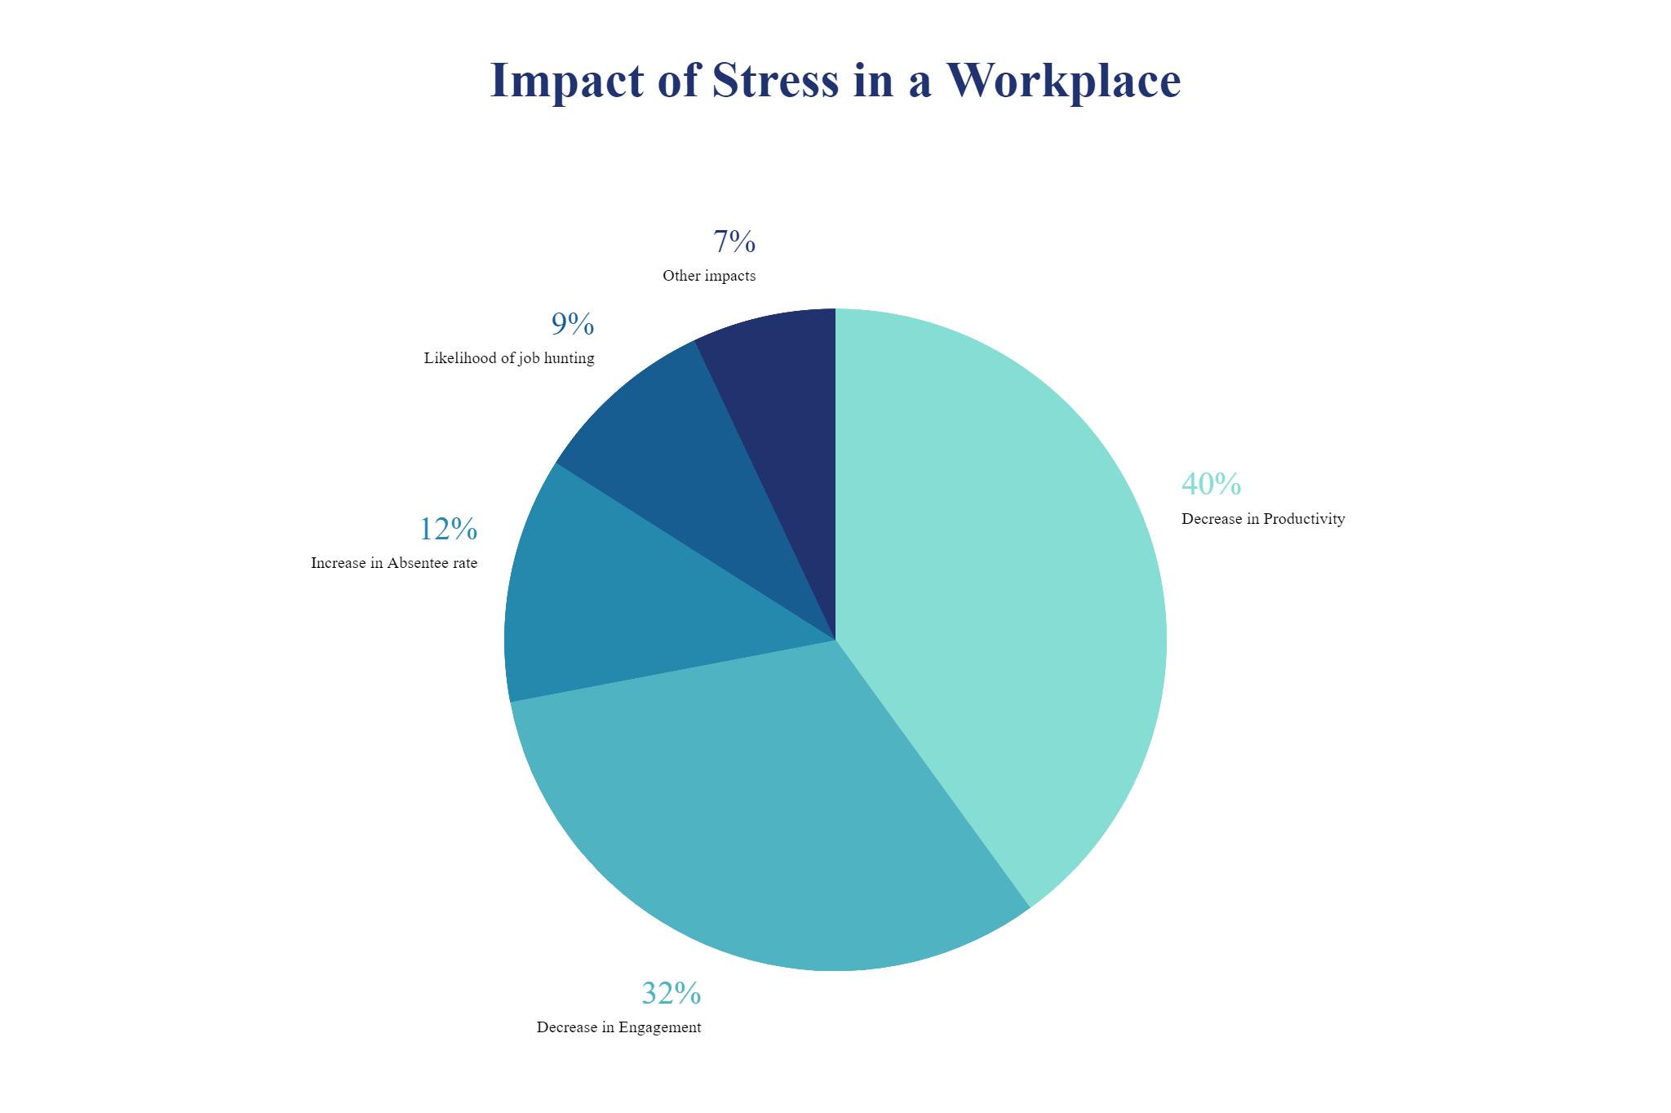
(Dagget, Molla and Belachew, 2016)
Notes:
The term psychology refers to a person's brain capacities. In a perfect scenario, an employee can offer the greatest possible outcome while also aiding his or her organization in accomplishing its desired goals. It’s not possible for every employee to comply with all the rules and policies without any complaints, its human nature. There might be some policies that the employees have problems with that affect their efficiency. Few firms collect data from various surveys conducted within their organization to discover solutions for poor performance, and they develop policies that help enhance job quality and reduce workplace stress. It is important to modify or alter the working conditions of an organization to make it easier for the employees to cope with the work and reduce psychological stress. (Raziq, A., & Maulabakhsh, R. 2015) Then, focus on individuals who are still struggling to cope with these implementations. The final objective is to develop individual and group relationships among employees and try to modify these relationships so that like-minded people work in groups, and these implementations may lessen stress among employees as they aspire to become useful members of the organization.

Slide 7
Causes and effects analysis
Work load
Management Role
Work overload
Misuse of power
Mood disorder
Lack of leadership
Poor Healthcare
Poor communication
STRESS
IN
WORKPLACE
Personal illness
Repeated mistakes
Family problems
Harassment
Friendship issues
Poor motivation
Personal issues
Poor support
(Plaford, G. R. 2018)
Notes:
Stress is commonly defined as a deviation from the regular functioning of the body that interferes with its optimal functioning. Given the comprehensive explanations for the rise in workplace stress, it would be insufficient to create a remedy to address these difficulties. Another view holds that stress, to a certain extent, can be useful because it pushes a man to his limits, but pushing too hard might lead to breaking. Managing stress and emotions includes healing, and it’s important to do that otherwise we are doomed to eternal grief. (Plaford, G. R. 2018) We need to find ways of engaging in different activities that help in relieving stress for example dancing, singing, sports etc. If these do not prove to be effective, one should seek aid, and organizations should provide counselling to their employees. There should also be some professional honesty among enterprises in that they support and motivate their people, and if necessary, aid. This instils confidence in other employees that their company cares about their well-being. Many firms ignore policies like these since the impacts of stress on employees, for some reason, lead to worse difficulties in the future and force them to face the costs sooner.

Slide 8
Pestle analysis
P POLITICAL | E ECONOMIC | S SOCIAL | T TECHNOLOGICAL | L LEGAL | E ENVIRONMENTAL
mistrust towards government policies. increase in taxations. lack of policies limiting causes of workplace stress. | Poor profit turnover for company. National/ international economic instability. | Workplace conflict among employees. Biasness or nepotism present in organisation. Misuse of power by high ups. | Advancement of technology leading to less job security. Human labour being replaced leading to job redundancy. | Legislative changes may force you to adapt procedures to comply with new legal obligations. This could include rules governing taxation. | These are becoming an increasingly influential area in business. Due to sociological trends of greener living. Increased pressure to reduce the rate of global warming.
(Reding, M 2021).
Notes:
Pestle represents societal political, economic, social, technological, legal, and environmental aspects. Pestle analysis elements can be explained in a variety of ways in our given topic of stress in the UK.
Political elements or points of view refer to how a government benefits from a certain industry. From a political standpoint, stress has some negative consequences in our case. If the employees of an organization are under a lot of stress and have not been able to perform well and efficiently, it could result in a loss for the organization and it would generate less revenue. Less revenue means less taxes for the government and from a broader perspective, fewer industries would be willing to invest in the future. From an economic standpoint, stress can lead to poor employee performance, stifling an organization's growth and limiting new opportunities that may have arisen. Because of inflation, the corporation may soon be unable to pay off its debts and may face financial difficulties. Stress can also have an impact on an organization's social balance because employees cannot work in groups for an extended period of time, which creates certain barriers for a business to operate in the long run. Assaults may occur more frequently among highly stressed workers than those experiencing less stress (Di Martino, V., 2003)

Slide 9
PMI for Employees
PLUS | MINUS | INTERESTING
Employee will be satisfied {+7} Less absence {+8} Financial support {+7} Confident level {+8} | Costly {-3} Less time {-2} Time to time change {-1} Internet problems {-3} | Attract more people {+8} Enjoy with new skills like {+6} digitals skills {+7} More Socialise {+7}
Total= +23
Total = -9
Total= +28
Total= 23-9+28= 42 This decision found through this analysis is feasible.
Notes:
PMI is a method to find results of any decision made by different figures collected estimated. This table shows employees pros, cons and interests during their period of work with company. The numbers are in order of positive and negative to show the result. Final result is calculated after completing table.

Slide 10
Grid analysis of work related stress
Element | Efficiency | Long term result | sources
Weights | 5 | 5 | 5
Departmental involvement | +4 | +3 | +3 =50
Personal involvement | 3 | 1 | 3 =35
Total = 44
Notes:
Work related stress is checked through grid analysis for a business which is calculated through table created above .Finally average of the total numbers is given in total. Grid analysis is one of the tool for compatibility of workers or business.

Slide 11
Solution to stress in workplace
Too much decrease in stress might lead to less effeincy of workers because a certain stress level help individuals be more productive.
The workers may have different responses to less stress-inducing workplace environment.
Some workers have better performave in a stressful environment.
(Bicer,2020)
Notes:
There are many ways that an organization can reduce stress in a workplace environment. One way is to take part in health and wellness retreats for workers. This would help the workers by giving them a place to refresh with their coworkers. Another option for reducing stress is to decrease the working hours and teach the employees to manage their time properly, so that they are nor overloaded by the work (BİÇER, 2020). Also, the manager can give each employee the appropriate workload so that they can have a better work-life balance and get the required sleep to be more productive and less stressed (Stander and August Korb, 2015). The organization can be open about its working so that the employees understand the economic position of the company and know when they are in danger of being fired due to downsizing (Cheng et al., 2021). By doing so, they would reduce the stress of the employees about being fired. Another measure that the organization can take to reduce stress is to have an open communication channel between the employees and the management (Panari et al., 2010). This way the employees will be able to share their problems and the management can resolve them.

Slide 12

Workers suffering from stress are more at risk to suffer from anxiety, a heart attack, substance abuse, burnout and so on.
Psychological impacts of Stress
Notes:
Other than workplace stress, there are other multiple types of stress that are just as dangerous and harmful and have a significant negative impact on the performance of employees. According to statistics obtained in 2020, work stress is at the top of the list, but other sorts such as financial restrictions, family difficulties, health problems, and personal relationships also affect a considerable number of people. These types are secondary but are still causes of the major problem faced by employees. For example, if an employee is having trouble at work and is always having difficulty coping with his job, it can lead to financial stress, such as losing his job, and over time, it can lead to marital troubles, family stress, and health problems. Therefore, trying to find the root cause of stress and addressing it is important in order to eliminate it. Various surveys have been undertaken, and they all show that workplace stress is the major cause of stress among people, with employees choking up between other types of stress. It is the organizations responsibility to keep a proper check on its employees mental and physical health and provide any assistance that is needed.

Slide 13
Stress impacts an Organization
Studies have shown that workers which have manageable stress levels are shown to more productive and more positive.
With manageable stress levels, workers were able to take fewer sick days (Grawitch, Ballard and Erb, 2015).
There was a boost in morale due to healthy stress levels.
Employees are also able to abstain from absenteeism at work.
Notes:
Stress in an unavoidable and inevitable element that can affect the day-to-day endeavors of individuals anywhere. (Vineet Kumar & Sandeep Kumar. 2014) It has been labeled "invisible" since it can affect that individual, others close to him, and his company, weakening the organization's pillars. If an organization is experiencing these issues in multiple employees and the quality of work they are performing, it is an unsettling situation for the organization, and they must take action to prevent the problem from spreading further and harming the organization in the long run. Ignoring it is not going to help at all. People face stress in their daily lives, such as students coping with academic obligations, people on the job and in business who must work hard to get their mind off being replaced or fear of losing their job or promotion. Stress has been shown to improve work performance by enhancing and polishing the employee's talents. However, crossing that limit can have an impact on individuals' capacities, as well as lead to physiological and social illnesses that are difficult to recover from and have an unexpected impact on the organization.

Slide 14

Conclusion
Stress needs to be managed properly among employees and kept within a healthy range in order to for it not to prove detrimental to the health of the employees or the reputation and working of the organization. Previously I could not explain PESTLE ANALYSIS which I have done now to change the slide of PESTLE. I also have fixed GRID ANALYSIS and PMI ANALYSIS. FISH BONE model also explained according to feedback given in my failed assignment.
Notes:
We have come to the conclusion that workplace stress is a huge issue in the UK, affecting many firms. Stress affects a person’s ability to work efficiently. It is inescapable, but certain precautions can be taken, and a few rules can be put in place to lessen the problem to the point where it is no longer a threat to an organization. The state of unsatisfaction with one’s position in the workplace and other such problems are the major reasons for stress among employees. They are like the pillars of a company, and they need to be strong; if they aren’t, the employees are burdened with unnecessary responsibilities. We may learn from reputable firms that invested in the well-being of their employees and received loyalty, efficiency, and devotion in return. If an organization is having problems, a specific department should brainstorm together, explore possible solutions, and allow everyone an opportunity to share their thoughts. This instils a sense of responsibility in employees since they are being honored, and it improves their performance and efficiency at work. Following this practice relieves the stress of being a lone warrior as well as the hesitancy to ask for support from superiors. Employees are motivated to seek solutions in a systematic and focused manner as a result of coaching, consulting, and motivation. Organizations can work on improving productivity by reducing stress in its employees. This can be accomplished by encouraging workers to take part in health and wellness retreats, decreasing the working hours, assigning appropriate workload to employees, being transparent about their workings, and having an open communication channel between the employees and the management. In conclusion, stress reduction in employees should be the goal of all organizations in order to be efficient and successful.

Slide 15
References:
BİÇER, C. (2020). IS OVERLOOKING WORKPLACE INCIVILITY JUST LIKE EXPERIENCING “BOILING FROG SYNDROME”? UNCIVIL BEHAVIORS AT WORKPLACE AND THEIR MAJOR NEGATIVE CONSEQUENCES AND HOW TO REDUCE THEIR NEGATIVE OUTCOMES. Ömer Halisdemir Üniversitesi İktisadi ve İdari Bilimler Fakültesi Dergisi.
Cheng, J., Usman, M., Bai, H. and He, Y. (2021). Can authentic leaders reduce the spread of negative workplace gossip? The roles of subordinates ’ perceived procedural justice and interactional justice. Journal of Management & Organization, pp.1–24.
Dagget, T., Molla, A. and Belachew, T. (2016). Job related stress among nurses working in Jimma Zone public hospitals, Southwest Ethiopia: a cross sectional study. BMC Nursing, 15(1).
Edwards, J.A., Webster, S., Van Laar, D. and Easton, S. (2008). Psychometric analysis of the UK Health and Safety Executive’s Management Standards work-related stress Indicator Tool. Work & Stress, 22(2), pp.96–107.

Slide 16
References:
Grawitch, M.J., Ballard, D.W. and Erb, K.R. (2015). To Be or Not to Be (Stressed): The Critical Role of a Psychologically Healthy Workplace in Effective Stress Management. Stress and Health, 31(4), pp.264–273.
Hamaideh, S.H. (2011). Occupational Stress, Social Support, and Quality of Life among Jordanian Mental Health Nurses. Issues in Mental Health Nursing, 33(1), pp.15–23.
Panari, C., Guglielmi, D., Simbula, S. and Depolo, M. (2010). Can an opportunity to learn at work reduce stress? Journal of Workplace Learning, 22(3), pp.166–179.
Stander, M.P. and August Korb, F. (2015). Depression and the Impact on Productivity in the Workplace: Findings from a South African Survey on Depression in the Workplace. Journal of Depression and Anxiety, 01(S2).
Stranks, J. (2005). Stress at Work (1st ed.). Routledge. https://doi.org/10.4324/9780080481180
Alanzi, S., (2018). PESTLE Analysis. Project Management.Available at: .https://scholar.google.com/scholar?hl=en&as_sdt=0%2C5&q=defination+of+pestle+analysis&btnG=#d=gs_cit&u=%2Fscholar%3Fq%3Dinfo%3AXhljAWid40MJ%3Ascholar.google.com%2F%26output%3Dcite%26scirp%3D2%26hl%3Den( Accessed on 05 April 2022).

