Slide 1
YSGOGwyr Newid: Adeiladu eich Brand Personol ar gyfer Cyflogaeth Gynaliadwy
Changemakers: Building Your Personal Brand for Sustainable Employment

Slide 2
ATGRYNHOI Recap
Beth rydym wedi’i drafod hyd yma?
What have we covered so Far?

Slide 3
AMCANION Y SESIWN Session Objectives
Erbyn diwedd y sesiwn hon byddwch yn gallu:
  Gwerthuso’n feirniadol fodelau adfyfyriol allweddol
  Trafod sut mae’r modelau adfyfyriol yn ymwneud â datblygu eich brand personol.
By the end of this session you will be able to:
  Critically evaluate key reflective models
  Discuss how the reflective models relate to developing your personal brand.

Slide 4
DAMCANIAETHWYR ALLWEDDOL
Key Theorists
Gibbs
Kolb
Schön
Driscoll
Gibbs
Kolb
Schön
Driscoll

Slide 5
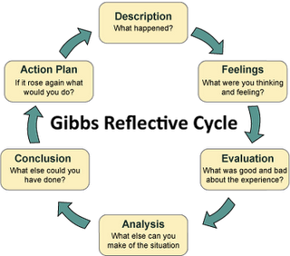
Gibbs
Beth wyddoch chi am Gibbs?
What do you know about Gibbs?

Slide 6
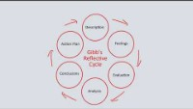

Slide 7
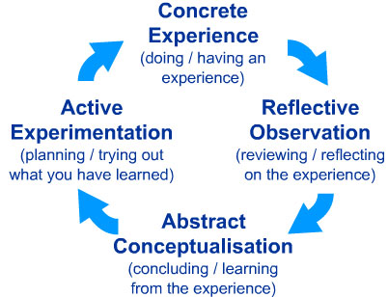
Kolb
Manteision
  Man cychwyn sylfaenol? Yn cynnwys gwneud, gofyn sut/pam, gwneud dyfarniad, profi.
Anfanteision
  adfyfyrio arwynebol – dim cyfeiriad at feddwl yn feirniadol/ dadansoddi /tybiaethau
Pros
  Basic starter? Consists of doing, asking how/why, making judgement, testing out.
Cons
  superficial reflection- no referral to critical thinking/analysis/assumptions
Notes:
Concrete experience:
You consciously and physically experience a situation, which makes you realise that you need to reflect systematically in order to learn something new or improve on your existing skill and practice. At this stage you will make a note of the specific situation and just describe what you see, how you feel and what you think.
Reflective observation:
Having written down the description of the experience, it is now time to reflect more deeply on what has happened in that situation. The questions you need to ask yourself are: what worked? what failed? why did the situation arise? why did others and I behave the way we did?
Abstract conceptualisation:
The guiding question for this stage leads on from the questions in the reflective observation stage: what could I have done better or differently? how can I improve? Initially, you try to find different ways for dealing with the situations and think up strategies for when you experience a similar situation again. Also, this is the stage where you should consult colleagues and literature in order to get a better understanding and further ideas.
Active experimentation:
This stage is now practising the newly acquired theoretical knowledge. You take your own reflections and thoughts about improvements as well as the theories back into your practice and try out the new strategies. Some of them will work, others won’t, so this is then automatically the basis for the new cycle. As the experiences within the active experimentation stage become the new “concrete experiences”.

Slide 8
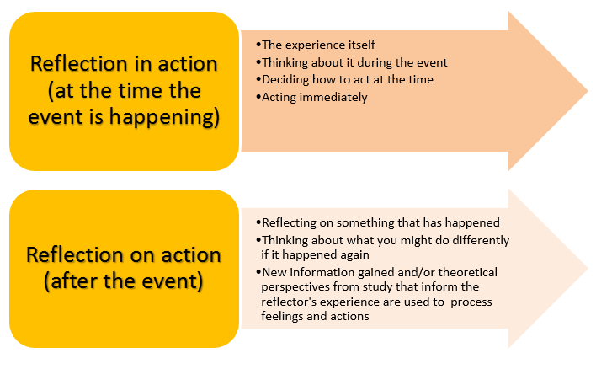
Schön
Manteision
  Model proffesiynol: ennill sgiliau proffesiynol a chynyddu hyder proffesiynol.
Anfanteision
  yn amlygu’r gwahaniaeth rhwng y ddau fath o adfyfyrio ond ddim yn rhoi cyfarwyddyd helaeth ynghylch cyflawni’r naill na’r llall
Pros
  Professional model: gaining professional artistry and increasing professional confidence.
Cons
  highlights the difference between the two types of reflection but does not provide extensive guidance for carrying out either
Notes:
Reflection-in-action, sometimes described as 'thinking on our feet', is the process that allows professionals to reshape the situation or activity on which they are working while it is unfolding. It is generally associated with the experience of surprise: Schon suggests that, by "reflecting-in-action", professionals reflect on unexpected experiences and conduct 'experiments' which serve to generate both a new understanding of the experience and a change in the situation.
Reflection-on-action involves reflecting on an experience, situation or phenomenon after it has occurred. When professionals "reflect-on-action" they explore what happened in that particular situation, why they acted as they did, whether they could have acted differently, and so on. Reflection-on-action is often associated with reflective writing in which professionals reflect on their experiences and examine alternative ways to improve their practice.

Slide 9
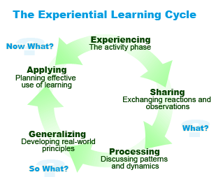
Driscoll
Manteision
  Hawdd ei gofio pan fyddwch hwnt ac yma, drwy ddefnyddio “Beth? Beth felly? Beth nawr?”
Anfanteision
  ddim yn arwain at adfyfyrio dyfnach amdanoch chi eich hun, dim ond am y sefyllfa.
Pros
  Easy to remember when you’re out and about using the simple “What? So what? Now what?”
Cons
  does not lead to deeper reflection about yourself, only the situation.
Notes:
Driscoll (2007) first developed their reflective model in 1994 as a framework to guide self-reflection on specific events or happenings. The model was based on the 1970s work of Borton (1970) who had advocated for reflective practice using three questions: What? So what? and Now what? (Driscoll, 2007). These three questions are useful but may be argued as somewhat ambiguous, so Driscoll's development took Boston's questions and matched them to an experiential learning cycle (Driscoll, 2007).
Driscoll's (2007) model is designed for the learner guide their own learning by reflecting on the event using the three questions, with the addition of guidance regarding what should be incorporated at each stage pf the model. The first stage, the What? Is where the learned should reflect on what happened, first considering why they are undertaking the reflection. For example, the learner may want to understand why they reacted in a specific way, to assess what went right or what went wrong and identify behaviours or practices to avoid, repeat, or improve, or any combination of these motivations. The what stage is a descriptive stage, describing what occurred, the questions which may be used at this stage to fully describe what occurred may include several of the following questions:
• What was it that happened?
• What did you observe?
• What action(s) did you take?
• How did you react?
• How did other people react?
• What are the most important elements in the event?
This stage is purely descriptive; it is not asking why, the stage is merely allowing the data to be collected that will form the framework for the next stage of the analysis. However, the process does require the user to be honest and recall events accurately.
The second stage is the So What? question. This is the stage where the analysis is undertaken, and it the stage where most learning will be undertaken. By asking So What? the model will trigger the cognitive processes to increase understandings of the event (Driscoll, 2007). During this stage, the learner will examine their own feelings regarding the event and assess the way their feelings impacted on their behaviour or actions (Driscoll, 2007). Questions the learner may ask themselves during this stage include:
• What did you feel during the event?
• How do you feel about it now?
• Do you feel differently now? If you do, why do you feel differently?
• Why did you react (or fail to react) in the way you did?
• What (if any) were the positive aspects of the happening?
• What were the negative or worrying aspects of the experience?
• Were your experiences different to others? If so, why was that?
The second stage requires the learned to accept and acknowledge weaknesses or errors, but it is also a stage where the strengths and good reaction may be recognised. The understanding of what happened leads naturally to the last stage: Now What?
The third question leads to the improvement with the learner developing an action plan to decide who they will react or behave the next time they are in a similar position (Driscoll, 2007). To adjust behaviours and reactions, the learner must have self-awareness and understand how and why they acted or reacted in a specific way (Perusso, Blankesteijn and Leal, 2019). By understanding and being aware of the issues, they may adjust their reactions, even if the improvements are not fully aligned with the desired outcomes (Moon, 2004). Questions a learner may ask themselves during this stage may include:
• What impact did the event have on/for you?
• What needs to take place to alter the outcome?
• What actions would you take next time in the same situation?
• What information will you need when you face the same situation again?
• What do you need to prepare or adapt so you can improve your performance the next time?
This is a planning stage: by determining what needs to be done next time the learning process is brought to the fore, allowing a proactive approach which is more likely to create change compared to an unstructured and anecdotal review or unplanned approach (NMC, 2020; Driscoll, 2007). The process creates a cycle, as when the event or a similar event occurs, the same stages of What? So What? And Now What? with the next first stage identifying what happened and how, which will reflect any changes which are made and will allow reflection of the process, creating an ongoing learning cycle (Driscoll, 2007)

Slide 10
TASG Task
Mae’r pedwar model adfyfyriol oll yn cael eu beirniadu am fod yn rhy fas o ran eu hadfyfyrio.
Mewn grwpiau bach ymchwiliwch i fodelau adfyfyriol sy’n darparu ar gyfer mwy o adfyfyrio gan y dysgwr.
Byddwch yn barod i gyflwyno i’r grŵp
The four reflective models are all criticised for being shallow in their reflection.
In small groups research reflective models that allow for greater reflection from the learner.
Be prepared to present to the group.

Slide 11
SUT MAE HYN YN YMWNEUD Â’CH BRAND PERSONOL?
How does this link to your personal brand?
Trafodaeth
Discussion

Slide 12

Cwestiynau?
Questions?​

