Slide 1


Slide 2
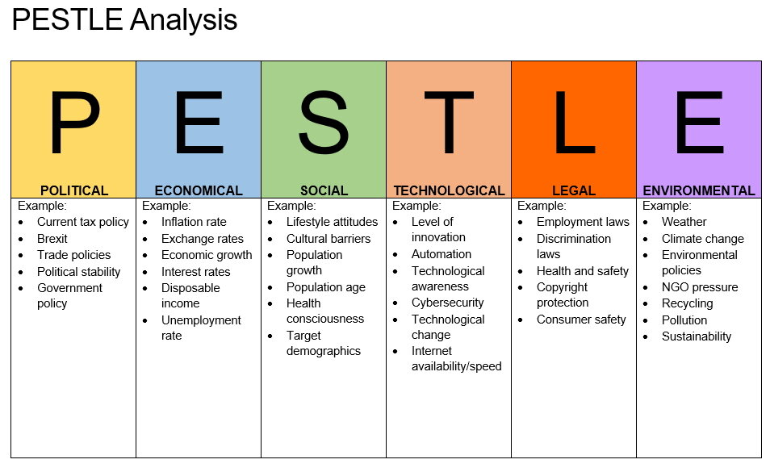
PESTEL
P= POLITICAL
E= ECONOMY
S= SOCIAL
T= TECNOLOGY
E= ENVIRONMENTAL
L= LEGAL

Slide 3
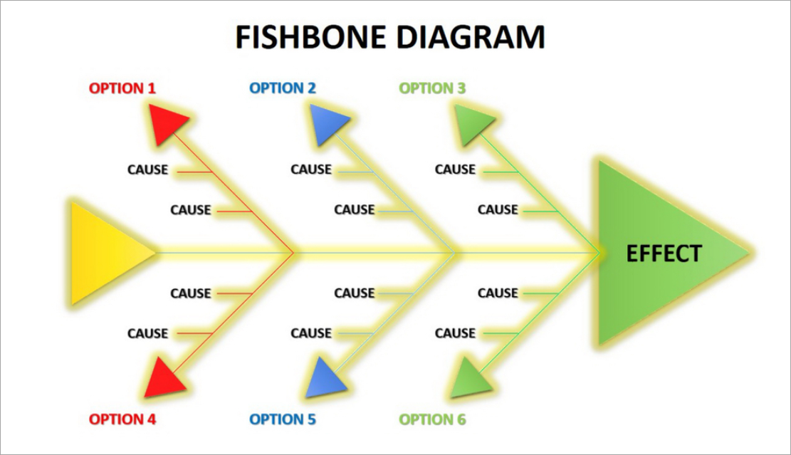
Fishbone “Kaoru Ishikawa”
Man
Machine
Measurement
Method
Material
Environment

Slide 4
Rational decisionmaking matrix
bad=2
poor=3
ok= 1
good=4
very good=5
solutions | weighting | cost |  | time |  | impact on staff |  | impact on customers
 |  | score | total | score | total | score | total | score | total
close stores | 5 | 5 | 25 | 3 | 15 | 2 | 10 | 3 | 15
reduce staff | 4 | 3 | 12 | 4 | 12 | 3 | 12 | 3 | 12
use only owed stores | 4 | 4 | 16 | 3 | 12 | 3 | 12 | 3 | 12
ask for loan | 2 | 2 | 4 | 3 | 8 | 4 | 8 | 5 | 10
 | total |  | 57 |  | 47 |  | 42 |  | 49

Slide 5
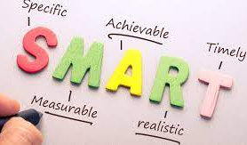
Smart goal
Specific: detail
Measurable: putting figures signs
Achievable: needs to be possible
Relevant : it has to give you solutions
Time bound: it has to be achievable in a specific time

Slide 6

Planning
What is action planning?
What is monitoring ?
What is evaluation?

Slide 7
Reference
T.M.Lewin: Shop online men's shirts, suits & accessories (no date) tmlewinuk. Available at: https://tmlewin.co.uk/ (Accessed: November 6, 2022).
TM lewin calls in administrators for second time in two years (2022) The Guardian. Guardian News and Media. Available at: https://www.theguardian.com/business/2022/mar/17/tm-lewin-calls-in-administrators-for-second-time-in-two-years (Accessed: November 6, 2022).
WW, F.N. (no date) TM lewin rescue deal imminent - report, FashionNetwork.com. Available at: https://ww.fashionnetwork.com/news/Tm-lewin-rescue-deal-imminent-report,1395566.html (Accessed: November 6, 2022).
Daily (2022) TM lewin could return to high street after being rescued, This is Money. This Is Money. Available at: https://www.thisismoney.co.uk/money/markets/article-10701123/TM-Lewin-return-High-Street-rescued.html (Accessed: November 6, 2022).

