Slide 1
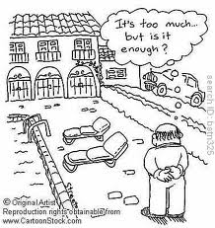
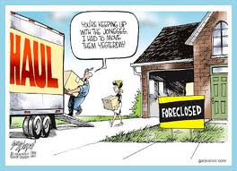
Class Relations

Slide 2
Key Themes
How is class performed through consumption, leisure, lifestyle and objects
Conspicuous consumption
Class as
  Distinction
  Taste
Can we think of class relations as a form of emulation?
Gender, generation and its interplay with class

Slide 3
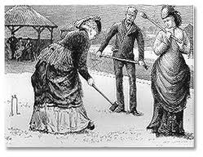
Veblen (1994), The Leisure Class
Conspicuous consumption and its relation to class
Spending for the sake of prestige
Symbolic, over the utilitarian, role of goods
The way that the elite ‘leisure class’ differentiated themselves from the working class

Slide 4
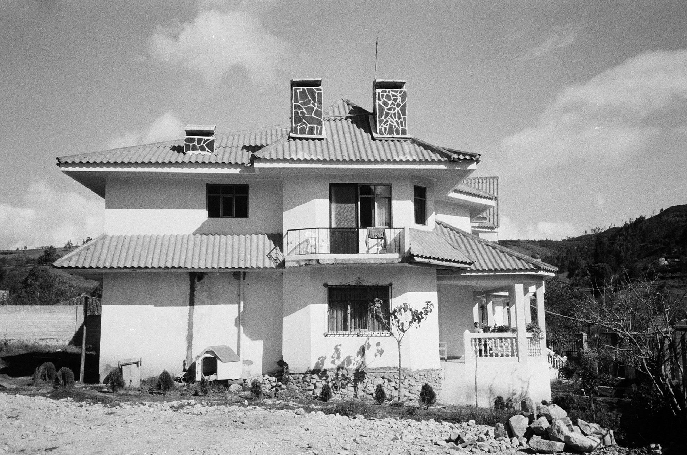
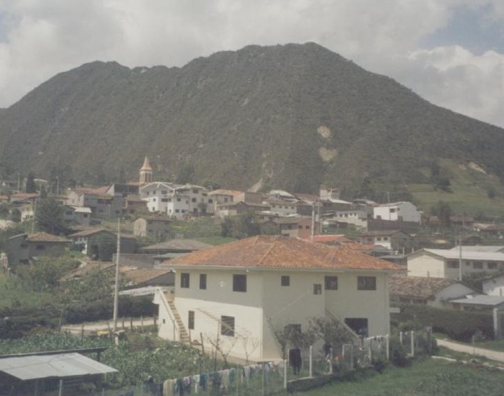
Influence in Ethnography
Abbots (2012):
  Domestic Service among the Migrant/Peasant Class
Conspicuous consumption
Social value of ‘leisure’

Slide 5
Emulation
The leisure class set the social standard
Working class aspire to attain that standard
“the possession of goods …becomes the conventional basis of reputability” (Veblen 1994 : 37)

Slide 6
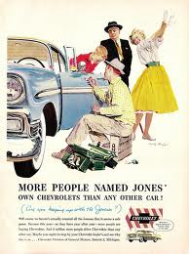
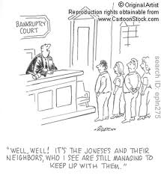
Or in other words…..

Slide 7
Exercise: Good and Bad Taste
Organise your examples into those that are:
  Good Taste
  Bad Taste
How is social class reflected in these examples?
  Pick a few key examples
What would Bourdieu have to say about this?

Slide 8
Bourdieu (1984) Distinction
‘Taste’ among the French bourgeoisie
They distinguish themselves from other classes through their everyday consumption of household items,
  such as furniture, clothing and food
Different social groups inhabit differentiated social spaces
These are characterised by distinct lifestyles

Slide 9
Cultural Capital
The difference between cultural and economic capital
‘Taste’ is a mode of social and class distinction
The cultured elites are distinguished from the newly-wealthy,
  not in terms of their material resources
  but in the expression and articulation of their preferred everyday ‘tastes’

Slide 10
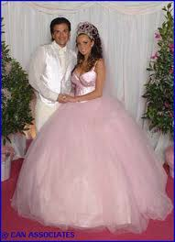
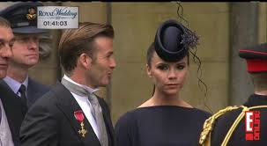
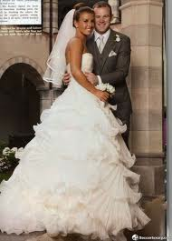
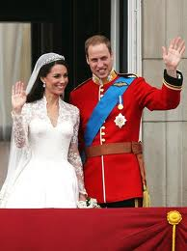

Slide 11
Broadcasting Class
Taste performs a social orientation role
Gives a ‘sense of one’s place’
Possession of certain ‘prestige’ commodities becomes a means for an individual to acquire and express social status
Aesthetic judgements are culturally and socially determined

Slide 12
Habitus, Emulation and Trajectories
Tastes change and the goal posts move
Trajectory Effect
  Practices of a given group (habitus)
  Objective possibilities that are open to them
Relationship is not static
Symbolic boundaries are social boundaries
Struggle over ‘tastes’ are political struggles

Slide 13
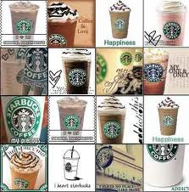
Roseberry (1996), Yuppie Coffees
The emergence of gourmet coffee market in the US
Backdrop of declining sales
Shift from mass market to segmentation
Imagines, but also reflects existing, class and generational relations

Slide 14
Are you an individual or a ‘Joel’?
We may think of ourselves as actors and individuals
But our ‘choices’ are shaped along class lines
Not an orchestrated conspiracy by big business
Small and medium players, and new entrants to the market
Bumbling experimentation and stumbling upon strategies

Slide 15
Abbots (2011, 2012)
The migrant peasantry are forging new routes of distinction
  Through their consumption practices
Emulation of the elites and middle classes is limited
Orientated towards different sites of symbolic value
Emergence of new class boundaries and new sources of culture capital

