Slide 1
Portfolio – 4 Elements
Flavian Branescu
2434712
Daniel Payne

Slide 2
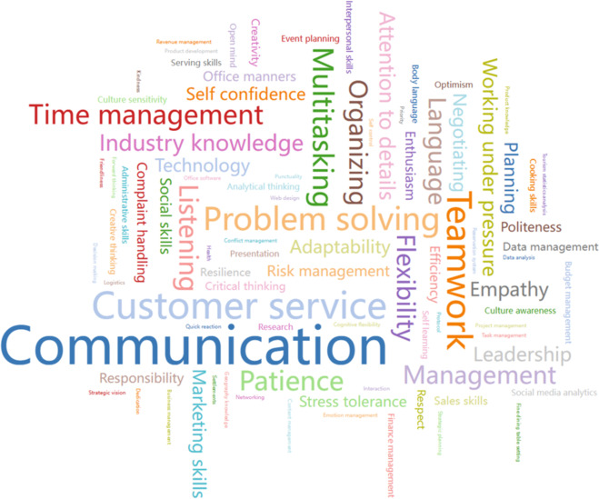
Weeks 2-8
Communication
Time Managemet
Digital Skills
Writing Skills
Referenceing

Slide 3
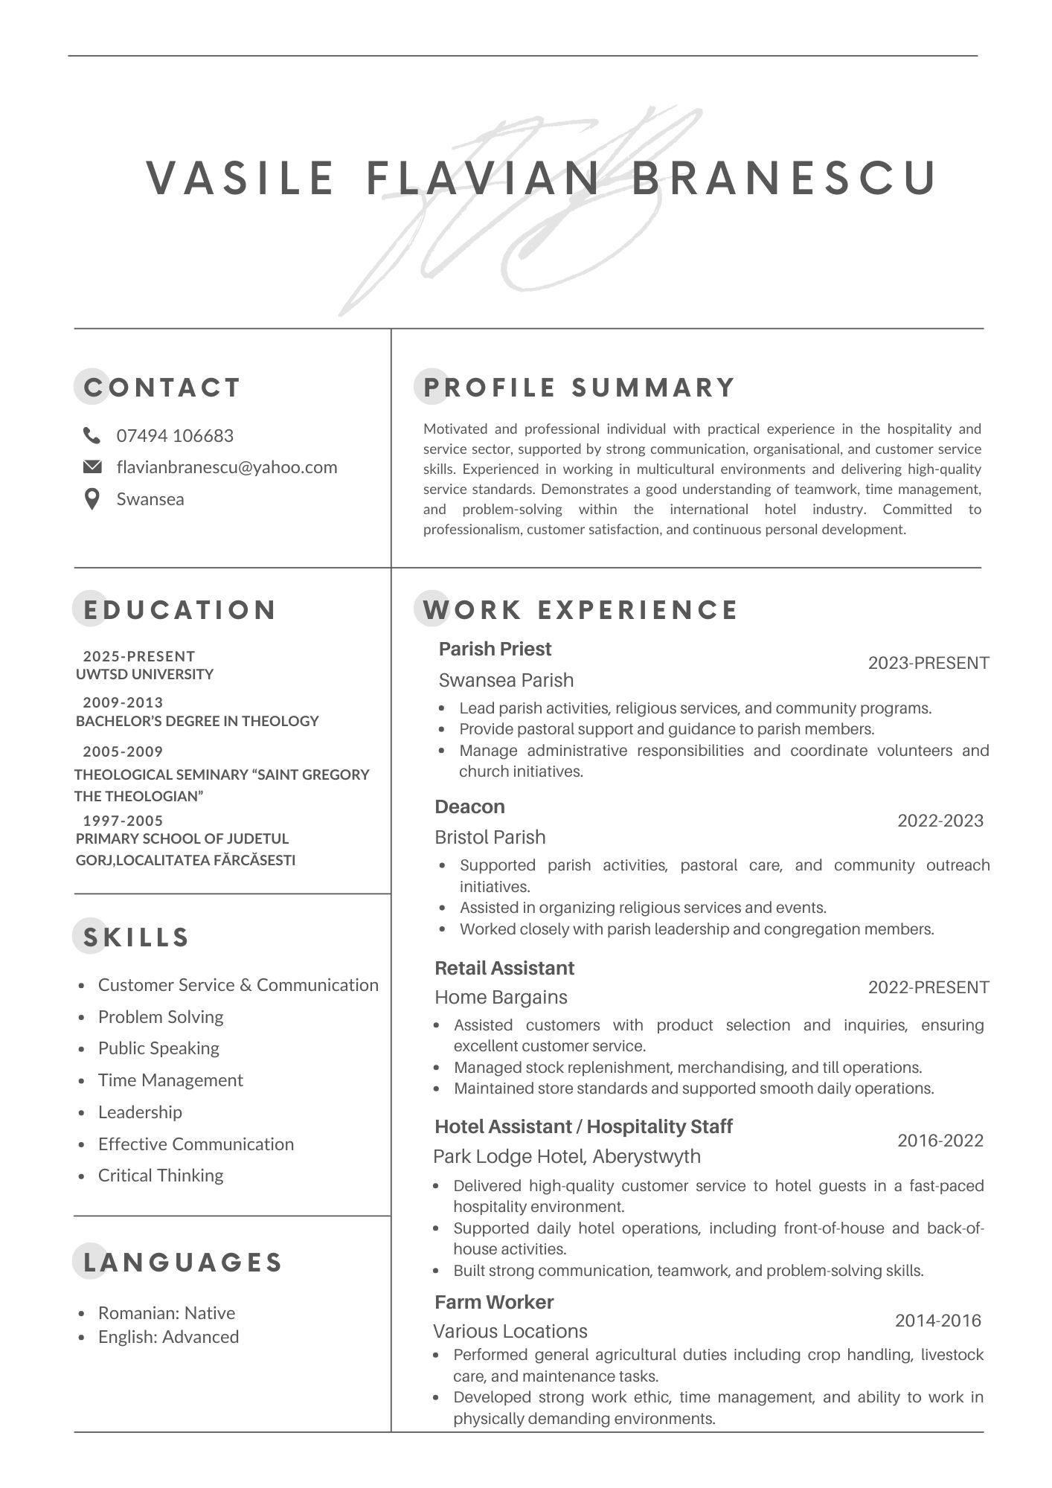
CV/LinkedIN
LinkedIn Personal link to Account

Slide 4

Action Plan
Build a professional network on LinkedIn and industry events
Enhance leadership, problem-solving, and time management
Improve international customer service knowledge

