Slide 1
Religions in Africa
Prof Bettina E. Schmidt

Slide 2
Topic Today
Religious Diversity in Africa
Core Reading:
Grillo, Ndzovu, H. J., & Van Klinken, A. S. (2019). Religions in contemporary Africa : an introduction. London: Routledge. [e-copy via UWTSD library]

Slide 3
Reasons to study religions in Africa
Long and rich history
Second largest continent in the world and very diverse
Through centuries Africa has been involved in trans-continental exchange and interaction.
Vital part of the contemporary world and focus of a new “scramble of Africa” (referring to the colonial engagement) due to demographics (next slides)
Notes:
Grillo and van Klinken list five reasons to study religions in Africa (p. 4):
“First, the continent has a long and rich history, and has been home to great civilizations and cultures (Parker and Rathbone 2007). Second, as the second largest continent in the world, Africa is enormously diverse; it presents a great variety of cultural and artistic traditions, beliefs and values, forms of social organization and political structures. Third, through the centuries Africa has been involved in trans-continental exchange and interaction, informing Europe, the Middle East, Asia, and the Americas (Reid 2012). Fourth, today Africa is a vital part of the contemporary world, commanding an ever-increasing cultural, economic and political significance.”

Slide 4
Growing population
In 2018, the continent’s population was about 1,300,000,000, which is 17 per cent of the total world population.
It is expected to almost double to over 2,500,000,000 by 2050 (Worldometers 2018).
(cited by Grillo and van Klinken, p. 4)
Notes:
Africa has a rapidly growing population with a comparatively young demographic. In 2018, the continent’s population was about 1,300,000,000, which is 17 per cent of the total world population. It is expected to almost double to over 2,500,000,000 by 2050 (Worldometers 2018).

Slide 5
And overall young population
Median age in Africa is 19.4 years
-> half of the population is even younger
Africa = youngest continent in the world
Notes:
the median age in Africa is 19.4 years, meaning that half of the population is even younger, making Africa the youngest continent in the world

Slide 6
These demographics lead to
New cultural production, economic activity and social change
As well as migration out of Africa
It might also lead to increased social tensions and political conflicts about scarce economic resources
Notes:
This demographic situation will not only stimulate new cultural production, economic activity and social change on the continent, but could also intensify migration from it. It is also likely to increase social tensions and political conflict about scarce economic resources.

Slide 7
Another reason
5. “Unfortunately there exist many stereotypes and misrepresentations of African cultures and societies, especially in Europe and North America where the relationship to the continent is built on the history of the slave trade and colonization.” (Grillo, van Klinken, page 4)
Also ignorance of African history among youth in Africa
Notes:
“Fifth, unfortunately there exist many stereotypes and misrepresentations of African cultures and societies, especially in Europe and North America where the relationship to the continent is built on the history of the slave trade and colonization. Ironically such distortions are also prevalent on the continent itself where many people, especially youth, are ignorant of African history and alienated from its traditions.”

Slide 8
But why study religions?
Rich diversity of religious traditions including a long history of Christianity and Islam on the continent
Religious practice intertwined with other spheres of life such as cultural production, social organization, political institutions and economic activity.
    -> Understanding religion is key to understanding African societies
Notes:
“In addition to the general importance of studying the African continent, we believe it is of vital importance to learn about religions in Africa for a variety of reasons. First, the continent is home to a rich diversity of religious traditions. The beliefs, rituals and practices of indigenous religions differ among the ethnic groups of any given country, and vary even more widely from region to region. Christianity and Islam both have a long history and strong presence in Africa, and have also been shaped by African cultural, social and political contexts. All religious tradition is subject to the complex processes of religious change over time, and religions in Africa remain relevant to the changing circumstances on the continent. Second, religious practice in Africa is deeply intertwined with other spheres of life, such as cultural production, social organization, political institutions and economic activity (Ellis and Ter Haar 2004). Thus, understanding religion is key to understanding African societies generally. Religion is so much a part and parcel of African life that we even dare to say that one cannot understand African politics, media, popular culture and so on without engaging with religious thought and practice.

Slide 9
3. Due to transatlantic slave trade and more recent migration patterns, the religious traditions of Africa have spread globally
4. “the concept of religion itself – what we think “religion” is and does – has historically been defined by Western traditions, and therefore can be enriched, nuanced and complicated by the study of religious thought and practice in African societies.” (Grillo/van Klinken, p. 5)
Notes:
Third, as a result of the transatlantic slave trade and more recent patterns of migration and globalization, the religious traditions of Africa – indigenous religions as well as African forms of Christianity and Islam – have spread globally and have a profound impact on religious cultures worldwide. Thus, knowledge of the African religious climate is crucial to understanding the everexpanding plurality of religions in our globalizing world. Fourth, the concept of religion itself – what we think “religion” is and does – has historically been defined by Western traditions, and therefore can be enriched, nuanced and complicated by the study of religious thought and practice in African societies

Slide 10
Diversity of religions in Africa
In addition to a range of traditional religions also Islam and Christianity (or better Christianities) as well as Hinduism and even Judaism
Over time new combinations developed

Slide 11
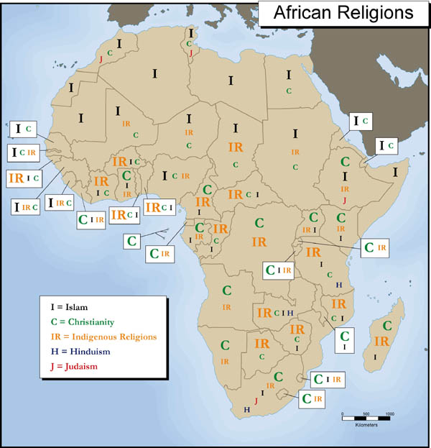
African religious landscape

Slide 12
Indigenous religions
Countless traditions across sub-Saharan Africa
Each has a different focus though some similarities exist
  To be presented next week

Slide 13
Early roots of Christianity
Continues presence of Christianity in Africa since the 1st century
Start in Egypt with the first church in Alexandria, formed by a group of Jewish converts to Christianity with direct links to the apostles
the first bishop of Alexandria was ordained in the year 62

Slide 14
From Alexandria, the Christian faith spread further into Egypt and then to North Africa
the Christian centres in Egypt and North Africa played a leading role in establishing the early church
For six centuries the church flourished in North Africa and Egypt before the arrival of Islam

Slide 15
Ethiopian Orthodox Church
Roots even in pre-Christian time with the Queen of Saba mentioned in the Hebrew Bible
the Ethiopian Church is one of the oldest Christian church (founded around 500) and still present as a form of African Christianity

Slide 16
Missionary Christianity
the early introduction of European Christianity in settlements on the coast of the continent, from the 15th to the 17th century
The Kingdom of Kongo was Christianized in the 16th century

Slide 17
Missionary Churches
Establishment of various Protestant missionary societies from the turn of the 19th century that started working in Africa
  Such as the Baptist Missionary Society (founded in 1792), the London Missionary Society (1795), the Basel Mission (1815) and the Paris Mission (1822).
A few decades later, from the 1840s, Catholics also became active in Africa, through a range of missionary congregations established in France and to a lesser extent Italy, Belgium and Germany

Slide 18
“Missionaries instilled in Africans the idea that becoming Christian meant to become “civilized” (that is, Europeanized).
Moreover, conversion gave access to education and employment opportunities under the colonial system.” (Grillo/Van Klinken, p.40)

Slide 19
Post-colonial development
during the 1960s/70s most African countries gained independence
-> Development of African Independent Churches
for instance: Prophet-Healing or Spiritual Churches, emerged from the early 20th century

Slide 20
Islam
The presence of Islam varies by region
Islam is most strongly represented in North Africa
with significant adherence within West Africa and East Africa
Weaker in South Africa

Slide 21
Islam first arrived in Ethiopia (615–616) at a very early stage, through Arab Muslim converts seeking asylum.
Arab-Muslim forces conquered Egypt in 639 and bought it under Muslim control
Afterwards conquest of much of the North African region

Slide 22
Islam in sub-Saharan West Africa was diffused by migration of Muslim merchants, teachers and settlers linked together by trading networks, family connections, teacher-student and Sufi fellowship.
On the coasts of the Indian Ocean and the horn of Africa another form of Islamic civilization emerged due to the influence of Muslim traders and settlers upon the local African communities.

Slide 23
Other religions
There is also a presence of Judaism and Indian religions (mainly Hinduism) in several sub-Saharan countries
Due to migration or trade connections

