Slide 1

Enterprise and Entrepreneurship
Assessment Task 2
Individual Presentation
Notes:
To change the image on this slide, select the picture and delete it. Then click the Pictures icon in the placeholder to insert your own image.

Slide 2
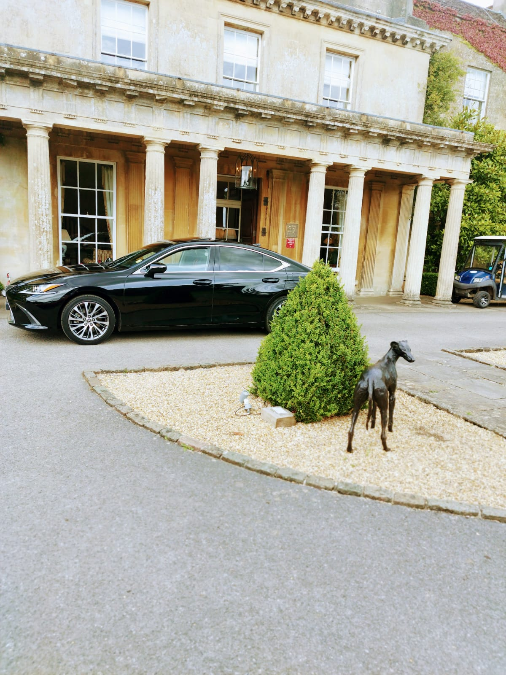
Business Plan
Module: Enterprise and Entrepreneurship
Module Code: LCLM4006
Student: Mihai Barbu (2332260)
Lecturer: Charles Obinwa

Slide 3
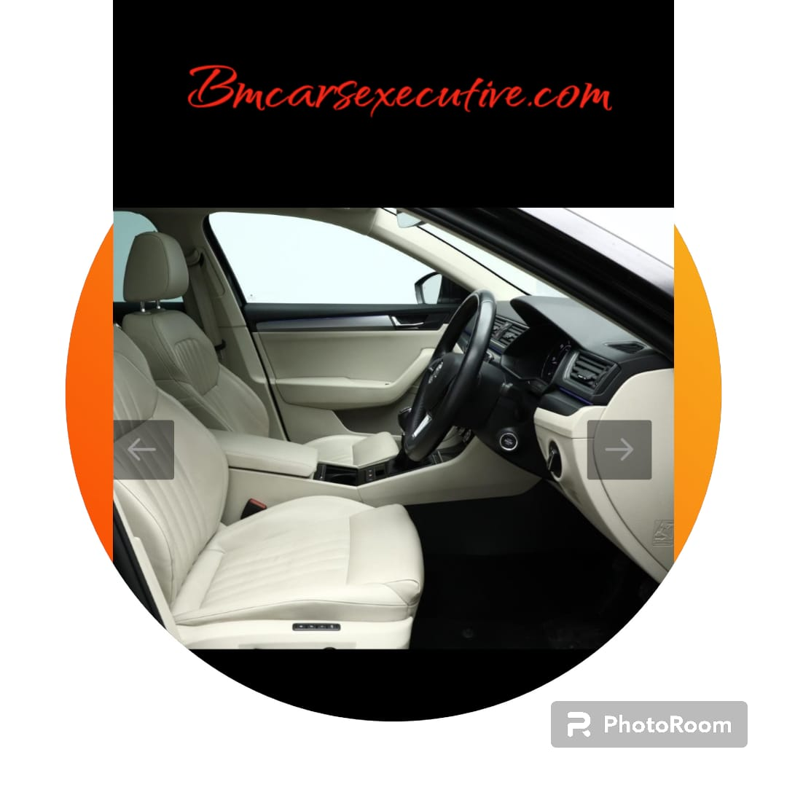
Agenda
Introduction
Management Structure
Legat Format
PESTEL Analysis
Marketing Strategies
Funding and Allocation

Slide 4
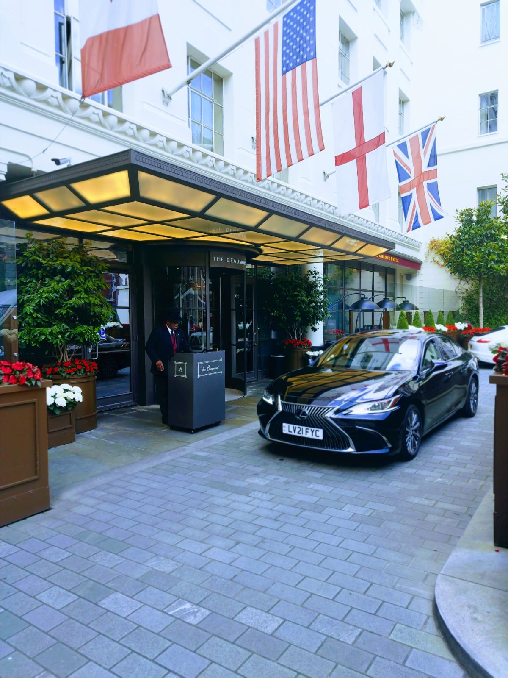
Introduction
Good Afternoon,
My name is Mihai Barbu. Today, I will present my business proposition to you. Becoming an entrepreneur involves spotting and seizing an opportunity, then coordinating resources to create value through a new business, often between risk and variability (Shane and Venkataraman, 2000).
With this in mind, and after many failed attempts, I decided to start my own business and venture into this new world. As I am a private hire taxi driver, I decided to establish my own chauffeuring company, “BM Cars Executive”, motivated by my passion for driving and discovering new places.

Slide 5
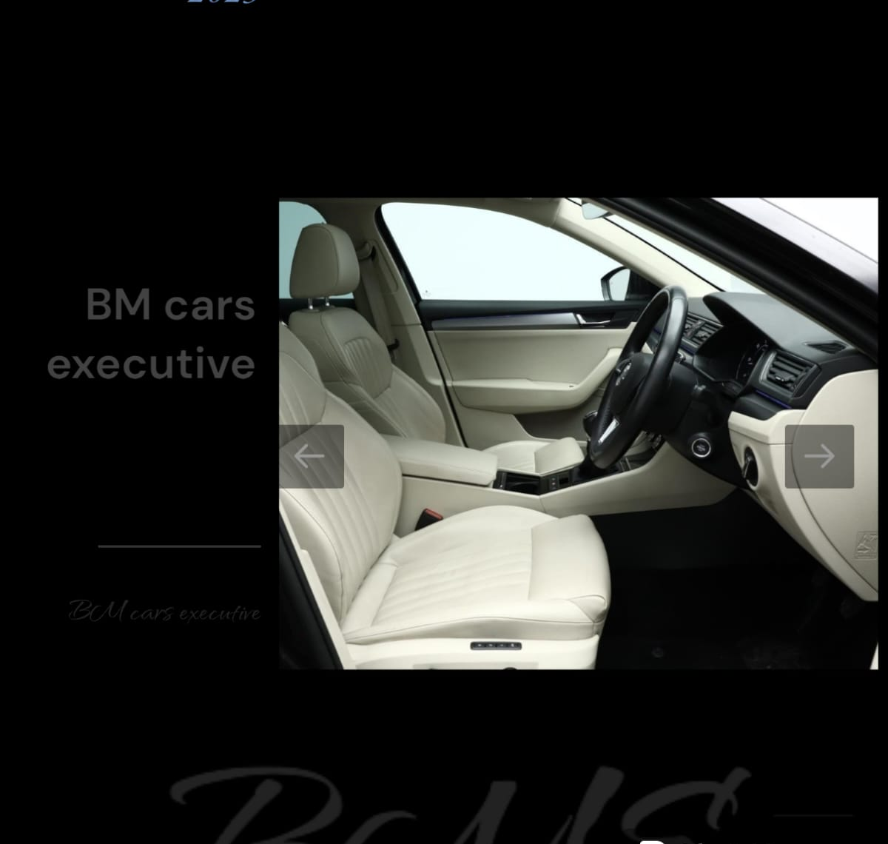
Management Structure
As I start my journey, I will keep my business family-run, with my wife, who also works as a private hire taxi driver, helping me. In the future, I aim to partner with other drivers for large bookings. Since we share similar passions and goals, such as being skilled drivers and good at interacting with people, she will be an ideal addition to my business.

Slide 6
Legat Format
I chose to start my business as a sole trader because it's easy to establish and allows me to make my own decisions, set my own work hours, and spend more time with my family. This flexibility has given me the chance to enjoy fun activities with them. However, I am also fully responsible for all aspects of the business. As a sole trader, I face ‘unlimited liability,’ which means I am personally liable for any debts. If problems occur, there is less legal protection for me as the owner. (GOV.UK, 2025)

Slide 7

PESTEL Analysis
Political: Transport policies like congestion and emissions charges may raise operating expenses, but also promote cleaner fleets. BM Cars should stay alert to policy updates.
Economic: Key costs include fuel, insurance, and vehicle financing. Pricing strategies must cover these costs while remaining appealing to customers.
Social: There's increasing demand for dependable, pre-booked travel. Customers value personalised, professional service more than the lowest price for loyalty.
Technological: Online reviews and digital tools influence trust. BM Cars requires easy-to-use, tech-enabled systems for booking, confirmation, and payment.
Environmental: Stricter emissions standards demand cleaner, compliant vehicles. Adhering to and promoting these standards can be a competitive advantage.
Legal: As a sole trader, strict licensing and unlimited personal liability make compliance, robust insurance, and accurate record-keeping vital.

Slide 8
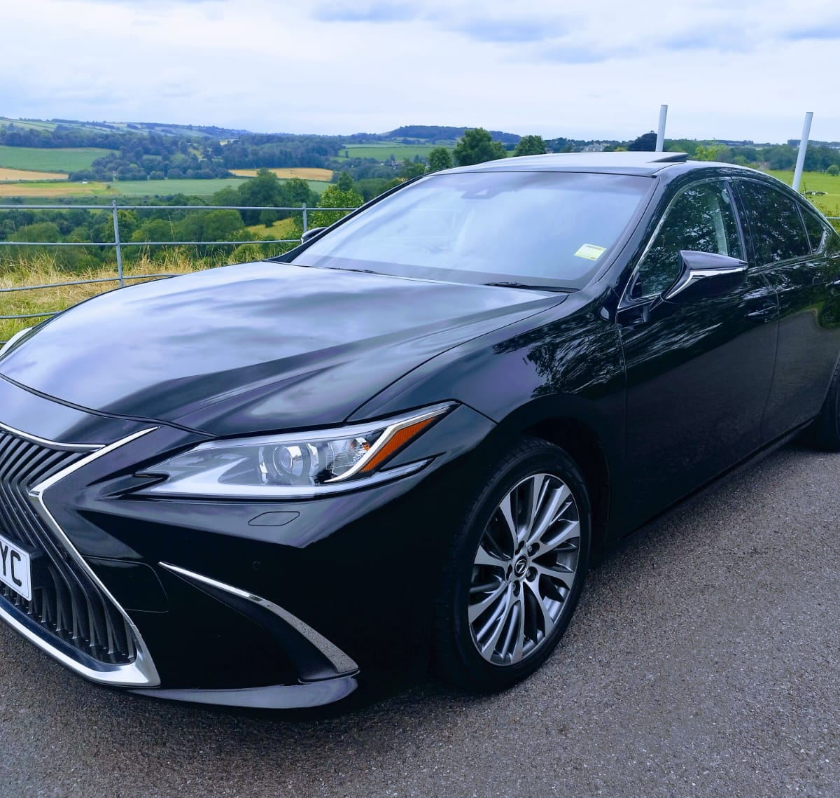
Align PESTEL with BM Cars business strategy
Focus on trust, comfort, and reliability (Social/Legal): Position BM Cars as a licensed, safety-first, family-friendly chauffeur service to emphasise trustworthiness over price.
Implement lightweight digital systems (Technological): Offer contactless payments and digital receipts to fulfil customer needs with minimal technological complexity.
Adopt smart pricing and bundles (Economic): Provide fixed-price airport and long-distance packages to safeguard profit margins and promote repeat bookings.
Manage risks for sole traders (Legal): Ensure robust PHV and liability insurance alongside transparent cancellation policies to minimise personal risk and enhance credibility.

Slide 9
Marketing Strategy
Objective & Positioning
Develop a reliable local brand catering to airport, family, and small business travellers.
Establish a reputation as a safe, punctual, and family-friendly chauffeur service.
Service & Pricing
Highlight fixed-price airport transfers and regular packages for families and school runs.
Provide straightforward business accounts for local companies.
Digital Presence & Booking
Maintain a basic website or landing page, along with a Google Business Profile featuring reviews.
Facilitate easy booking via WhatsApp or SMS, and support card, contactless payments, and digital receipts.
Promotion & Partnerships
Leverage Google reviews, local Facebook groups, and directories.
Collaborate with schools, small businesses, and B&Bs/hotels to generate repeat business.
Retention & Measurement
Monitor repeat customers, review feedback, and booking sources.
Reward customer loyalty and tailor offers by focusing on what proves most effective.

Slide 10
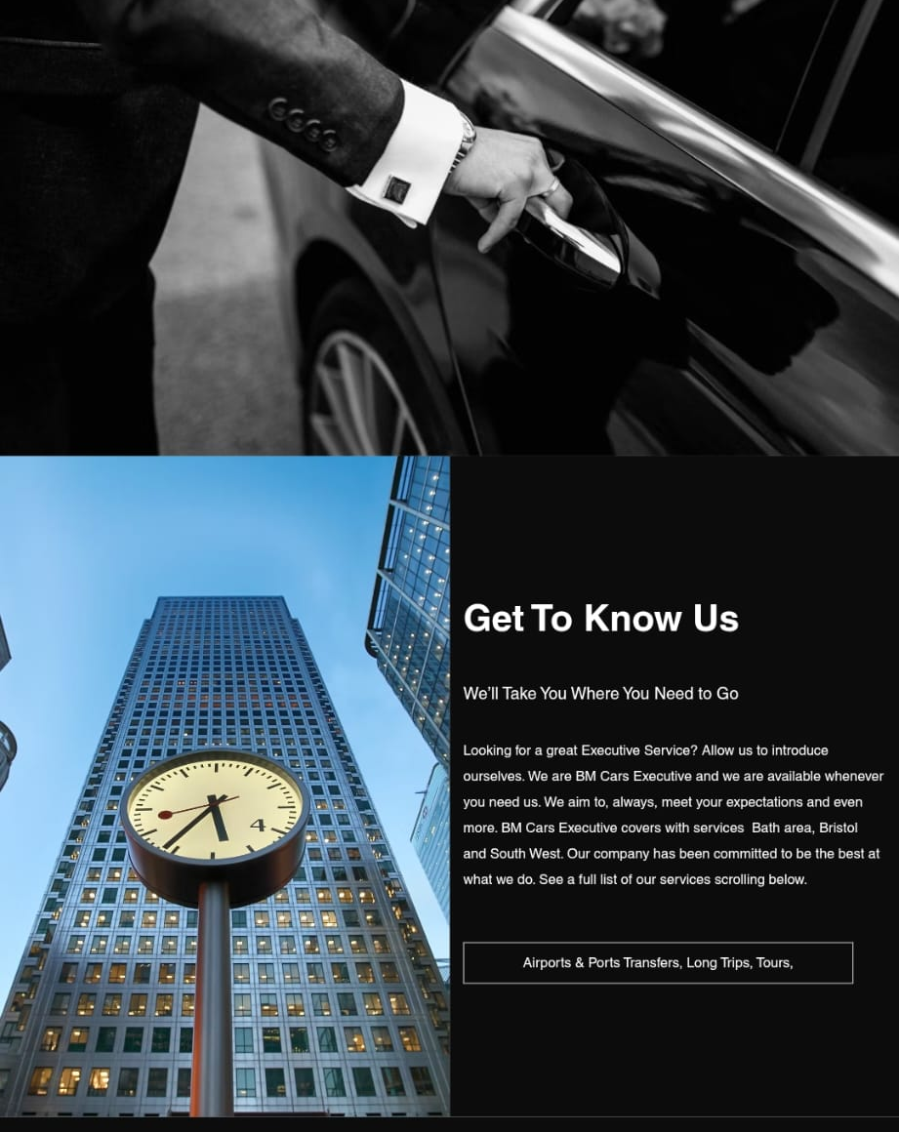
Target Market STP
Overall STP Focus:
Segment by safety, convenience, comfort
Target repeat-use customers
Position on trusting relationships
Primary Target Segment 1 – Airport Transfers
Who: Professionals and families pre-booking airport trips
Needs: Punctual, safe, fixed-price service that accommodates luggage
Reason to target: Growing demand and lower price sensitivity
Primary Target Segment 2 – Local Families
Who: Parents or guardians requiring trusted regular transportation (such as school runs and outings)
Needs: DBS-checked drivers, familiarity, reliability, and clean vehicles
Reason to target: Consistent weekday demand and strong loyalty potential
Primary Target Segment 3 – Small Businesses
Who: Local companies needing dependable transport for meetings and client visits
Needs: Professionalism, discretion, and punctual service
Reason to target: Willingness to pay a premium for reliability

Slide 11
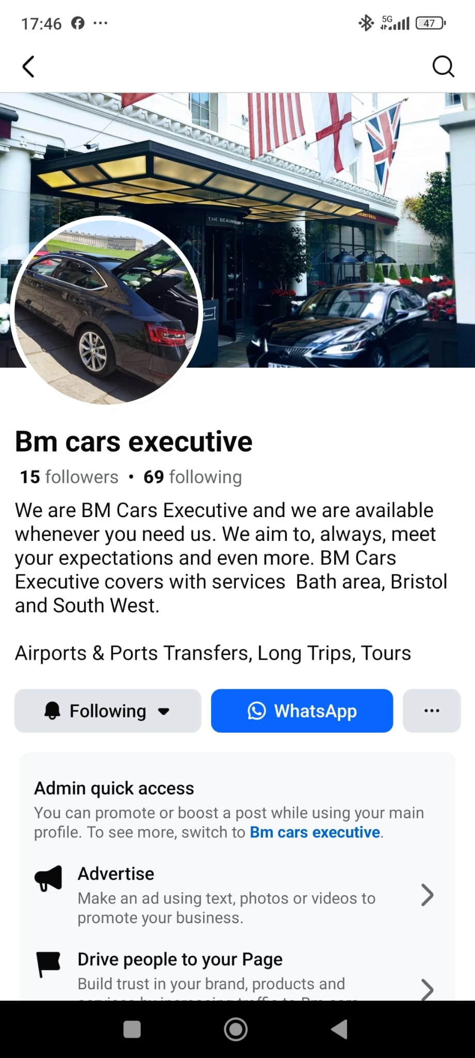
Positioning Statement and USP
“BM Cars Company provides safe, reliable, and friendly chauffeur-style private hire transportation for families, airport travellers, and local businesses. We deliver a premium, personalised service you can trust, all at fair fixed rates.”
BM Cars offers more than just transportation from one place to another! Upon request, we can share information about local tourist attractions and act as guides for visitors. Learning about our local area helps us build connections with our customers by sharing helpful tips on good restaurants, coffee shops, and farmers' markets with quality produce. Companies that consistently surpass expectations can stand out in the marketplace and gain a competitive edge (Bitner, 1990).

Slide 12
Funding Requirements and Allocation
To launch my business, I am seeking funding to purchase a vehicle and invest in technology, marketing, branding, and working capital. I have created a financial forecast for the next six months to help me visualise my expected cash inflows and outflows.
Startup Cost
Vehicle (deposit) | 10,000
Technology | 200
Marketing and Branding | 1,000
Working Capital | 2,000
Total | 13,200

Slide 13
Fixed Costs
Licensing and Compliance | 50
Car Finance | 57
MOT and Servicing | 50
Wages | 2,000
Drawings | 2,000
Insurances | 365
Telephone | 50
Accountant | 75
Total | 4,615
Variable Costs | Jan | Feb | Mar | Apr | May | Jun
Car Maintenance | 200 | 200 | 350 | 330 | 410 | 600
Materials | 50 | 30 | 120 | 185 | 150 | 200
Petrol | 600 | 650 | 780 | 850 | 900 | 1200
Repairs | 0 | 0 | 150 | 80 | 250 | 150
Total | 850 | 880 | 1,400 | 1,445 | 1,710 | 2,150

Slide 14
Based on the charts above, the investment required is the startup total, £13,200, plus the estimated loss over the next six months, £2,030, resulting in a total of £15,230.
 | Jan | Feb | Mar | Apr | May | Jun
Fixed Costs | 4,615 | 4,615 | 4,615 | 4,615 | 4,615 | 4,615
Variable Costs | 850 | 880 | 1,400 | 1,445 | 1,710 | 2,150
Total Cost | 5,465 | 5,495 | 6,015 | 6,060 | 6,325 | 6,765
Revenue | 4,500 | 5,900 | 4,950 | 6,800 | 6,750 | 7,500
Profit/Loss | -965 | 405 | -1,065 | 740 | 425 | 735

Slide 15
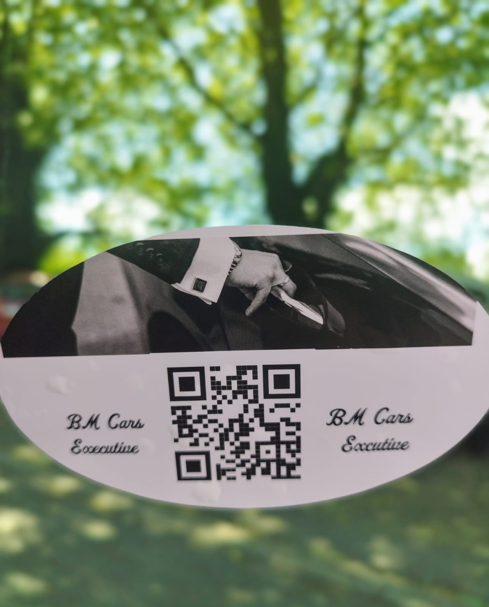
BM Cars Executive
Safe journeys. Trusted driver. Every time.
Thank you.

Slide 16
References
Anna Money (2025) ‘How to become a private hire driver [Step-by-step UK guide]’. Available at: Anna Money website (Accessed: 23 November 2025).
Bitner, M.J., Booms, B.H., and Tetreault, M.S. (1990) The service encounter: Diagnosing favourable and unfavourable incidents. Journal of Marketing, 54(1), 71-84. https://doi.org/10.1177/002224379005400107.
GOV.UK (2025) ‘Become a sole trader’. Available at: GOV.UK (Accessed: 22 November 2025).
Shane, S. and Venkataraman, S. (2000) ‘The promise of entrepreneurship as a field of research’, Academy of Management Review, 25(1), pp. 217–226.
TfL (2025a) Taxi and private hire action plan 2025. London: Transport for London.

