Slide 1
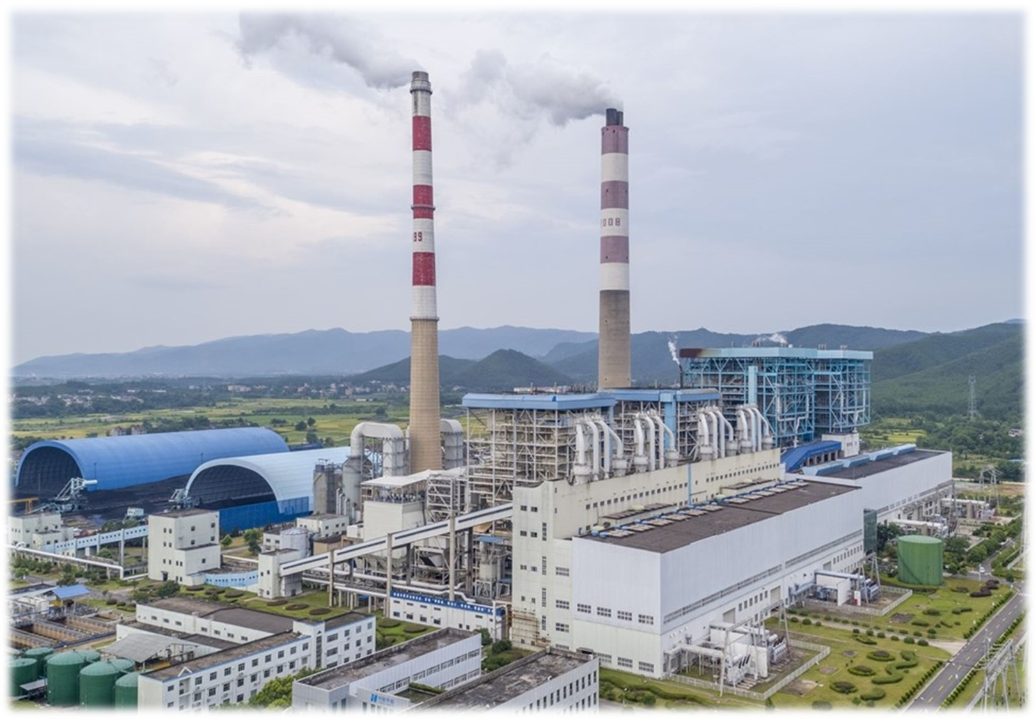

Fundamentals of EIA & Reviewing EIA
ACBA 7004
Week 4
Alisdair Cunningham
a.cunningham@uwtsd.ac.uk

Slide 2
Activities for next week:
Read and review: Government outlines plans to replace ‘over-complicated’ EIA regime (endsreport.com)
New legislation proposes radical changes, replacing EIA | UK (environment-analyst.com)
(2) Divergence Series | Divergence in environmental policy post-Brexit – YouTube
Additional suggested readings in Moodle (Week 2)

Slide 3
Outline
Recap from last week
Impact management
Impact mitigation
Process of reviewing EIA
EIA review (Activity)

Slide 4
EIA—Three core values
Integrity - the EIA process will conform to agreed standards
Utility - the EIA process will provide balanced, credible information for decision-making
Sustainability - the EIA process will result in environmental safeguards
Source: Sadler, 1996
ACBA 7004

Slide 5

EIA — guiding principles
The EIA process should be:
purposive – meeting its aims and objectives
focused – concentrating on the effects that matter
adaptive – responding to issues and realities
participative – fully involving the public
transparent – clear and easily understood
Source: Sadler, 1996; IAIA/IEMA 1999
ACBA 7004

Slide 6
Key operating principles of good EIA practice
EIA should:
be applied to all proposals with significant impacts
begin early in the project cycle
address relevant environmental, social and health impacts
identify and take account of public views
result in a statement of impacts and mitigation measures
facilitate informed decision making and condition setting
Source: Sadler, 1996
ACBA 7004

Slide 7
EIA — guiding principles
(continued)
rigorous – employing ‘best practicable’ methodology
practical – establishing mitigation measures that work
credible – carried out with objectivity and professionalism
efficient – imposing least cost burden on proponents
Source: Sadler, 1996; IAIA/IEMA 1999
ACBA 7004

Slide 8
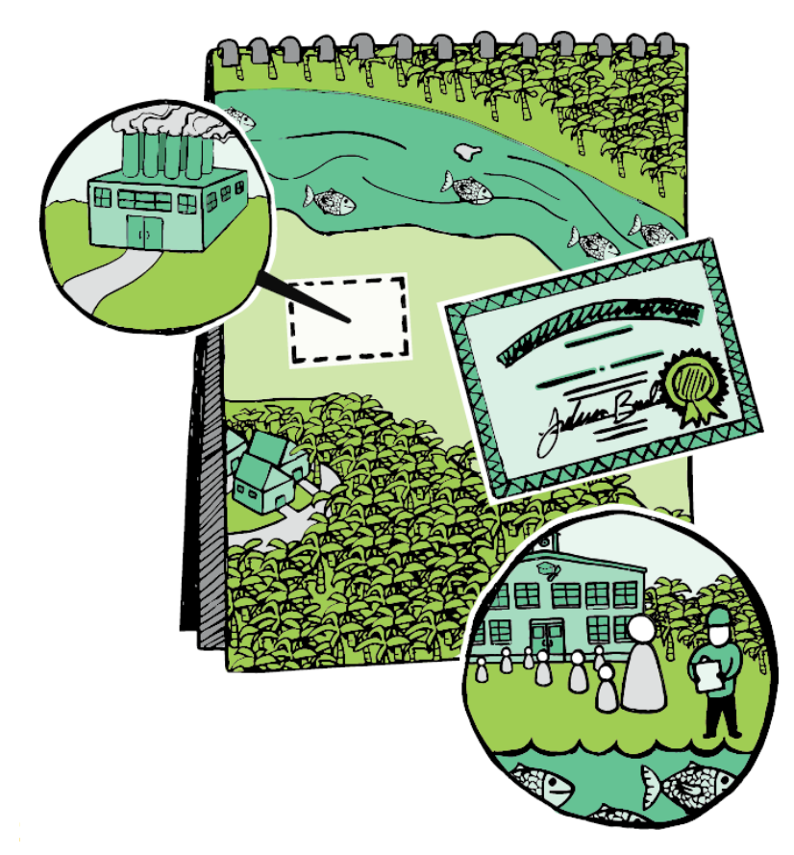
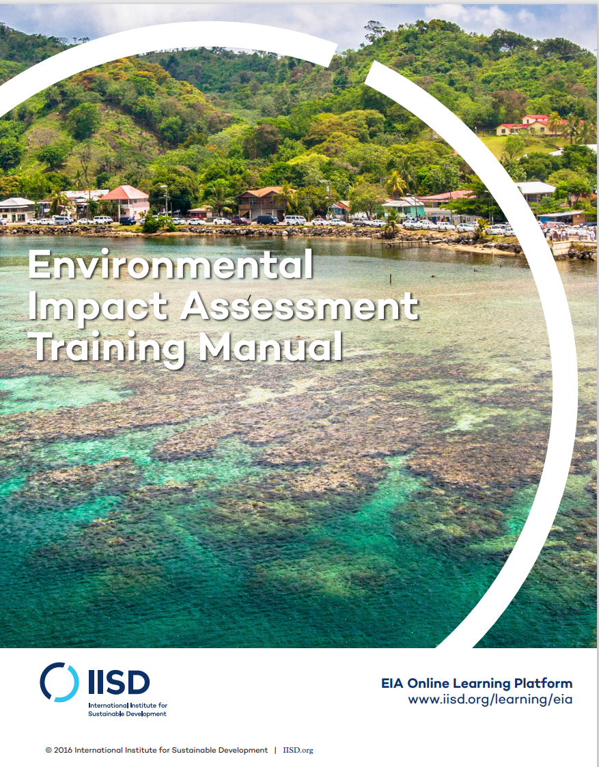
Recap
EIA-Manual.pdf (iisd.org)

Slide 9
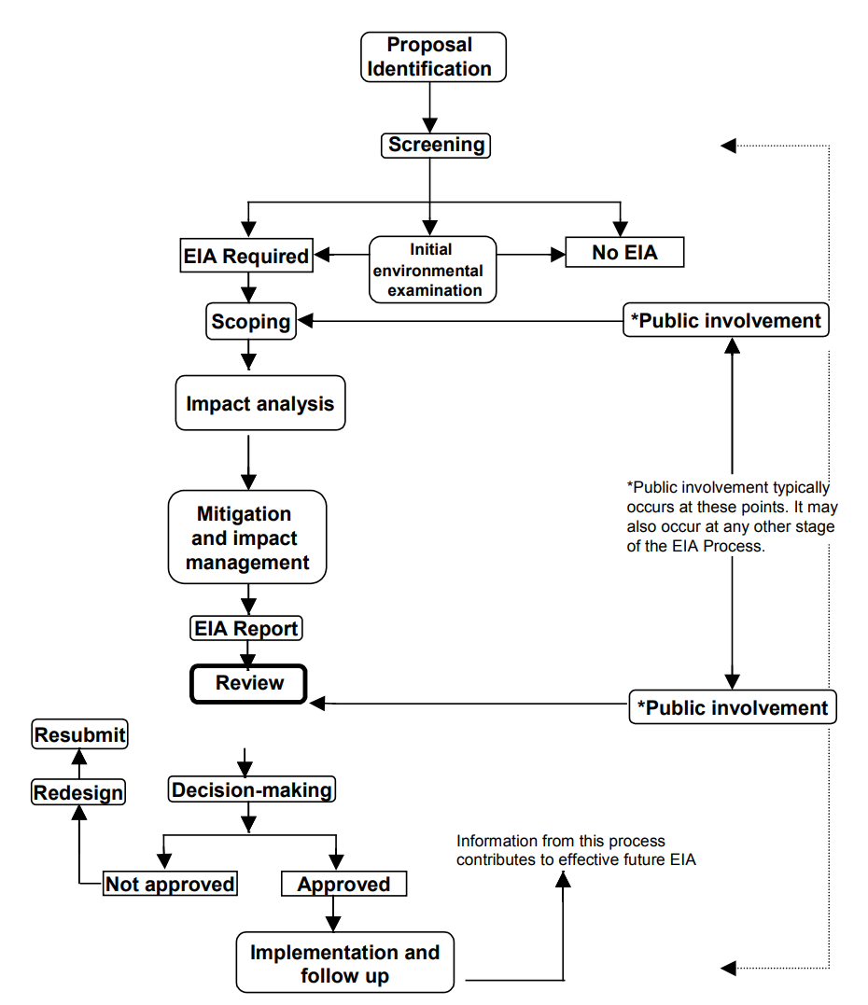
EIA-Manual.pdf (iisd.org)

Slide 10
What is screening?

Slide 11
What is scoping?

Slide 12
What sorts of things do we consider in impact analysis?

Slide 13
What public involvement initiatives should be considered…?

Slide 14
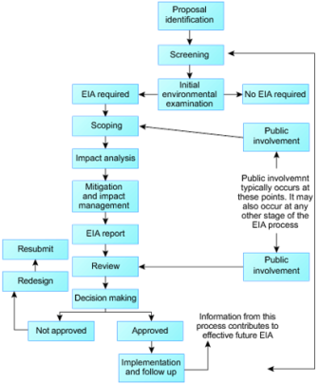
Public participation
Involvement of the public is crucial to the EIA process
The general public are one of the key stakeholders who may potentially be impacted by the development
They also have a right to care for, and protect, the environment
However, how, and if, the public are included in the EIA process varies between projects, and can be a significant element of success or failure depending on the approach of the developer.
Ignoring the public’s opinion, or planning a development that does not take into account the feedback, can result in very strong public resistance towards a development and lengthy planning ‘battles’
Source: United Nations University (2007)
https://wedocs.unep.org/bitstream/handle/20.500.11822/26503/EIA_Training_Resource_Manual.pdf

Slide 15

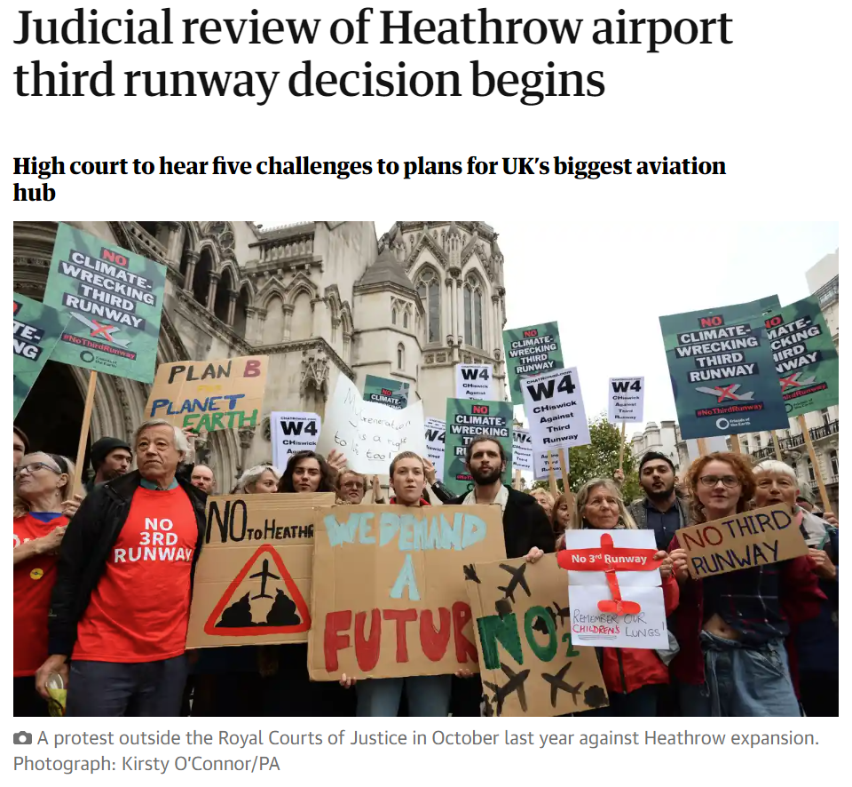
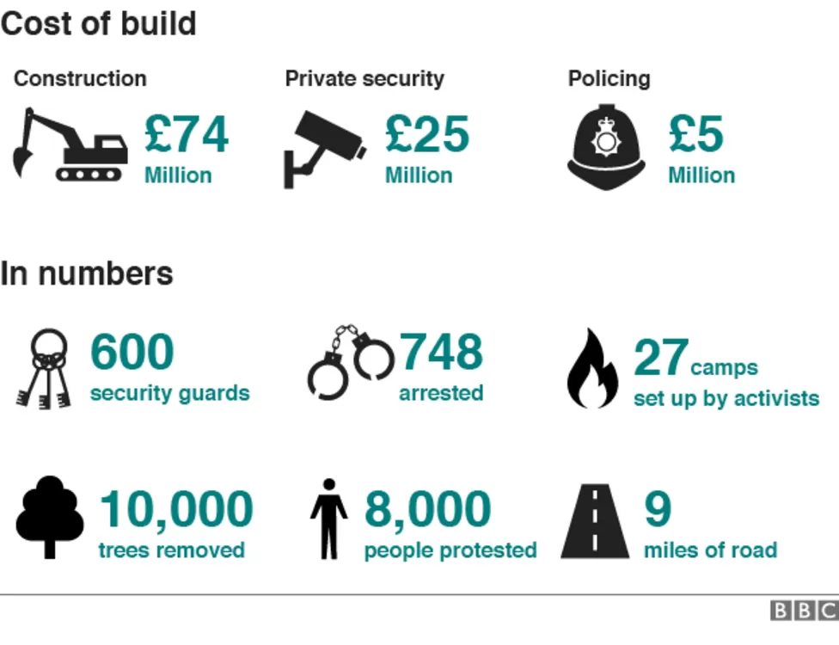

Public participation
Several notable cases evidence the impacts to proposals of not having public backing.
Not engaging with the public in a constructive, inclusive, and candid manner can result in strong public opposition, leading to high profile activism against a development.
Notes:
Did the Newbury bypass tree-huggers change anything? - BBC News - https://www.bbc.co.uk/news/uk-england-berkshire-35132815

Slide 16
Pros and Cons of Public participation
There are a number of benefits to public participation, but they can also be seen as detrimental to the project from the developer's perspective.
Benefits | Drawbacks
Identify local factors not readily identifiable from other sources | Increases the public profile of the development
Determine the feasibility of alternatives, or even identify new ones. | Extended timeframes to incorporate public opinion
Allow for information dissemination and reduce spread of misinformation | Additional cost involved in public consultations
If done correctly, can avoid lengthy and costs legal challenges | If not conducted, or done effectively, can lead to costly and lengthy public inquires / legal challenges
Increase the public’s say in the decision-making process | Deviate away from the initial preferred option.
Source: United Nations University (2007)
https://wedocs.unep.org/bitstream/handle/20.500.11822/26503/EIA_Training_Resource_Manual.pdf

Slide 17


Levels of Public participation
It is important to recognise that involvement of the public in the EIA process can be varied in approach.
Particular attention should be paid to the ability for the public to participate in the decision-making process.
Question: What do you think are the pros and cons of each approach (for the public or the developer)?
Approach | Example application
Information feedback | Presentation, press release, website
Consultation | Public hearing, survey, interview
Joint planning | Workshop, advisory committee
Delegated authority | Citizen’s planning commission
Low
Extent of public power in decision-making
High
Adapted from: Westman, 1985
Notes:
Westman, W.E., 1985. Ecology impact assessment and environmental planning. John Wiley & Sons.

Slide 18

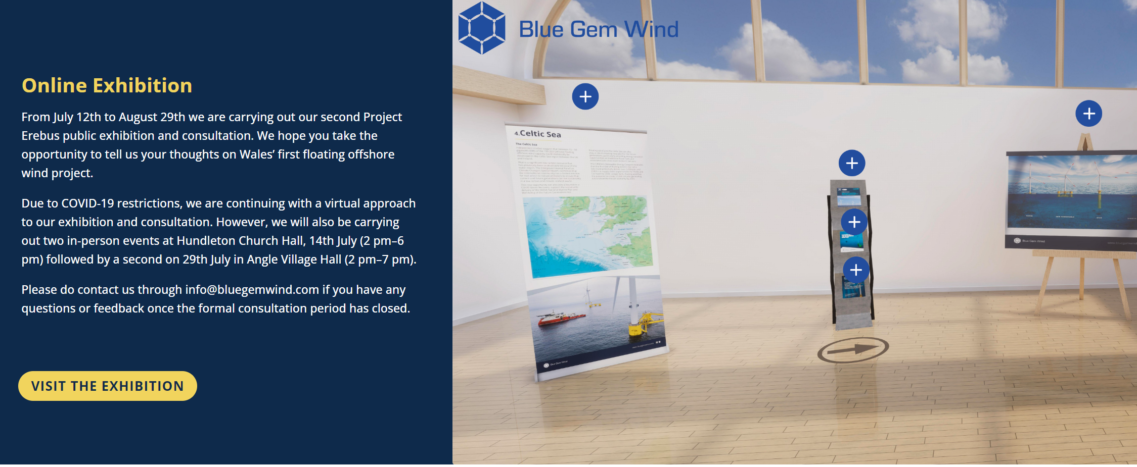

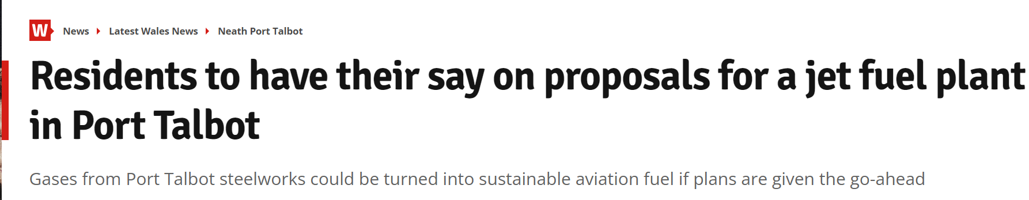
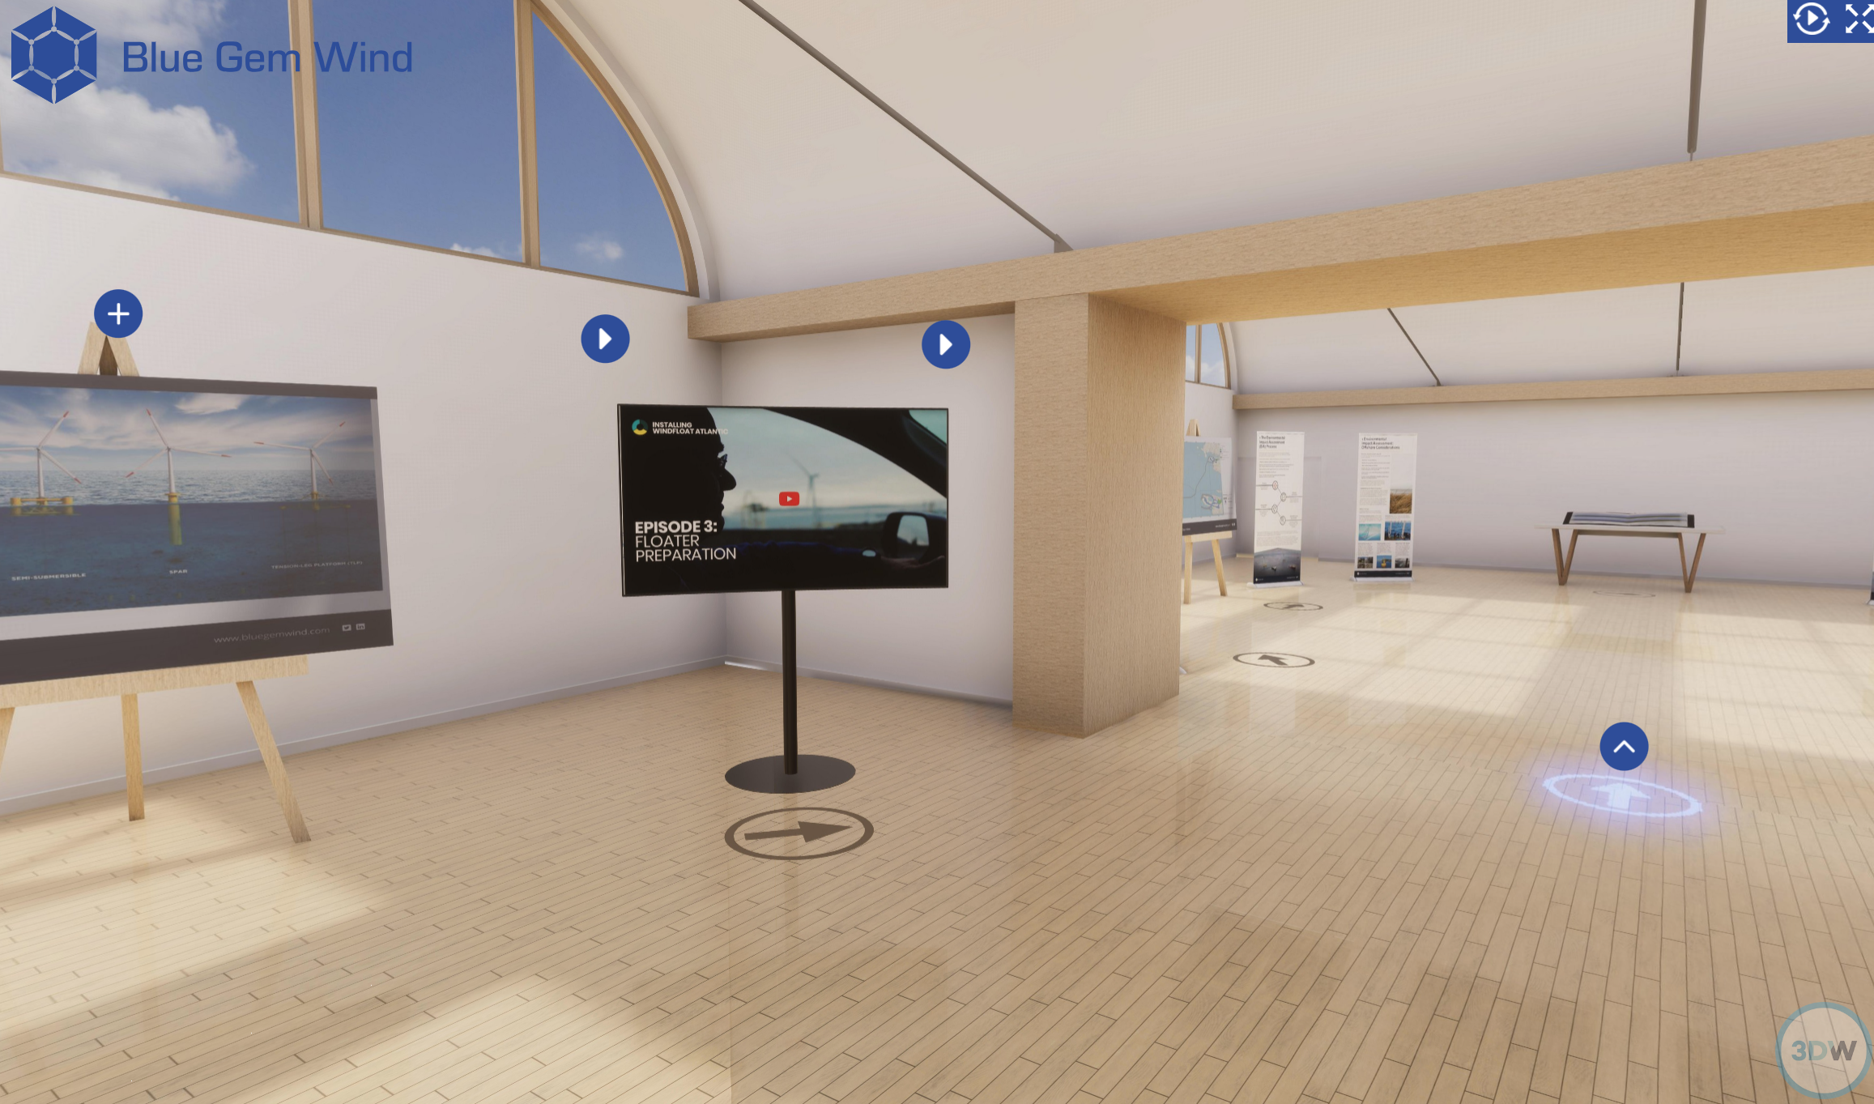
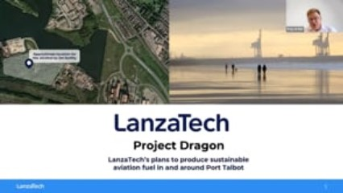
Examples of Public participation
It is important to recognise that involvement of the public in the EIA process can be varied in approach.
Particular attention should be paid to the ability for the public to participate in the decision-making process.
Blue Gem - Erebus - Virtual Exhibition (3dwtech.co.uk)
Notes:
Residents to have their say on proposals for a jet fuel plant in Port Talbot - Wales Online

Slide 19

Activity
For your EIA case study, conduct some quick investigation to see if you can identify any public consultation
Check the ES for references to ‘Public’
Check the appendices for examples of consultations and feedback
Google search the development name and see if any public consultations were advertised online in news articles or develop websites

Slide 20

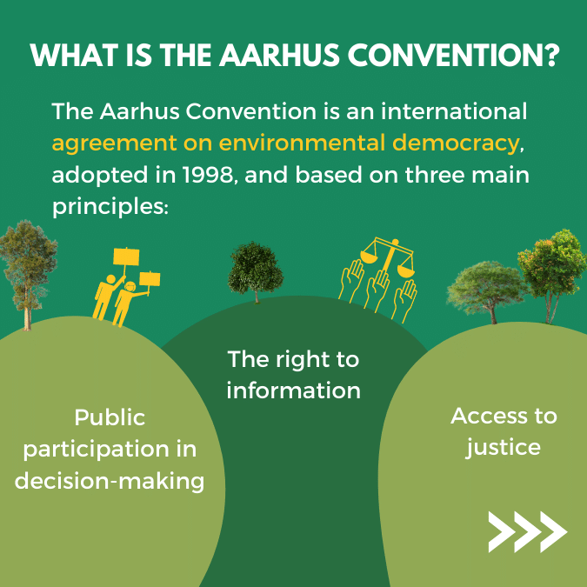
Legal requirement of Public participation
Within the UK context, the requirement for public participation was enhanced with the “UNECE Convention on Access to Information, Public Participation in Decision-making and Access to Justice in Environmental Matters”, also known as the Aarhus Convention, a global agreement on the rights of the public to information, decision-making, and justice in environmental manners.
The associated EIA Directives which adopted these principles determine the need in the UK for ‘the public’ to be informed in decisions, both of the proposal, and how to engage in consultation.
Additionally, ‘the public concerned’ must be given ‘early and effective’ opportunities to participate.
However, the application of this legal right is mixed (Hartley and Wood, 2005), and even adopted to minimal standards (Glasson et al., 2012)
Notes:
O'Faircheallaigh, C., 2010. Public participation and environmental impact assessment: Purposes, implications, and lessons for public policy making. Environmental impact assessment review, 30(1), pp.19-27.
Hartley, N. and Wood, C., 2005. Public participation in environmental impact assessment—implementing the Aarhus Convention. Environmental impact assessment review, 25(4), pp.319-340.

Slide 21
Recommendations for Public participation
Best practice guidance for inclusion of the public in EIA processes states that early and effective communication is ideal, benefiting the environment, the rights of the public, and the developer.
It is essential that the public are considered during all stages of the process, and not included as a box-ticking exercise.
There should be evidence that the public have had the opportunity to influence the decision-making process and been kept informed.
There is also the requirement for accessibility of information and inclusion of minority groups. Identifying all groups and providing the ability for everyone to partake is challenging but critical.
Source: United Nations University (2007)
https://wedocs.unep.org/bitstream/handle/20.500.11822/26503/EIA_Training_Resource_Manual.pdf

Slide 22
Today:
Mitigation and Impact Management
Decision Making
Review of EIA

Slide 23


Impact Management in EIA

Slide 24
Impact Management in EIA
In this section we will learn about plans that you need to develop to specify, implement and monitor the identified mitigation measures and address other risks that the project could present, such as technological failures and other emergencies.

Slide 25
Impact Management in EIA
Impact management is a series of plans and protocols that are part of the EIA process (and also continue after project implementation) to manage and monitor identified mitigation measures and other risks such as technology failures and natural disasters that may occur over the project lifetime.
acba7004
25

Slide 26
Impact Management in EIA
The analyses of the impacts and mitigation measures (carried out in the previous step) will likely identify a number of changes in the project design, implementation and closure. It will also require additional action plans to manage risks and carry out monitoring.
The need for these plans depends on the type of project, the identified impacts, and the risks associated with the project based on its activities and the natural and social context where it will take place. Some of the plans are compulsory, such as an environmental management plan (EMP) which is required as part of an EIA report in most countries
acba7004
26

Slide 27
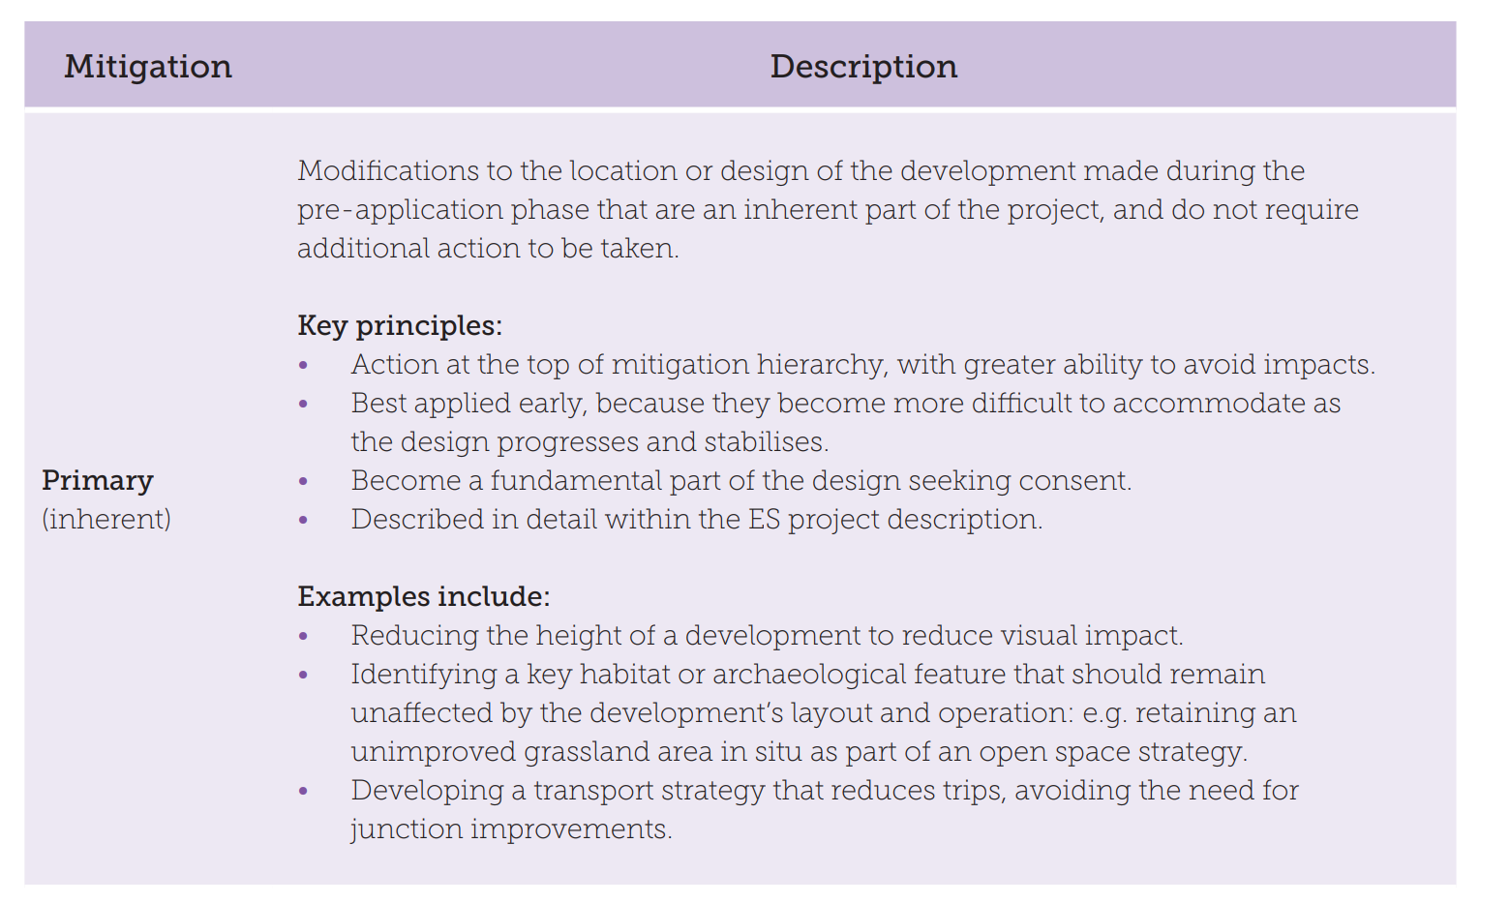

Slide 28
Option | Example
Avoid at source | Avoid machinery
Minimise impacts at source | Use quiet machinery
Abate impacts on site | Use acoustic barriers
Abate impacts at receptor | Provide double glazing
Repair impacts | Monitor and remedy
Compensate in kind | Move residents for duration of construction
Other compensation and enhancement | Liaise with residents
Mitigation hierarchy. Adapted from Department of Environment, Transport, and Regions (DETR) 1997
acba7004
28

Slide 29
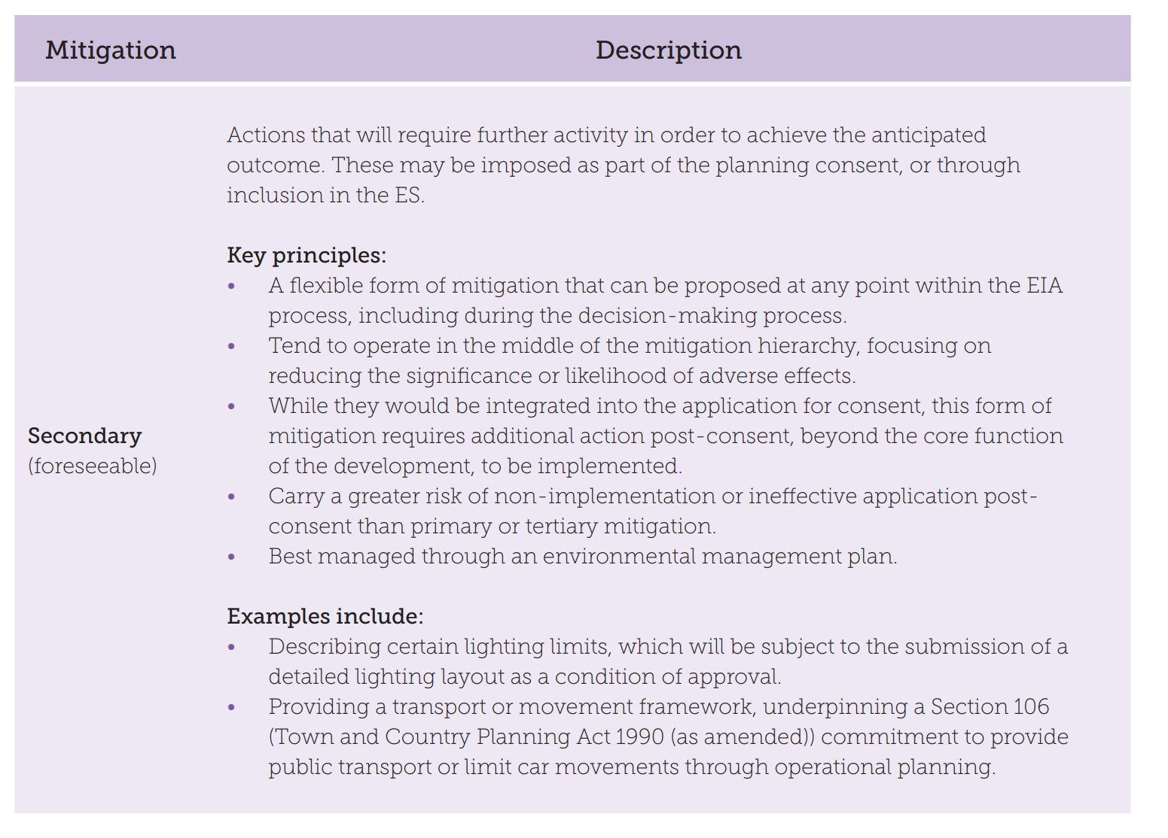

Slide 30
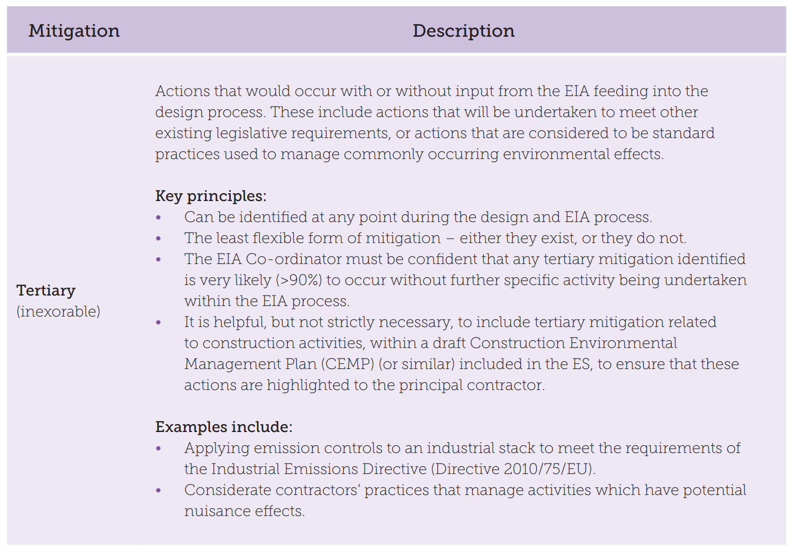

Slide 31
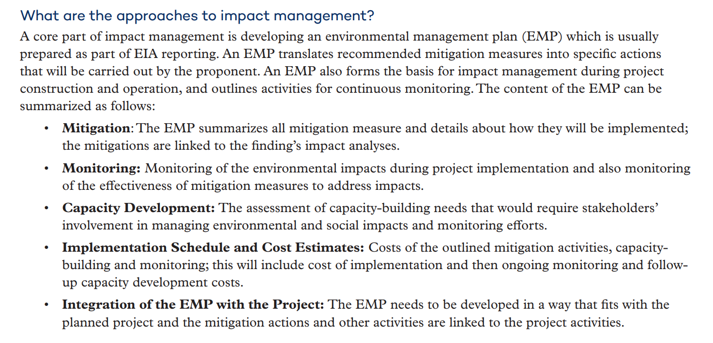

Slide 32
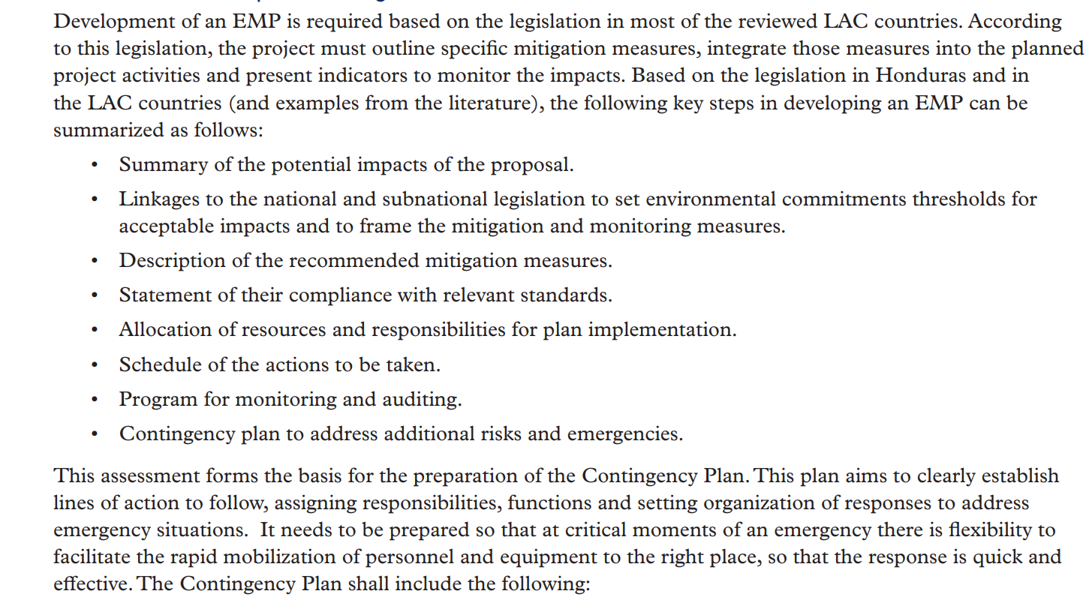
How to conduct impact management
EIA-Manual.pdf (iisd.org)

Slide 33

How to conduct impact management
Microsoft Word - Environmental Management Plan KGSHE044 Rev A 19 01 15 (2).doc (nottinghamshire.gov.uk)

Slide 34
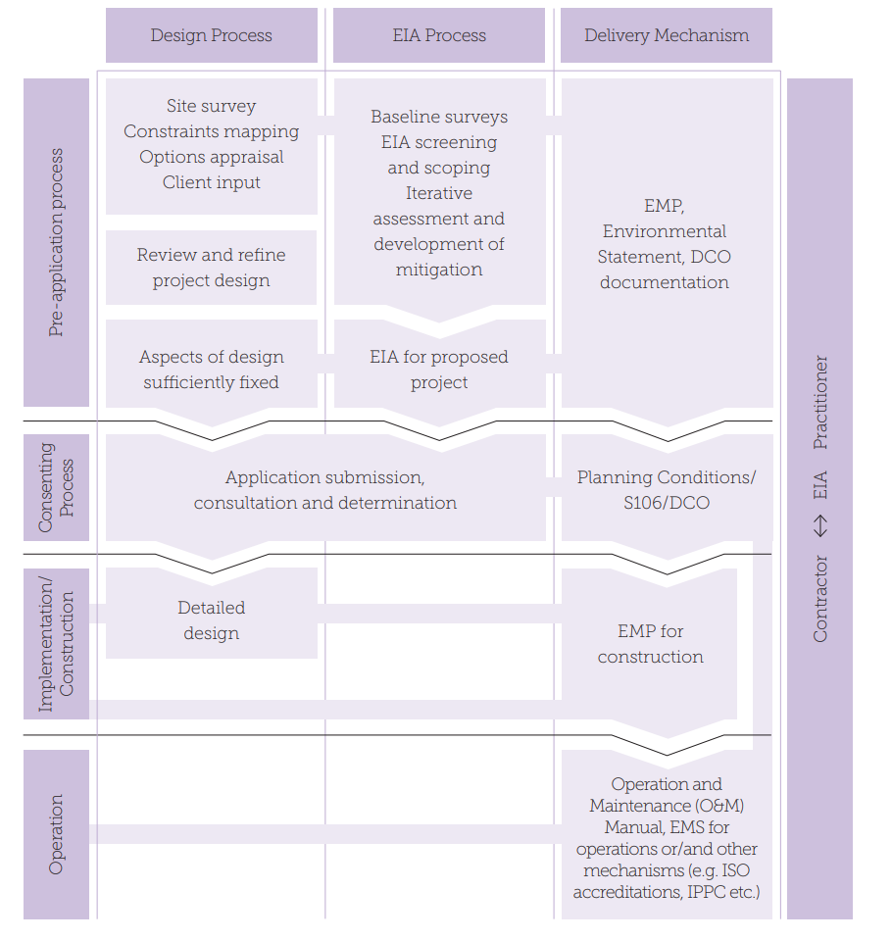
EMP
The link between Design and EIA processes and Mechanisms to Deliver Mitigation (Adapted from Lochner 2005)
From: EIA: Delivering Quality Development. IEMA (2016)

Slide 35
EMP
The link between Design and EIA processes and Mechanisms to Deliver Mitigation (Adapted from Lochner 2005)
From: EIA: Delivering Quality Development. IEMA (2016)

Slide 36
EMP
The link between Design and EIA processes and Mechanisms to Deliver Mitigation (Adapted from Lochner 2005)
From: EIA: Delivering Quality Development. IEMA (2016)

Slide 37
EMP
The link between Design and EIA processes and Mechanisms to Deliver Mitigation (Adapted from Lochner 2005)
From: EIA: Delivering Quality Development. IEMA (2016)

Slide 38
EMP
An EMP during the construction stage is often known as a Construction EMP or CEMP. Consenting authorities often require a CEMP to ensure that the developer is committed to the implementation of mitigation measures identified as part of the EIA at the construction stage.

Slide 39
EMP
An EMP can be used to both improve proportionality of EIA practice and secure environmental mitigation early on in the process, even at the Screening and Scoping stages.
This has the benefit of identifying environmental topics and effects for which, with the implementation of mitigation, there may be no ‘likely significant effects’.
The consenting authority and stakeholders should be part of this process. This can help to ensure that only significant topics/effects that would remain following the adoption of the EMP are taken forward into assessment. During the EIA, an EMP can be developed further refining and adding mitigation measures alongside the iterative scoping process, e.g. following the completion of baseline surveys or modelling/assessment.

Slide 40
Activity
Click on the following link to read an example of an EMP.
Microsoft Word - Environmental Management Plan KGSHE044 Rev A 19 01 15 (2).doc (nottinghamshire.gov.uk)
What things are covered?
Can you find another example of an EMP? Perhaps for your EIA / project?
(20 mins)

Slide 41

Take a break
10mins

Slide 42

Planning Application Determination

Slide 43

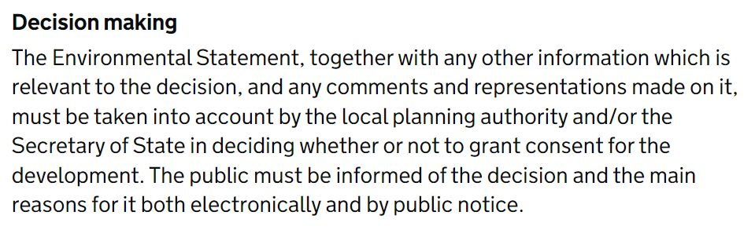
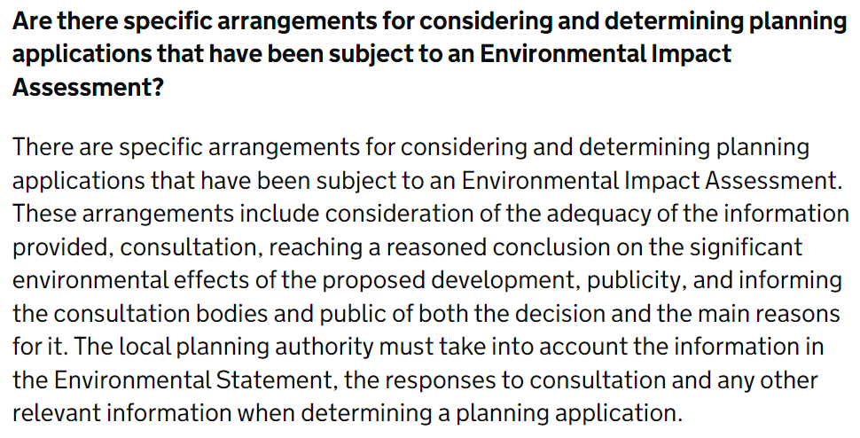
UK Decision Making guidance
The government guidelines for decision making are as follows:
Notes:
Environmental Impact Assessment - GOV.UK (www.gov.uk) https://www.gov.uk/guidance/environmental-impact-assessment#decision-making-subject-to-EIA
Environmental Impact Assessment - GOV.UK (www.gov.uk) https://www.gov.uk/guidance/environmental-impact-assessment

Slide 44
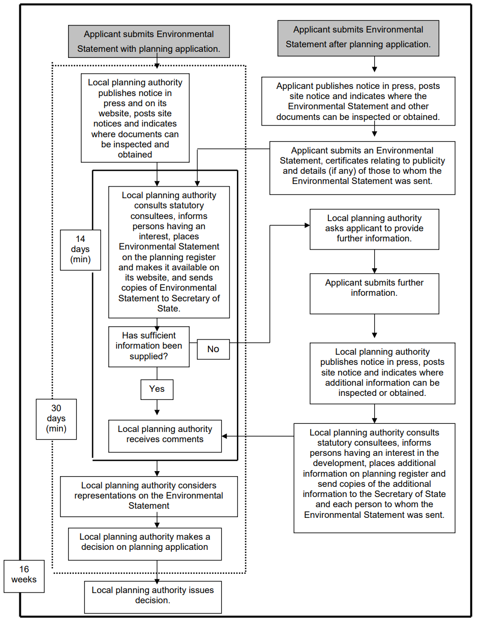
Determining EIA and Planning applications
EIA-Manual.pdf (iisd.org)

Slide 45
Determining EIA and Planning applications
EIA-Manual.pdf (iisd.org)

Slide 46
Determining EIA and Planning applications
EIA-Manual.pdf (iisd.org)

Slide 47
Determining EIA and Planning applications
EIA-Manual.pdf (iisd.org)

Slide 48
Determining EIA and Planning applications
EIA-Manual.pdf (iisd.org)

Slide 49
How long does a local planning authority have to determine a planning application involving an Environmental Impact Assessment?
How long does a local planning authority have to determine a planning application involving an Environmental Impact Assessment?
Where a valid planning application and Environmental Statement have been received by the local planning authority, they must determine the application within 16 weeks beginning with the day immediately following the day of receipt of the application and Environmental Statement (regulation 68(2)). This period may be extended by written agreement between the local planning authority and the applicant.
Where an Environmental Statement has not been submitted with a planning application but the applicant indicates that they propose to provide one, consideration of the application should be suspended until the Environmental Statement has been received (regulation 20(8)).
Paragraph: 050 Reference ID: 4-050-20170728
Revision date: 28 07 2017 See previous version
EIA-Manual.pdf (iisd.org)

Slide 50
More information required
If the local planning authority considers that further information is required, they must ask the applicant, in writing, to provide it (regulation 25).
All information provided must be publicised, and consulted on.
Requests for further information should be limited to the “main” or ”significant” environmental effects to which a development is likely to give rise and must be on relevant matters and directly relevant to reaching a reasoned conclusion on the significant effects of the proposed development on the environment (regulation 26).
The local planning authority, the Secretary of State or an Inspector may also require an applicant or appellant to produce evidence to verify any information in the Environmental Statement.
EIA-Manual.pdf (iisd.org)

Slide 51
More information required
EIA-Manual.pdf (iisd.org)
Additional information of a substantive nature submitted voluntarily by an applicant must be treated in the same way as information required by the local planning authority (see the definition of “any other information” in regulation 2(1)).
The 16 weeks time limit for determination of an Environmental Impact Assessment application continues to run while any correspondence about the adequacy of the information in an Environmental Statement is taking place.

Slide 52
Transboundary impacts
What are the procedures for considering whether a proposal is likely to have transboundary effects on another country within the European Economic Area?
Local planning authorities are required to send a copy of every Environmental Statement and related planning application to the Secretary of State (Planning Casework Unit) within two weeks of receipt. This is to enable consideration of whether the proposed development is likely to have significant effects on the environment of any European Union Member State, or any other country that has ratified the United Nations Economic Commission for Europe Convention on Environmental Impact Assessment in a Transboundary Context (known as the ‘Espoo Convention’).

Slide 53
Transboundary Consultation
As a proportion of all planning applications, the number of developments in UK that are likely to have significant effects on the environment of another country will be small. However, should they occur, the Secretary of State must send information about the development to the government of the affected country, and invite them to participate in the consultation procedures, determining with them a reasonable timescale to allow them to do so. In such a case, the Secretary of State may direct (article 31(1) of the Town and Country Planning (Development Management Procedure) (England) Order 2015) that planning permission may not be granted until the end of such time as may be necessary for consultations with that government.
See the Espoo Convention.
More on the Convention | UNECE
Text of the Convention | UNECE

Slide 54
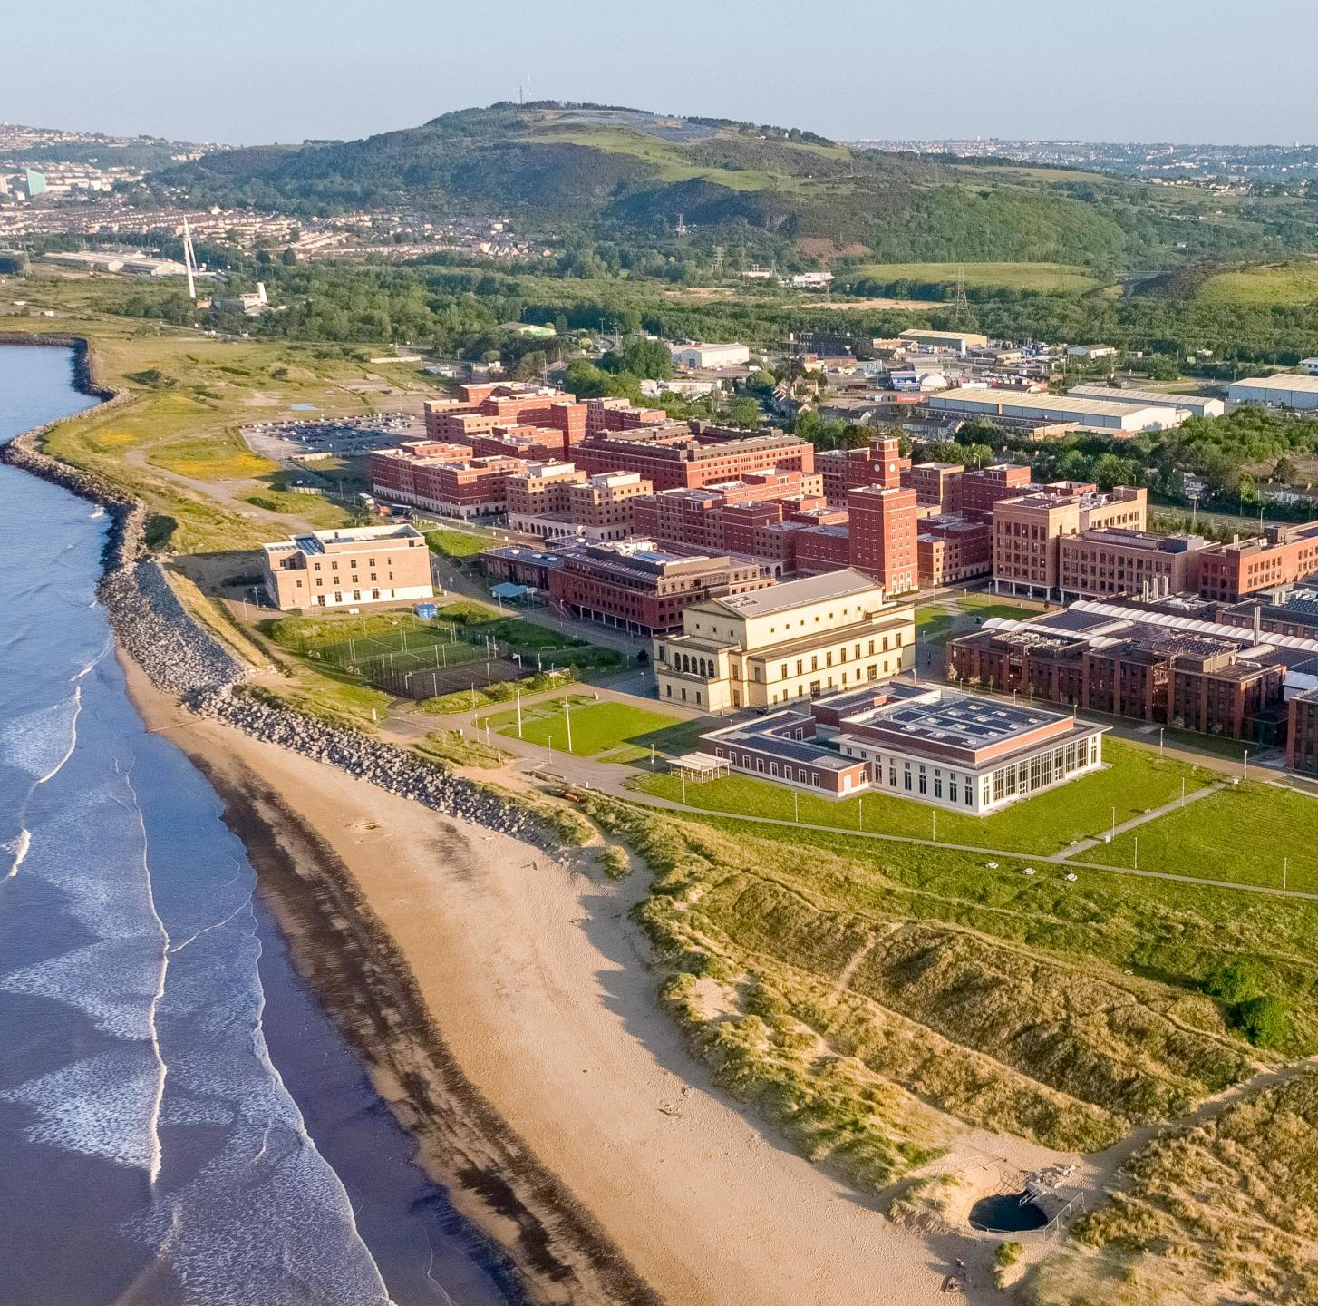
Bay Campus Planning Committee Decision
Crymlyn Burrows SSSI
In February 2011, Neath Port Talbot council planning committee met to discuss the application of Swansea University – Bay Campus.
The outcome was to approve the application, subject to conditions.
The committee meeting documents highlights the contrasting trade-offs between social, economic, and environmental factors, the latter detailed in the Environmental Statement.
PLANNING AND DEVELOPMENT CONTROL COMMITTEE (npt.gov.uk)
Sand Dunes
54
Notes:
PLANNING AND DEVELOPMENT CONTROL COMMITTEE (npt.gov.uk) https://democracy.npt.gov.uk/Data/Planning%20and%20Development%20Control%20Committee/20110222/Agenda/$PLANDEV-220211-REP-EN-GW.doc.pdf

Slide 55

Bay Campus Planning Committee Decision
The committee meeting highlights the following:
“Swansea University held four public exhibitions. These took place following submission of the application, and were held on the 18th March at Swansea University, 22nd March at Crymlyn Burrows Community Centre, 23rd March at Aberavon Shopping Centre, Port Talbot, and on the 25th March in the Waterfront Museum, Swansea.” (p. 5)
“Environment Agency Wales- No Objection, subject to conditions.” (p. 6)
“The application fails to provide an adequate and robust assessment of any other alternative model for University expansion on another site or sites in a more sustainable location or locations closer to the Swansea City Centre which could result in greater overall regeneration benefits to the City and City region” (p. 6)
55

Slide 56


Bay Campus Planning Committee Decision
The committee meeting highlights the following:
“Neath Port Talbot Biodiversity Forum- The planning sub-group wishes primarily that permission to develop land on Crymlyn Burrows for the proposed Swansea University Second Campus is not granted. It is hoped that this land will be left to develop naturally so that this area will once again become a dynamic sand dune habitat, as set out in the UDP. In the event that this area is granted planning permission clear mitigation measures need to be researched and agreed” (p. 7)
NPBF highlight conflicting interesting between financial and environmental impacts
  The dune systems of Neath Port Talbot provide the only natural habitats within the county
  “If access to the SSSI from the campus is not subject to very strict control, then significant areas will suffer irreversible damage. This is not something that should be left to discussion after planning permission has been granted” (p.8)
  “It is also of significant concern that the mitigation proposals are so light and vague. An area of dune system that already exists seems to be offered as compensation against loss of dunes from the main site. This does not equate to a target of ‘no net loss’.” (p.9)
  “In conclusion it is our belief that the mitigation proposals in their current state fall well short of satisfying the concerns of many highly experienced naturalists.” (p. 9)
56

Slide 57
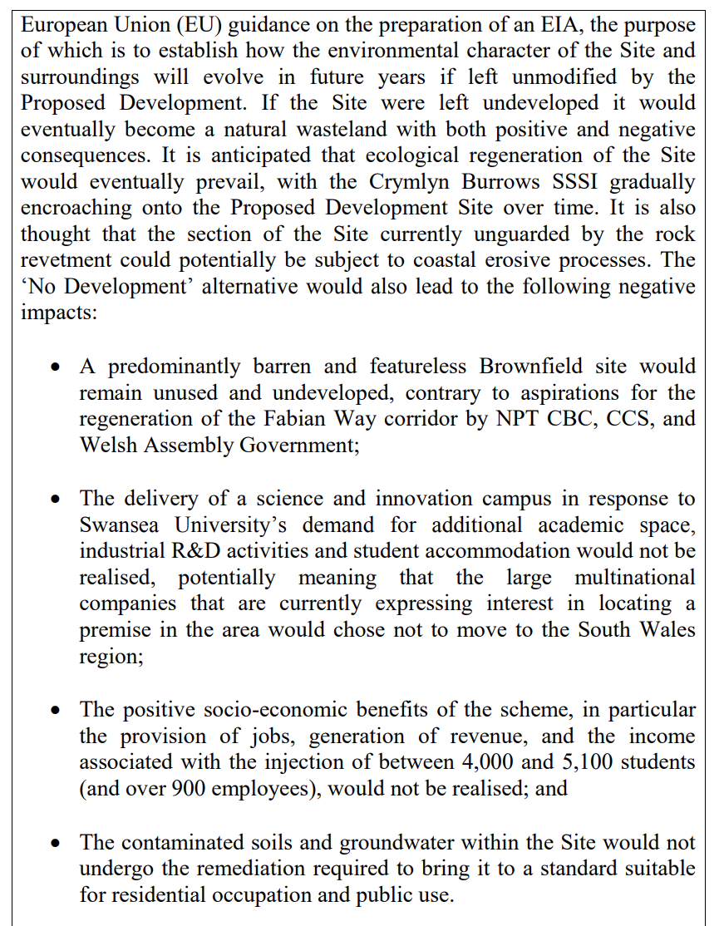
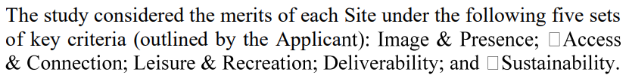
Bay Campus Planning Committee Decision
The committee meeting highlights the following:
Summary of the Environmental Statement:
  EIA requirement for alternatives, highlighting the benefit of converting a site that would otherwise become a ‘natural wasteland’
  The loss of realisation of Swansea University aims (socio-economic benefits)
  Remediation of contaminated soil not being conducted
  For ecology, “there is scope to negate the impact through an off-site funding scheme, to recreate and/or restore an equivalent or larger area of sand dune habitat than is lost by the proposals.” (p.45)
57

Slide 58
Bay Campus Planning Committee Decision
The committee meeting concludes:
“The proposed benefits of the scheme at a national level to provide a significant expansion of Swansea university, and the regional benefits that the investment in integrating education and industry at this single site offer a unique opportunity. This opportunity will potentially drive forward the aspirations for the knowledge economy, within this wider region, and at a local level generate significant socio-economic benefits. The location of the development along the Fabian Way Corridor, which has benefited from significant development at SA1, will further improve this gateway into Swansea, and will raise the profile of the area as a whole. The interaction between the site and wider environment, including the SSSI is seen as a key feature, and intrinsic in this will be the benefits of Wardening to the SSSI and the creation of a management committee to oversee the future of these areas, which are considered equally important in attracting further investment into the wider area.” (p. 117)
“The Environmental Statement has adequately addressed and provided clarity on mitigation measures to ensure that the impacts of the development are minimised. The provision of mitigation with regard to impacts upon transport, and ecology are to be secured through a section 106 agreement, and the imposition of conditions ensure that the requisite level of controls are placed upon the development with regard to environmental impacts both during construction, and post construction including monitoring of these measures for the future. (p. 118)
“It is therefore considered that the proposed development would significantly benefit the aspirations and key principles for socio-economic growth in the region” (p.118)
58

Slide 59
Bay Campus Planning Committee Decision
The committee meeting recommendation:
“That the Council be minded to grant planning permission.” (p. 118)
1. The provision and long-term retention of security and wardening for the Crymlyn Burrows SSSI, the details for which are to be agreed in discussion with CCW and the LPA. This shall include, but not be limited to site security, site management, access management, habitat management and community liaison, for which the security element shall be in place and operational as approved prior to any development taking place, and the warden provision being in place and operational prior to the first use or occupation of any development on the site.
2. The provision and long term (minimum 15 years) retention of security/wardening for the Dune Compensation Area at Witford Point, Baglan (as shown on Drawing No. 5077146-BAG-DWG4038 submitted under Regulation 19) and the beach adjacent to the development site and SSSI. The details for which are to be agreed in discussion with the LPA, but shall include, but not be limited to site security, site management, access management, habitat and species management and monitoring, and the production of awareness raising materials. The scheme shall be in place and operational as approved prior to any development taking place on the development site, including vegetation clearance. These sites also to be overseen by the management committee to be created under the SSSI wardening scheme.
3. The creation of a management committee to address issues of arising from the proximity of the Residential Campus to Crymlyn Burrows SSSI, that shall include but not be limited to site management, access management and community liaison. This committee shall be held quarterly, with representatives of the University, SMD Ltd (as SSSI owners), CCW and the LPA. Regarding the SSSI and it future management .
59

Slide 60
Take a break
10mins

Slide 61

After consent in EIA

Slide 62
Implementing/Construction
Following consent, a Construction EMP (CEMP) outlines the relevant mitigation identified at the pre-application and consenting stage. As additional design or construction information becomes available, the CEMP should amend and further develop relevant content from any previous EMP and evolve this through consultation and direct input from the project team (and ideally the EIA co-ordinator and practitioners).
This will ensure the mitigation measures outlined within an Environmental Statement and supporting EMP continues to be achievable, viable and deliverable by a contractor.

Slide 63
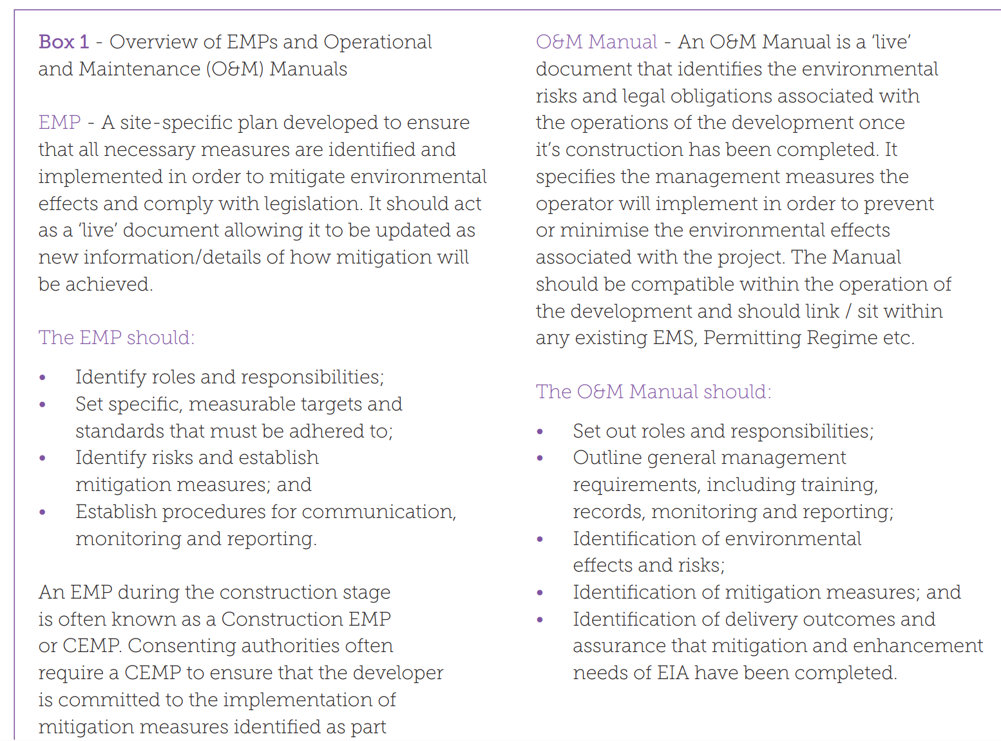
Implementing/Construction

Slide 64
Conditions
EIA-Manual.pdf (iisd.org)
Conditions attached to a planning permission or subsequent consent may include mitigation measures. However, a condition requiring the development to be “in accordance with the Environmental Statement” is unlikely to be sufficient unless the Environmental Statement was exceptionally precise in specifying the mitigation measures to be undertaken, and the condition refers to the specific part of the Environmental Statement specifying the mitigation measures.
Mitigation measures can also be secured through planning obligations which are enforceable by the local planning authority. Planning obligations may be entered into unilaterally by a developer or by agreement between a developer and the local planning authority.

Slide 65
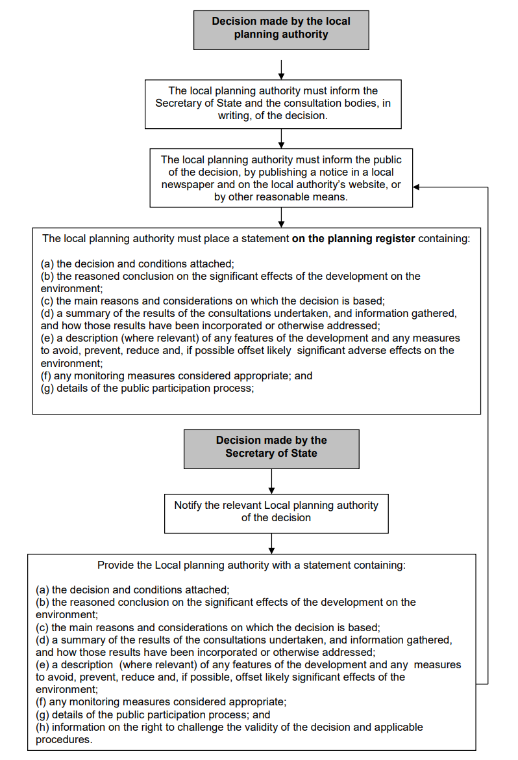
Decision Time
EIA-Manual.pdf (iisd.org)

Slide 66
Publicising the EIA decision
EIA-Manual.pdf (iisd.org)
What are the arrangements for publicising the decision on planning applications involving Environmental Impact Assessment?
The notification and publicity requirements for the Environmental Impact Assessment determination decision are set out in regulation 30.

Slide 67


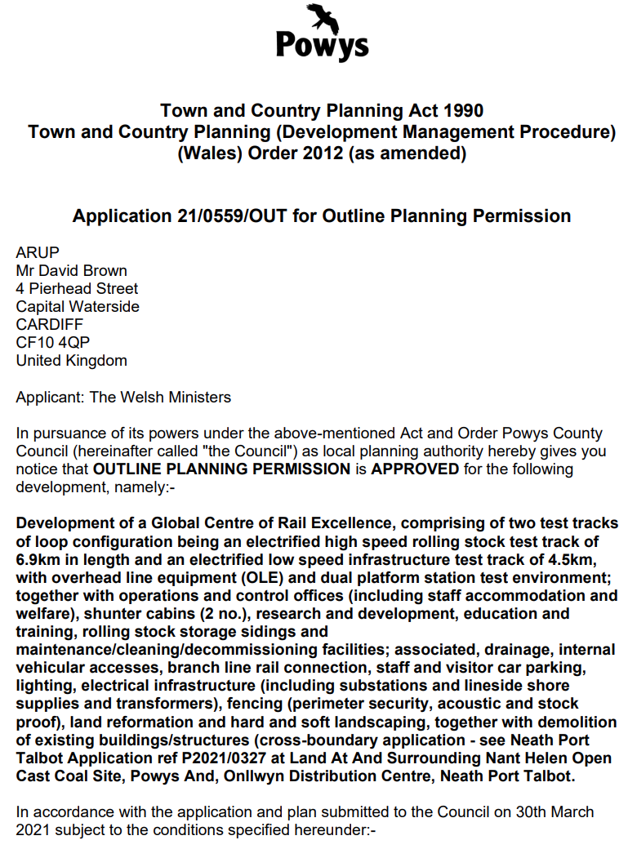
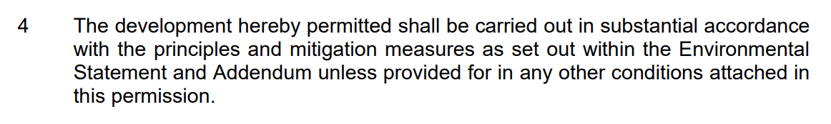
Final Decision
The decision notice stipulates the conditions under which the application is approved, and outlines these in the decision letter, often citing regulations and referring to aspects of the proposed management plan from the ES.
First page of the 31-page decision document for the GCRE project
67

Slide 68
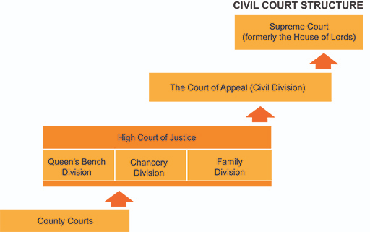
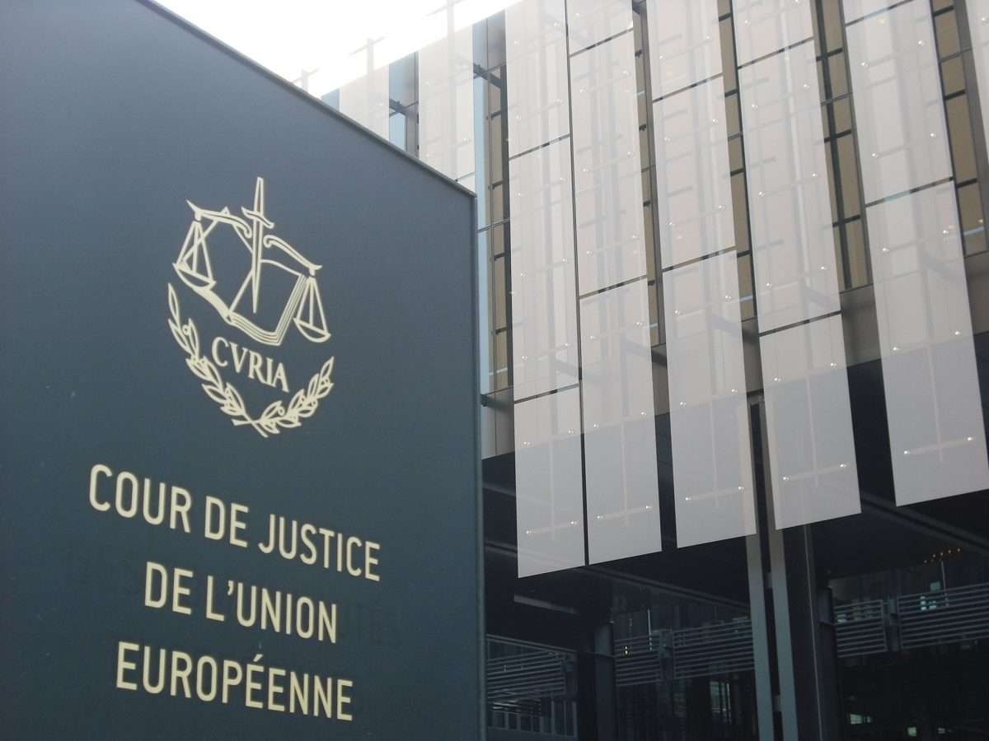
Challenging a Decision
After a decision has been made by the competent authority, there is still the opportunity for it to be challenged.
Challenges in the UK can be either through:
Judicial review
  process of challenging the lawfulness of decisions made by public authorities.
  can challenge whether an EIA was required if it was screened out, or challenge the decision of the competent authority, even if this is the Secretary of State.
European Commission
  Case needs to demonstrate that the UK did not adhere to the obligations to EC Directives, including not conducting an EIA.
  Penalties can be sanctioned to the Member State.
68

Slide 69
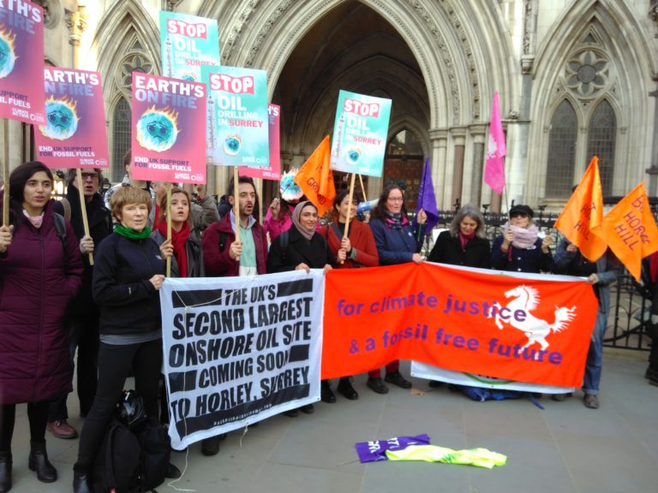


Challenge example: Horse Hill
Case study example: Horse Hill oil drill in Surrey
  Project is to extend oil drilling in Surrey, with four additional wells
  Opposition believes the EIA did not include the contribution of GHG emission from future burning of oil. Council did not believe this to be an indirect effect.
  Challenged in both UK High Court, Court of Appeal, and Supreme Court
  Outcome of High court – dismissed
  Outcome of Court of Appeal – dismissed (2 out of 3 judges dismissed): In Finch the Court of Appeal declines to define significant indirect effects for EIA | Cornerstone Barristers
  Supreme Court hearing in July 2023. Will set a precedent for all future fossil fuel projects in the UK
  Last week: Statement from Surrey County Council: Oil drilling at Horse Hill | Surrey News
“The Supreme Court ruled that the County Council acted unlawfully by not considering the indirect, downstream emissions of the oil when burnt in the Environmental Statement submitted with the application”
69

Slide 70
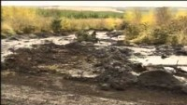
Challenge example: Derrybrien wind farm
Case study example: Derrybrien wind farm in County Galway
  Project for 70 wind turbines was approved without an EIA in 2001, and work began in 2003
  Opposition believes the project required an EIA due to environmental impacts
  Structural damage to underlying geology resulted in significant landslides in October 2003
  Construction continued in 2004, and completed in 2006
  Challenged in Court of Justice for the European Union (CJEU)
  Outcome of challenge – CJEU determined that Ireland failed to ensure an EIA was conducted
  Developer fined a lump sum of €5m and a daily fine of €15,000 until compliance is achieved
  Developer required to submit a retrospective EIA report
  A retrospective EIA report was submitted but deemed unacceptable as some of the evidence provided was over 15 years old.
  As a result, in 2022, the developer announced that
  they would decommission the wind farm.
  European Court of Justice – Tuesday, 9 Nov 2021 – Parliamentary Questions (33rd Dáil) – Houses of the Oireachtas
  Project Information (derrybrienwindfarm.ie)
Watch Politics of Peat (start at 4:15mins)

Slide 71
Take a break
10mins

Slide 72

Assessing what makes a good EIA report?

Slide 73
Why do we review an EIA?
The ultimate purpose of the EIA is to provide critical inputs for decision making about the planned development. The review is carried out to confirm the quality of the information and methods used in the EIA, and that the EIA report addresses all the critical and cumulative impacts as well as the relevant mitigation measures.
Once the EIA report is submitted, designated authorities will usually go through it thoroughly, weighing the methods used, data, mitigation measures and conclusions to assess the impacts of the planned development.
Their review will determine whether or not the project adequately addresses major environmental and social impacts and other risks, and whether or not to grant a licence to the project proponents (or perhaps to request changes). This means that a good quality EIA might still lead to the planned development not being permitted to go ahead based on the identified impacts.
Notes:
Science and Law/management see articles in Principles of conservation linked to National Parks Wright et al in Owen Lib

Slide 74
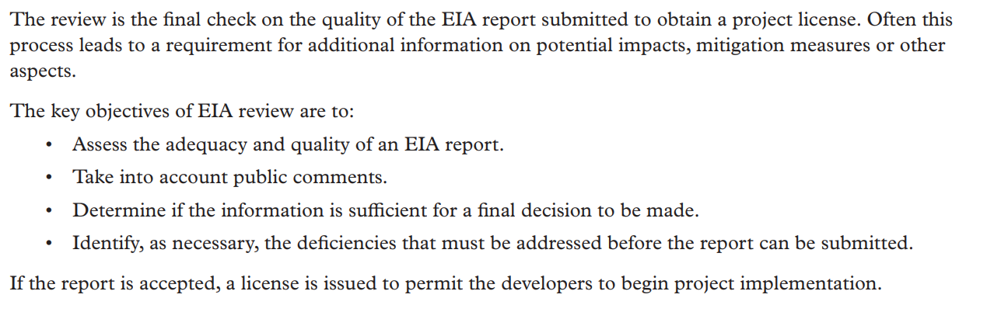
EIA Review
Notes:
Science and Law/management see articles in Principles of conservation linked to National Parks Wright et al in Owen Lib

Slide 75
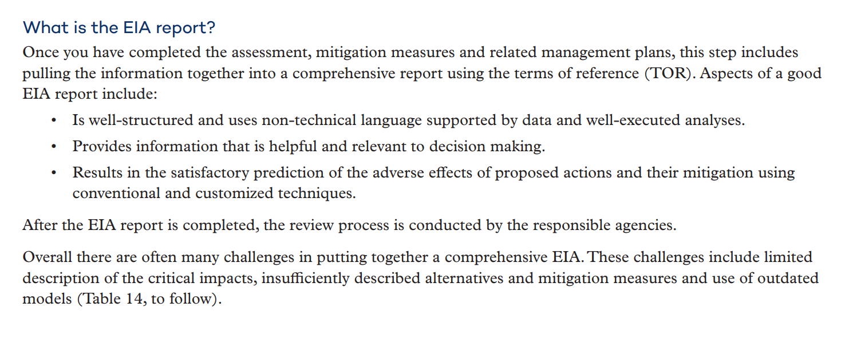
Basic Requirements
Notes:
Science and Law/management see articles in Principles of conservation linked to National Parks Wright et al in Owen Lib

Slide 76
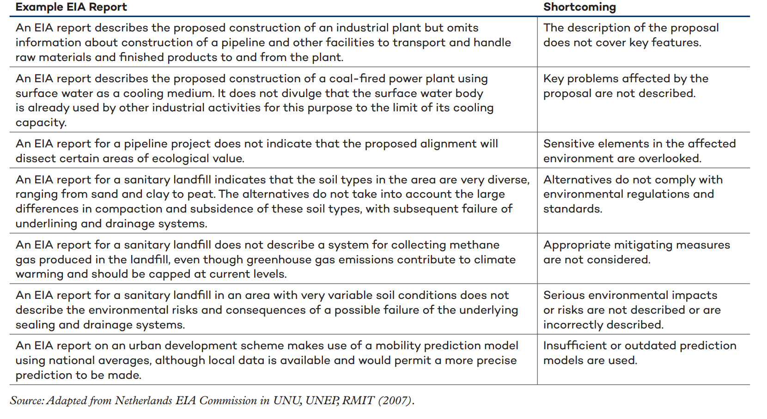
Deficiency examples
Notes:
Science and Law/management see articles in Principles of conservation linked to National Parks Wright et al in Owen Lib

Slide 77
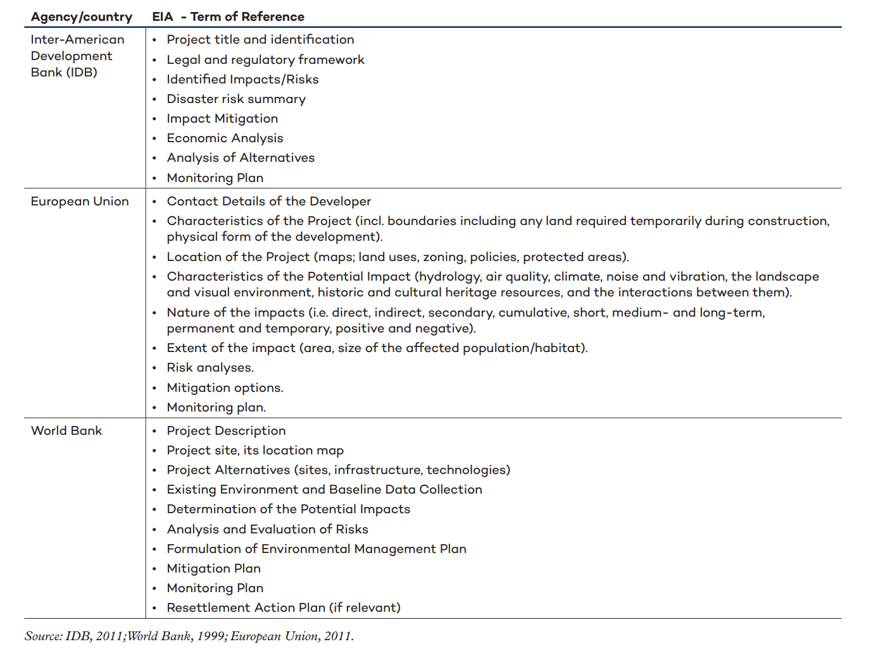
TOR by major organisations
Notes:
Science and Law/management see articles in Principles of conservation linked to National Parks Wright et al in Owen Lib

Slide 78
TOR (Terms of Reference) Examples
Terms of Reference for Environment Impact Assessment (physicalplanning.gov.dm)
EIASampleTOR.pdf (physicalplanning.gov.dm)
TOR.pdf (iisd.org)
Notes:
Science and Law/management see articles in Principles of conservation linked to National Parks Wright et al in Owen Lib

Slide 79
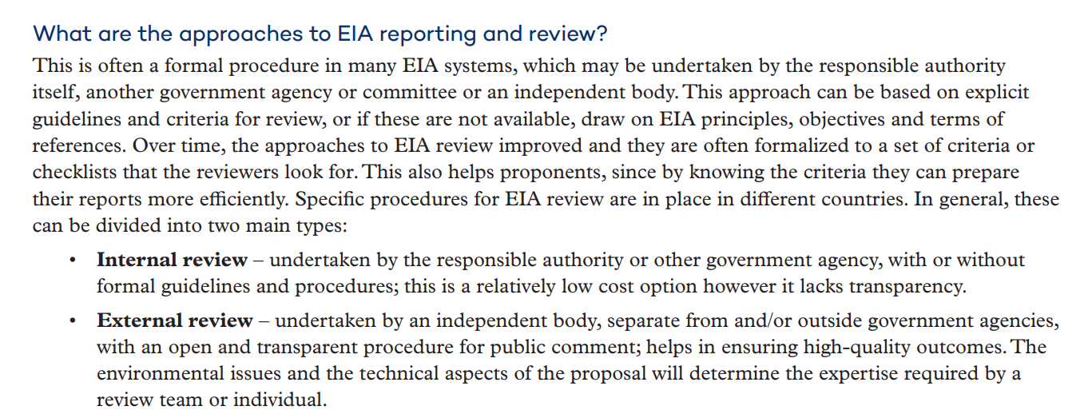
Internal and External Review
Notes:
Science and Law/management see articles in Principles of conservation linked to National Parks Wright et al in Owen Lib

Slide 80
Public Comment in EIA Review
Using input from public comment:
Experience with EIA review in a number of countries has shown that public comment is a critical part of the EIA review process.
Input may come from a public hearing, or from written comments submitted to the proponent or government department.
From a hearing there will often be a summary of issues provided by the panel or officers responsible for hearing the submissions. With written comments, a summary of key points will be needed to guide the review of the EIA.
In both cases the summary should focus on information that helps to identify problems with the EIA, contributing to the assessment of impacts, and identifying ways to reduce impacts.
Notes:
Science and Law/management see articles in Principles of conservation linked to National Parks Wright et al in Owen Lib

Slide 81
Systematic Review
A systematic review is based on specified criteria.
Criteria can also be formulated as questions and then the reviewer assesses if the EIA meets the criteria completely, partially or not at all.
A detailed list of criteria and questions for reviewers is presented here.
Notes:
Science and Law/management see articles in Principles of conservation linked to National Parks Wright et al in Owen Lib

Slide 82
EIA Review
Determining remedial options: Three remedial options are available when an EIA report fails to meet the standards required; these can be listed as follows:
• Acceptable – The EIA has acceptable quality; it identifies and mitigates the impacts of the development while at the same time identifying and addressing public participation and social impacts. Here it is also important that the data and methods meet national protocols and/or internally accepted relevant standards. At this level, it is also important that the information is well presented. The EIA is often considered satisfactory, although there may be some minor omissions and inadequacies of approach. The reviewing authority often provides a list of modification needed.
• Partially acceptable – The EIA considers the key impacts of the planned project, but there are significant omissions and inadequacies in the methods used, or some mitigation actions may be lacking. At this level, substantial modifications or complements are necessary. The reviewing authority often provides a list of modification needed.
• Deficient. The background data are unsatisfactory, poorly analyzed and presented and biased. They are not acceptable.
Notes:
Science and Law/management see articles in Principles of conservation linked to National Parks Wright et al in Owen Lib

Slide 83
How to conduct an EIA Review
How to conduct a review? The review can be carried out in three steps: • Step 1: Identify the deficiencies in the EIA report, using the Terms of Reference, relevant guidelines, criteria and information on standards by national agencies and comparable EIA reports.
• Step 2: Focus on any shortcomings in the EIA report and identify gaps and areas that require further information and improvements in the methods based on suggested protocols; look at key gaps in areas that prevent qualified decision making. If no serious omissions are found, this should be stated clearly.
• Step 3: Recommend how and when any serious shortcomings are to be remedied, in to facilitate informed decision making and appropriate measures for project implementation. The elements of EIA review and the aspects considered may differ from the arrangements that are in place in a particular country
Notes:
Science and Law/management see articles in Principles of conservation linked to National Parks Wright et al in Owen Lib

Slide 84
Considerations
A comprehensive review of the adequacy and quality of an EIA report would address many or all of the following issues:
• Does the report address the terms of reference?
• Is the necessary information provided for each major component of the EIA report?
• Is the information correct and technically sound?
• Have the views and concerns of affected and interested parties been considered?
• Is the statement of the key findings complete and satisfactory, e.g., for significant impacts, proposed mitigation measures, etc.?
Notes:
Science and Law/management see articles in Principles of conservation linked to National Parks Wright et al in Owen Lib

Slide 85
Considerations (Continued)
Is the information clearly presented and understandable by decision makers and the public?
• Is the information relevant and sufficient for the purpose of decision making and condition setting?
The response to the last question is the most significant aspect for review conclusions, and will largely determine whether or not an EIA can be submitted as is or with minor revisions.
Notes:
Science and Law/management see articles in Principles of conservation linked to National Parks Wright et al in Owen Lib

Slide 86
Reviewer Steps:
• Read the contents of the analysis included in the qualification list, study them, and reflect on the information requirements and qualification criteria.
• Identify the information required. If the communication of results and fulfillment of formal and administrative aspects are not adequate, the reviewer should request the project coordinator to rewrite the study report and explain its deficiencies. If the communication of results is appropriate and the study provides the necessary information, the review team should continue with the analysis.
• Study the specific tasks that should have been carried out to comply fully with the requirements described.
• Seek answers to the questions in the tables. The information required can be found in the study itself; it may be necessary to look for it—do not presume that it is implicit.
• The study can be qualified negatively if information is repeatedly found to be lacking. Carefully review the qualification system to understand its logic, since this system will be used to deal with each review criterion.
• Decide on the appropriate qualification and record it in the qualification summary list.
• Decide if the EIA is acceptable and the licence to operate can be awarded, if the EIA needs improvements or shows that the planned development could have impacts to the area that are too severe and thus is to be rejected.
EIA-Manual.pdf (iisd.org)
Notes:
Science and Law/management see articles in Principles of conservation linked to National Parks Wright et al in Owen Lib

Slide 87
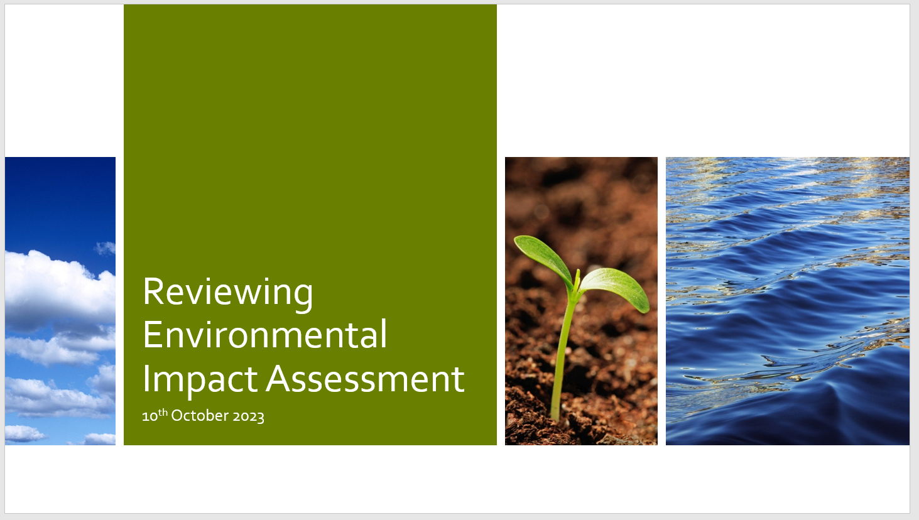
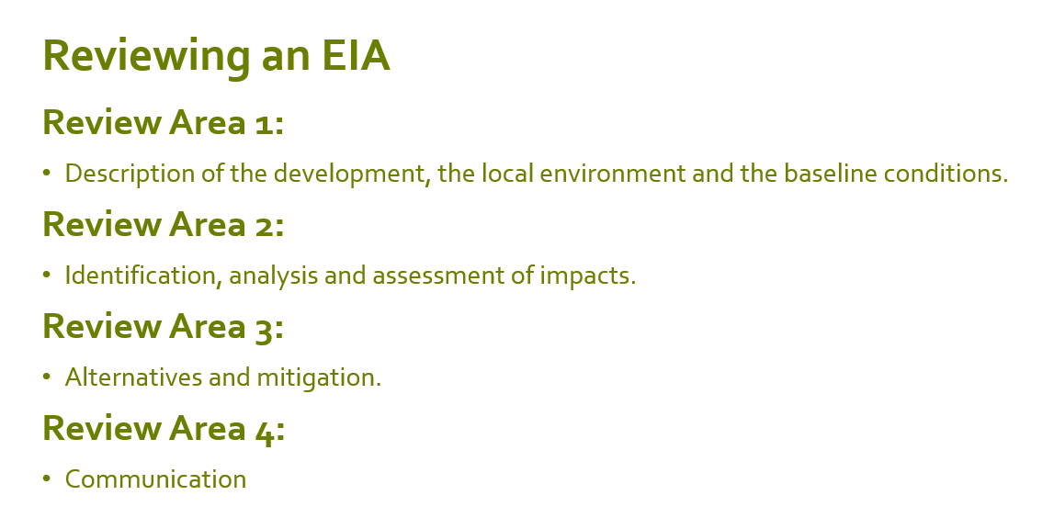
Reviewer Steps:
Notes:
Science and Law/management see articles in Principles of conservation linked to National Parks Wright et al in Owen Lib

Slide 88
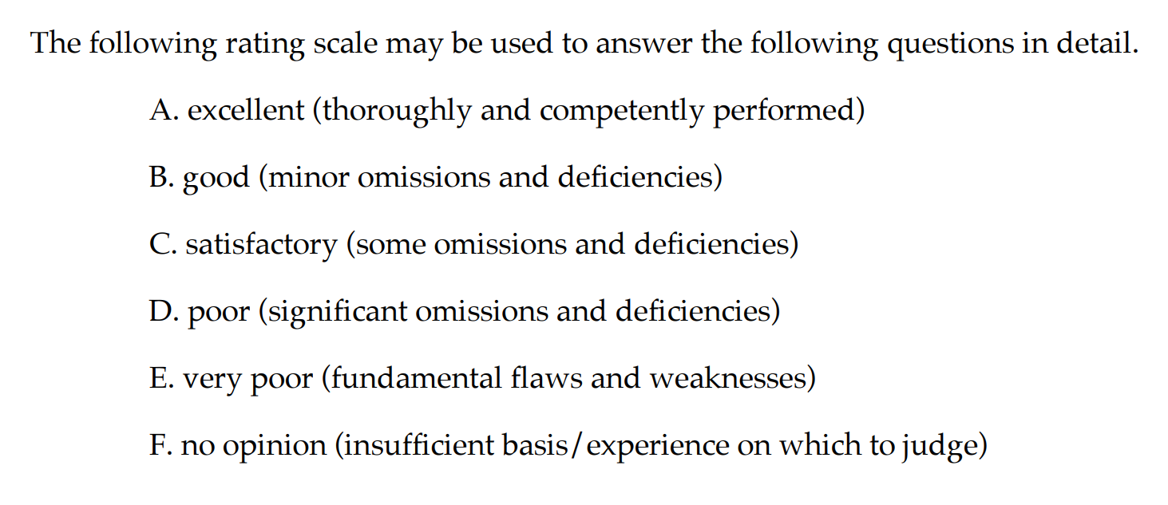
Reviewer Steps:
Notes:
Science and Law/management see articles in Principles of conservation linked to National Parks Wright et al in Owen Lib

Slide 89
Activity
We will be spending the rest of this session reviewing an EIA.
Working in pairs…. Select an EIA report
Using the Powerpoint provided template: assess your EIA
Provide your EIA a scorecard (e.g. A to F) for the relevant considerations.

