Slide 1

Strategies for Effective Communication in a Business Setting
Student names/ numbers:
Teodora Stoyanova - 2125443
Asen Chipilov - 2128091
Andrea Tudorache - 2130698
Laura Lojewski - 2128409
Module: Effective Team Working and Communication (BMSW_4002)
Module lead: Hafiz Rahmani

Slide 2

Introduction
Amazon is an internet based business that facilitates delivery of products all over the world, they also provide digital streaming, cloud computing and artificial intelligence services. They have become the mainstream e-goods purchase website over the past 20 years
They overview the transactions between users and intervene in disputes as the mediator, ensuring high user satisfaction and keeping scammers out of their domain
By Teodora Stoyanova

Slide 3


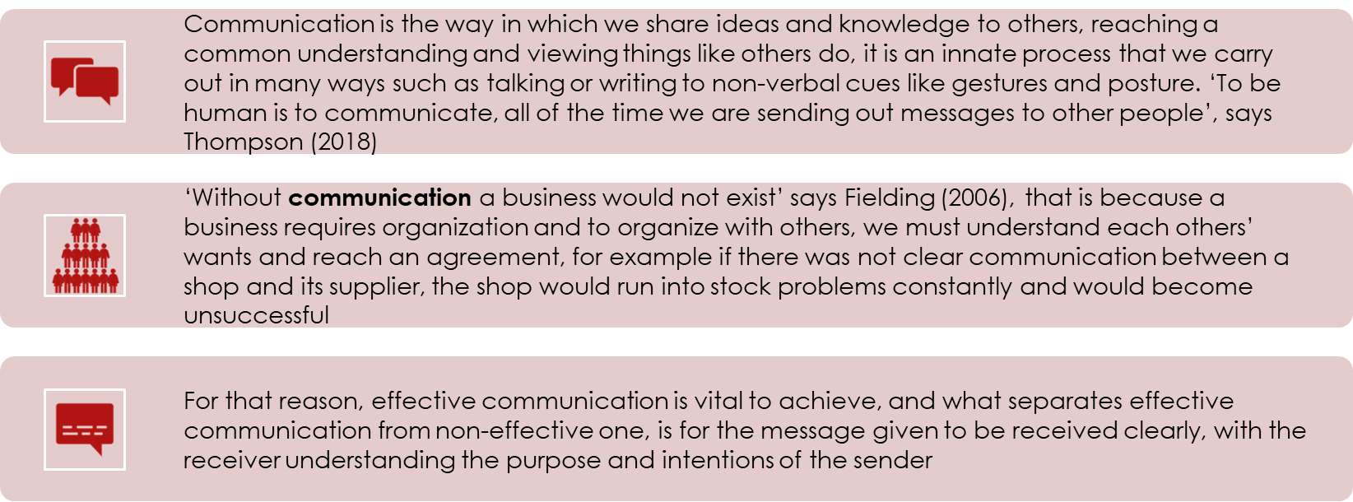



EFFECTIVE COMMUNICATION
By Teodora Stoyanova

Slide 4

BENEFITS OF EFFECTIVE COMMUNICATION
Husain (2013) states that ‘communication has positive correlation with many organizational outputs like performance’, a few ways in which this is true are:
Trust is improved amongst staff members when leaders practice effective communication and leave no room for confusion, this is because conflicts can be avoided this way
Loyalty grows to the business because staff feels appreciated when leaders communicate effectively and involve themselves in the work rather than managing things from a distance, leading to increased job satisfaction
Higher engagement is a direct result of effective communication as there is constant clear contact and relay of information between staff
Teamwork is formed by collaboration amongst the team, a culture of effective communication, being clear, timely and kind, strengthens the inner team workings
Productivity rises due to staff understanding what it is exactly that they are responsible for and what they need to do to achieve their goals. Removing any possible confusion through clear messages lets staff focus all their energy properly
Innovative ideas might come up if everyone fully understands their roles and the details of the task at hand
Better relationships with customers will take place, the good habit of communicating clearly within the business will also spread to interactions with clients
By Teodora Stoyanova

Slide 5
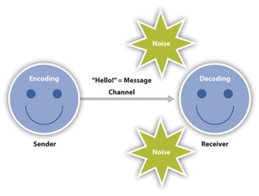
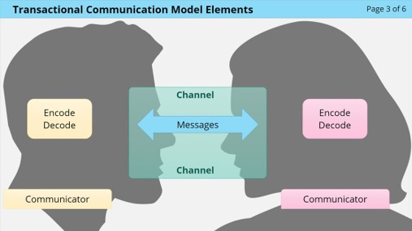
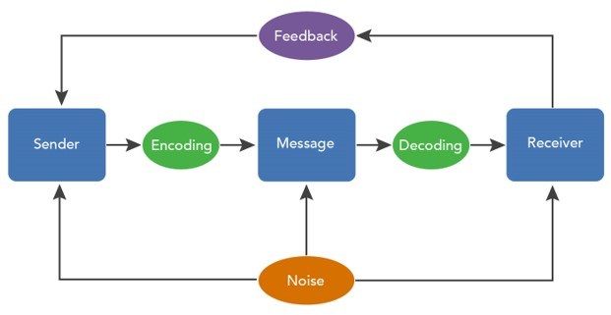
What are the models of communication?
By Asen Chipilov

Slide 6
What models of communication should Tom apply and why?
Since Tom is dealing with a huge project which will require lots of planning and teamwork, he should not use the transmissional model, as it can be seen as bossy which can demotivate his workers and will not be very useful in keeping him updated due to the lack of feedback. Feedback and reviews are too important to give up as shown by Clark (2017) who claims ‘49% of consumers trust online reviews more than other sources’
A better option would be the interactive model where Tom can engage his workers and listen to their concerns as well as ideas. This removes confusion and can avoid issues by making sure everyone received the message properly and knows what they are doing, as well as letting Tom know of any potential issues he might have overlooked. This can be done in a formal way for example via e-mail or meetings to help record the information discussed, which will also foster trust and teamwork with his staff and would help fix the difference in ideas between his staff members because, ‘both parties can voice their opinions’ as stated by Tiwary, S. (2022)
The transactional model could also work as it shares many similarities with the interactive model benefits, mainly the ability to give feedback which can be taken into account by Tom. However this might not be as easy when dealing with large groups of workers as it is hard to pay attention to all of them at once, and it would be easier to co-ordinate it through the interactive model
By Asen Chipilov

Slide 7

Which communication barriers have or can negatively impact the project team
Physical barriers
Cultural noise
Attitudes
Language
Phychological
Jumping to conclusion
Andreea Tudorache

Slide 8
Physical barriers- A physical barrier is a natural environmental condition that acts as a barrier in communicating by sending a message from the sender to the recipient.
Attitudes- Attitudinal barriers are behaviours, perceptions and assumptions that are discriminatory towards people with disabilities.
Psychological- Physiological obstacles to communication are linked to the limits of the human body and the human spirit (memory, attention and perception).
Culture noise- Cultural noise is a communication barrier caused by the incorrect interpretation of another person's behavior. Cultural noise is produced, in particular, by non-verbal communication from people of different cultural backgrounds.
Language- There are usually language barriers when two people who speak different languages are unable to understand each other, and there is a language and communication problem.
Jumping to conclusion- Jumping to conclusions makes it hard to see situations clearly and increases the chance of making bad decisions.
Andreea Tudorache

Slide 9
Importance of communication channel
  According to the 'Lendle-Daft model Channel Richness Hierarchy' the most effective channels of communication are:
    face-to-face
    video conferencing
    Telephone
    But the channels are low or high richness and depending on the message, the communication channel must be clearly chosen for the information to be transmitted and received without doubt or misunderstood.
Laura Lojewski

Slide 10
Face-to-face communication includes both verbal and non-verbal elements:
Body movements
Tone of voice
Facial expression
Body language
Laura Lojewski

Slide 11
Face-to-face benefits:
Resolving conflicts between team members
Helps building relationships and increases teamwork
Reduce misinterpretation of information
  Better communication
  between team member
Laura Lojewski

Slide 12

Video conferencing – online meeting in real time that creates virtual face-to-face meeting
  Allows to maintain a clear way of communication with the team members.
    Make decisions on the spot rather than sending out an email and wait for everyone's response
  Allows to read the body language and the tone of participants' voice.
    Increase decision-making and productivity
    Allows everyone from the team to share their screen giving others the opportunity to help remotely with any issue.
    Gives a team the ability the record meeting or events and can be used by members to catch up with vital information they missed.
    Reduce the costs of meeting abroad by effectively meet that person virtually, saving time and money.
Laura Lojewski

Slide 13
5 BODY LANGUAGE TIPS THAT CAN HELP SET YOU UP FOR SUCCESS IN BUSINESS AND IN LIFE
Eye contact
Facial expression
Handshake
Posture
Gestures
Laura Lojewski

Slide 14

TIPS IN MIND WHEN YOU’RE INTERACTING WITH SOMEONE
SMILE SLOWLY
Don’t fake it.
LOWER YOUR VOICE
A deeper voice is considered to have more authority and confidence.
MAKE EYE CONTACT
Eye contact shows that you are interested in the conversation and that you are a good listener.
HAVE A GOOD POSTURE
Don’t slouch. Sit or stand up straight.
LEAN IN
Move your body slightly forward toward the person you’re talking to – this reflects interest.
MIRROR THE OTHER PERSON’S MOVEMENTS
– like smiling when the other person is smiling
Laura Lojewski

Slide 15
In a workplace, such as Amazon, communicating face-to-face can bring many benefits, helping to achieve their ambitious target in an efficient manner, without any limitations.
For example, this choice of communication could build trust among employees because it shows that you value them and whatever they have to say.
The non-verbal cues are key in this type of communication because it helps the person you are communicating with assess if you are credible and worth building a relationship with.

Slide 16
REFERENCES
Brignall, M. (2022). Describing the Transactional Communication Model. Available at:https://www.wisc-online.com/learn/humanities/communication/oic22421/describing-the-transactional-communication-mo Accessed: 3 November 2022
Clark, E. G. (2017). Integrating consumer feedback into business marketing strategies (Doctoral dissertation, Walden University).
Demchenko, V; Khoroshevskaya, J; Krukov, K., Communication Barriers of a Construction Company’s Network Management, IOP Conference Series. Materials Science and Engineering; Bristol Vol. 1079, Iss. 3, (Mar 2021). DOI:10.1088/1757-899X/1079/3/032089
Laura Hemingway, Disabled people and housing: Choices, opportunities and barriers, 2011 Edition: 1 Published by: Bristol University Press, Policy Press https://doi-org.ezproxy.uwtsd.ac.uk/10.2307/j.ctt9qgstp Pages: 224
Fielding, M. (2006). Effective communication in organisation. Juta and Company Ltd.
Husain, Z. (2013). Effective communication brings successful organizational change. The Business & Management Review, 3(2), 43.
Indeed (2022), What is face-to-face communication and why is it important?. Available at: https://uk.indeed.com/career-advice/career-development/face-to-face-communication (Accessed: 7.11.2022).
Oxbridge Academy (2014) Top body language tips to make a good first impression. Available at: https://www.oxbridgeacademy.edu.za/blog/top-body-language-tips-make-good-first-impression/ (Accessed: 10.11.2022).
Thompson, N. (2018). Effective communication: A guide for the people professions. Bloomsbury Publishing.
Tiwary, Shivendra ‘Interactive Model of Communication’ [blog] Digiaide. 20 January 2022. Available at: https://digiaide.com/interactive-model-of-communication/ (Accessed: 3 November 2022)
University of Minnesota (2016). 1.2 The Communication Process. Available at: https://open.lib.umn.edu/communication/chapter/1-2-the-communication-process (Accessed: 2 November 2022)
Vonage (2022), 7 Ways Video Conferencing Brings Teams Together and Boosts Productivity. Available at: https://www.vonage.co.uk/resources/articles/7-ways-video-conferencing-brings-teams-together-and-boosts-productivity/ (Accessed: 7.11.2022).

Slide 17
Teamwork Evaluation | Team responses.
Who was in your team? | Teodora Stoyanova Asen Chipilov Andrea Tudorache Laura Lojewski
What were the key strengths of your team? | This was not a team, Teodora tried to keep the 'team' together. Laura surprised me with her fast response on her slides.
What were the challenges that you overcame as a team? | We couldn't overcome anything. The whole thing was a joke from the beginning. Communication is the biggest issue.
What would you do differently if you worked as a team again? | I would get rid of some of the members 100%. It's hard to collaborate with too many people who live in different parts of the country, work different shifts. Sometimes less is better.
How would you rate your team working? Out of 10? | 1

