Slide 1


IKEA
Strategies for resilience and prosperity

Slide 2
Strategic management
Strategic management is a set of decisions and actions that result to the formulation and implementation of plans.
Strategic management includes understanding the strategic position of an organisation, making strategic choices for the future, and managing strategy in action. (Johnson et al 2011)

Slide 3
Overview of IKEA
In 1926 Ingvar Kamprad’s idea with IKEA is to offer a wide range of home furnishings of good design and functionality at a price low enough to be affordable to most people. (Edvardsson et al 2006) shows how over six decades IKEA went from the woods of southern Sweden to be a major retail experience in 40 countries/territories around the world. ("History - IKEA", 2020) Kampard started selling matches at the age of five expanding over time to selling other items, until he was established in nineteen forty-three as a furniture dealer and entrepreneur, the year IKEA was formed. I.K the inventers initials, E for Elmtaryd his childhood village and A from Agunnaryd the farm where he grew up.
His idea and products were so popular that by 1953 he opens a showroom. Within three years competitor pressure stopped the supply of furniture and Kampard was forced into designing IKEAs own furniture. Exploration of flat packaging begins when one of the first IKEA co-workers removes the legs of the LÖVET table so that it will fit into a car and avoid damage during transit. (IKEA.com 2020)

Slide 4
Position in the market
IKEA has a cost leadership strategy this is where a business focuses on the reduction of costs on delivery of the products to the consumer, adding profit to the organisation. IKEA uses technology and innovations that reduce costs and is resilient enough with these processes to resist price increases keeping the organisation competitive.

Slide 5
Porters 5 forces
Bargaining power of suppliers
Threats of new entrants
Threat of substitution
Buyer power
Competitive rivelry
Notes:
Threat of new entrants ikea is huge in this market. Ikea is recognized as the number one in furniture sales , ikea has been extremely successful in entering and transforming the global furniture market and also blocking others out so this posses no threat
Power of buyers
With global reach and extensive connections the furniture giant is able to leverage bargaining and pricing advantages over competition, with experience and precision so this is not a problem.
Power of suppliers
21% of ikeas suppliers are from china, in the unique market of furniture where different parts, such as glass and lumber are manufactured separately, ikea requires long term relationships and connections to bring together and produce quality products at a reasonable cost so this again is no problem.
Threat of substitution
This is an area of concern for ikea. Competitors advertising environmentally friendly products at low costs , an ever changing society involved more and more in their ecological footprint are led to purchase these new competitors produce, substituting a giant such as ikea
Competitive rivalry
From the analysis using the five forces model would mostly be a positive outcome. As limited focus is required on the already existing buyers, suppliers and market entry, security it appears that these factors must be exercised to establish. A foundation. In more environmental; materials or processes, even if it requires eating into profits temporarily or adjusting suppliers , to realize economies of scale in am ore environmentally conscious way. With such a strong market presence, eco friendly suppliers would be anxious to make sales with ikeas, before its competitors. meaning aa quick response on ikeas end could still lead to an even stronger and more environmentally friendly realization of economies of scale.

Slide 6
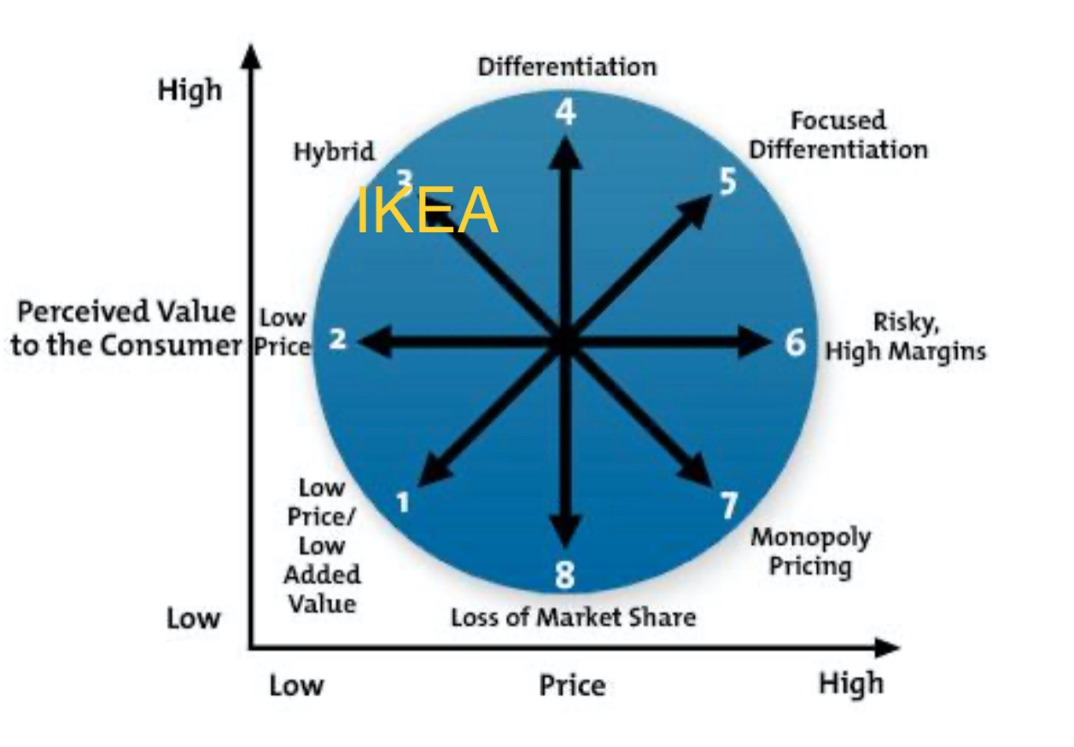
Bowmans strategic clock

Slide 7
Strengths and weaknesses
strengths Understanding their customer needs Affordability A strong global idea, brand recognition The use of modern/ unique and specialised designers Unique instore design incurring less costs where customer collects directly from warehouse. | Weaknesses 1.low quality 2. seemingly cheap 3.home assembly, self-collection, barriers to home delivery furniture. 4.the size of the business, hard to ensure and control the standard / quality 5. environmental impact of throw away culture

Slide 8
Opportunities and threats
Opportunities Global markets open to move into in south America/ Asia Online shopping Food and grocery stores Growing demand for eco green products / products sourced from recycled products | Threats Established Competitors entering the low-price household and furnishing markets. Countries with higher revenue may want a better-quality product Economic factors including COVID and natural disasters affecting the potential customer base affecting job security.

Slide 9
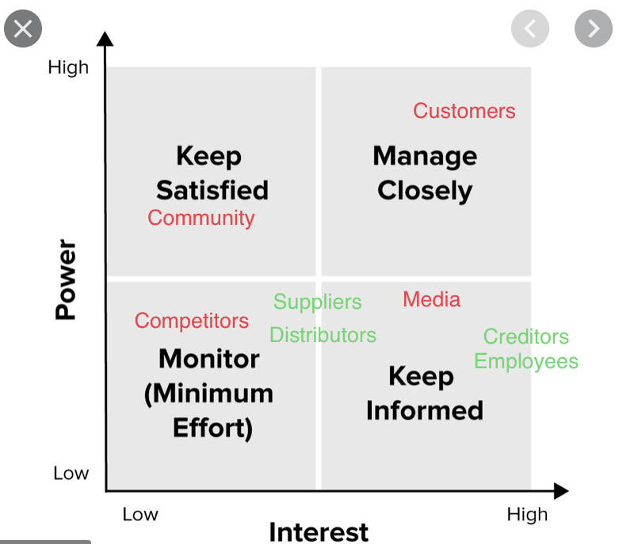
Mendelows power-interest matrix

Slide 10
Recommendations to strategy
IKEA already has a loyalty card scheme called “Family” which introduces a different price for selected items around the store. There could be a development of the card scheme like other retailers where the card can be used in several different UK fun day out schemes, eating out and lifestyle .

Slide 11
Develop online sales strategy
IKEA could develop an online food and shopping deliveries strategy leading to more sales and being able to increase ikeas countywide reach. Even partnering up with an existing delivery service such as for example waitrose’s experimental use of Ocado delivery service.

Slide 12
Extend its ranges
IKEA could consider introducing a less throw away range of completely ecological based furniture with either
1. 100% recycled materials, maybe even an exclusive ikea recycling unit , where old furniture can be used to make new products.
2.completly ecological tree materials where the wood is sourced from ikeas own forestry program.

Slide 13
References
Introduction to Bowman's Strategy Clock | Resources | Get Lucidity. (2020). Retrieved 12 October 2020, from https://getlucidity.com/strategy-resources/introduction-to-bowmans-strategy-clock/
History - IKEA. (2020). Retrieved 13 October 2020, from https://www.ikea.com/ms/en_JP/about_ikea/the_ikea_way/history/index.html

