Slide 1

Academic and Employability Skills

Slide 2
Table of Contents
Slide 3- Introduction
Slide 4- Industry would work in
Slide 5- Job Advertisement
Slide 6- Evaluation of the skills
Slide 7- Time management tools
Slide 8 Personal Development Plan
Slide 9- Conclusion
Slide 10- Reference List
Slide 11

Slide 3
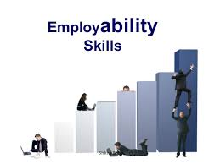
Introduction
Academic skills refer to the attributes of the individual that may help in gaining better career growth in the future
Employability skills are the attributes of the individual that prepares them for future challenges in their professional career
Notes:
Academic skills refer to the attributes of the individual that may help in gaining a better career growth in the future (Ashton-Hay and Doncaster, 2021). The academic skills will be helpful in making certain that proper growth is being gained by the employees. Employability skills are the attributes of the individual that prepares them for the future challenges in professional career(Di Gregorio et al., 2019). Are also helpful through which the employees get better ability to manage the work and become a better resources for the organisation. In the following presentation, specific industry where I would be working will be analysed along with the skills and the competencies that might be needed by the individuals. Job advertisements will also be analysed through which better analysis of the skills and the responsibilities can be gained. Furthermore, the evaluation of the skills will be done which may also be helpful identifying the usefulness of such skills. Lastly, the SWOT will be used along with the time management tools that might help in identifying the issues and challenges that are being faced by me.

Slide 4
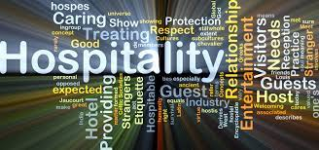
The industry I would work in
The employability skills that I have are a proper team working and communication skills along with proper referencing and academic writing being the academic skills that I possess.
The skills that I want to improve will be the problem solving and technical skills that comprise academic and academic skills
Notes:
The employability skills that I have are a proper team working and communication skills along with proper referencing and academic writing being the academic skills that I possess. The skills that I want to improve will be the problem solving and technical skills that comprise academic and academic skills. The skills I want to I was always eager to ensure that I am having great interpersonal skills I can also assure that I would be able to manage my job role in the hospitality industry. I want to be in the industry as a reception manager working for a hotel as after the pandemic the hotels are expected to witness a massive increase in the flow of customers. This industry is booming and is expected to see a rise in employment by 2022. Communication and coordination are some of the most essential skills that might be needed by the employees. It can also be stated that such skills will help create a better scope for the employees that may also be supportive in increasing their performance. The hospitality industry also expects team working as the hotel and the resorts would need a huge amount of workforce through which development of the work can be done. Employees have to ensure that the best skill development is being gained which will help create better development in an organisation. Team working skills will be essential through which the quality of the work will remain strong and will develop a huge sense of punctuality (Rimmer, 2019). This will be helpful for an organisation I am working with as they may get higher profits and more customer footfalls.
Being in the hospitality industry, it will be essential to govern an organisation as this is the only way through which better management of the employees can be done. The leadership style will also be judging the different forms of the activities of an organisation through which better analysis of the employees can be done. Choosing the appropriate leadership style will also be essential in gaining better profits and efficiency of an organisation (Daniëls et al., 2019). The skills that I have in abundance are proper time management and teamwork, which will help create a better opportunity for employees.

Slide 5

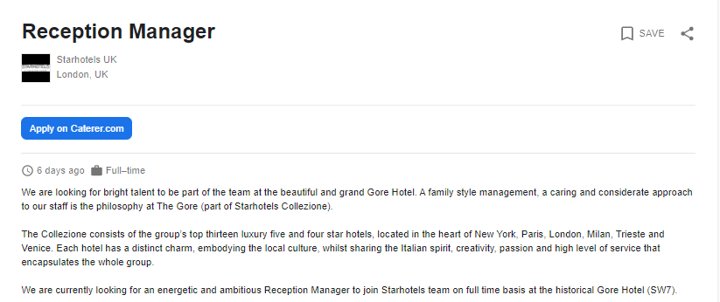
Job advertisement
In the hospitality industry, the best job role that would suit me is the Reception manager through which I can demonstrate the existing skills and gain new ones.
This way the organisational values and loyalty from the customers can be expected.
Notes:
In the hospitality industry, the best job role that would suit me is the Reception manager through which I can demonstrate the existing skills and gain new ones. The position of reception manager includes a lot of responsibility and skills. Some of the skills that might be necessary for the developments of the role are interpersonal and communication skills, which is essential in dealing with customers, suppliers and clients. This way the organisational values and loyalty from the customers can be expected. The hospitality industry needs too many skills and competencies from the employees. This organisation stresses all forms of the things that might be needed by the organisation. Time management, decision making and problem-solving are yet other forms of the skills that are essential in carrying out the job responsibilities. The above-mentioned job role is for the reception manager by which best form of the skills and the knowledge can be gained. The job role will be essential in making certain that a proper form of management is being done for the employees of the organisation. It can also be stated that each form of the work is being effectively done.
Moreover, the reception manager will be making certain that all forms of operational measures are taken care of through, which the best form of profits can be assured. Since I am having great leadership skills through which I can assure to govern the organisation effectively. The leadership skills in me are purely transformational as I can analyse the changes that the employees and the staff would need. The team working skills in me are also in abundance through which the employees of the organisation can maintain coordination and support from other team members. My current skills comprise leadership and communication through which I can make better choices and decisions and will also help ensure that all the members of the organisation are also increasing productivity. This will also be helpful through which I can help in improving the decision-making process (Gallivan et al., 2018).
Evaluation of the skills that I possess and the way I wish to improve them
The skills that I possess are the team working, communication and leadership skills, which will help me be an efficient employee of the organisation. The skills have been gained through strong practice. To analyse the different forms of the advantages of the organisation use of the SWOT and PDP will be used through which better analysis can be done. The Eisenhower method will be used to analyse the time management method and the things that should be done to prioritise the work.

Slide 6
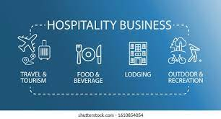
Evaluation of the skills that I possess and the way I wish to improve them
SWOT Analysis
Strengths
My team working skills are good as I have good coordination.
Leadership is a strength as I can provide support to my friends
Weaknesses
Tend to get hostile at times as I have less patience
Lose focus at times as I often become demotivated
Opportunities
Internship programs were attended during the initial years helped me to understand different subjects
Threats
Peer completion is high for which I may not be able to gain better marks.
The current jo scarcity is causing a huge issue in getting a desirable job.
Notes:
As per the SWOT Analysis, it can be stated that I have a great strength of teamwork through which I can coordinate with the team and the staff of the hotel. This will also help make sure that the best form of management of the employees is being done. Furthermore, my communication skills will be helping me to ensure that all the information’s are being passed to employees effectively. At times, I tend to lose focus on the work and become hostile in difficult situations, which also work as a weakness and may hamper my activities in the future. My time management skills are great through which I can schedule the work effectively and ensure that good quality work is being provided at all the times through which the profits are also increasing. Moreover, my internships would also motivate me to complete my degree and stay active on the professional front. Lastly, the negotiations skills in me are quite poor and they possess a threat. I may tend to pay higher for a particular commodity or service through which the organisation can effectively manage the work.
During the initial days of the college, I had issues in communicating with the tutors and the moderators of the course for which I would often make errors in work. However, I ensured to read books and magazines through which I learned the different ways of putting the statement. This way clarity was developed among us through whom I was able to understand the assignment and the subjects effectively. In the future, I wish to work with diverse cultural groups through which I can further improve communication and develop fluency in the future. Communication skills will also be useful for the organisation, as they will provide better coordination. Improper communication will lead to the poor planning of the work and will lead to the devastation of the organisational values.
The team working skills were developed within me because of group projects that I had done during the class activities and the assignments that were given in the group so that all the members can effectively participate and complete the work. During that time I had faced issues regarding the support from certain team members as they had different issues. However, others had ensured that nevertheless, absentees work is being again divided in the group through which the best form of support was formed between the members of the team. This also resulted in the effective development of the team working practices. This is also helpful in increasing the quality of the assignment, In the future; I aim to work for the organisation being a Reception manager so that I can effectively ensure that I am working with all the staff and the members of the organisation and maintaining proper coordination.
The leadership skills were embedded in me through the form of governing that we have received from the tutors and the lecturers, they would analyse the changes needed within me through which the work can be effectively managed. Moreover, during the group activities, the tutor would select a leader who would be the prime source of communication with the module assessors and the group. At times, the assessors would make me the group leader for which I would need to devote a higher amount of time in analysing the needs and the demands of the students. This made me more effective in deciding the things that need to be maintained and provided to the team. In future, I wish to demonstrate the existing skills in an organisation so that I can also learn through the gaps I have in the skill. This will help in identifying the actions that I need to take so that the skills can be effectively completed. The leadership skills can only be analysed in the organisation by which the governance of the employees can be identified. However, choosing an appropriate leadership style is equally essential which may also lead to the devastation of the firm’s values and ethics.

Slide 7
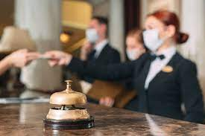
Time management tools
 | Urgent | Not Urgent
Important | Completing Assignments on time | Gaining skill development certificates
Not Important | Strategic planning of the work | Leisure trips
Notes:
The time management model has helped frame the time in such a way that non-urgent work and the urgent would relate to the important and the non-important factors of the individual. The urgent and important work would be completing the assignment, as they will help give me better marks. However, the non-urgent work comprises of applying for a job right now, as I would need to get training on relevant roles and competencies. The not important and non-urgent work would comprise of buying a house or taking leisure trips.

Slide 8
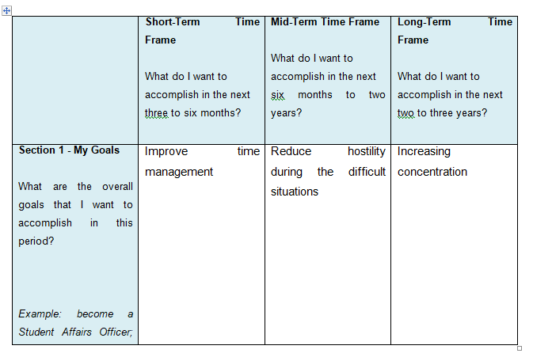
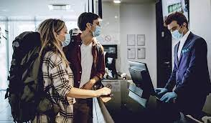
Personal Development Plan
Notes:
Personal Development Plan
Short-Term Time Frame
What do I want to
accomplish in the next
three to six months?
Mid-Term Time Frame
What do I want to
accomplish in the next
six months to two years?
Long-Term Time Frame
What do I want to
accomplish in the next
two to three years?
Section 1 - My Goals
What are the overall goals that I want to accomplish in this period?
Example: become a Student Affairs Officer; learn computer graphics
Improve time management
Reduce hostility during the difficult situations
Increasing concentration
Section 2 - Skills and Knowledge to be
Learned
What specifically do I need to learn? What project do I need to work on?
Example: Student advising;
Banner; Dreamweaver; develop a procedure manual
Scheduling the time based on the work received
To gain patience and stay motivated
To be able to attend to the assignments properly and improve quality
Section 3 - Next Steps
How am I going to acquire the skills and knowledge? How am I going to do this project?
Example: take Dreamweaver class; do an
informational interview; set up a project outline
Supervision and work plan sheets
Motivational speeches and meditation
Reading books and practising concentration
Section 5 - Time Schedule
What is my schedule?
3 HOURS
2 HOURS
2 HOURS
When will I start?
August 2021
September 2021
January 2022
When do I expect to finish?
October 2021
January 2022
July 2022
Section 6 - Completion
When have I completed each
step?
13th October 2021
27th January 2022
15th July 2022
Table 3: PDP Plan

Slide 9
Conclusion
To conclude it can also be stated that the industry that fascinates me has been analysed based on the skills and the talents needed along with a comparison of the current skills I have. It was found that communication skills and time management skills are necessary for the role. However, I have good leadership and team working capabilities through which the development can be brought. Furthermore, evaluation of the skills has been done through the use of SWOT analysis and time management tools and identified that I have poor negotiation skills. The non-important and non-urgent works are buying a house or going on trips. Lastly, the PDP has been witnessed based on the issues and the challenges faced by me so that I can complete them effectively.
Notes:
To conclude it can also be stated that the industry that fascinates me has been analysed based on the skills and the talents needed along with a comparison of the current skills I have. It was found that communication skills and time management skills are necessary for the role. However, I have good leadership and team working capabilities through which the development can be brought. Furthermore, evaluation of the skills has been done through the use of SWOT analysis and time management tools and identified that I have poor negotiation skills. The non-important and non-urgent works are buying a house or going on trips. Lastly, the PDP has been witnessed based on the issues and the challenges faced by me so that I can complete them effectively.

Slide 10
Reference List
Di Gregorio, A., Maggioni, I., Mauri, C. and Mazzucchelli, A., (2019). Employability skills for future marketing professionals. European management journal, 37(3), pp.251-258.
Jackson, T.L. and Robbins, S.A., (2019). CV Writing Workshop (No. LA-UR-19-26689). Los Alamos National Lab.(LANL), Los Alamos, NM (United States)
Notes:
caterer.com 2021 Reception Manager [online] Available at: https://www.caterer.com/job/reception-manager/starhotels-uk-job93755211?utm_campaign=google_jobs_apply&utm_source=google_jobs_apply&utm_medium=organic&v=1627385954981 [Accessed 27 July 2021]
Ashton-Hay, S.A. and Doncaster, N., 2021. Student success and retention: What’s academic skills got to do with it?. Journal of Academic Language and Learning, 15(1), pp.102-116.
Di Gregorio, A., Maggioni, I., Mauri, C. and Mazzucchelli, A., 2019. Employability skills for future marketing professionals. European management journal, 37(3), pp.251-258.
Daniëls, E., Hondeghem, A. and Dochy, F., 2019. A review on leadership and leadership development in educational settings. Educational research review, 27, pp.110-125.
Rimmer, A., 2019. The firm: does it hold the answers to teamworking and morale?. BMJ: British Medical Journal (Online), 365.
Gallivan, J.P., Chapman, C.S., Wolpert, D.M. and Flanagan, J.R., 2018. Decision-making in sensorimotor control. Nature Reviews Neuroscience, 19(9), pp.519-534.

Slide 11


