Slide 1

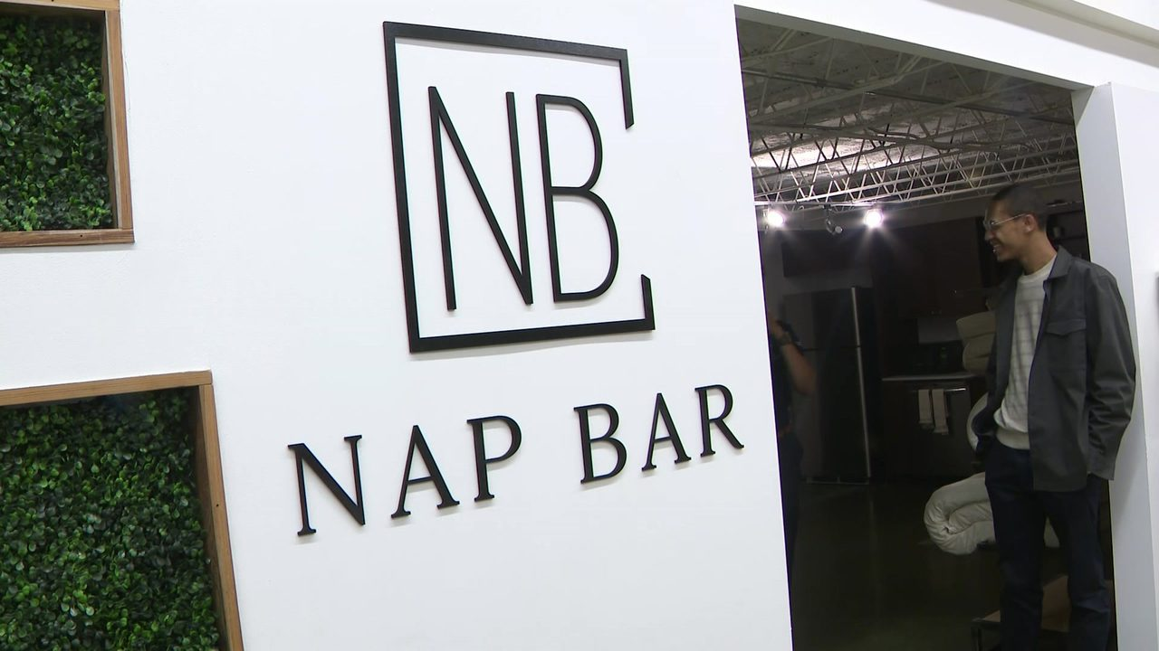
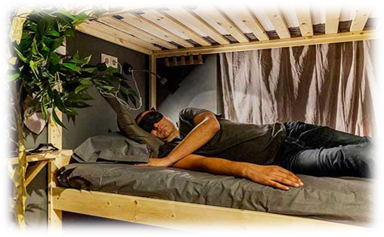
Nap Bar
-Sleep Better, Work Better
BMSW4006
Logo:

Slide 2
Executive Summary
A few years back, the concept of napping on the job places may have sounded like an offence. Today, businesses realize that well-rested employees come with benefits. It just might be in their best interest to allow a quick snooze. Many adults simply aren't getting enough sleep. In the work world, that can translate into staff struggling to concentrate, crankiness and lowered productivity and could contribute to longer-term consequences, including chronic diseases.
So, we are interested in starting a Nap Bar business.

Slide 3
Company Overview
Everyone needs to take a nap when they are frustrated and tired. But for a short rest, everyone needs a safe, calm and comfortable environment. Nap Bar offers a haven napping facility at Gulshan, plus brings onsite, in-suite services to businesses to help increase productivity at professional work. It's time to get detached from technology and nestle inside a custom patented Nap Bar pod designed with sustainable materials with hospital-grade, infection controlled pods, mattresses and bedding.
Nap Bar is a kind of service industry. Introducing Nap Bar, the best solution for work-wellness and increased productivity. Nap Bar is the first napping centre in Bangladesh. We offer a white-glove of health and wellness experience in the UK. Our service offers plush organic New Living Bungalow mattresses, freshly tossed organic cotton sheets, pillows, and swanky surroundings to help ease into SnoozeVille.

Slide 4

Our goal is to promote wellness and turn sustainable rest into sustainable productivity for health-conscious humans.
Our Slogan is “sleep better, work better”.
Our vision is to be the market leader in Nap business.
Our mission is to help people to sleep well, stay fit, increase productivity and make life easier.

Slide 5
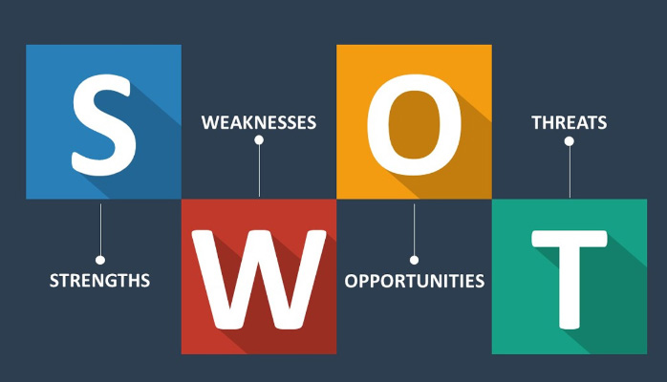

Slide 6
SWOT Analysis
Strength: Nap Bar business is our unique business Idea. We are providing service to the people who are employees, bankers, Workers who work 8 to 12 hours a day and who need a space to take rest or a sound sleep at break time. Today, businesses realize that well-rested employees come with benefits. It just might be in their best interest to enable a quick snooze. Taking a rest for 20 to 40 minutes can will allow one's energy to work, and it refreshes one's mind.
Weakness: Our business is about the Nap bar business, it is first, and there is no other nap bar business available now. We are hoping to be successful, but still, we are confused. Money can be the second problem and some new laws that Govt. has taken recently can affect our business.
Opportunity: We want to start our business in one of the busiest location in the UK. Because there will be a lot of banks and other corporate organizations available here and the employees of those organizations work for 8 to 12 hours. They fell tired and frustrated in working. They need to take enough rest at break hour, which will refresh and bring the energy back for working. There's a demand here. People want Nap Bar. People want to be connected to something bigger than them. "NASA found that a 26-minute power nap increased productivity by 34 percent and alertness by 54 percent"(Gordon, March 25, 2019). So, we want to use the opportunity. On the other hand, it has been proven that naps will increase productivity at work. That includes professionals, entrepreneurs, tourists, students, teachers or anybody with a busy schedule.
Threat: As though we are the first in the napping business, money and experience are our business's main threats. Because we are new and we don't have this type of experience before. On the other hand, the latest Govt. law is another issue. We want to locate our business, Bashundhara R/A, there is a considerable living cost. It may be another obstacle, etc.

Slide 7
Management Team
Managing director (CEO)
Financing & Accounting manager (CFO)
Marketing manager (CMO)
Research development and operation manager (COO)
Sleep specialist

Slide 8

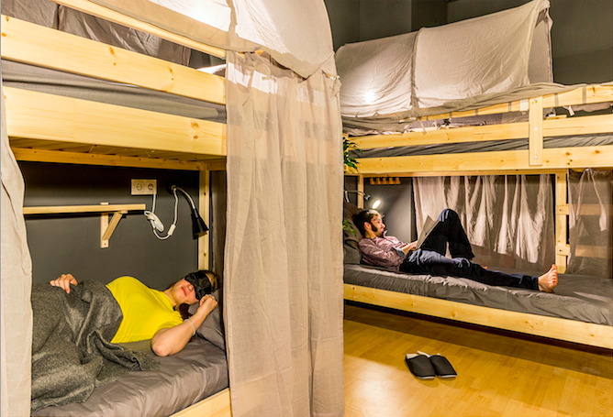

Product/Service Description

Slide 9
Nap Bar is located at Southampton, UK. It’s open Saturday through Thursday for 24 hours and Friday is closed.
We offer a white glove, health and wellness experience in Southampton, UK.
Our service offersplus organic new living Bungalow mattresses, freshly tossed organic cotton sheets, pillows, and swanky surrounding to help ease one into snooze Ville.
We also offer Fresh juice, drinks, snacks and we have proper meal system. We charge extra money for those items.
And we have silent, neat & clean zone for the people who need a room for meeting purpose. And we charge hourly for renting the room.
Memberships are 1500 per month. Individual naps are 50 for 30 minutes or one hour 100.

Slide 10
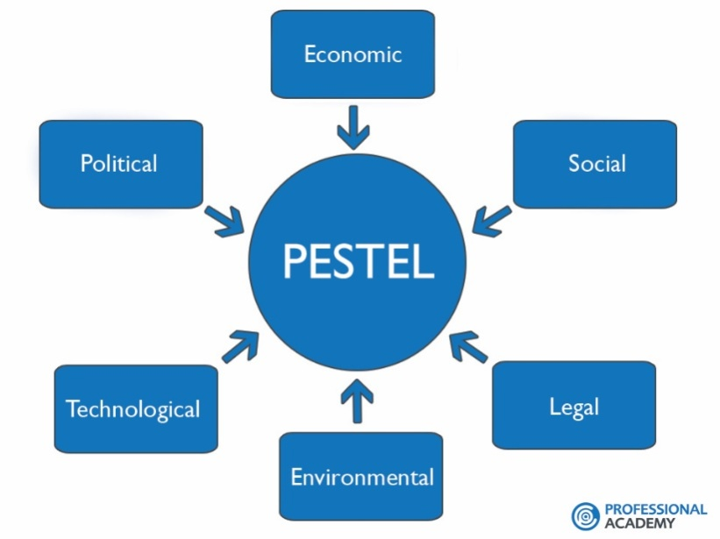
Industry Analysis

Slide 11
PESTEL
Political: Political elements connect with government controls and impacts over economy or industry. Government elements might be regulation or financial strategies (Sydney, 2021). Political factors that can affect businesses include taxation policy and trade regulations. As a businessman or woman, before taking any strategy step, it is important to assess the impact any changes in regulation may have on the business. Also, we will like to know the taxes and other incentives the government is coming up with so that we can comply and make most of the opportunities available. Other political factors we may need to consider are political stability or political unrest in that region. Also, terrorism is becoming a global phenomenon. We will consider the safety of our investment. Still, under political factors in our PESTEL analysis, we need to consider the impact the change in government may have on our business.
Economic: Financial elements a straightforwardly affect an organization's drawn out possibilities in a market. The monetary climate might influence how an organization costs their items or impact the market interest model (Sydney 2021). Such things that may likely affect or determine the buying power of consumers include their levels of disposable income, unemployment level, inflation rate, general and product-specific taxation. Other factors we will consider in our PESTEL Analysis under economic factors include foreign exchange rates, trade tariffs, GDP and the state of the economy. During the economic boom, businesses usually thrive, but the opposite is the case during the economic depression. Starting a business during an economic recession will be a wrong decision, except the business is recession-proof. So we will make our business recession-proof.
Social-Factors: Social Factors As part of the factors to consider in PESTEL Analysis are the changes in tastes and lifestyles of consumers. We will consider the cultural, ethnic and religious factors as well (Self Developed). Other factors under the social factors in PESTEL Analysis include population size/demographics, income distribution, levels of education, brand preferences, consumer buying pattern and attitudes to work and leisure, and any law that affects social factors. And we hope our business will be socially accepted.

Slide 12
PESTEL
Technological: Technological Factors The level of government spending in research and development is a major factor to consider under this heading in PESTEL Analysis. It is new ways to deal with doing new and old things, and handling new and old issues; these don't really include specialized gear - they can be novel perspectives or of getting sorted out (Knowledge, 2022) Businesses rely on technology to help them operate daily. From laptop computers with Internet capabilities to printers, online file storage and Web-based applications, technological advances impact businesses across various industries. Technology can affect the business in positive and adverse ways, depending on the goals of a business. Technology will give our businesses the ability to connect with their customers via e-mail, blogs, social networks and forums. We can take advantage of this instant connection by getting feedback from customers and applying it to the business immediately.
Environmental Factor: In PESTEL Analysis, this can also be called ecological factors (Academy, 2021). We need to consider how the use of raw materials, components and energy sources impact our environment. We need to forestall noise and water pollutions our business might cause the environment and the resistance level from people where we operate. We may consider the use of more environmentally friendly substitutes. Compliance with environmental legislation is very important.
Legal Factor: Every business is expected to operate within specific legal frameworks (Academy, 2022). We need to keep ourselves abreast of legislations that affect our business. Apart from the general legislation such as employment law, health and safety laws, and consumer protection law, there will be some specific regulations. Our business has a legal framework. We have a trade license to start our business.

Slide 13
Market Segmentation
Geographic Segmentation: Geographic division makes different objective client bunches in light of geological limits (Islam and Mamun, 2017). Since potential clients have necessities, inclinations, and interests that vary as per their geologies, understanding the environments and geographic districts of client gatherings can assist with figuring out where to sell and promote
Demographic Segmentation: Segment division sorts a market by segment components, for example, age, training, pay, family size, race, orientation, occupation, identity, and then some. Segment division is one of the least complex and most ordinarily utilized types of division on the grounds that the items and administrations we purchase, how we utilize those items, and the amount we will spend on them is most frequently founded on segment factors.
Behavioral Segmentation: Behavioral segmentation divides markets by behaviors and decision-making patterns such as purchase, consumption, lifestyle, and usage. For instance, Bankers and other employees may buy our service for boosting energy. They work long hour so it is important for them but for the teenagers it is not important and they won’t be interested also to take a nap. Segmenting markets based off purchase behaviors enables marketers to develop a more targeted approach.
Psychographic Segmentation: Psychographic division considers the mental parts of buyer conduct by partitioning markets as indicated by way of life, character characteristics, values, suppositions, and interests of shoppers (Islam and Mamun, 2017). Enormous business sectors like the wellness market use psychographic division when they sort their clients into classes of individuals who care regarding sound living and exercise.

Slide 14
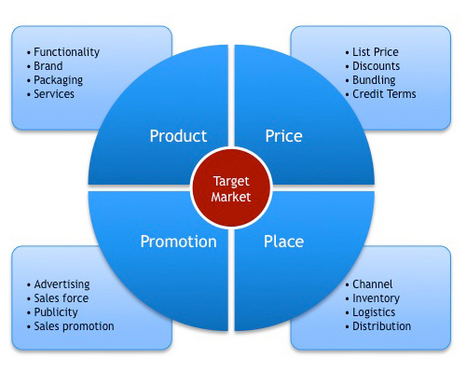
MARKETING PLAN

Slide 15
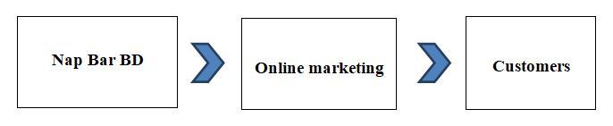
Operational Plan
We have a better quality website & a better customer care, which will provide better customer service. Our distribution channel will be:
We will serve our customers by time basis. Our customers can book a specific time for napping or they can also purchase the time by reaching there. Our customers can pay money by online, using master card and visa card. They can also pay money via Credit/Debit Card or cash in hand. Our managerial department is very small and cost effective.
Nap Bar

Slide 16
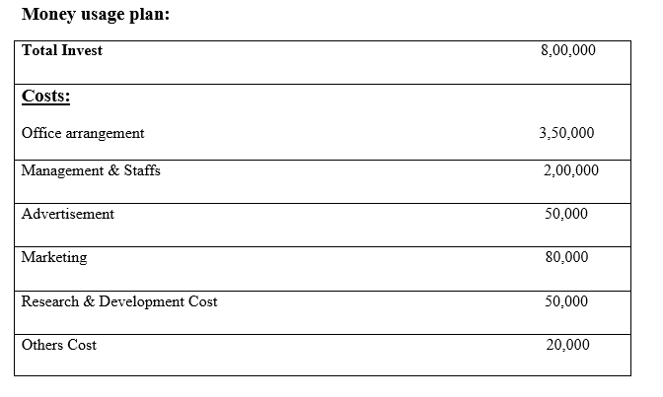
Financing of the Business

Slide 17
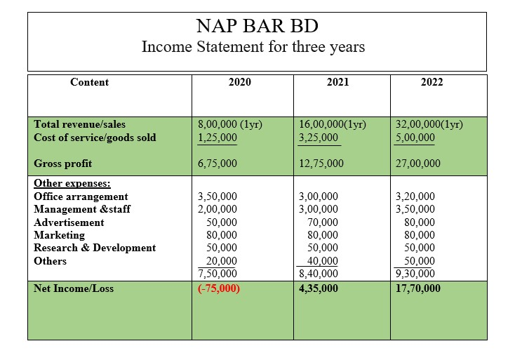
NAP BAR

Slide 18
Conclusion
Entrepreneurship development is very important for us to improve the economic growth. We are very much sure that we can improve our economy in the long run. Our business is napping business though we have different features also. Introducing Nap Bar, the solution for work-wellness and increased productivity (Islam and Mamun, 2017). Nap Bar is the first napping center in UK. We offer a white-glove, health and wellness experience in Southampton, United Kingdom. Expect a sustainable rest and a full-service Comfort Concierge to help one gently fall asleep and wake up refreshed. Our country is digitalizing day by day.
So there is a big opportunity to do this kind of business. We have qualified and experienced managerial team. They will help us to take our business to our goal. We have taken some innovative and effective marketing plan. We have done industrial analysis, marketing analysis and SWOT analysis very effectively. By that we can know what customers expect from us, how we can give better service in less cost etc. If we can give better service in less cost customers must come to us. We think that our business plan is a better one for investing and we also think that our business plan is a realistic one and it has a potentiality of sustainable growth.

Slide 19
References
(2022) Scitepress.org. Available at: https://www.scitepress.org/Papers/2015/53375/53375.pdf (Accessed: 1 March 2022).
SAGE Business Cases - Sleep Cafés: Nap and Go (2020). Available at: https://sk.sagepub.com/cases/sleep-cafes-nap-and-go (Accessed: 1 March 2022).
Ulubeyli, S. and Kazanci, O. (2018) "Holistic sustainability assessment of green building industry in Turkey", Journal of Cleaner Production, 202, pp. 197-212. doi: 10.1016/j.jclepro.2018.08.111.
STEPE�Social, Technical, Economic, Political and Ecological Factor Model (2022). Available at: https://pages.gseis.ucla.edu/faculty/richardson/STEPE.htm (Accessed: 1 March 2022).
Islam, F. and Mamun, K. (2017) "Possibilities and Challenges of Implementing Renewable Energy in the Light of PESTLE & SWOT Analyses for Island Countries", Smart Energy Grid Design for Island Countries, pp. 1-19. doi: 10.1007/978-3-319-50197-0_1.
The impact of political, economic, socio-cultural, environmental and other external influences | Health Knowledge (2022). Available at: https://www.healthknowledge.org.uk/public-health-textbook/organisation-management/5b-understanding-ofs/assessing-impact-external-influences (Accessed: 1 March 2022).
Marketing Theories – PESTEL Analysis (2022). Available at: https://www.professionalacademy.com/blogs/marketing-theories-pestel-analysis/ (Accessed: 1 March 2022).
PESTLE Analysis: How to Use The #1 Macro Analysis Framework (2021). Available at: https://www.thepowermba.com/en/blog/pestle-analysis (Accessed: 1 March 2022).
Jurevicius, O. (2021) PEST & PESTEL Analysis: The Ultimate Guide - SM Insight, Strategic Management Insight. Available at: https://strategicmanagementinsight.com/tools/pest-pestel-analysis/ (Accessed: 1 March 2022).

Slide 20


