Slide 1

ECAD5012
A presentation of the critical evaluation of how Assessment for Learning can be utilised in a learning episode to aid progression across a chosen area of learning and experience.
Alyssa Rees
2313422

Slide 2

Part 1- Introduction
What will be covered during this presentation ……
What AFL is, and their advantages and disadvantages.
What Area of Learning my lesson was based on.
What AFL strategies I used and why I used them.
Theorists who agree or disagree with the use of those AFL strategies.
My conclusions on my lesson and what I will do next time to improve.

Slide 3

Part 2-
Introduction
Assessment for Learning strategies I used:
Pit Stops
Think, Pair, Share
WHY?
I found that these AFL strategies were best suited for my class, and were the only methods I found the children took seriously to see their understanding.
What is AFL and why it is important?
In my opinion AFL strategies are used within the classroom to aid pupils learning in a fast and fun way, providing rich data as well as supporting the teacher.

Slide 4
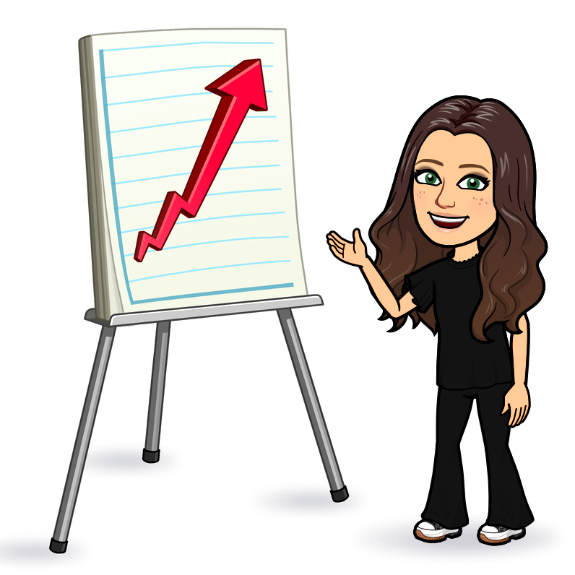
Part 3A- Assessment for Learning (AFL)
Deborah Bullock- States that AFL strategies are usually used by teachers to retrieve information based on children's attainment.
Background of AFL Assessment for learning (no date) -
Originates from research of UK professors:
Paul Black
Dylan William – black box
Formative assessment- is a method of testing the children's abilities during the lesson instead of at the end of topic or lessons (positive).
Tes Editorial (2024)
Key Principles of AFL-
Communicates confidence that every learner can improve.
Empowers learners to take an active part in their own learning.
Develops learners' confidence in peer and self-assessment.

Slide 5

Part 3B-
Literature Review
Framework for AFL/Key Principles:
Teachers need effective planning
Helps the learners understanding of Learning Intentions and Success Criteria's
Aids improvement
Looks at how children learn
Feedback (two stars one wish)
Flórez, M.T. et al. (2013)
Applying AFL in the classroom:
Clearly state Lesson Intentions and Success Criteria’s.
Live Marking
Use several different AFL strategies:
Peer Assessment
Think, Pair, Share
Mini Whiteboards/Secret Squirrels
Pit Stops/MKOs

Slide 6

Part 3A- Literature Review
Advantages of AFL:
It is not seen as a test
Improves productivity
Improves attainment
Improves learners' confidence
Hawthorne, H. (2024).
Potential drawbacks of AFL:
A couple of AFL strategies were most suited for learners who had greater proficiency language GOV.WALES (2022).
Time
Teacher knowledge
Funding
Hawthorne, H (2024).

Slide 7


Literature Review
Theorists who agree with AFL:
Paul Black
Dylan William
David Sadler
Theorists who disagree with AFL:
Robert Coe and Maltby, E. (2024)
Carol Dweck

Slide 8

My Class
Year 4
31 children
Three ability groups:
Green
Yellow
Red
AoLE- Mathematics and Numeracy.
I chose my Mathematics lesson because I found that it had a true reflection on the AFL strategies I used.
I also found that when doing Math's lessons, I could really see the different workloads for each ability groups and how it was best suited to them.

Slide 9
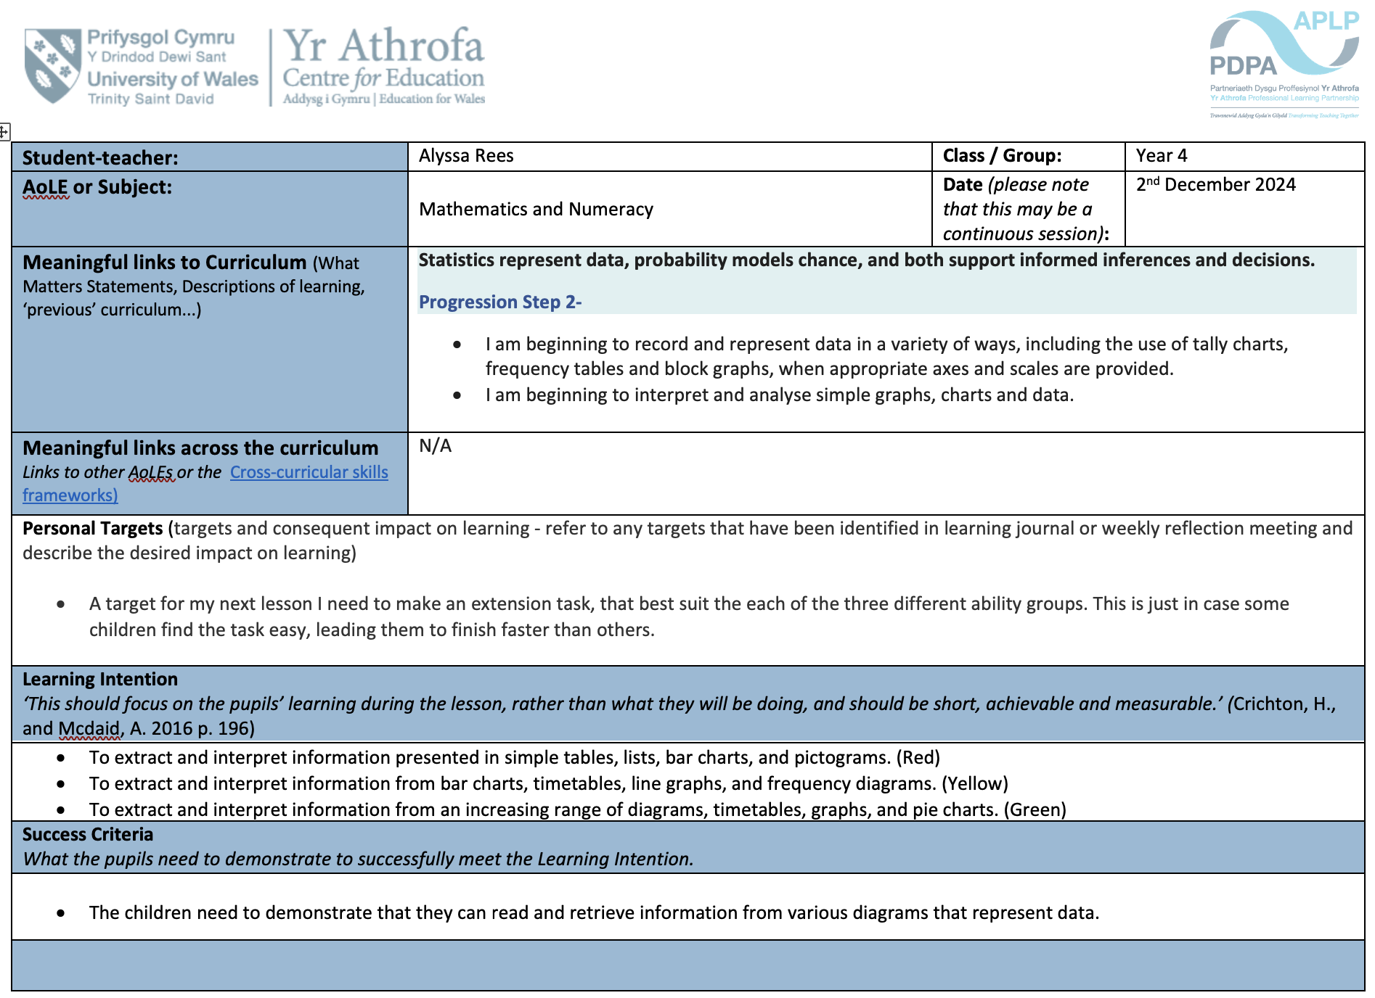
Lesson Plan
High Progression Step 2
Learning Intention
Success Criteria

Slide 10
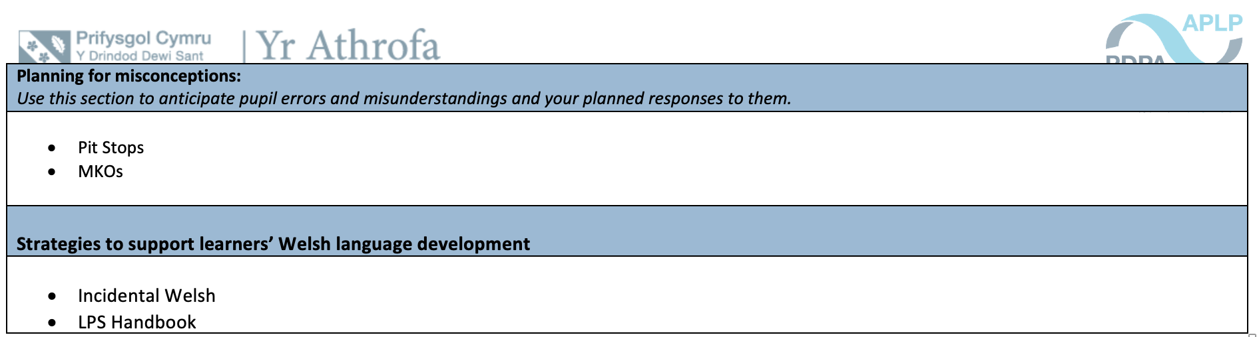
Lesson Plan

Slide 11
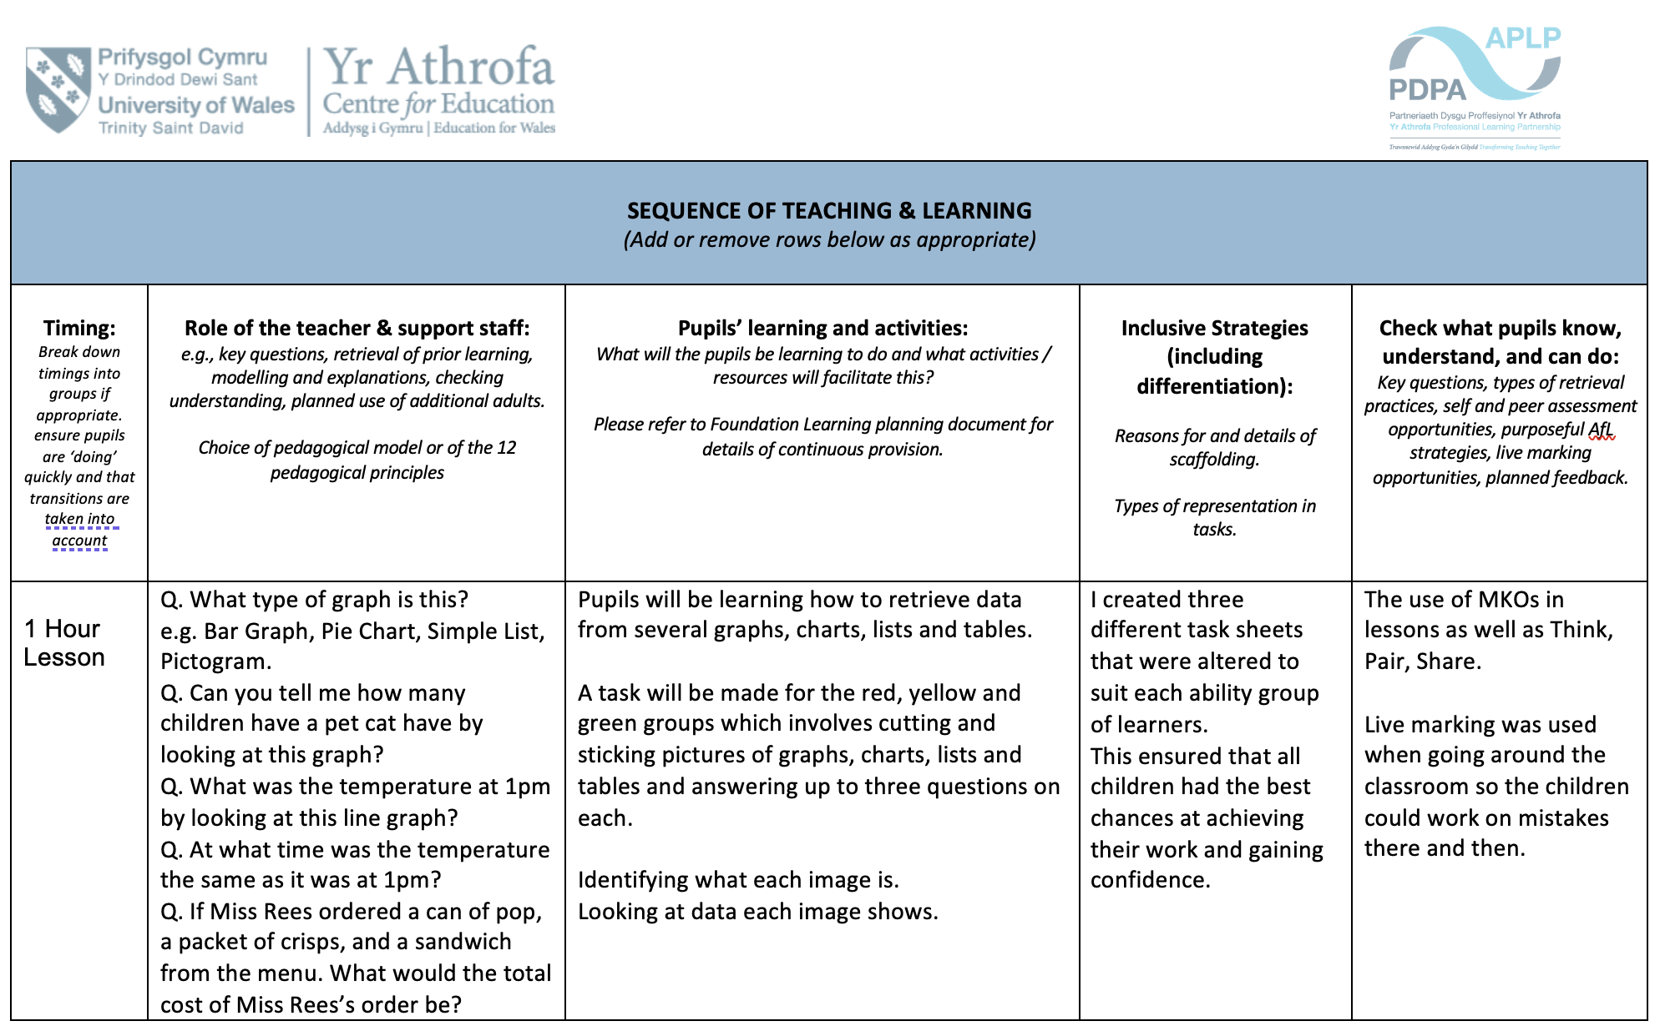

Slide 12

Pit Stops
Pit Stops-
I found that pit stops were beneficial in my class when teaching Math's’ because….
However, I found that a problem that comes with pit stops is….
Supporting Theorist- Hattie
Pitstops allow a loop of feedback between the teachers and the children, which is specific and is tailored to some of the children's confusion. This has been shown to be extremely effective and crucial to improving the children's learning outcomes. He concludes that pit stops have an overall positive influence on children's learning outcomes.
Richards, J. (2024)
Theorist against- Skinner
Skinner believes that learning is purely through positive reinforcements and repetition.
Howard Gardner-
Gardner states that every individual has multiple Intelligences which means that pit stops may work for some people but not every learner.
Kurt, S. (2021)

Slide 13

Think, Pair, Share
Think, Pair, Share- I think that Think, Pair, Share was beneficial in my class because….
However, a problem I found with Think, Pair, Share was….
Theorist for Frank Lyman 1981-
He states that TPS allows for a greater level of engagement, which leads to more academic success.
It focuses on wait time between the question from the teacher and the learner's response which enhances higher order thinking and increases confidence.
Crockett, B. (2022)
Theorist against Cooper Schinske 2021-
Cooper suggests that some problems with think, Pair, Share is that learners who ‘volunteer’ to answer in the group or pair discussions often are the same students who contribute to class when they aren’t participating in TPS.
Calling on students in the share aspect of this AFL strategy may cause an increase in anxiety- making them learn less in pairs.
Psychology Today. (2021)

Slide 14

Conclusion
Overall, I think that Assessment for Learning plays a crucial role in children’s learning and contributes massively to their future successes.
I think that to improve my use of AFL strategies in the future when teaching I should continue to use a varied amount of AFL strategies and figure out what works best for myself as well as the learners. As a result, this will make my classroom a safe, calm, and understanding learning space where we all aim for high achievements.
Personally, as an individual who struggled with tests and exams throughout school, I think that Assessment for Learning is a great way of having an insight to the children's abilities when completing tasks. In doing so, there is less pressure caused or any unnecessary stress by putting them in test or exam conditions.
Thankyou for listening!

Slide 15
References List 1:
Assessment for learning (no date). https://www.teachingenglish.org.uk/professional-development/teachers/assessing-learning/articles/assessment-learning/.
Brodie, K. (2024). Carol Dweck’s Growth Mindset: Transforming Early Years Education. [online] Early Years TV. Available at: https://www.earlyyears.tv/carol-dwecks-growth-mindset-transforming-early-years-education/.
Crockett, B. (2022). How effective is think pair share? [online] Durrington Research School. Available at: https://researchschool.org.uk/durrington/news/how-effective-is-think-pair-share.
Flórez, M.T. et al. (2013) Assessment for learning: effects and impact, Assessment for Learning: Effects and Impact. CfBT Education Trust. https://files.eric.ed.gov/fulltext/ED546817.pdf.
Getting started with Assessment for Learning (no date). https://www.cambridge-community.org.uk/professional-development/gswafl/index.html.
Hawthorne, H. (2024) 'How to use assessment for learning in Schools,' The Hub | High Speed Training, 13 March. https://www.highspeedtraining.co.uk/hub/how-to-use-assessment-for-learning-in-schools/#:~:text=The%20many%20benefits%20of%20using%20effective%20assessment%20for,Improved%20classroom%20culture%20and%20teaching%20and%20learning%20environments.
Hawthorne, H. (2024b) 'How to use assessment for learning in Schools,' The Hub | High Speed Training, 13 March. https://www.highspeedtraining.co.uk/hub/how-to-use-assessment-for-learning-in-schools/#:~:text=The%20many%20benefits%20of%20using%20effective%20assessment%20for,motivation.%206%20Improved%20metacognitive%20talk%20in%20the%20classroom.
Kurt, S. (2021) Theory of Multiple Intelligences - Gardner - Educational technology. https://educationaltechnology.net/theory-of-multiple-intelligences-gardner/#:~:text=The%20Theory%20of%20Multiple%20Intelligences%20was%20first%20presented,and%20that%20people%20had%20various%20levels%20of%20each.
Maltby, E. and Maltby, E. (2024) 'Tips for teachers: 35. Engagement and Proxies for learning - Schoolaspect,' Schoolaspect - Supercharging School Improvement, 21 May. https://schoolaspect.com/insights/blogs/tips-for-teachers-35-engagement-and-proxies-for-learning/.
Psychology Today. (2021). Is ‘Think-Pair-Share’ the Best Approach to Learning? [online] Available at: https://www.psychologytoday.com/gb/blog/the-ethical-professor/202103/is-think-pair-share-the-best-approach-to-learning?msockid=307fad78893a6e2d027ab85a88816f70 [Accessed 14 Jan. 2025].
psycnet.apa.org. (n.d.). APA PsycNet. [online] Available at: https://psycnet.apa.org/record/1990-06033-001.
Richards, J. (2024) Pupil Progress Pitstops: Formative assessment in action. https://www.sec-ed.co.uk/content/best-practice/pupil-progress-pitstops-formative-assessment-in-action
Richards, J. (2024). Pupil Progress Pitstops: Formative assessment in action - SecEd. [online] SecEd. Available at: https://www.sec-ed.co.uk/content/best-practice/pupil-progress-pitstops-formative-assessment-in-action.
Simply Psychology (2024) Operant Conditioning in Psychology: B.F. Skinner Theory. https://www.simplypsychology.org/operant-conditioning.html.

Slide 16
Reference List 2:
Supporting progression in language learning: assessment in the Curriculum for Wales (summary) [HTML] | GOV.WALES (2022). https://www.gov.wales/supporting-progression-language-learning-assessment-curriculum-wales-summary-html.
Teaching Expertise. (2012). Black, Wiliam and Assessment for Learning. [online] Available at: https://www.teachingexpertise.com/articles/black-wiliam-and-assessment-for-learning/.
Team, E. (2017). A beginner’s guide to Professor Robert Coe. [online] EdCentral. Available at: https://edcentral.uk/edblog/beginner-guides/beginners-guide-professor-robert-coe [Accessed 14 Jan. 2025].
Tes Editorial (2024) 'What is formative assessment?' Tes Magazine, 27 December. https://www.tes.com/magazine/teaching-learning/general/what-is-formative-assessment-and-how-do-schools-use-it.
University of the People (2020). What Is Think-Pair-Share And How To Use It In Your Classroom. [online] University of the People. Available at: https://www.uopeople.edu/blog/think-pair-share/.
www.bitmoji.com. (n.d.). Stickers. [online] Available at: https://www.bitmoji.com/stickers/.
Welsh Government (2013). Assessment for learning and the National Literacy and Numeracy Framework Guidance. [online] Available at: https://hwb.gov.wales/api/storage/b447d1fe-5463-4382-9726-e68623a05dd2/assessment-for-learning-and-the-national-literacy-and-numeracy-framework.pdf.
‌

