Slide 1

Emotional Intelligence and Cultural Intelligence in Leadership
Student Name: Cristina Nicolae
Student ID: 2226305
Lecturer: Olu Adegbite
Module: Leadership and Management Theory and Practice

Slide 2

Introduction
Leadership is important in modern organisations.
Emotional intelligence helps leaders manage emotions and relationships.
Cultural intelligence helps leaders work effectively with people from different cultures.
Both concepts are essential in global businesses.

Slide 3
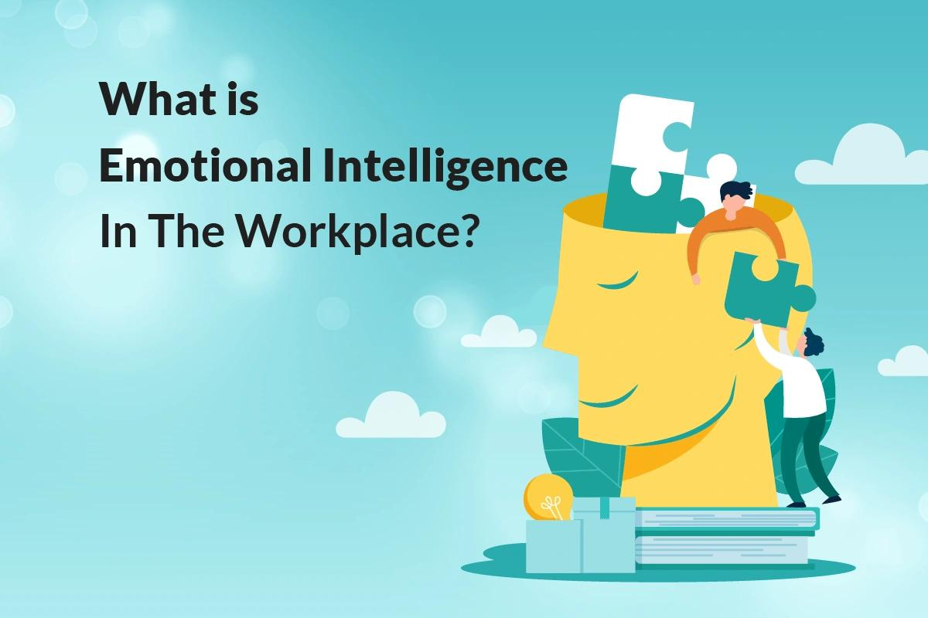
Emotional Intelligence (EI)
Emotional intelligence was developed by Daniel Goleman.
EI focuses on understanding and managing emotions.
Emotionally intelligent leaders improve teamwork and communication.

Slide 4

Goleman’s Emotional Intelligence Theory
Self-awareness
Self-regulation
Motivation
Empathy
Social skills

Slide 5


Business Example – Starbucks
Starbucks managers use empathy and communication skills.
Employees are encouraged to create positive customer experiences.
This improves teamwork and customer satisfaction.

Slide 6

Business Example – Asda
Asda managers support employees and solve workplace conflicts.
Managers use emotional intelligence to maintain positive relationships.
Employees feel more motivated and valued.

Slide 7

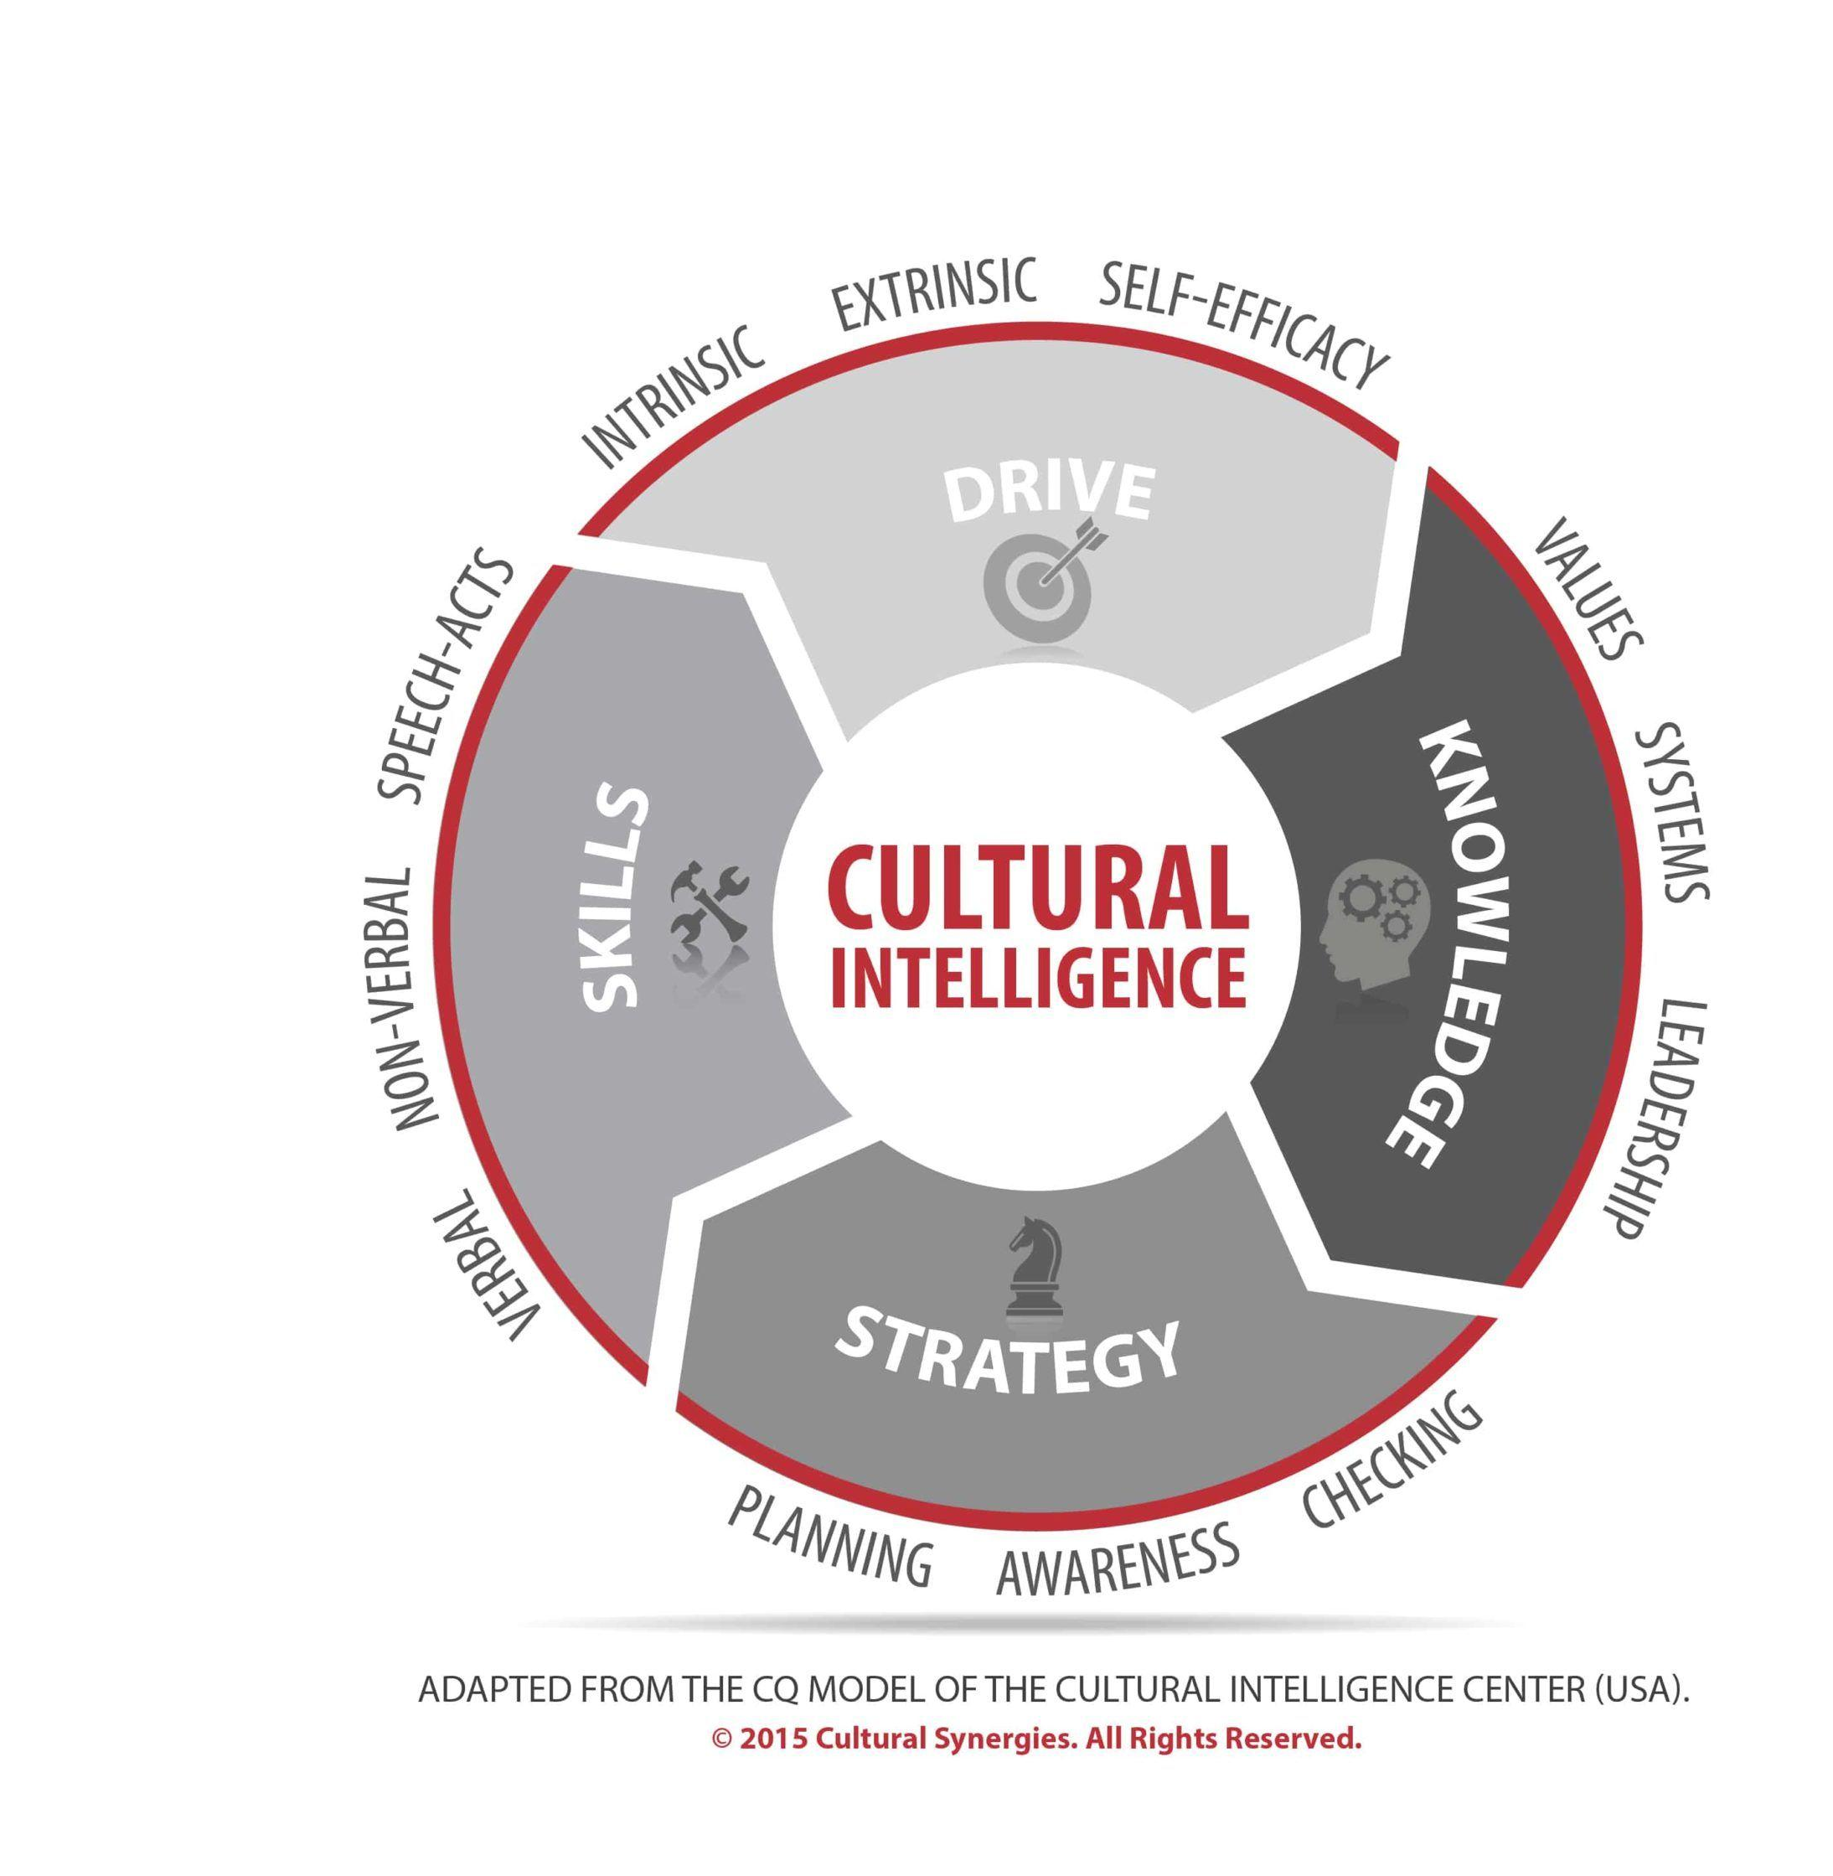

Cultural Intelligence (CQ)
Cultural intelligence is the ability to work effectively across cultures.
Leaders with CQ adapt their behaviour in multicultural environments.
CQ is important for global companies.

Slide 8
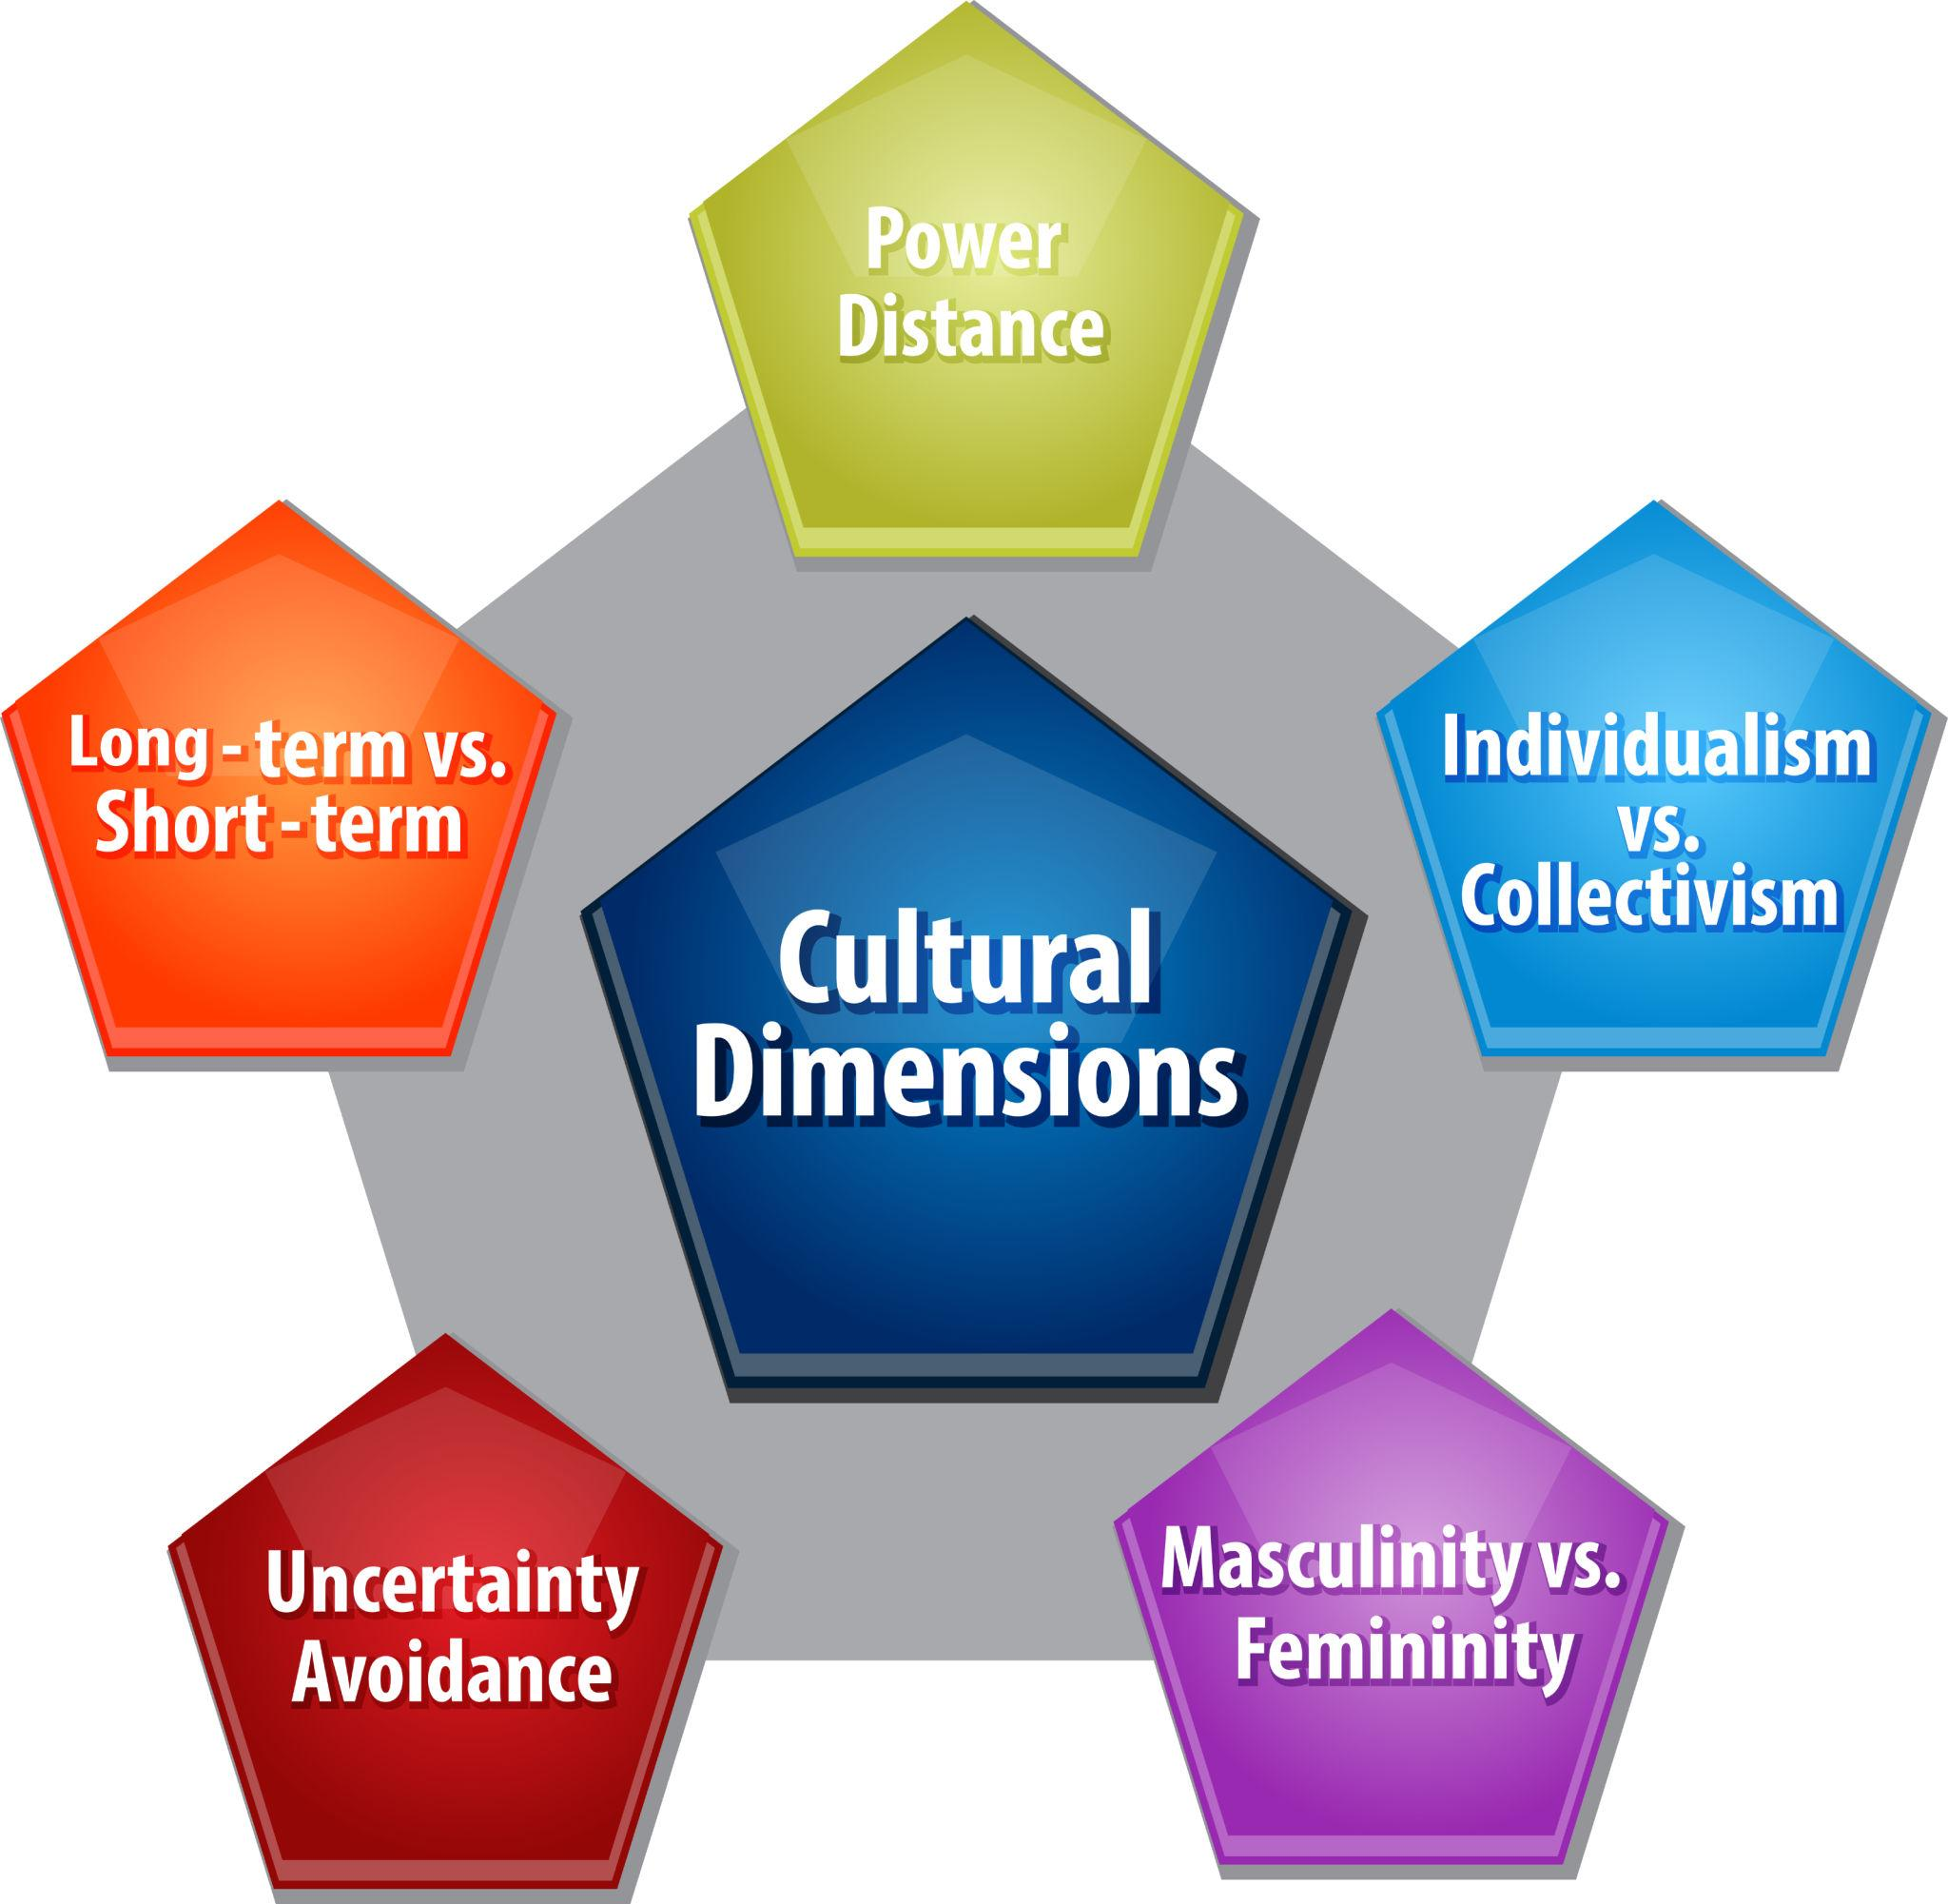
Hofstede’s Cultural Dimensions Theory
Developed by Geert Hofstede.
Explains differences between national cultures.
Includes power distance, collectivism, and uncertainty avoidance.

Slide 9

Business Example – McDonald’s
McDonald’s adapts menus and management styles in different countries.
The company respects cultural differences worldwide.
This helps the business succeed globally.

Slide 10

Business Example – Apple
Apple works with multicultural teams around the world.
Leaders need strong communication and cultural awareness.
Cultural intelligence supports innovation and collaboration.

Slide 11

Critical Evaluation
Emotional intelligence improves teamwork and employee relationships.
Cultural intelligence helps leaders manage global teams.
One limitation is that leadership styles may not work equally in all cultures.
Both theories are important in modern leadership.

Slide 12

Comparison Between EI and CQ
EI focuses on emotions and interpersonal relationships.
CQ focuses on understanding cultural differences.
Both help leaders communicate effectively.

Slide 13

Conclusion
Successful leadership requires emotional and cultural understanding.
Businesses benefit from emotionally intelligent leaders.
Global organisations need culturally aware leadership.
This Photo by Unknown Author is licensed under CC BY-SA

Slide 14
References
Apple Inc. (2025) Apple. Available at: https://www.apple.com (Accessed: 20 June 2026).
Asda Stores Ltd. (2025) Asda. Available at: https://www.asda.com (Accessed: 20 June 2026).
Earley, P.C. and Ang, S. (2003) Cultural Intelligence: Individual Interactions Across Cultures. Stanford, CA: Stanford University Press.
Goleman, D. (1995) Emotional Intelligence: Why It Can Matter More Than IQ. New York: Bantam Books.
Hofstede, G. (2001) Culture's Consequences: Comparing Values, Behaviors, Institutions and Organizations Across Nations. 2nd edn. Thousand Oaks, CA: Sage.
McDonald's Corporation (2025) McDonald's. Available at: https://www.mcdonalds.com (Accessed: 20 June 2026).
Northouse, P.G. (2022) Leadership: Theory and Practice. 9th edn. Thousand Oaks, CA: Sage.
Starbucks Corporation (2025) Starbucks. Available at: https://www.starbucks.com (Accessed: 20 June 2026).

