Slide 1
Community Care and Management of Longer-term Conditions
Semester 1
Assessment Workshop Component 2
Individual Presentation
©Dr Aishat Bakre

Slide 2
Learning outcomes
Upon successful completion of this module, student should be able to:
Critically evaluate the physical, psychological, and social impact on individuals and families living with a long-term condition(s) and its treatment.
Critically assess the key areas of local and national political, health and social care agendas and initiatives relating to long term conditions.
Critically evaluate the skills, values and behaviours required to provide co-productive and traditional models of care as appropriate.
Critically analyse the contribution of empirical evidence and local, national, and international guidelines to informing the delivery of ‘whole person’ care and self-management support for individuals with long term conditions.

Slide 3
Module Summary
The module aims overall to develop student understanding of the theories, values and policies in managing patients with longer term conditions in different healthcare settings.
To gain an understanding of healthcare work across traditional primary/secondary/social care boundaries and collaborate with patients/carers and other professionals within the NHS, social and private/voluntary sector to continuously improve the information, support, care, and person-centred approaches to treatment of people living with long term conditions.

Slide 4


Slide 5
Aims of the Session
To understand
What is expected in the assessment?
What is an individual presentation?

Slide 6

What does the assessment entails?

Slide 7
Task
To increase the awareness of a specific long-term condition,
Your task is to prepare an individual presentation focusing on the diagnosis, assessment, treatment, management, and prevention of a specific long term health conditions in the UK.

Slide 8
What must the slides contain?

Slide 9
Slides contents
The presentation should include the following:
The overview of the chosen long-term condition including the definition, symptoms and aetiology (causes)
How prevalent is the long-term condition in the UK and worldwide
Economic and Social Burden of the chosen long-term condition
Diagnosis and Initial Assessment of the chosen long-term condition.

Slide 10
Slides contents
Management of the Long-term condition following a specific UK guidance.
You should determine which current models and frameworks that have been or can be implemented within current practice to improve outcomes for patients affected by the long-term conditions.
Treatment option available for the long-term condition in the United Kingdom

Slide 11
Activity
Working independently explore the document in the link below
Delivering better services for people with long-term conditions: Building the house of care
https://www.kingsfund.org.uk/publications/delivering-better-services-people-long-term-conditions
Feedback your findings to the whole class

Slide 12
Slides contents
Highlight the comorbidity that can accompany your chosen long-term condition.
How can the long-term condition be prevented
Critically evaluate the skills, values and behaviours required to provide co-productive care to a person suffering from the long-term condition

Slide 13
Activity
Working independently highlight the comorbidity that can accompany your chosen LTC
Feedback your findings to the whole class

Slide 14
Activity
Working independently highlight how your chosen LTC can be prevented
Feedback your findings to the whole class

Slide 15
Co-Production model
Co-production model requires ownership for working in collaborative partnership with service users, patients, clients and their families/friends as equal partners.
This co-production requires an openness to see that individual’s should be able to express what they want to help meet their needs from supportive and understanding health and social care staff.
There has to be a culture of honesty and openness in the way health and social care staff communicate with them.

Slide 16
Co-Production model
Co-production recognises that there is a sharing of power in respect of decisions made about what is to be achieved to meet the individual’s needs.
It requires a commitment to good open communication channels.
It recognises that individuals are in the best position to express what they want to do to help them meet their needs.
This means that their views, wishes and feelings are taken into consideration and are valued and respected.

Slide 17
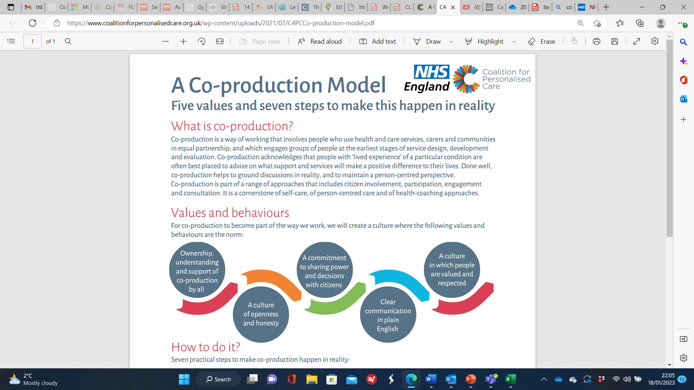
C4CC Steering Group v5 (coalitionforpersonalisedcare.org.uk)
Notes:
C4CC Steering Group v5 (coalitionforpersonalisedcare.org.uk)
Co-production module requires ownership for working in collaborative partnership with service users, patients, clients and their families/friends as equal partners.
This co-production requires an openness to see that individual’s should be able to express what they want to help meet their needs from supportive and understanding health and social care staff.
There has to be a culture of honesty and openness in the way health and social care staff communicate with them.
Co-production recognises that there is a sharing of power in respect of decisions made about what is to be achieved to meet the individual’s needs.
It requires a commitment to good open communication channels.
It recognises that individual’s are in the best position to express what they want to do to help them meet their needs. This means that their views, wishes and feelings are taken into consideration and are valued and respected.

Slide 18
Activity
Co-production: what it is and how to do it – SCIE
Co-production – SCIE
Social Care Institute for Excellence (SCIE)
Notes:
Co-production: what it is and how to do it - SCIE

Slide 19
Slides contents
Provide recommendation of how the comprehensive model of personalised care and self-management support can be used in the management of the chosen long-term condition drawing on all the six evidence-based components of the model.
Notes:
self-care techniques for improved outcomes for patients affected by long-term conditions

Slide 20
Activity
Working independently explore the document in the link below
https://www.england.nhs.uk/personalisedcare/comprehensive-model-of-personalised-care/
Feedback your findings to the whole class

Slide 21
Activity
Working independently explore the document in the link below
A practical guide to self-management support - The Health Foundation
And
Moodle page for supported self-management summary guide
Feedback your findings to the whole class

Slide 22
Individual Presentation
Word count: 10mins
Submission deadline
Individual presentations commencing on
Check the assessment brief
Submit Individual presentation slides to Turnitin-Check the assessment brief for date/Time of submission

Slide 23
General Submission Guidance
All your presentation must include a title page that clearly states your names, your student numbers, the module code and title, your lecturer’s name, and your assignment title.
All your submissions should be typed in Arial font size 20 or more, using 1.5 line spacing.
All presentation must have a reference list, and citations should be used throughout your work/slides using Harvard referencing.

Slide 24
General Submission Guidance
It is essential that you follow the University’s Harvard referencing requirements.
Ensure you provide a reference list which is in alphabetical order, includes all the author details and the date of publication.
It is important that you check your work, proofread the contents, spell check it and look at punctuation and grammar so that your assignment reads clearly.

Slide 25
Activity
Working independently explore the document below
https://www.ncbi.nlm.nih.gov/pmc/articles/PMC2071971/pdf/bmj-335-7627-ac-00968.pdf
https://www.who.int/health-topics/self-care#tab=tab_1
Feedback what you have learnt to the whole class
Notes:
bmj-335-7627-ac-00968.pdf (nih.gov)
Self-care interventions for health (who.int)

Slide 26
Activity
Watch the video below
https://www.youtube.com/watch?v=Uk1pq8sb-eo
https://www.youtube.com/watch?v=uQhVDH9p7aU
Feedback what you have learnt to the whole class
Notes:
What is plagiarism? | Scribbr 🎓 - YouTube
How to Avoid Plagiarism with 3 Simple Tricks | Scribbr 🎓 - YouTube

Slide 27
Activity
Watch the video below
https://www.youtube.com/watch?v=HnJ1bqXUnIM
Feedback what you have learnt to the whole class
Notes:
What is Critical Thinking? - YouTube

Slide 28
Activity
Watch the video below
Paraphrasing
https://www.youtube.com/watch?v=oiM0x0ApVL8
Quote
https://www.youtube.com/watch?v=DhMl3eIcGbI
Feedback what you have learnt to the whole class

Slide 29
Reminder
Remember just one citation cannot suffice for a whole paragraph with more than one sentences.
Avoid contraction in academic writing. Always write in full. e.g. "You will" instead of "You'll".
Always proofread your work to avoid a typographical/grammatical errors.
Avoid the use of personal pronoun in academic writing except in reflective writing.

