Slide 1

Timetabling
& Timesheets

Slide 2

Timetabling at IICL Birmingham
IICL Birmingham has 3 timetables per academic year, September, January and May. From week 2 of each term, we will be preparing the timetable for the next term.
For example, we will start preparing for the September term from week 2 of the May term.
All staff can access their timetables on Celcat. A guide on ‘Accessing Your Timetable’ is available on Moodle.
Current Term Weeks 6
Review Module Diets.
Meet with Programme Managers.
Current Term Week 5
Review Availability forms. Meet with Academic Directors.
Current Term Week 7
Meet with Programme Managers.
Timetabling
Cycle
Current Term Week 2 Availability form sent to all HPLs. Create Timetable Tracker.
Current Term Week 8
Draft timetable.
Current Term Week 11 ➔ Making any necessary adjustments to rooms, staffing & groups.
Current Term Week 9
Review timetable draft with Dean, Operations Manager and Academic Directors.
Current Term Week 10
Add timetable to Celcat and release timetables to staff.

Slide 3
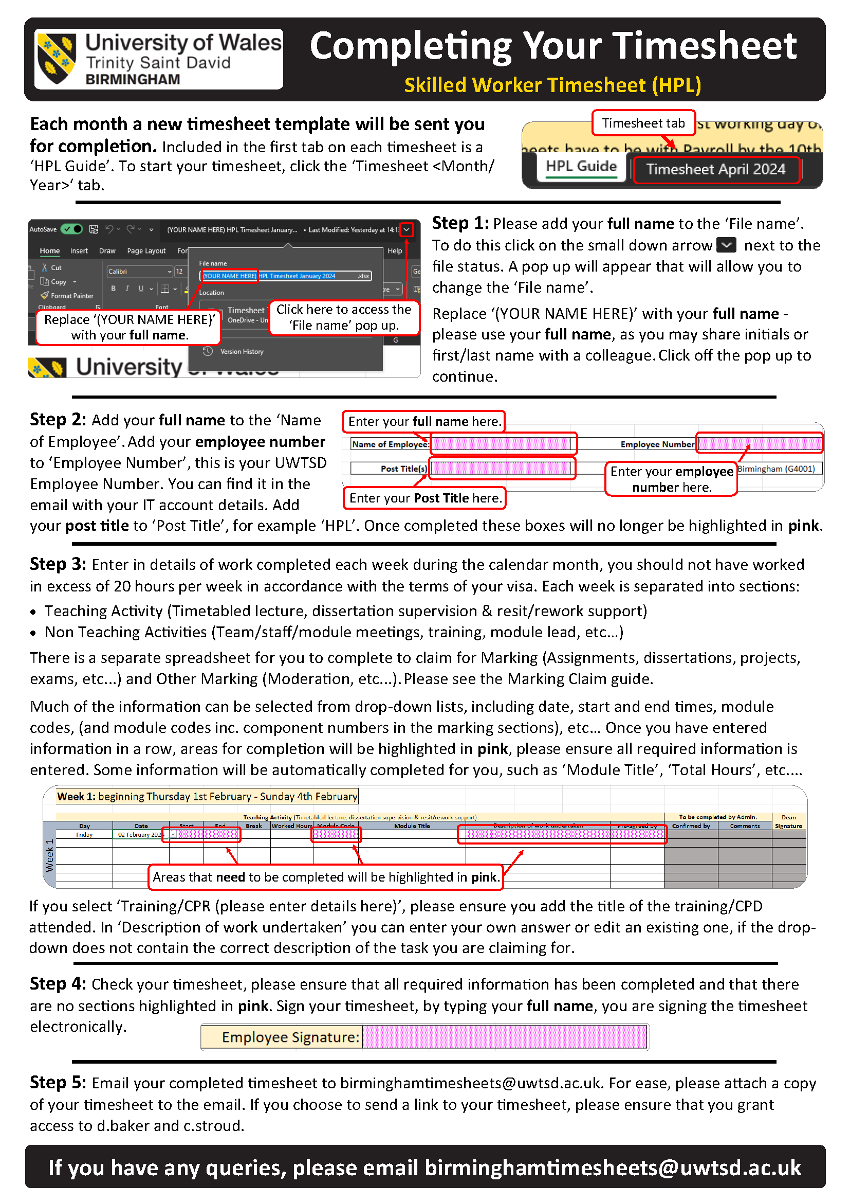
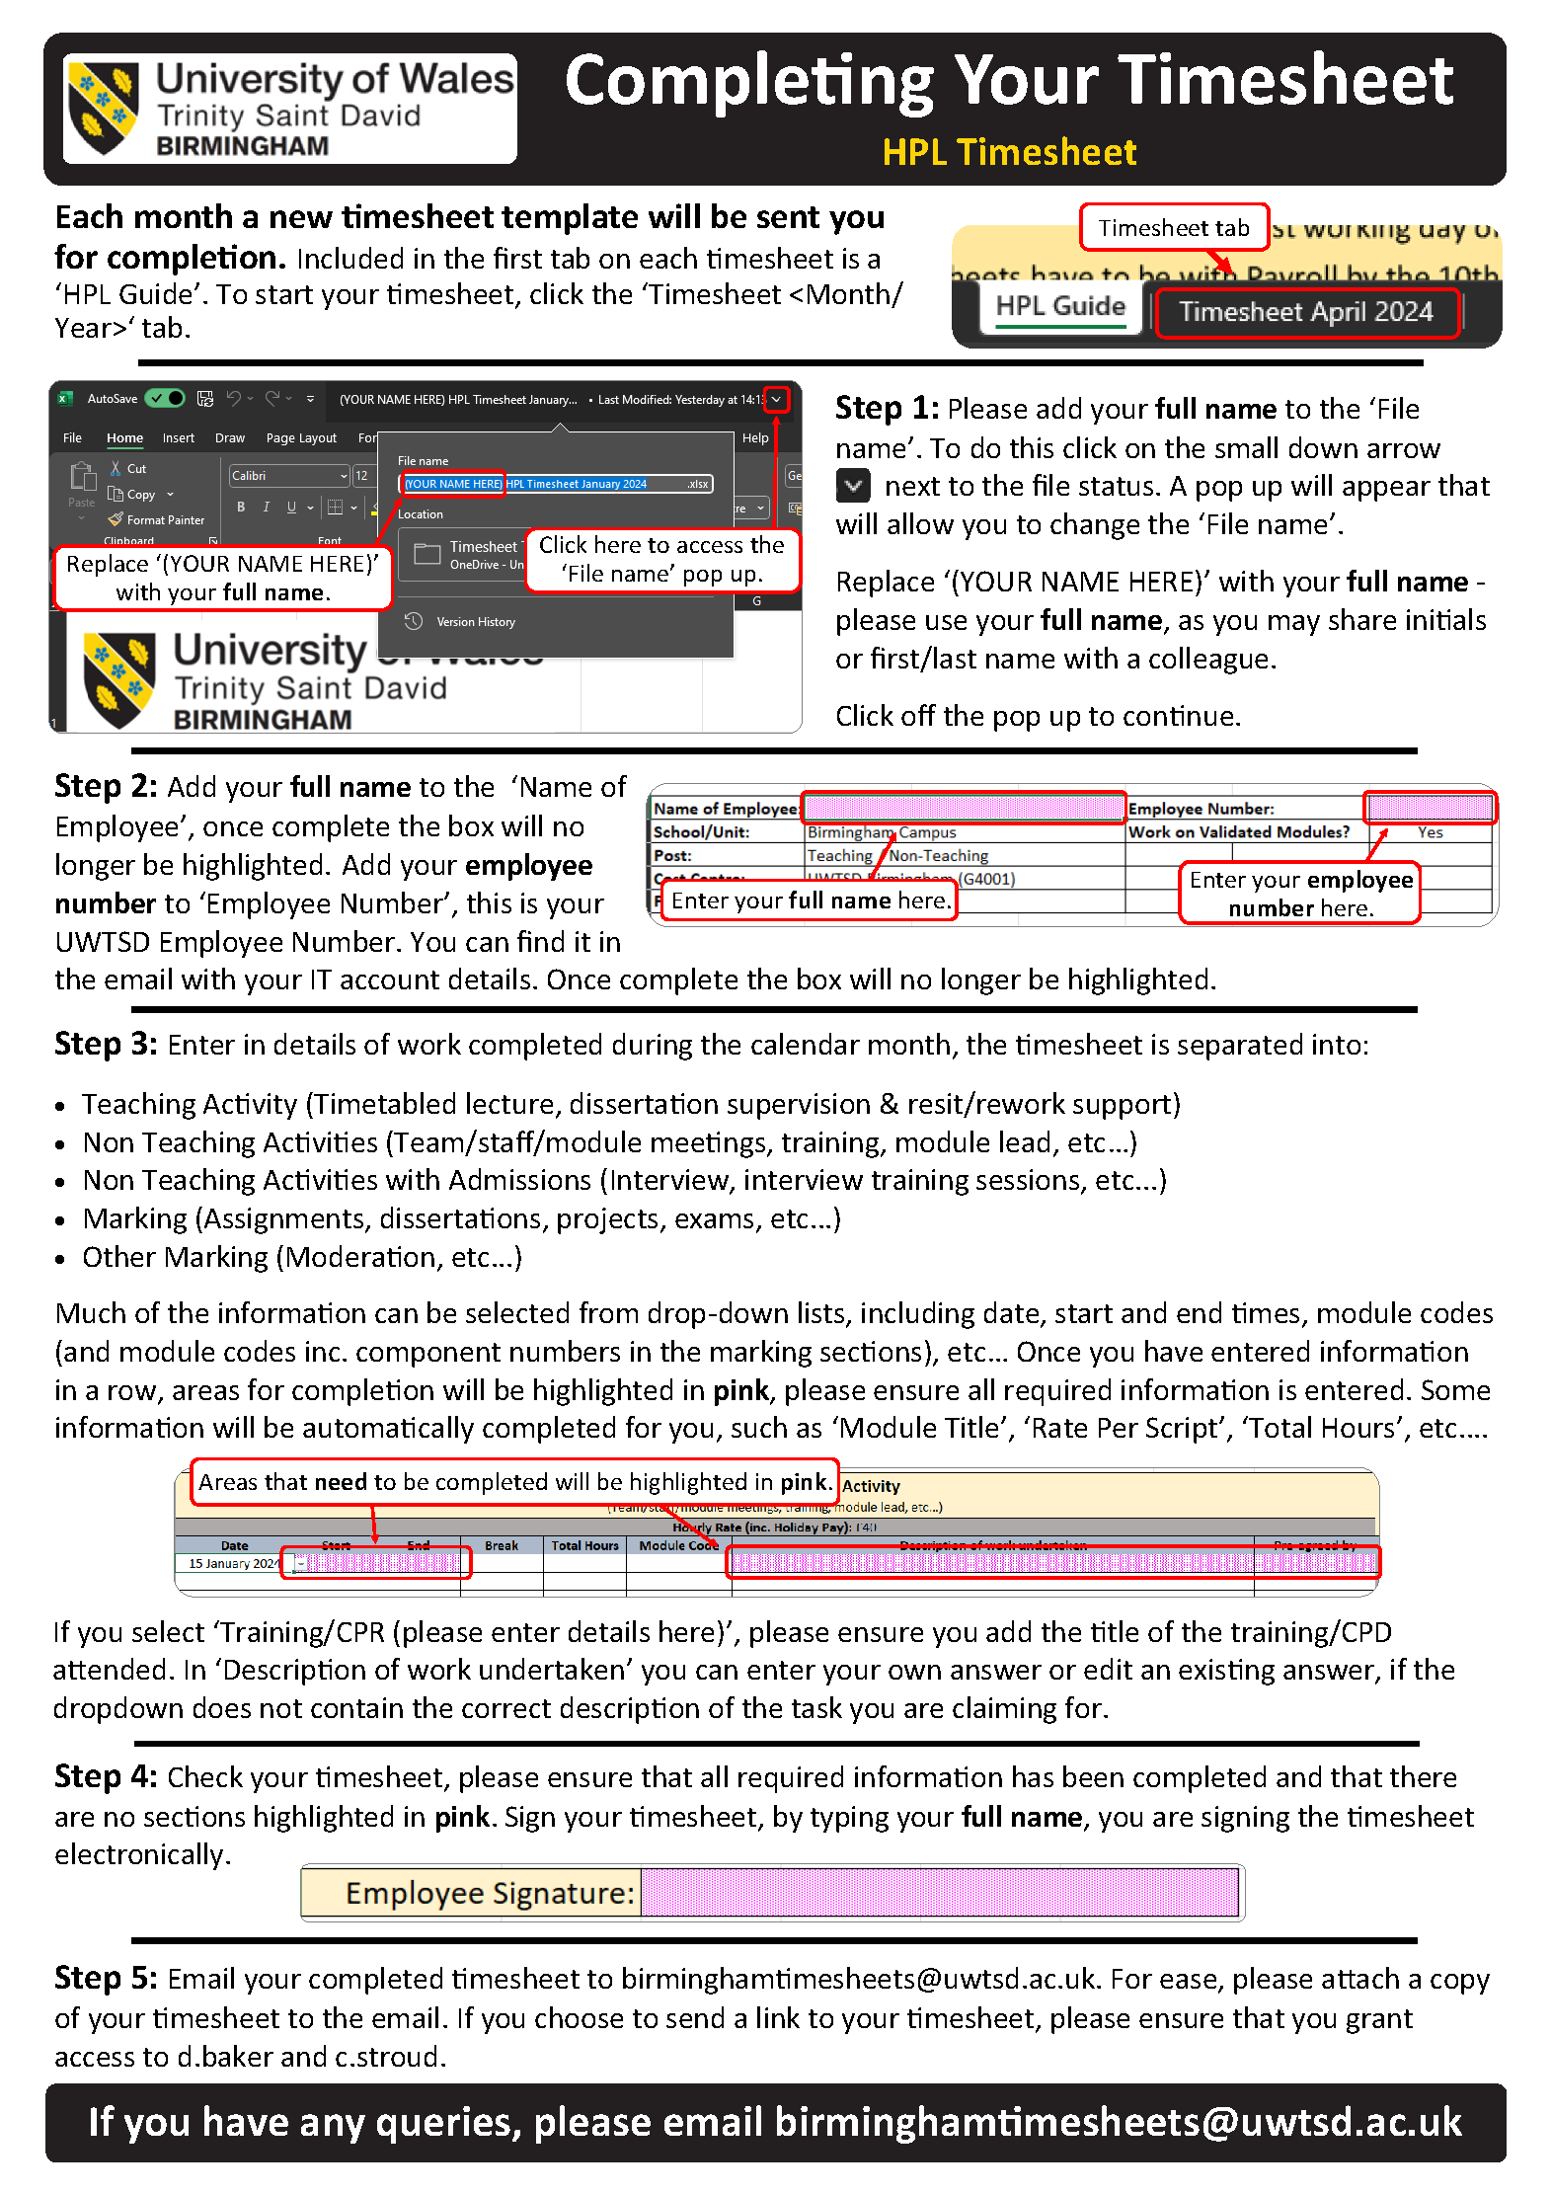
Timesheets at IICL Birmingham
HPLs are required to complete a monthly timesheet. It is expected that all hours worked during a month will be claimed on that month’s timesheet. For example, hours worked in April, should be claimed on the April timesheet.
Updated timesheet templates are sent out monthly, along with a HPL Claims Guide and video/written guides on how to complete your timesheet. All guides are available on Moodle.
Timesheets should be submitted by 5pm on the last working day of the month, any timesheets submitted after this deadline may not be processed until the following month. Reminder emails containing the submission deadline will be sent to all HPLs.
Please be aware, at UWTSD we pay our HPLs a ‘Consolidated Rate’. This means for which means for each 1 hour of face-to-face teaching, you are paid for 1 hour of preparation, assessment and administration.
If you have any questions, please email birminghamtimesheets@uwtsd.ac.uk

Slide 4
Reception, Parking & Room Booking.

Slide 5
Reception, Parking and Room Booking.
Reception
If you need help or have any queries you can pop to reception. If reception cannot answer your query, they can direct you to the correct department or member of staff who can help. Reception can also help with stationary needs.
Staff Parking
Parking is available for staff at Quay Place (under Victoria House, Louisa House and a small number outside) and Sparkhill (carpark entrance is on Clarence Road, which is one-way, you’ll need to approach via Avondale Road or Hillfield Road). Please visit reception to request a parking permit.
Room Bookings
If you need to book a room, contact birminghamenquiries@uwtsd.ac.uk, please remember to include the time/date required, campus, number of people attending, etc...
Opening & Closing of Campus Buildings
Campus buildings are open between 8.00am and 6.15pm Monday to Sunday (Monday to Friday for Sparkhill). Operations Admin are responsible for opening and closing of campus buildings. If you need to stay later than 6.15pm, please let reception know as soon as possible.

