Slide 1
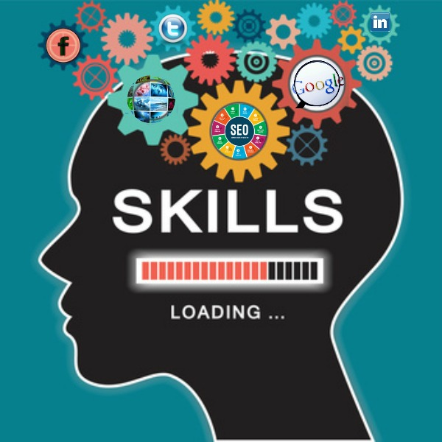
Module title: Digital skills and research methods.
Module code: LCHS4002
Assignment Title: Are digital skills important for study and work?
Group members: Shazia Malik
Nada Akhtar
Student numbers: 2227141
2227514
Lecturer: Dami Pokubo
Date: 20 February 2023

Slide 2
Contents
Title page
Contents page
Introduction
Research Question
Literature Review
Methodology
Ethical considerations
Conclusion
Reference list

Slide 3

Are digital skills important for work and study?
Introduction
Digital skills is the ability to use digital devices and communication applications to access and manage information.
A few examples of digital skills are: Social Media, Marketing and navigating the internet.
Digital skills are a crucial aspect of education. Kure (2023)
According to Leahy Diana Wilson (2014) digital skills are developed over time and everyone needs to know how to use digital skills to succeed in finding and creating Informations so they can learn these skills to better themselves for better jobs higher education.

Slide 4

Which digital skill do UWTSD students think is most important?
To find out which digital skill students at UWTSD found important, we did a mini research project consisting of a questionnaire.
The aim of the research was to find out what students at UWTSD think about using digital skills.
This is the link to the questions :
https://docs.google.com/forms/d/e/1FAIpQLScTzO2j9wjFLV4xW9_oUUyGpj9eW2Zt5jrc4lnBk7xuyxzh0g/viewform?usp=pp_url

Slide 5
Literature Review
The conclusive evidence that I have got is that when digital equipment, tools, and resources are used effectively, they can increase the speed and depth of learning for example when I was conducting research I found out during lockdown Microsoft teams, zoom and WhatsApp were important tools to use as a lot of learning was done online.
Microsoft Teams is an effective virtual learning platform because of its quality user friendliness and functionalities. (www.ccsenet.org, n.d.)

Slide 6

Methodology
What is primary research: Primary research is research that has been carried out first hand by researcher.
The research we are carrying out is to find out what digital skills are most important.
Its relevant to do the research to find out what methods are preferred.
We will carry out mini research consisting of questionnaires to get overall review of what skills students found best to use.
We shall involve students at UWTSD.
Quantitative research is based on data that is gathered in numbers and groups of people.
All aspects of study's taken are carefully designed before the data is collected.
Researchers use tools like computer software and questionnaires to collect numerical data.
(ref NY: ME sharp 2008)

Slide 7
Ethical considerations
Problems | solutions
Data breach in big organisations/companies. | Improve employee training programmes to avoid costly mistakes.
Information leak. | Use passwords, store properly, passwords.
Breaching confidentiality can cause harm to people. | Storing information correctly and well documented.
Personal information breach. | Keeping personal information ammoniums. Keeping sensitive information protected and well stored.
What are ethical issues that can happen during data collected.
How to solve those ethical issues.
Data breaches are becoming more common nowadays as there is evidence to provide this by the large companies that have been victims of data breach via cyber attacks. (wei zhang osf preprints 2023)

Slide 8
conclusion
In conclusion digital skills tool that student of UWTSD use has had conclusive evidence that when digital equipment, tools, and resources are used effectively, they can increase the speed and depth of learning however there can also be set backs such as data breech and information leak but overall we think digital skills is very important Digital skills are required for 82% of all online job openings. (www.bath.ac.uk, n.d.)

Slide 9

Reference
www.ccsenet.org. (n.d.). Home | International Education Studies | CCSE. [online] Available at: https://www.ccsenet.org/journal/index.php/ies [Accessed 15 Oct. 2022].
www.bath.ac.uk. (n.d.). Your digital skills and capabilities. [online] Available at: https://www.bath.ac.uk/campaigns/your-digital-skills-and-capabilities/#:~:text=Importance%20of%20digital%20skills%20in%20the%20workplace&text=82%25%20of%20all%20online%20job%20vacancies%20require%20digital%20skills.&text=Salaries%20for%20more%20specialised%20digital [Accessed 18 Feb. 2023].
Kure, Astrid Elizabeth Journal of computer assisted learning 2023,vol39(1)
Jerad M garner , timothy c Allen archives of pantology & laboratory medicine 143(1) 75-80-2019Leahy Diana Wilson ICT information management Ifipwg 34?37 international conferences
NY MF SHARP 2008 csu Colorado state university Singh ,Los angles CA sage 2007
‌
‌

