Slide 1
EAEE5002C Adfyfyrio ar ddarpariaeth blynyddoedd cynnar
EAEE5002 Reflections on early years provision
Wythnos 1 Week 1

Slide 2
Tîm y modiwl Module team
Gwyneth Davies
g.m.davies@uwtsd.ac.uk
Dawn Jones
  dawn.jones@uwtsd.ac.uk

Slide 3
Cynnwys Content
NOS
Deillinnau dysgu
Asesiad
Beth yw arfer adfyfyriol?
NOS
Learning outcomes
Assessment
What is reflective practice?

Slide 4
Cysylltiadau NOS EAEE5002/C NOS links
Craidd/Core: K28, K29
CCLD0417 K60
CCLD0412 P1
SCH32 1, 2, 3

Slide 5
Adnoddau’r modiwl Module resources
Moodle
Canllawiau Panopto
Llawlyfr
Templedau
Darllen
Sway
PP darlithoedd
Teams – recordiadau
Cysylltiadau Turnitin
Moodle
Panopto guidance
Handbook
Templates
Reading
Sway
Lecture PP
Teams – recordings
Turnitin links

Slide 6
Deilliannau dysgu
ddangos dealltwriaeth fanwl o wybodaeth ddamcaniaethol sy’n sail i arfer effeithiol yn y blynyddoedd cynnar yn cynnwys y defnydd o adfyfyrio fel arf ar gyfer datblygu a gwella arfer da;
adfyfyrio ar eu profiadau a’u datblygiad eu hunain fel ymarferwyr blynyddoedd cynnar cymwys a darparu tystiolaeth o ddatblygiad personol a phroffesiynol parhaus, yn cynnwys modelau adfyfyrio priodol;
dangos gwerthfawrogiad beirniadol dyfnach o faterion sy’n ymwneud â darparu gwasanaethau o ansawdd i blant ifanc;
trefnu eu gwybodaeth a’r hyn y maent wedi’i ddysgu drwy ddefnyddio amrywiaeth o adnoddau gwybodaeth, a chyflwyno’u gwaith ar y lefel briodol.

Slide 7
Learning outcomes
demonstrate a thorough understanding of the theoretical knowledge underpinning effective early years practice including the use of reflection as a tool for developing and enhancing good practice;
reflect on their own experiences and development as competent early years practitioners and provide evidence of continuing personal and professional development, including appropriate models of reflection;
demonstrate a deeper critical appreciation of issues involved in providing quality services for young children;
organise their knowledge and learning through use of a range of information resources, and present their work at the appropriate level.

Slide 8
Asesu Assessment
Portffolio
4 elfen
  Gwerthuso y ddefnydd o modelau adfyfyriol
  Papur briffio
  Log adfyfyriol
  Cynllun Datblygiad Personol (CDP)
Dyddiad cyflwyno: 17.01.2021 23.59 Turnitin
Portfolio
4 elements
  Evaluate the use of reflective models
  Briefing paper
  Reflective log
  Personal Development Plan (PDP)
Submission date:
17.01.2021 23.59 Turnitin

Slide 9
Elfen 1 Element 1
Gwerthuswch ddefnydd modelau adfyfyriol fel adnoddau ar gyfer cefnogi arfer adfyfyriol effeithiol o fewn arfer blynyddoedd cynnar (1,000 o eiriau).
30 marc
Evaluate the use of models of reflection as resources for supporting effective reflective practice within early years practice (1,000 words).
30 marks

Slide 10
Elfen 2 Element 2
Paratowch bapur briffio ar gyfer ymarferwyr blynyddoedd cynnar am bwysigrwydd arfer adfyfyriol fel dull o gynnal gwasanaethau o safon ar gyfer plant ifanc a’u teuluoedd (2 tudalen A4);
30 marc
Prepare a briefing paper aimed at early years practitioners about the importance of reflective practice as a means of maintaining quality services for young children and their families. (2 A4 pages)
30 marks

Slide 11
Elfen 3 Element 3
Log adfyfyriol yn manylu eich cyfraniad tuag at weithgaredd yn eich lleoliad/gweithle; adnabyddwch sut mae’r gweithgaredd hyn wedi helpu datblygu sgiliau, gwerthoedd a gwybodaeth benodol (1000 o eiriau);
20 marc
A reflective log detailing your contribution to an activity within your placement/workplace; identifying how this activity helped you to develop specific skills, values and knowledge. (1000 words)
20 marks

Slide 13
Elfen 4 Element 4
Cynllun Datblygiad Personol yn nodi agweddau ar gyfer datblygiad personol a phroffesiynol pellach wedi ei gysylltu â’ch profiadau ar leoliad ac o fewn eich lleoliad a/neu’r gweithle.
10 marc
A Personal Development Plan identifying areas for further personal and professional development linked to your placement and/or workplace experiences
10 marks

Slide 15
Area for further development (provide details) | Why do I need to develop this aspect? | How can I achieve this? | Who/Where can I go for help/support/provision? | When?

Slide 16
Beth yw adfyfyrio?
What is reflection?

Slide 17
Beth yw adfyfyrio?
What is reflection?
Trafodaeth grŵp
  Pwrpas?
  Pryd?
  Pwy?
  Pam?
Group discussion
  Purpose?
  When?
  Who?
  Why?

Slide 18
Sway
Self-assessment, reflective practice and quality improvement processes
11 Nov 2012
https://www.youtube.com/watch?v=lU65AjcHVJg

Slide 19
Arfer adfyfyriol
Reflective practice
‘The ability to think critically and creatively.’
(Appleby, 2010:8)
‘Reflecting on practice underpins the work of early years practice.’
(Reed and Canning, 2010:1)
‘Reflective practice is a state of mind, an ongoing attitude to life and work.’
(Bolton and Delderfield, 2017:1)

Slide 20
Arfer adfyfyriol
Reflective practice
Dysgu personol
Datblygiad proffesiynol
Gwybodaeth
Sgiliau
Gwerthoedd
Personal learning
Professional development
Knowledge
Skills
Values

Slide 21
Dealltwriaeth Understanding
Gwybodaeth
Sgiliau
Gwerthoedd
Knowledge
Skills
Values

Slide 22
Gweithgaredd
Activity
https://www.youtube.com/watch?v=7TXEZ4tP06c

Slide 23
Tasg adfyfyriol
Reflective task
Cryfderau academaidd
Heriau academaidd
Cryfderau proffesiynol
Heriau proffesiynol
Academic strengths
Academic challenges
Professional strengths
Professional challenges

Slide 24
Dysgu o Brofiad
Learning from Experience
Sut gallwn dysgu o’r profiadau a gawn?
Nododd Dewey (1933, dyfynwyd yn Lindon, 2012) y dair nodwedd neu agwedd sy’n nodweddu pobl adfyfyriol, sef;
  meddwl agored
  cyfrifoldeb
  ymroddiad
  Edrych
  Deall
  Dysgu
How do we learn from the experiences that we have?
Dewey (1933, cited in Lindon, 2012) identified the three characteristics or attitudes of people who are reflective as;
  open-mindedness
  responsibility
  wholeheartedness.
  Look
  Understand
  Learn

Slide 25
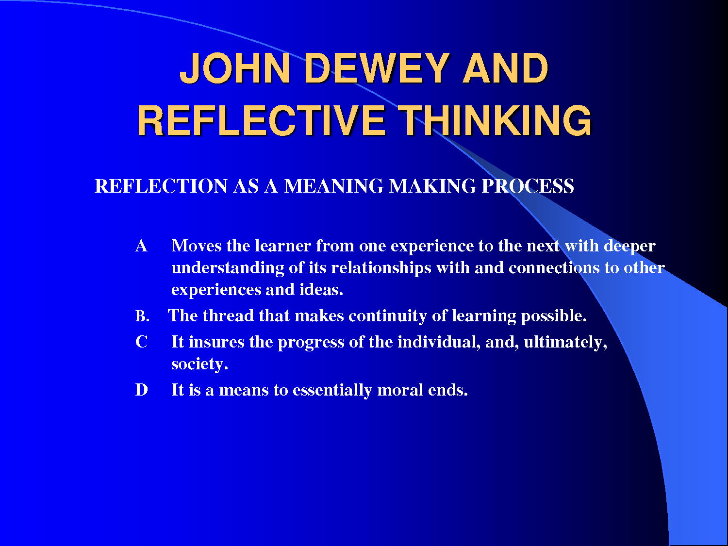
Notes:
https://www.bing.com/images/search?view=detailV2&ccid=lwwVo6jb&id=1B64683E457C0115C347D93D05C5A5556BBD95C9&thid=OIP.lwwVo6jbHhuZ1vRkg0ZvMgEsDh&q=John+Dewey%27s+Reflective+Thinking+Model&simid=608053240483286260&selectedIndex=0&ajaxhist=0
This is the link for this slide

Slide 26
Dysgu adfyfyriol yn y gwaith
Work-based reflective learning
‘Work-based learning concerns any learning which derives from the experience of engaging in work, however, it is the nature of the relationship between work and learning that is important.’
  (Hallet,, 2013: 41)

Slide 27
Dysgu trawsnewidiol
Tranformational learning
Profiad ymarferol
Gwybodaeth broffesiynol
Gwybodaeth academaidd
Arfer adfyfyriol
Practical experience
Professional knowledge
Academic knowledge
Reflective practice

Slide 28
Dewey
Camau adfyfyriol
  Cynnig atebion
  Gosod cwestiynau
  Damcaniaethu
  Rhesymu
  Profi
Reflective steps
  Suggesting solutions
  Posing questions
  Hypothesising
  Reasoning
  Testing
Notes:
Examining beliefs and assumptions can lead to transformational learning. This step by step approach is found in many of the reflective models that we’ll discuss next week.

Slide 29
Lindon & Trodd, 2016:4
‘Genuine reflective practice is underpinned by an outlook or lifelong learning – far removed from the attitude of ‘I’ve been trained, that’s it!’’

Slide 31
Schön
Mae Schön yn nodi dau fath o adfyfyrio :
1. Adfyfyrio-wrth-weithredu
2. Adfyfyrio-ar-weithredu
Schön identifies two kinds of reflection :
1. Reflection-in-action
2. Reflection-on-action

Slide 32
‘Swampy lowlands’
Mae arfer adfyfyriol yn ein codi uwch iseldiroedd corsog ein harfer, gan gynnig persbectif gwahanol.
Reflective practice raises us above the ‘swampy lowlands’ of our practice and gives us another perspective.

Slide 33
Schön
Adfyfyrio ar weithredu
  Pethau wnaeth ddim mynd yn dda
  Pethau aeth yn dda
  Eich ymatebion chi
  Ymatebion pobl eraill
Reflection on action
  Things that did not go well
  Things that went well
  Your responses
  The responses of others

Slide 34
Tasg sylw critigol
Critical attention task
Defnyddio lens critigol
Disgrifiwch
Gwerthuswch
Dadansoddwch
Cysylltwch damcaniaeth ac arfer
Argymhellion
Using a critical lens
Describe it
Evaluate it
Analyse it
Apply theory and practice
Recommendations

Slide 35
Log adfyfyriol Reflective log
Profiad neu gweithgaredd
Adfyfyrio’n gritigol
Arfer dda?
Datblygiad pellach?
Experience or activity
Critical reflection
Good practice?
Further development?

Slide 36
Tasgau ymchwil
Research tasks
Sway
https://sway.office.com/GwPbJyrif2fKdlMQ?ref=Link

Slide 37
Cyfeiriadau References
Appleby, K. (2010) Reflective thinking: reflective practice. In M. Reed and N. Canning (2010) Reflective practice in the early years. London: Sage. Pp.7-23.
Bolton, G. & Delderfield, R. (2018) Reflective practice: writing and professional development. 5th Ed. London: Sage.
Hallet, E. (2013) The reflective early years practitioner. London: Sage
Lindon, J. & Trodd, L. (2016) Reflective practice and early years professionalism. London: Hodder Education.
Reed, M. and Canning, N. (2010) Reflective practice in the early years. London: Sage.

