Slide 1

Communicating Across Cultures
Week 4

Slide 2

Learning Objectives
Identify cultural variables in communication.
Recognise factors causing communication noise.
Develop strategies for effective cross-cultural communication.

Slide 3
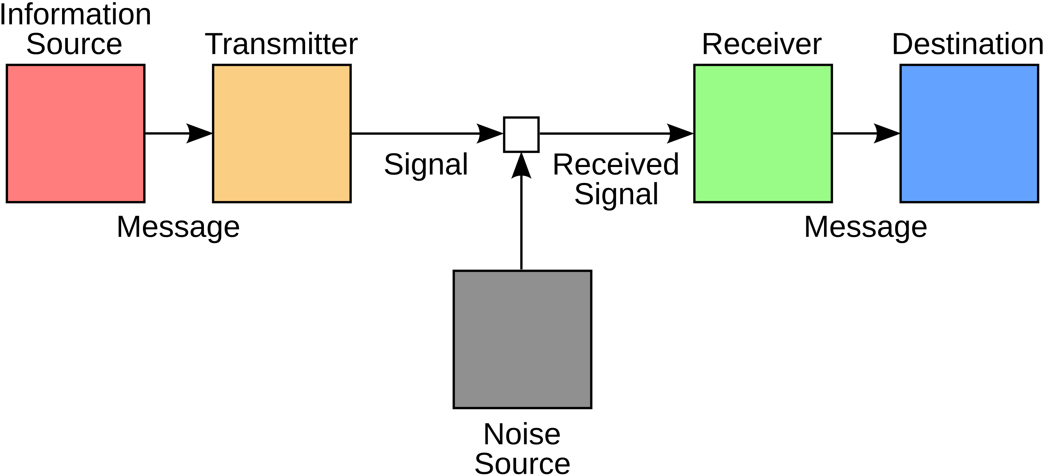
The Communication Process & Cultural Noise
The Communication Process in a cross-cultural context involves several key components that can be influenced by cultural differences.
Cultural noise: Differences in language, values, and behaviours that hinder understanding. (Hall, 1976)
Strategies: Develop cultural sensitivity, use clear language, seek feedback. (Hofstede, 2001)

Slide 4
Trust & Communication Across Cultures
Trust is a fundamental element in cross-cultural communication, but its meaning and development vary across societies.
Practical Approaches to Establishing Trust
Active listening and showing empathy.
Understanding local customs and etiquette.
Investing in relationship-building efforts before conducting business.

Slide 5
Nonverbal Communication & Cultural Differences
Kinesics: Body movements and facial expressions vary. (Birdwhistell, 1970)
Proxemics: Personal space differs (high-contact vs. low-contact cultures). (Hall, 1966)
Paralanguage: Tone, pitch, and speed influence interpretation.
Examples: Italians use expressive gestures; Arabs prefer high-contact communication.

Slide 6
Context & Its Impact on Communication
High-context cultures: Implicit, relationship-based communication (Japan, China). (Hall, 1976)
Low-context cultures: Direct, explicit communication (U.S., Germany). (Ting-Toomey, 1999)
Adapting Communication for Different Contexts
Be aware of cultural expectations regarding implicit vs. explicit communication.
Adjust tone, body language, and indirect messaging as needed.
Build long-term relationships in high-context cultures before engaging in business.
Use clear, structured messages in low-context environments.

Slide 7
Cultural Sensitivity & Adaptation
Cultural sensitivity is the ability to recognize, respect, and adapt to cultural differences in communication and business interactions.
Importance of Cultural Sensitivity (Hofstede, 2001; Earley & Ang, 2003)
Reduces misunderstandings and conflicts.
Enhances trust and collaboration in global business.
Improves cross-cultural negotiations and teamwork.

Slide 8

Practical Approaches to Developing Cultural Sensitivity
Read about the culture before engaging in business.
Observe and listen actively to local norms.
Adjust speaking pace and tone to match cultural expectations.
Build relationships before discussing business, especially in high-context cultures.

Slide 9

Managing Cross-Cultural Business Communication
Encoding: Use culturally appropriate symbols and language.
Transmission: Adjust for audience (face-to-face preferred in high-context cultures).
Decoding: Seek multiple sources of feedback to ensure clarity.
Follow-up: Strengthen relationships and confirm understanding.

Slide 10
Conclusion
Cross-cultural communication requires awareness, adaptation, and strategic management.
Successful communication depends on cultural intelligence and continuous learning.

Slide 11

References:
Deresky, H. (2017). International Management. Pearson.
Dignen, B., & McMaster, I. (2013). Collins Effective International Business Communication. Collins.
Hall, E. T. (1976). Beyond Culture. Anchor Books.
Hofstede, G. (2001). Culture’s Consequences. Sage Publications.
Meyer, E. (2014). The Culture Map. PublicAffairs.
Ting-Toomey, S. (1999). Communicating Across Cultures. Guilford Press.
Earley, P. C., & Ang, S. (2003). Cultural Intelligence: Individual Interactions Across Cultures. Stanford University Press.

