Slide 1
Sina
Leadership development program
Siqi Li
1704338

Slide 2
CONTENTS
01
Background
02
Skills & Traits
Information and situation of Sina.
To identify the skills and traits that a leader need.
03
Theory & Development Programme
04
Why me?
To prove why our team is good
According to powerful theory to make a clear project plan and provide some suggestions

Slide 3

01 Background of Sina
Sina
Sina is an Internet media company which serving Chinese and global Chinese communities. Sina has its own digital media network that consist of the portal Sina network (SINA.com), mobile portal mobile phone sina network (SINA.cn) and social media Sina micro-blog (Weibo.com), it helps the majority of users through the Internet and mobile devices to obtain professional media and user self-generated multi-media content (UGC) and to share with friends. (Corp.sina.com.cn, 2018)

Slide 4
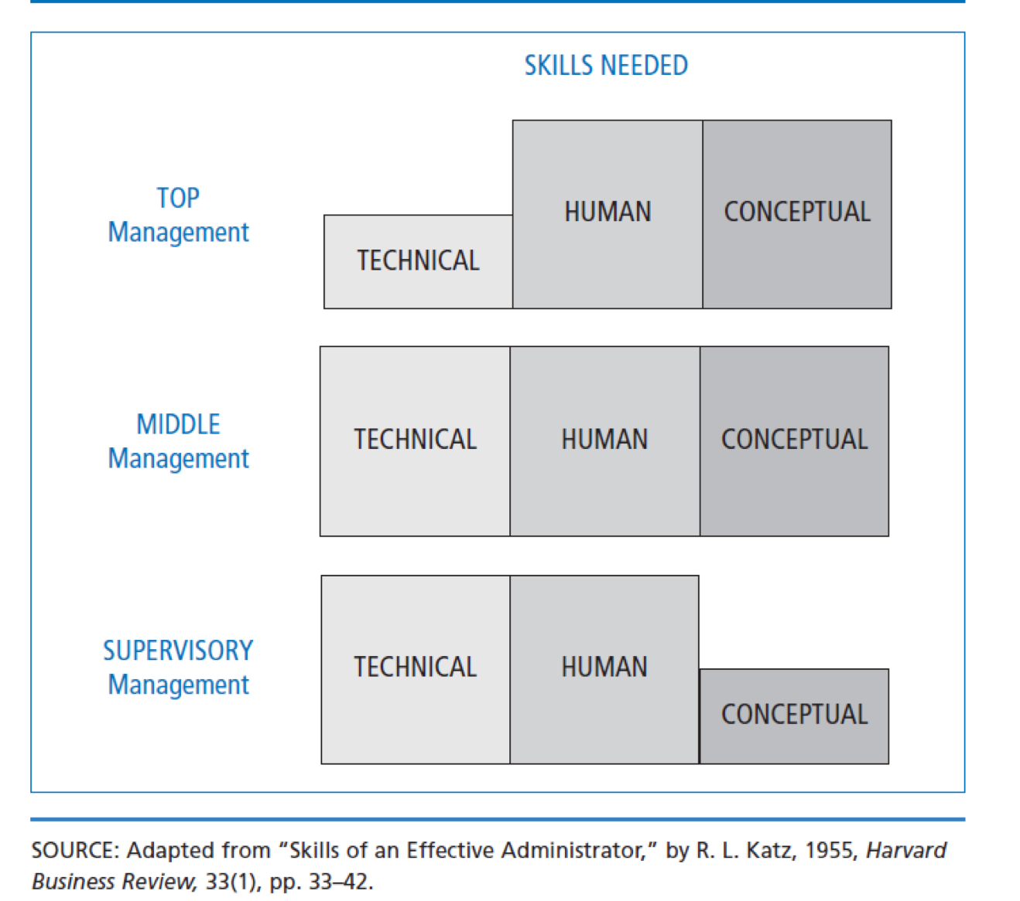
02 Skills & Traits
Human Skills
Human skill as the executive's ability to work effectively with a team, understanding and acknowledging group members viewpoints.(Katz,1995)
Conceptual Skills
Conceptual skill involves the formulation of ideas. Managers understand abstract relationships, develop ideas, and solve problems creatively.

Slide 5
02 Skills & Traits
First step to be a good leader
Leadership is an influence process that enables managers to get their people to do willingly what must be done, do well what ought to be done. (Cribbin, 1981)
Human Skills
High work efficiency and high loyalty of company
Leader’s vision is more broad and comprehensive.
“The important aspect of the management process is to understand the enterprise as a whole, and also to realize the whole situation related to the enterprise.” (Barnard)
Conceptual Skills
Great ability to solve problems
Leader’s ability is promoted.

Slide 6
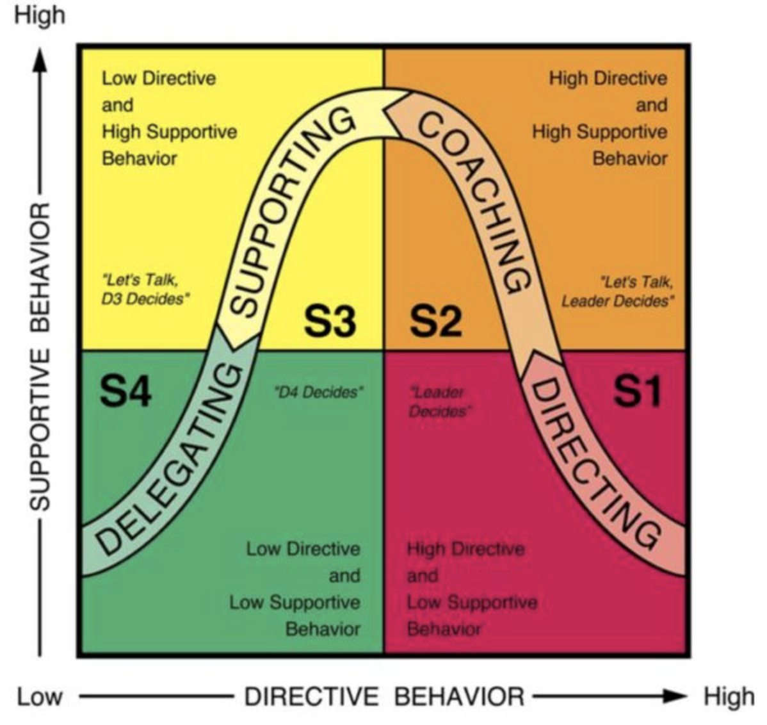
03 Theory & Development Program
Situational leadership theory
According to the situational leadership II proposed by Blanchard, the leadership behavior can be divided into four types: Directing, Coaching, Supporting and Delegating. (Blanchard, 1994)
Figure 2: Situational Leadership Theory (Williams, 2018)

Slide 7


03 Theory & Development Program
Challenge
Situational leadership theory
Situational leadership theory is simpler, easier to understand than other theories. It can make the completion degree higher under the premise of ensuring the quality of the project.
A major criticism lies in the ambiguity surrounding the conceptual definition of follower development level. (Northouse,2007)
It is hard to identify the staff’s ability and attitude. Different leader has his own standard to evaluate the staff level.
The theory has stood the test of time in the marketplace of leadership training programs, as it is well-known and commonly used for training leaders. (Northouse,2007)
It emphasizes leader flexibility - there is not one best style of leadership, several styles are needed which depend on the requirements of the situation.

Slide 8
03 Theory & Development Program
Leadership
Development
Program
Communication
Depth of
professional
knowledge
insight
Do not be afraid of your own unique views, because the common sense we have accepted is unique.（Russell）
brainstroming

Slide 9

First step in this program
It will start from the beginning of the project to the end.
Depth of the Professional Knowledge
Between today and tomorrow, there is a very long time; while you still have the spirit of the time, learn to act quickly. -- Gerd

Slide 10
Second step of the program
It will last 3-5 days (flexible)
Three ways to improve insight
Find the difference
Find new information
Abandon the old idea
It will helps you to cultivate insight if you take initiative to observe and compare difference.
A good knowledge base is the foundation for improving insight.
self- examination
Source: Klein, Deng and Ju, 2014

Slide 11

Third step of the program
It will last 3-5 days (flexible)
Communication Training
01 Theoretical Study
02 Discussion and Conclusion
03 Make a speech and Practice more

Slide 12

Final step of the program
It will last one day or shorter
Brainstorming
Brainstorming is a business technique that can work for any department, in any type of business, including HR. Brainstorming is not about winning the wacky prize; it’s about getting ideas to flow freely and creatively. (Benz Communications, 2018)

Slide 13
Benefits
01
More trust and more unity
02
Fostered a group of backbone force for the company
03
Form a unique culture of organization

Slide 14

04 Why me
❖ Professional
❖ Youthful
❖ I know you

Slide 15
THANK YOU

Slide 16
References
Benz Communications. (2018). Brainstorming tips to improve employee benefits engagement. [online] Available at: https://www.benzcommunications.com/blog/solve-employee-benefits-engagement-challenges-through-better-brainstorming [Accessed 15 Apr. 2018].
Corp.sina.com.cn. (2018). abstract of Sina. [online] Available at: http://corp.sina.com.cn/chn/sina_intr.html [Accessed 15 Apr. 2018].
En.wikipedia.org. (2018). Sina Corp. [online] Available at: https://en.wikipedia.org/wiki/Sina_Corp [Accessed 14 Apr. 2018].
Katz, R. (2009). Skills of an Effective Administrator. Boston: Harvard Business Review Press.
Klein, G., Deng, L. and Ju, W. (2014). Seeing What Others Don’t: The Remarkable Ways We Gain Insights. Beijing: Zhong xin Publisher.
Leaping Hare. (2018). Effective Communication Workshop - Your Local Directory - Leaping Hare. [online] Available at: https://leapinghare.org/events/norfolk-1/thetford-1/adult/effective-communication-workshop/ [Accessed 15 Apr. 2018].
M, P. (2018). How can Business Start-ups Project a Professional Image? – Startup Today. [online] Startuptoday.co.uk. Available at: http://startuptoday.co.uk/business
-1/how-can-business-start-ups-project-a-professional-image/ [Accessed 22 Apr. 2018].
Meng, G. (1985). Harvard Management Papers. Beijing: China Social Sciences Press.
Wang, J. (2010). 125 creative thinking games. Beijing: Minzhu and Jianshe publisher.

