Slide 1
Defenders, Conquers and Vanquished
Lecture 15: Roman Dominance

Slide 2
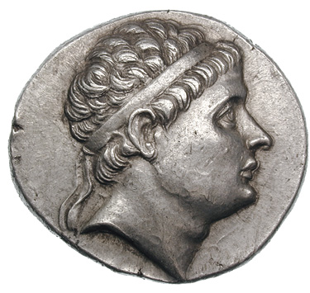
Antiochus II (261-246)
Second Syrian War
(Re)expansion
Diplomatic marriage
Bactria?

Slide 3
Second Syrian War (261-253)
Ptolemy II invades
Antiochus II retakes Miletus, Ephesus, Samos, Pamphylia and Cilicia
Re(expansion)
Some success in Thrace
Some success in Asia Minor
Perhaps the loss of Bactria

Slide 4
Diplomatic Marriage
Peace treaty at the end of the Second Syrian War c.252
  Antiochus II marries Berenice, the daughter of Ptolemy II Philadelphus
Antiochus already has a wife (Laodice) and 2 sons
  Laodice moves to Asia Minor, her family’s traditional power base
In 246, forsakes Berenice and returns to Laodice
He dies shortly there after (poison or natural causes?)

Slide 5
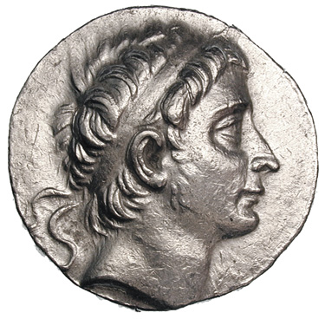
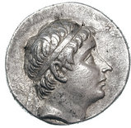
Seleucus II (246-226)
Antiochus Hierax (c.244-c.229/8)
Laodicean War
War of the brothers
Bactria?

Slide 6
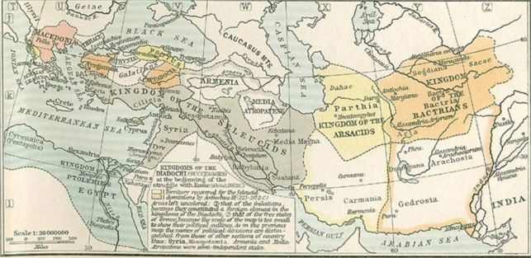
State of the Empire at the Death of Seleucus II

Slide 7
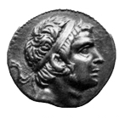
Seleucus III (226-223)
Attempt to retake Asia Minor

Slide 8
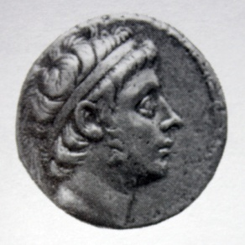
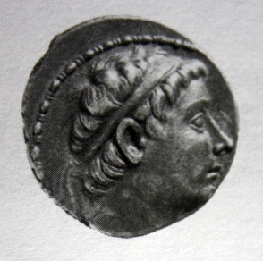
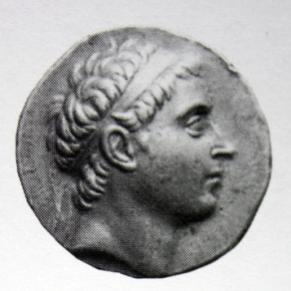
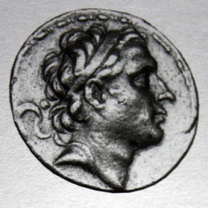
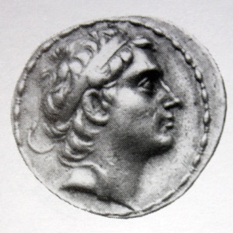
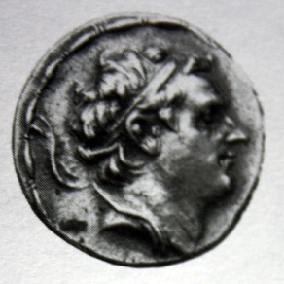
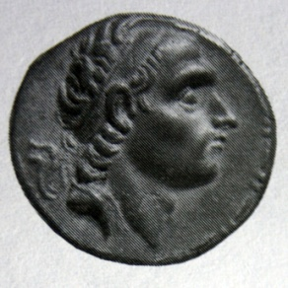
Antiochus III (223-187)
Coele-Syria (Syria/Palestine)
Molon and the East
Coele-Syria (Syria/Palestine)
Asia Minor
The Anabasis
Coele-Syria (Syria/Palestine)
Europe and the Romans

Slide 9
Immediate Succession
Proclaimed by the army as king in 223
Sends Achaeus to deal with problems in Asia Minor
Molon and his brother revolt in Persia and Media
Syrian invasion
  Not particularly successful

Slide 10
Molon and the East
3 generals are sent to defeat the rebellion
Antiochus goes in person with his army to face Molon
  Follows the advice of Zeuxis
A large portion of Molon’s army defects to Antiochus
Molon is defeated and Antiochus is able to reestablish control in the East

Slide 11
Battle of Raphia 217
The armies having been drawn up in this fashion, both the kings rode along the line accompanied by their officers and friends, and addressed their soldiers. 2 As they relied chiefly on the phalanx, it was to these troops that they made the most earnest appeal, Ptolemy being supported by Andromachus, Sosibius and his sister Arsinoë and Antiochus by Theodotus and Nicarchus, these being the commanders of the phalanx on either side. The substance of the addresses was on both sides very similar. For neither king could cite any glorious and generally recognized achievement of his own, so that it was by reminding the troops of the glorious deeds of their ancestors that they attempted to inspire them with spirit and courage. They laid the greatest stress, however, on the rewards which they might be expected to bestow in the future, and urged and exhorted both the leaders in particular and all those who were about to be engaged in general to bear themselves therefore like gallant men in the coming battle. So with these or similar words spoken either by themselves or by their interpreters they rode along the line.
Polybius 5.83

Slide 12
Asia Minor
Achaeus had begun to claim Asia Minor as his own kingdom
Spends 3 years pursing Achaeus in Asia Minor
Pins Achaeus in Sardis and after a long siege defeats him

Slide 13
The Anabasis
Armenia
  Makes Xerxes a vassal
The Parthians
  2 years of fighting, some success?
Bactria
  2 more years, fails to defeat the Bactrians
India
  Treaty with Sophagasenus, gets more elephants
Persis and the Persian Gulf
Babylon
  204 returns and celebrates 20 years as king and take the title Megas

Slide 14
“Secret Pact”
204 Ptolemy IV dies, replaced by boy king
Philip V focuses attention eastward after 1st Macedonian War
Antiochus returns from expeditions to the East and Asia Minor
Secret Pact?

Slide 15
5th Syrian War
201, Antiochus invades Koile Syria
Seleucids take control of Koile Syria and Palestine
Seleucids now control Jerusalem
Ptolemaios, son of Thraseas

Slide 16
Asia Minor
197, Attalus I dies and replaced by Eumenes II
Zeuxis attacks Pergamene territory
Antiochus’ fleet takes coastal cities in Asia Minor
  Ephesus
  Lampsacus and Smyrna view the activities as hostile
    Embassies sent to Rome

Slide 17
Greek Freedom
Smyrna and Lampsacus asserted their right to be free and there was danger, should their claim be allowed, of other cities in Aeolis and Ionia following the example of Smyrna, and those on the Hellespont the example of Lampsacus. Accordingly he despatched a force from Ephesus to invest Smyrna and ordered the troops in Abydos to march to Lampsacus, only a small detachment being left to hold the place. But it was not only the threat of arms that he made use of, he sent envoys to make friendly overtures to the citizens, and whilst gently rebuking their rashness and obstinacy lead them to hope that in a short time they would have what they wanted. It was, however, perfectly clear to them and to all the world that they would enjoy their liberty as the free gift of the king and not because they had seized a favourable opportunity of winning it. They told the envoys in reply that Antiochus must be neither surprised nor angry if they did not patiently resign themselves to the indefinite postponement of their hopes of liberty.
Livy 33.38

Slide 18
War with Antiochus
They ordered him, as regards the cities of Asia, to keep his hands off those which were autonomous and make war on none of them and to withdraw from those previously subject to Ptolemy and Philip which he had recently taken. At the same time they enjoined him not to cross to Europe with and army, for none of the Greeks were any longer being attacked by anyone or the subjects of anyone, and they announced in general terms that some of their body would come to see Antiochus.
-Polybius 18.47
It was not proper for them to receive their liberty by order of the Romans, but by his own gracious favour
-Polybius 18.51

Slide 19
War with Antiochus 191-189
Aetolian Alliance
Achaeans declare war on Antiochus (191)
Romans defeat Antiochus at Thermopylae (191)
Romans defeat Antiochus at Magnesia (189)
Peace of Apameia

Slide 20
Aetolian Alliance
Autumn 192
Antiochus III moves a small army to Greece
  10,000 men
  500 cavalry
  6 elephants
Notes:
Hannibal has been at the court since c. 196, Aetolians urge Antiochus to support them against Rome so that they can keep what they have taken, including Demetrias (one of the fetters)

Slide 21
Greek Cities and Antiochus
Antiochus hopes to be greeted as liberator
“Frees” Chalcis
Isolates Philip by a subordinate’s plan to replace him with his brother in law

Slide 22
Winter Preparations
The king left Demetrias for Chalcis. Here he fell in love with a daughter of Cleoptolemus, a Chalcidian magnate, and after numerous communications to her father followed by personal interviews (for he was reluctant to be entangled in an alliance so far above his own rank) Antiochus married the girl. The wedding was celebrated as though it were a time of peace, and forgetting the two vast enterprises in which he had embarked - war with Rome and the liberation of Greece - he dismissed all his cares and spent the rest of the winter in banquets and the pleasures attendant on wine, sleeping off his debauches, wearied rather than satisfied. All the king's officers who were in command of the different winter stations, especially those in Boeotia, fell into the same dissolute mode of life; even the common soldiers were completely sunk in it, not a man amongst them ever put on his armour or went on duty as guard or sentry, or discharged any military duty whatever. When, therefore, at the commencement of spring Antiochus passed through Phocis on his way to Chaeronea, where he had given orders for the whole of his army to muster, it was easy for him to see that the men had passed the winter under no stricter discipline than their leader. From Chaeronea he ordered Alexander the Acarnanian and the Macedonian Menippus to take the troops to Stratus in Aetolia...
Livy 36.11

Slide 23
Thermopylae (191)
Marcus Acilius Glabrio crosses into Thessaly and moves south
Antiochus defends at Thermopylae
Massively outnumbered
Outflanked
Defeated
Flees with what is left to Ephesus

Slide 24
Magnesia (189)
The king's army was a motley force drawn from many nations and presented the greatest dissimilarity both in the men and their equipment. There were 16,000 infantry in the Macedonian fashion. known as the "phalanx." These formed the centre, and their front consisted of ten divisions; between each division stood two elephants. They were thirty-two ranks deep. This was the main strength of the king's army and it presented a most formidable appearance, especially with the elephants towering high above the men. The effect was heightened by the frontlets and crests on the animals, and the towers on their backs on which stood the drivers, each accompanied by four soldiers. On the right of the phalanx Antiochus stationed 1500 Gallograeci infantry, and with them were linked up 3000 cavalry, clad in mail armour and known as "cataphracti." These were supported by the "agema," another body of cavalry numbering about 1000; they were a select force, consisting of Medes and men drawn from many tribes in that part of the world. Behind these in support were sixteen elephants. The line was continued by the royal cohort called "argyraspides" from the kind of shield they carried. Then came the Dahae, mounted archers, 1200 strong; then 3ooo light infantry, half of them Cretans and half Tralles. Beyond these again were 2500 Mysian bowmen, and at the end of the line a mixed force of Cyrtian slingers and Elymaean archers.
On the left of the phalanx were 1500 Gallograeci infantry and 2000 Cappadocian, similarly armed and sent by Ariarathes, next to whom were posted a miscellaneous force numbering 2700. Then came 3000 cataphracti and the king's personal cavalry, 1000 strong, with somewhat slighter protection for themselves and their horses, but otherwise closely resembling the cataphracti, made up mostly of Syrians with an admixture of Phrygians and Lydians. In front of this mass of cavalry were scythe chariots and the camels which they call dromedaries. Seated on these were Arabian archers provided with narrow swords four cubits long so that they could reach the enemy from the height on which they were perched. Beyond them again a mass of troops corresponding to those on the right wing, first Tarentines, then 2500 Gallograeci cavalry, 1000 newly enlisted Cretans, 1500 Carians and Cilicians similarly armed, and the same number of Tralles. Then came 4000 caetrati, Pisidians, Pamphylians and Lydians, next to these Cyrtian and Elymaean troops equal in number to those on the right wing, and finally sixteen elephants a short distance away.
Livy 37.40

Slide 25
Peace of Apameia
Cede all territory north of the Taurus mountains
No navy in the Aegean
No war elephants
15,000 silver talents payable in yearly instalments for 12 years

Slide 26
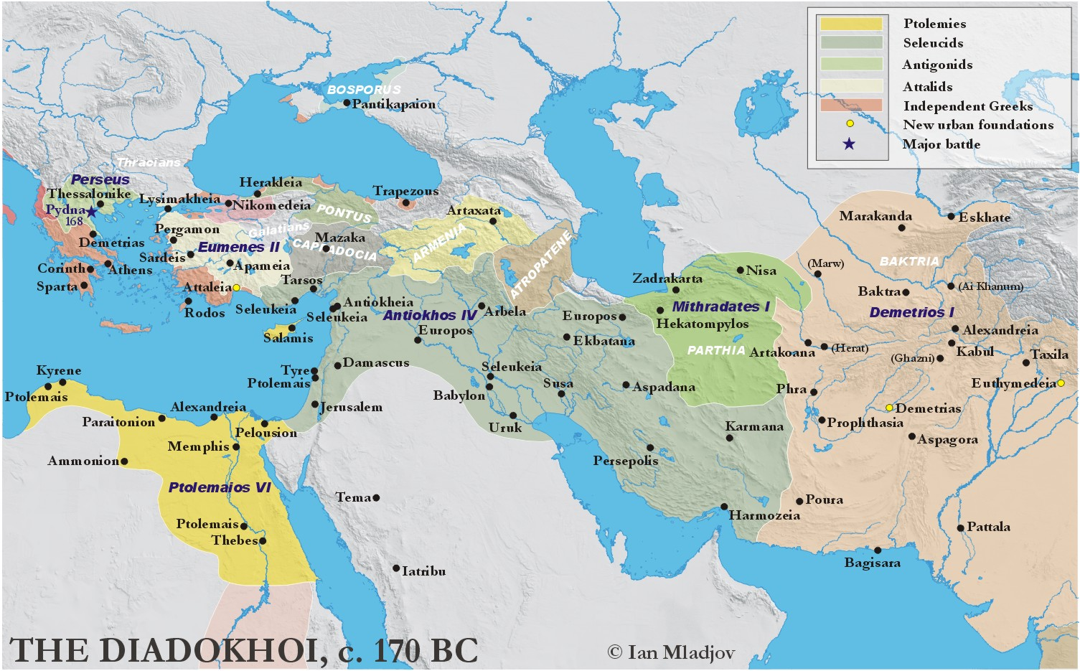

Slide 27
3rd Macedonian War
179: Philip V dies, Perseus takes the throne
Alliances with Prusias (king of Bithynia), Seleukos IV, Delphi, Rhodes
Marriage Alliances with Prusias II and Seleucus IV
Rome gives the Lycians independence from Rhodes (178)
172: Eumenes denounces Perseus at Rome

Slide 28
3rd Macedonian War
172: Q. Marcius Philippus tricks Perseus into thinking peace is possible with Rome
171: Roman army shows up in Greece and declares war on Perseus

Slide 29
Inscribed the charges against Perseus at Delphi
  [ - (line 6) = Know then first of all that Per]seus, contrary to what is proper, [came with an army to the feast of the] Pythia. [It was] evidently not [at all] right [for him to share with you in [either] sacrifices or games or [festivals, since] he brought in the [barbarians] from beyond the [Ister, who had been roused before for] no [good cause] but instead for the enslavement [of Greece, and who] having marched against the sanctuary [at Delphi, having in mind to plunder] and destroy it, received from [the god fitting punishment]. And he transgressed the oaths made by (his) [father, which he had himself renewed]. And [he conquered] (the) Thracians, who are our [allies. And he drove] Abroup[olis, whom we included in [the treaty with Philip], from his kingdom. And he removed (the) envoys [sent from (the) Thebans] to Rome about an alliance by the [treachery of a shipwreck].
  He came moreover, to this point of madness, [that, considering it a great thing contrary to] oaths [to destroy] the freedom [given] by our commanders by throwing] the whole nation into disorders [and political conflicts], he continued to do [nothing if not what is] base, but [confounding everything, and courting the masses, and] destroying leading men, [he mindlessly promised cancellations of debts] and brought about social revolutions, (thereby) showing [what hatred he had towards the best] men….
  Bagnall and Derow 44

Slide 30
3rd Macedonian War
Perseus wins the first battle
168: Rhodes attempts to negotiate and end to the war

Slide 31
Pydna and the end of the Antigonids
168: L. Aemilius Paullus takes command
June 168: Paullus defeats Perseus at Pydna
Macedon was divided into four separate states, Illyria into three
½ of old taxes now go as tribute to Rome
The gold and silver mines in Macedonia are shut down
1000 Achaean hostages in Rome (including Polybius)

Slide 32
Rome and Her Allies
Rhodes:
  Delos was declared a free port and given to Athens
Eumenes:
  Ignored when he arrives in Rome
  Accused of making common cause with Perseus

Slide 33
Day of Eleusis
At the time when Antiochus approached Ptolemy and meant to occupy Pelusium, Caius Popilius Laenas, the Roman commander, on Antiochus greeting him from a distance and then holding out his hand, handed to the king, as he had it by him, the copy of the senatus-consultum, and told him to read it first, not thinking it proper, as it seems to me, to make the conventional sign of friendship before he knew if the intentions of him who was greeting him were friendly or hostile. But when the king, after reading it, said he would like to communicate with his friends about this intelligence, Popilius acted in a manner which was thought to be offensive and exceedingly arrogant. He was carrying a stick cut from a vine, and with this he drew a circle round Antiochus and told him he must remain inside this circle until he gave his decision about the contents of the letter. The king was astonished at this authoritative proceeding, but, after a few moments' hesitation, said he would do all that the Romans demanded. Upon this Popilius and his suite all grasped him by the hand and greeted him warmly. The letter ordered him to put an end at once to the war with Ptolemy. So, as a fixed number of days were allowed to him, he led his army back to Syria, deeply hurt and complaining indeed, but yielding to circumstances for the present.
Polybius 29.27.1-6

Slide 34
Follow-up Reading
Errington, R.M. 2008. A History of the Hellenistic World: 323-30 BC. Oxford: Blackwell Publishing. 214-246.
Austin, M.M. 1986. “Hellenistic Kings, War, and the Economy” The Classical Quarterly New Series, Vol. 36, No. 2, pp. 450-466.
Morgan, M.G. 1990. “The Perils of Schematism: Polybius, Antiochus Epiphanes and the ‘Day of Eleusis’” Historia: Zeitschrift für Alte Geschichte, Vol. 39, No. 1, pp. 37-76.

