Slide 1
Understanding the Marketing environment
LCMB7024
Week 2 – Session 1

Slide 2
Content of the Session
To understand the marketing environment and including the micro-environment and macro-environment.
To understand the analysis tools used to analyse the micro-environment and the macro-environment.
  Microenvironment -> SWOT analysis
  Macroenvironment -> PESTLE analysis

Slide 3
Marketing Environment
A company’s marketing environment includes external actors and forces that influence marketing management’s ability to establish and sustain strong relationships with target customers.
Therefore, companies must continuously monitor and adapt to changes in their environment.

Slide 4
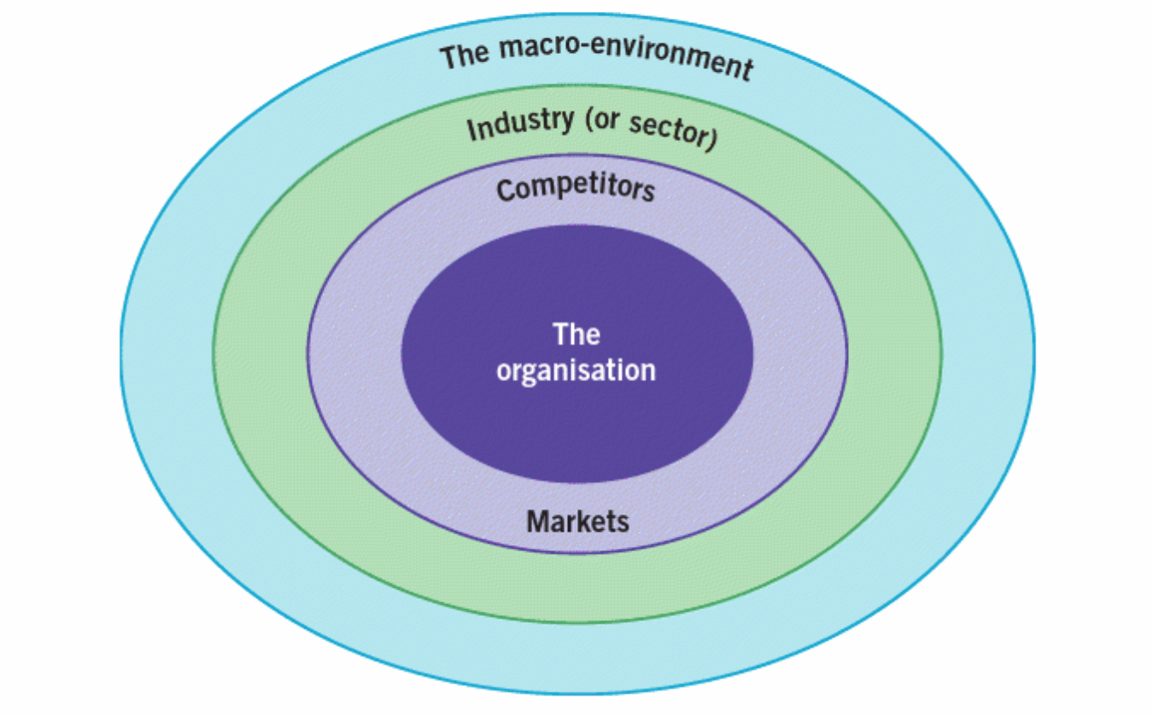
Layers of Business Environment
Figure: Layers of Business Environment
(Kotler et al., 2020)

Slide 5
Microenvironment
The microenvironment refers to the forces that are close to a company, directly influencing its ability to serve its customers effectively.
This includes suppliers, marketing intermediaries, competitors, customers, and various public groups.
By understanding and managing these elements, a company can make effective long-term and short-term strategic decisions.

Slide 6
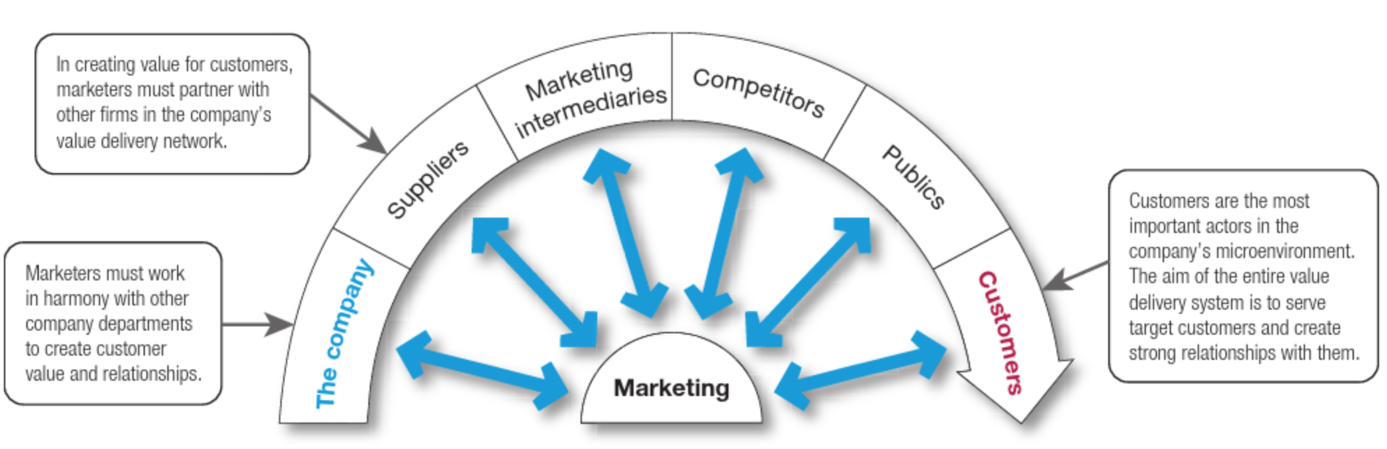
Microenvironment Actors
Figure: Actors of the Microenvironment
(Kotler et al., 2020)
Notes:
The microenvironment refers to the factors close to the company that influence a company's ability to serve its customers, including the company itself, suppliers, marketing intermediaries, customer markets, competitors, and the public.

Slide 7
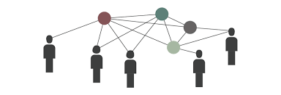
Company
Includes different departments (e.g., R&D, finance, HR) that must work together to create value for customers.

Slide 8

Suppliers
Provide the raw materials, goods, and services necessary for the company's operations.
A reliable supplier network ensures efficiency and quality.

Slide 9

Marketing Intermediaries
Firms that help distribute and promote the company’s products (e.g., retailers, wholesalers, logistics providers).

Slide 10

Competitors
Other businesses offering similar products or services. Companies must develop competitive strategies to differentiate themselves.

Slide 11
Publics
Any group that can influence the company's ability to achieve its objectives (e.g., media, government, pressure groups, financial institutions).
-> Let’s go through the example in next slide and discuss it.

Slide 12
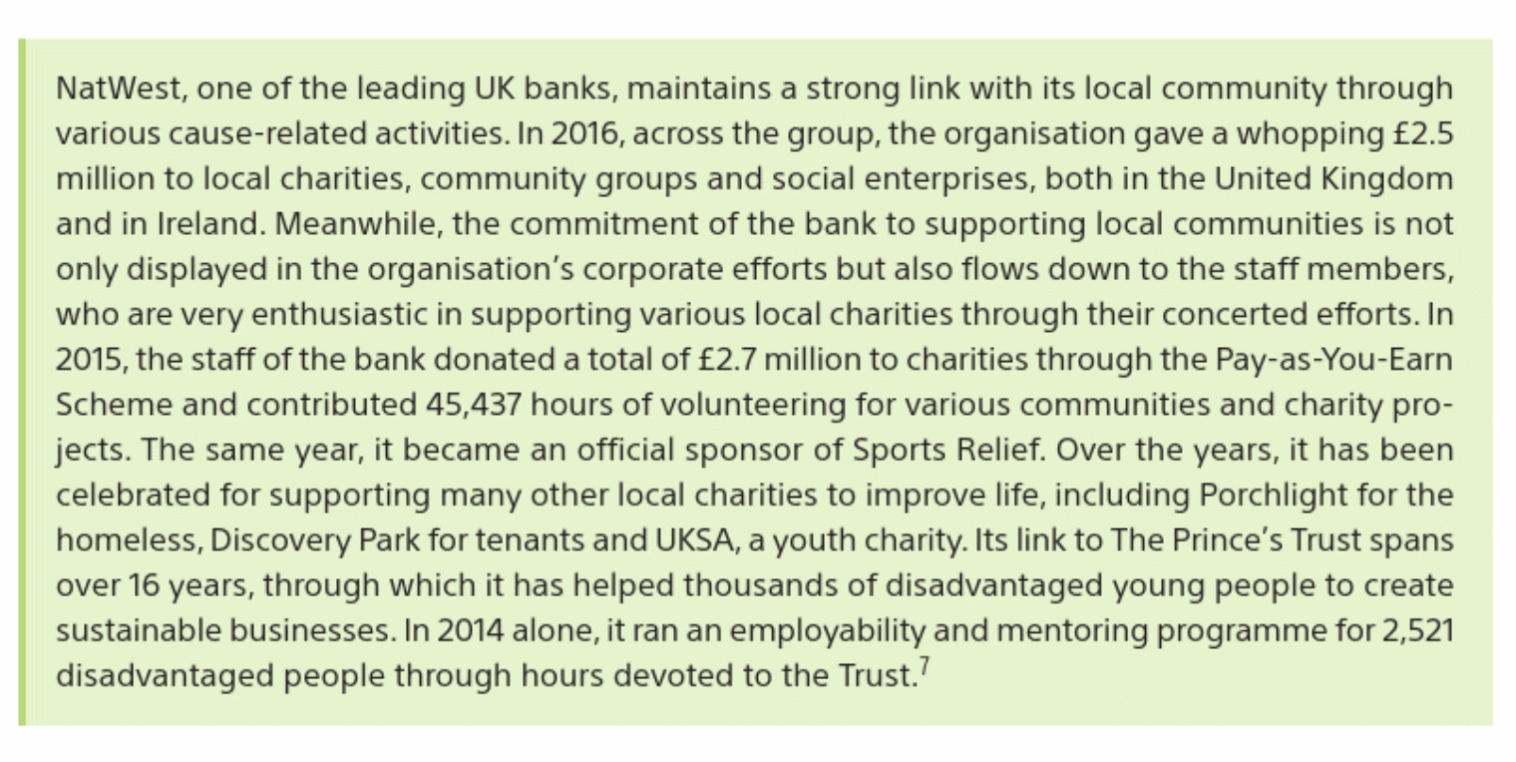

Slide 13
Customers
The ultimate goal of the microenvironment is to serve and build strong relationships with customers.
Understanding customer needs and preferences is key to business success.

Slide 14
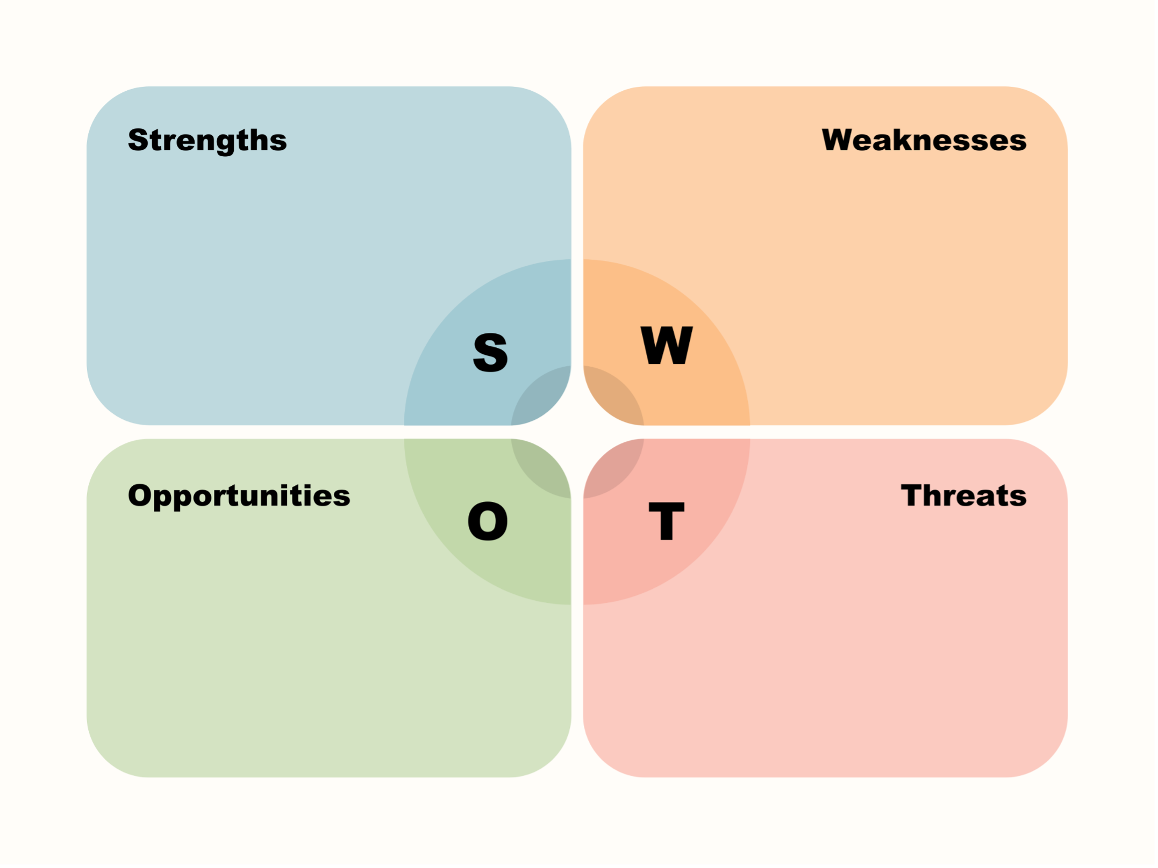
SWOT Analysis for Microenvironment

Slide 15
Macroenvironment
The larger societal forces that affect the microenvironment – demographic, economic, technological, and cultural forces.

Slide 16
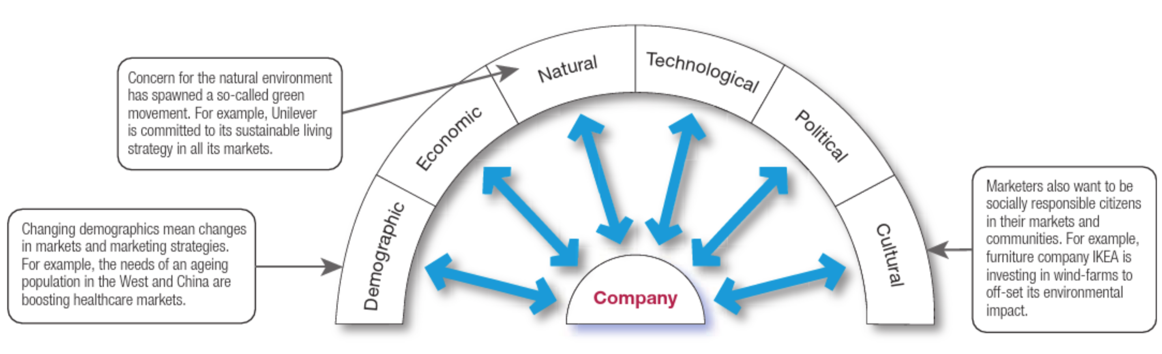
Macroenvironment Actors
(Kotler et al., 2020)

Slide 17
Demographic Actors
Changes in population characteristics (age, gender, income, education, etc.) affect market demand.
Example: An aging population in the West and China is increasing demand for healthcare services.

Slide 18

Economic Actors
Economic conditions, such as inflation, income levels, and consumer spending power, impact purchasing behaviour and business strategies.

Slide 19
Natural Actors
Environmental concerns, resource availability, and sustainability trends affect business operations.
Example: Unilever's commitment to a sustainable living strategy reflects the growing "green movement.”
-> Please another example in the next page and share your opinion.

Slide 20
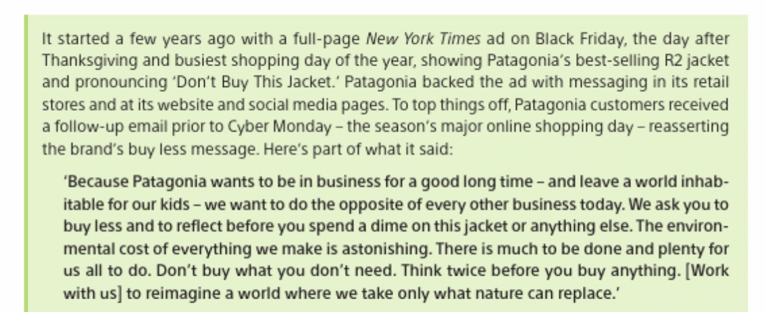

Slide 21

Technological actors
Advances in technology create new opportunities and challenges for businesses.
Companies must continuously adapt to innovations to stay competitive.

Slide 22

Political Actors
Government regulations, trade policies, and legal frameworks shape the business environment.
Companies must comply with regulations and anticipate policy changes.

Slide 23
Cultural Actors
Societal values, beliefs, and lifestyles influence consumer preferences and brand perception.
Example: IKEA’s investment in wind farms aligns with consumer expectations for social responsibility.

Slide 24
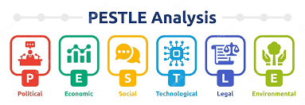
PESTLE

Slide 25
Activity
Form group of 3-4 and research cultural trends in UK.
Research one of them in depth and create a short presentation on the trend’s impact on marketing.
Be prepared to present your ideas as a group in front of the class.

Slide 26
References
Whittington, R., Regnér, P., Angwin, D., Johnson, G., & Scholes, K. (2023) Exploring strategy : text and cases. Thirteenth edition. Harlow, England: Pearson.
Kotler, P., Armstrong, G., Harris, L. and Piercy, N. (2020) Principles of marketing. 8th European edn. Harlow: Pearson.

