Slide 1
equlibria

Slide 2
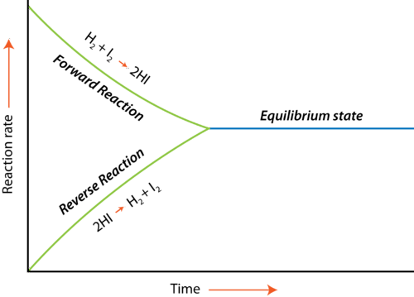
EQUILIBRIUM
H₂(g)+I₂(g)⇌2HI(g)
forward reaction:H₂(g)+I₂(g)→2HI(g) reverse reaction:2HI(g)→H₂(g)+I₂(g)
reactions do not go to full completion
there is an equilibrium (⇌) between concentrations or pressures of the reactants and products
at equilibrium the rate of the forward reaction equals the rate of a backward reaction
https://chem.libretexts.org/Bookshelves/Introductory_Chemistry/Book%3A_Chemistry_for_Allied_Health_%28Soult%29/08%3A_Properties_of_Solutions/8.02%3A_Chemical_Equilibrium

Slide 3
Equilibria play a significant role in the chemistry of explosives, influencing their stability, reactivity, energy release, and safety.
Understanding these equilibria allows engineers and chemists to design safer explosives, predict their behaviour under different conditions, and optimize performance for specific applications in munitions, mining, demolition, and defence.
equilibrium depends on the oxygen balance and temperature of explosion

Slide 4
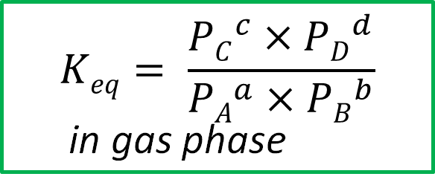
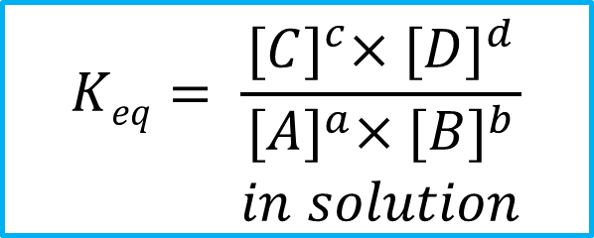
EQUILIBRIUM CONSTANT
for any hypothetical reversible reaction in which reactants A and B react to form products C and D the chemical equation at equilibrium can be written:
aA + bB ⇌ cC + dD (a, b, c, d – stoichiometric coefficients)
if the rates of the forward and reverse reactions are the same at equilibrium, the concentrations (pressures) of all of the substances must be constant
a ratio of the concentration (pressure) for any given reaction at equilibrium is called equilibrium constant, K_{eq}, and at T = const it has a constant value !!!
$$Keq= \frac{{[C]}^{c}×{[D]}^{d}}{\begin{aligned}{[A]}^{a}×{[B]}^{b} \\ in solution\end{aligned}}$$
$$Keq= \frac{{PC}^{c}×{PD}^{d}}{{PA}^{a}×{PB}^{b}}$$
in gas phase

Slide 5
Importance of Equilibrium Constant
K_{eq} > 0 => reaction favours products (detonation), K_{eq} > 0 => reactants (stability). (reaction extent)
High K_{eq} ensures maximum energy release and efficient detonation. (efficiency)
Helps assess how stable an explosive is under various conditions. (stability)
Shows how the explosive behaviour changes with temperature, crucial for safe handling. (temperature dependence)
Ensures the correct balance between oxidisers and fuels for efficient explosions. (optimal explosive mixture)
Helps in applying Le Chatelier’s Principle to predict the effects of pressure and temperature changes.

Slide 6
FACTORS AFFECTING POSITION OF EQULIBRIUM
The position of equilibrium (not the value of K_{eq}) depends on:
  Temperature
  Concentration
  Pressure (of gases)
Change in any of these factors will affect the balance of the system and results in a shift in the position of the equilibrium
If a chemical system is in equilibrium and one of the factors involved in equilibrium is changed, the equilibrium will shift so as to neutralise the effect of this change !!!

Slide 7
Le chatelier’s principle
Le Châtelier's principle states that if a dynamic equilibrium is disturbed by changing the conditions, the position of equilibrium shifts to counteract the change to re-establish an equilibrium.
aA + bB ⇌ cC + dD
  Temperature: add heat to exo- reaction – left shift
  Concentration: add reactants – right shift
  Pressure (of gases): Increasing pressure shifts the equilibrium towards the side with fewer gas molecules to reduce the pressure

Slide 8



EQUILIBRIA for EXPLOSIVE REACTION
→
←
CO₂ + H₂ CO + H₂O
Endo
← Exo
$$K= \frac{\left[CO\right][H2O]}{\left[CO2\right][H2]}$$
→
2 CO C + CO₂
CO + H₂ C + H₂O
←
$$K=\frac{\left[C\right][CO2]}{\left[CO\right]2}$$
→
←
$$K= \frac{\left[CO\right][H2O]}{\left[CO\right][H2]}$$
equilibria are temperature-dependant
at higher temperature more water will form
at lower temperature more CO₂ will form
Equilibrium constant, K, shows how the concentrations of the products vary with the concentration of the reactants.
position of equilibrium is changed when the concentration of species in the mixture change.
only change of temperature can change the equilibrium constant
Notes:
equilibrium position will move to favor the reactants or products depending on the temperature generated by the reaction

