Slide 1
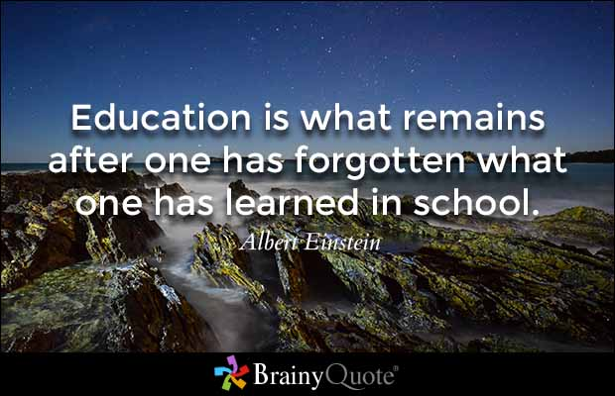
ECES6018/C
Hinsoddau Dysgu
Learning Climates
Sesiwn 1b / Session 1b

Slide 2
Deilliannau Dysgu
Learning Outcomes
Mynd i’r afael yn feirniadol ag ymchwil cyfoes a damcaniaethau seicolegol a dysgu allweddol er mwyn gwerthuso effeithiolrwydd amrywiaeth o strategaethau dysgu ac addysgu.
Critically engage with contemporary research and key psychological and learning theory in order to evaluate the effectiveness of a range of teaching and learning strategies.

Slide 3
Deilliannau Dysgu
Learning Outcomes
Dangos dealltwriaeth feirniadol o’r sgiliau proffesiynol sydd eu hangen i gynllunio, addysgu ac asesu ar gyfer cynnydd effeithiol a pharhaus mewn dysgu ac addysgu.
Demonstrate a critical understanding of the professional skills required to plan, teach and assess for effective and sustained progress in teaching and learning.

Slide 4
Deilliannau Dysgu
Learning Outcomes
Dadansoddi’n feirniadol elfennau ymddygiad effeithiol ar gyfer dysgu a chymhwyso damcaniaethau rheoli ymddygiad perthnasol mewn amrywiaeth o gyd-destunau addysgol.
Critically analyse the components of effective behaviour for learning and to apply relevant behaviour management theory in a range of educational contexts.

Slide 5
Amgylcheddau Dysgu Effeithiol Effective Learning Environments
Gwyliwch y fideo.
Adfyfyriwch:
  Pa weledigaeth o addysg a geir yma?
  I ba raddau rydych yn cytuno gyda’r portread yma?
  Pa gwestiynau/materion ynghylch addysg sy’n codi o’r portread yma?
Watch this short video.
Reflect:
  What vision of education is portrayed here?
  To what extent do you agree with this portrayal?
  What issues/questions around education does this portrayal raise?

Slide 6
Darlun traddodiadol o addysgu’n effeithiol
Traditional view of educating effectively
Pupils expect teachers to teach. They value lucid exposition, the clear statement of problems and guidance in their solution. Personal qualities of kindness, sympathy and patience are secondary, appreciated by pupils if they make the teacher more effective in carrying out his primary, intellectual task . . . there appears to be little demand by pupils that teachers shall be friends or temporary mothers and fathers.
(Musgrove and Taylor, 1969: 17 cited in Arthur and Cremin, 2010 )
Pa mor gywir yw’r farn hon am addysgu’n effeithiol heddiw?
How accurate is this view of educating effectively today?

Slide 7
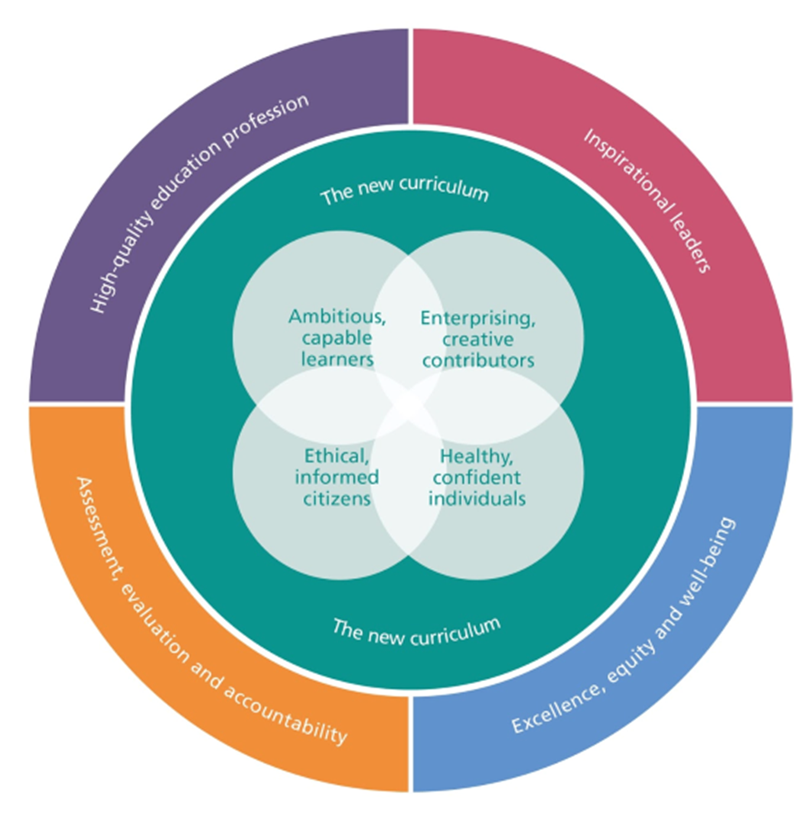
Rydym eisiau MWY i’n plant
We want MORE for our children

Slide 8
Cwricwlwm i Gymru/
Curriculum for Wales
…beth yw athro da?
…what does a good teacher look like?
Understanding of how social and psychological factors influence learning.
Excellent subject and methodological expertise.
Sound classroom craft skills.
Ability to engage and inspire children to become independent learners.
Donaldson, 2015

Slide 9
Os mai dyna yw dysgwr da...
So if that’s what a good learner looks like…
…
…beth yw athro da?
…what does a good teacher look like?
Dealltwriaeth o’r ffactorau cymdeithasol a seicolegol sy’n dylanwadu ar ddysgu
Arbenigedd mewn pynciau a methodolegau
Sgiliau crefft cadarn yn yr ystafell ddosbarth.
Y gallu i symbylu ac ysbrydoli plant i ddymuno dysgu ac i ddysgu’n annibynnol
Donaldson, 2015

Slide 10
John Hattie
Dysgu Gweledol / Visible Learning
Dadansoddiad meta o 180,000 o astudiaethau
Prif negeseuon:
  Mae athrawon effeithiol yn barod i addasu. Yn lle canolbwyntio ar eu dulliau addysgu, maent yn canolbwyntio ar yr effaith maent yn ei chael ar fyfyrwyr ac yn newid pethau pan fo angen.
  Mae angen i ddysgu ac addysgu fod yn ‘weladwy’. Ydy athrawon yn glir am beth maent yn ei addysgu? Ydy myfyrwyr yn gwybod beth maent i fod i’w ddysgu?
Meta analysis of 180,000 studies
Key messages:
  Effective teachers are ready to adapt. Instead of focusing on the teaching methods they use, they focus on the effects they have on students and change things where needed.
  Teaching and learning need to be made ‘visible’ – are teachers clear about what they are teaching? Do students know what they are supposed to be learning?

Slide 11
Tasg/Task
Mewn grwpiau gwnewch restr o 10 dylanwad allweddol ar ddysgu gan blant yn yr ystafell ddosbarth.
Er enghraifft, perthnasoedd cadarnhaol rhwng athrawon a disgyblion
Trefnwch eich rhestr gyda’r pwysicaf yn rhif 1
A wnaethoch i gyd gytuno ar y drefn
In groups make a list of 10 key influences on children’s learning in the classroom.
For example, positive teacher pupils relationships
Order your list 1 being most important
Did you all agree on the ordering

Slide 12
Influences on student learning
John Hattie 1999-2009 – research from 180,000 studies covering almost every method of innovation
Effect Size
Feedback 0.73
Teacher-Student Relationships 0.72
Mastery Learning 0.58
Challenge of Goals 0.56
Peer Tutoring 0.55
Expectations 0.43
Homework 0.29
Aims & Policies of the School 0.24
Ability Grouping 0.12
Compare your list to that created by Hattie. Does anything surprise you? Why?
Cymharwch eich rhestr ag un Hattie. Oes unrhyw beth annisgwyl? Pam?

Slide 13
Effective Educators
We can view teaching as a professional activity.
This term implies a number of attributes within the teacher, including:
  high levels of relevant knowledge about what is being taught and the children to whom it is being taught;
  knowledge of, and skill in using, a range of strategies to enable learning;
  the capacity to engage flexibly and thoughtfully in the classroom, taking into account the needs and responses of the learners as they develop and manifest themselves;
  an understanding of the importance of learners’ attitudes towards what they are learning and an ability to influence and develop these attitudes;
  the ability and willingness to learn from a variety of sources about effective teaching and to adapt practices to fit this ongoing learning.
  (Cremin and Burnett, 2018)

Slide 14
Addysgwyr Effeithiol
Gallwn ystyried addysgu fel gweithgaredd proffesiynol.
Mae’r term yn awgrymu nifer o rinweddau a welir mewn athro effeithiol:
  lefelau uchel o wybodaeth berthnasol am yr hyn sy’n cael ei addysgu a’r plant sy’n cael eu haddysgu;
  gwybodaeth am, a sgil wrth ddefnyddio, amrediad o strategaethau i alluogi dysgu;
  y gallu i ymgysylltu’n hyblyg ac yn feddylgar yn y dosbarth, gan gymryd i ystyriaeth anghenion ac ymatebion y dysgwyr wrth iddynt ddysgu ac amlygu eu hun;
  dealltwriaeth o bwysigrwydd agweddau dysgwyr tuag at yr hyn maent yn ei ddysgu a gallu i ddylanwadu ar yr agweddau hyn a’u datblygu;
  y gallu a’r parodrwydd i ddysgu wrth amrywiaeth o ffynonellau ynglŷn ag addysgu effeithiol ac addasu arferion i gydymffurfio â’r dysgu parhaus hwn. (Cremin a Burnett, 2018)

Slide 15
Report - What makes great teaching?
Pedagogical content knowledge
Quality of instruction
Classroom climate
Classroom management
Teacher beliefs
Professional behaviours
Coe et al, 2014
“Great teaching is defined as that which leads to improved student progress”
Evidence of impact on student outcomes:
Strong
Moderate
Some

Slide 16
Adroddiad – ‘What makes great teaching?’
Gwybodaeth addysgegol am y cynnwys
Ansawdd yr addysgu
Hinsawdd yr ystafell ddosbarth
Rheoli’r ystafell ddosbarth
Credoau’r Athro
Ymddygiadau proffesiynol
(Coe et al, 2014)
“Great teaching is defined as that which leads to improved student progress” (Coe et al, 2014, p.2)
Tystiolaeth o’r effaith ar ddeilliannau myfyrwyr:
Cryf
Canolig
Ychydig

Slide 17

“Good quality teaching will likely involve a combination of these attributes manifested at different times; the very best teachers are those that demonstrate all of these features”.
(Coe et al, 2014, p.2)

Slide 18
Galton’s Six Principles
Clear statement of learning objectives
Extended questioning during whole class discussion
More active pupil participation
Increased cooperation between pupils by working in pairs and groups
Less use of corrective and more informing feedback
More use of the assessment for learning approach
Whenever possible exploration precedes instruction and examples are situated in contexts that are meaningful to the pupils.

Slide 19
Chwe Egwyddor Galton
Datganiad eglur o’r deilliannau dysgu
Cwestiynu estynedig yn ystod y drafodaeth dosbarth cyfan
Mwy o gyfranogiad gweithredol gan y disgyblion
Mwy o gydweithredu rhwng disgyblion drwy weithio mewn parau a grwpiau
Llai o ddefnydd o adborth cywirol a mwy o adborth sy’n rhoi gwybodaeth
Mwy o ddefnydd o’r dull asesu ar gyfer dysgu
Pryd bynnag bod modd mae archwilio yn dod cyn yr addysgu ac mae enghreifftiau’n cael eu gosod mewn cyd-destunau sy’n ystyrlon i’r disgyblion.

Slide 20
Six Principles
CURRICULUM
PEDAGOGY
ASSESSMENT
QUESTIONING
ASSESSMENT FOR LEARNING
LEARNING OBJECTIVES
PUPIL PARTICIPATION
PAIR/GROUP WORK
FEEDBACK

Slide 21
Chwe Egwyddor
CWRICWLWM
ADDYSGEG
ASESU
CWESTIYNU
ASESU AR GYFER DYSGU
AMCANION DYSGU
CYFRANOGIAD DISGYBLION
GWAITH PÂR/GRŴP
ADBORTH

Slide 22
Munud i feddwl
Pause for Thought
Hattie
Coe et al
Galton

Slide 23

Ei roi ar waith
Putting it into Practice
Yn y darn nesaf, byddwn yn ystyried ffyrdd ymarferol y gall addysgwyr gymhwyso cysyniadau am ddysgu ac addysgu effeithiol i’w harfer yn yr ystafell ddosbarth.
Next, we will look at some practical ways that educators can apply concepts about effective t&l to their classroom practice.

Slide 24
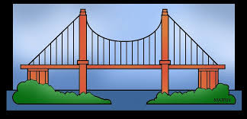
Gweithredu Gwybodaeth Flaenorol Activating Prior Knowledge
Disgyblion yn ‘ymuno’ –hefyd yn gallu bachu diddordeb y plant.
Mae’n helpu i gysylltu beth maent yn ei wybod yn barod â beth sydd i ddod.
Allwch chi gysylltu hyn â damcaniaethwr?
Pupils ‘tune in’ – can also be a hook to engage children’s interest.
Helps learners to connect what they already know to what is to come.
Can you link this to a theorist?

Slide 25
Gwnewch y Dysgu’n Eglur
Making the Learning Explicit
Objectives are:
what we intend the pupils to learn in terms of knowledge, concepts, skills and attitudes.
used to state what the children will be able to do as a result of the teaching and learning programme.
used to formulate sequences or ladders of success criteria on a gradient of complexity or ‘difficulty’.
can be used to review their progress and to help in understanding the level of challenge in a task.
A further refinement could be to specify ‘must’, ‘should’ and ‘could criteria as a bridge between curriculum planning and assessment for learning.”
Pollard et al, 2014
Why do we need learning objectives?

Slide 26
Gwnewch y Dysgu’n Eglur
Making the Learning Explicit
Amcanion Dysgu
  Gyda phartner, rhannwch unrhyw esiamplau o sut rydych wedi gweld y rhain yn cael eu defnyddio.
Gwyliwch y clip. Pa more effeithiol mae’r cyflwyniad yma o amcanion dysgu?
Learning Objectives
  With a partner, share any examples of how you may have seen these used.
Watch the following clip. How effective is this presentation of learning objectives?

Slide 27
Teachers tend to identify what pupils will do not what they will learn.
Which of the following tell pupils about learning?
1 To make a Christmas decoration
To be able to interpret a pie-chart
To improve ball throwing skills
To complete exercise 3a in your maths text book
To discuss what foods are good for us
To know when to use ‘a’ and ’the’
To draw and label a diagram of a simple electric circuit

Slide 28
Mae athrawon yn tueddu i ddynodi beth bydd disgyblion yn ei wneud nid beth byddant yn ei ddysgu.
Pa rai o’r canlynol sy’n dweud wrth ddisgyblion am ddysgu?
1 Gwneud addurn Nadolig
2 Gallu dehongli siart cylch
3 Gwella sgiliau taflu pêl
4 Cwblhau ymarfer 3a yn eich gwerslyfr mathemateg
5 Trafod pa fwydydd sy’n dda i ni
6 Gwybod pryd i ddefnyddio ‘y’ ac ‘yr’
7 Tynnu llun diagram cylched drydanol syml a’i labelu

Slide 29
Iaith Deilliannau Dysgu
Language of LOs
Some key action words when specifying learning objectives:
Low level (transmission): to recall, define, identify, state, recognise, name, list, measure
Medium level (application): to use, show, perform, explain, illustrate, predict, interpret
Higher level (understanding): to classify, design, organise, compose, discover, summarise, conclude, separate
Geiriau gweithredu allweddol wrth bennu amcanion dysgu:
Lefel isel (trosglwyddo): adalw, diffinio, dynodi, datgan, adnabod, enwi, rhestru, mesur
Lefel ganolig (cymhwyso): defnyddio, dangos, gwneud, esbonio, darlunio, rhagfynegi, dehongli
Lefel uwch (deall): dosbarthu, dylunio, trefnu, cyfansoddi, darganfod, crynhoi, gorffen, gwahanu

Slide 30
Defnyddio geiriau gweithredu allweddol
Using key action words
e.e. Cyfrif hyd at gant mewn degau a defnyddio’r dull hwn i wneud cyfrifiadau syml yn fwy cyflym. (lefel isel i ganolig)
e.e. Dysgu cerdd ar y cof a dangos dealltwriaeth drwy actio rhannau cymeriadau amrywiol yn y naratif. (lefel isel i ganolig)
e.g. To count up to one hundred in tens and to use this method to perform simple calculations more rapidly. (low to medium level)
e.g. To memorise a poem and demonstrate comprehension by acting out the parts of various characters in the narrative. (low to medium level)

Slide 31
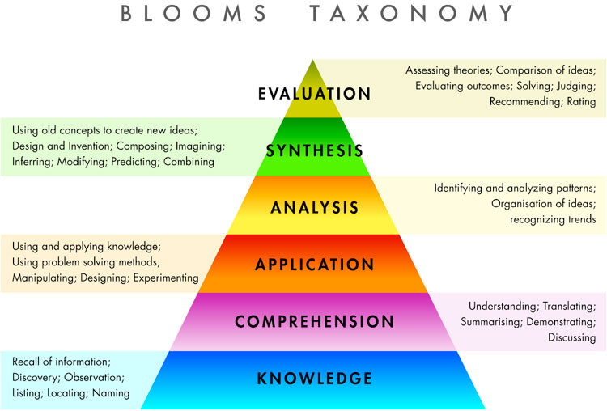
Task: At the end of a period of teaching, the children in your year 2 class will be writing a description of a haunted house. Write the
Learning objectives needed to teach the unit
Learning outcomes for the pupils
Alford, Herbert & Fragenheim 2006).

Slide 32
Siarad ar Gyfer Dysgu
Talk for Learning
Gwyliwch y clip.
Adfyfyriwch ar unrhyw esiamplau o arfer dysgu ac addysgu cyffredinol effeithiol a welwyd.
Sut mae’r athrawes yn defnyddio siarad ar gyfer dysgu? Beth yw’r effaith?
Watch the following clip
Reflect on any examples of general effective t&l practice noticed.
How does the teacher use talk for learning? What is the effect?

Slide 33

Cwestiynu Effeithiol
Effective Questioning
Beth yw diben cwestiynu yn y dosbarth?
Mathau o gwestiynau:
  Caeedig
  Agored
  Tenau a syml
  Tew a chymhleth
Gwyliwch y clip.
Ysgrifennwch restr o beth sy’n gwneud cwestiynu effeithiol yn yr ystafell ddosbarth.
What is the purpose of questioning in the classroom?
Question types:
  Closed Convergent
  Open Convergent
  Skinny Simple
  Fat complex
Watch the following clip.
Write a list of what constitutes effective questioning in the classroom.

Slide 34
Tynnu’r Llinynnau at ei gilydd
Drawing together the Strands
Rosenshines’s Principles of Instruction
Begin a lesson with a short review of previous learning
Present new material in small steps, with student practice after each step
Ask a large number of questions and check the responses of all students
Provide models for problem solving and worked examples
Guide student practice
Check for student understanding
Obtain a high success rate
Provide scaffolds for difficult tasks
Require and monitor independent practice
Engage students in weekly and monthly review
(Rosenshine, 2012)
Rosenshine’s POI focuses on the role of the teacher. Create your own model entitled ‘Principles of Learning’ which focuses on the role of the learner. Consider the knowledge, understanding, skills and attributes they would need at each stage.

Slide 35
Llyfryddiaeth
Bibliography
Cremin, T and Burnett,C. (2018) Learning to teach in the Primary School. Routledge: Oxon.
Coe, R., Cesare, A., Higgis, S. & Major, L. (2014) What Makes Great Teaching? Sutton Trust: Durham University. Available at: https://www.suttontrust.com/wp-content/uploads/2014/10/What-makes-great-teaching-FINAL-4.11.14.pdf (Accessed 2/2/23)
Galton, M. (2010) Using a Framework of 6 Key Principles to Increase the Effectiveness of Smaller Classes Maurice Galton Faculty of Education, University of Cambridge UK.
Hattie, J (2008) Visible Learning for Teachers, Routledge: Oxon.
Pollard, A. (editor)(2018) Reflective Teaching in Schools. Bloomsbury Academic: London
Rosenshine, B. (2012) Principles of Instruction: Research based principles that all teachers should know. American Educator, Spring 2012

