Slide 1
Human Evolution
Origin of Modern Humans
(Meaning our genetic, physical, biological origins – cultural origins are another debate....)
Notes:
1

Slide 2
Theories of our emergence
Multi-regional (M-R) or Regional Continuity Theory
Out of Africa (Eve, Replacement, Single Origin Theory, Recent African Orign)

Slide 3
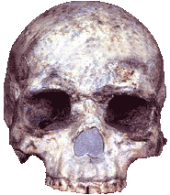
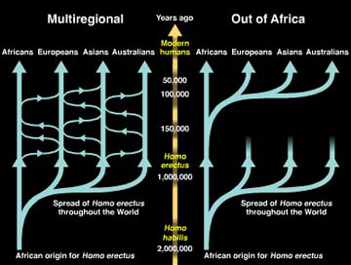
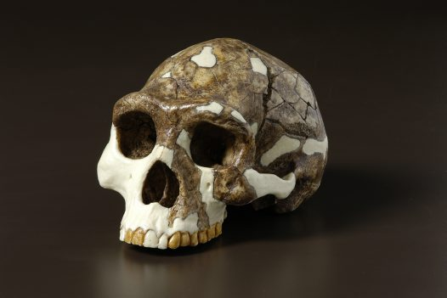
Multi-regional or Continuity model (Wolpoff, amongst others)
Homo erectus, Peking Man, below, and the early modern Liujiang skull, from China
www.bradshawfoundation.com/liujiang-skull.php

Slide 4
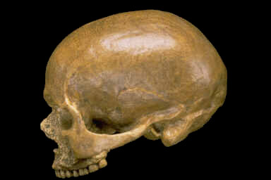
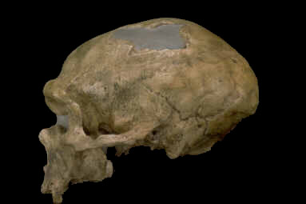
Out of Africa or replacement Theory

Slide 5
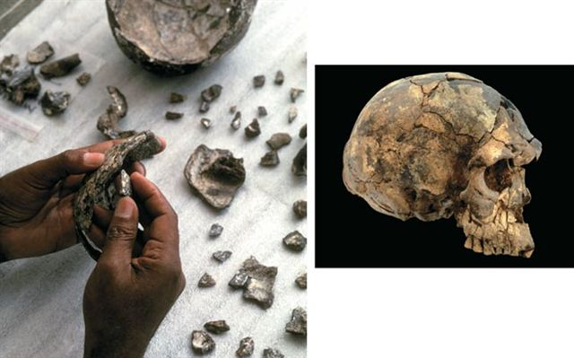
African fossil evidence
One of the most complete early specimens of the anatomically moderns at Omo Kibish Dated to 154,000 years ago

Slide 6
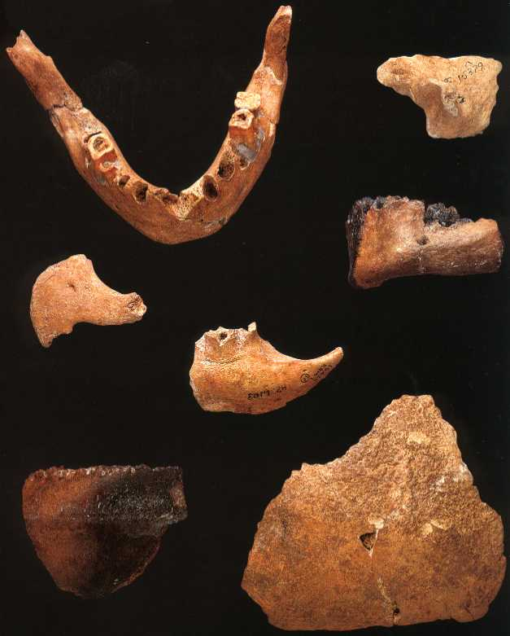
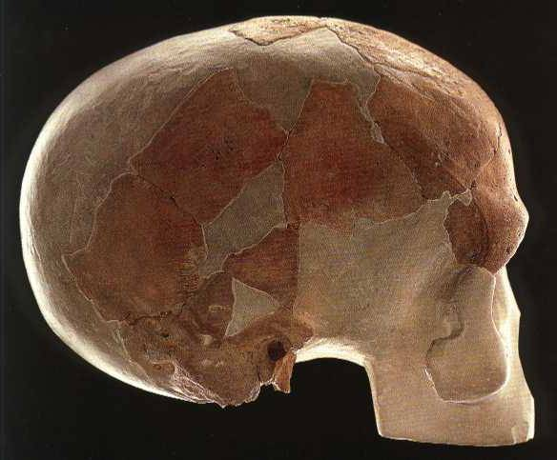
anatomically moderns (a.m.).
Fragments of the Border Cave , Africa, c.112,000 years.
They show a very different skull shape.
Klasies River Mouth, South Africa, Skull Fragments,
Dated to older than 90,000 years
www.msu.edu/~heslipst/contents/ANP440/sapiens.htm

Slide 7
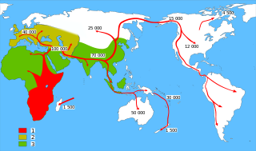
Model of the pattern of dispersal
1. Red = Homo sapiens
2. Brown = Neanderthals
3. Green = Early Hominid distributions i.e. Homo erectus

Slide 8
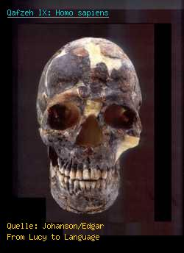
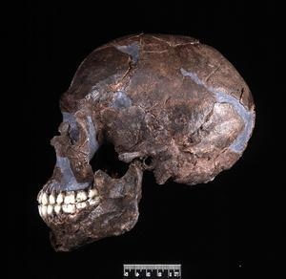
Qafzeh, early moderns from the Levant. They may predate some of the African evidence as early moderns.
Bio-geography

Slide 9
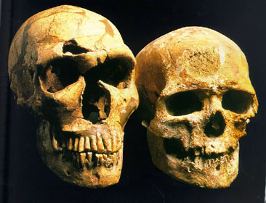
Left: La Ferrassie, a Neanderthal, and right, Cro-Magnon (anatomically modern human) show two contemporary but distinct lineages in Europe
Notes:
9

Slide 10
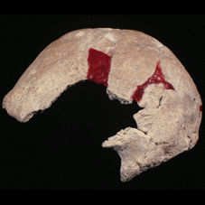
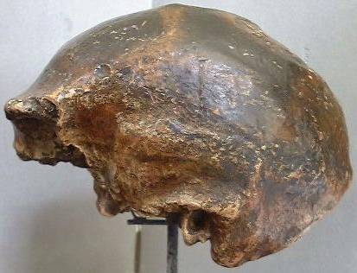
Continuity in Australasian material?
Nagnagdong, Homo erectus, left, and the a.m. WLH 50 (at 30,000 years) a corner stone in arguments for evolutionary continuity between the archaic and modern Indonesian and Australian populations

Slide 11
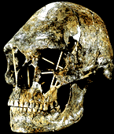
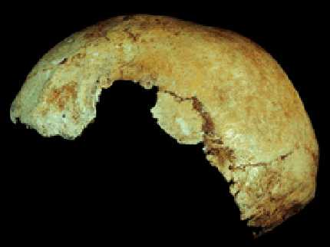
Kow Swamp 1, left and Lake Mungo 3, with some similarity to earlier forms.

Slide 12
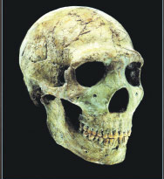
What do we do with the Neanderthals that are clearly not Neanderthal enough?
Amud, Levant, clearly lacking in the Classic Neanderthal traits

Slide 13
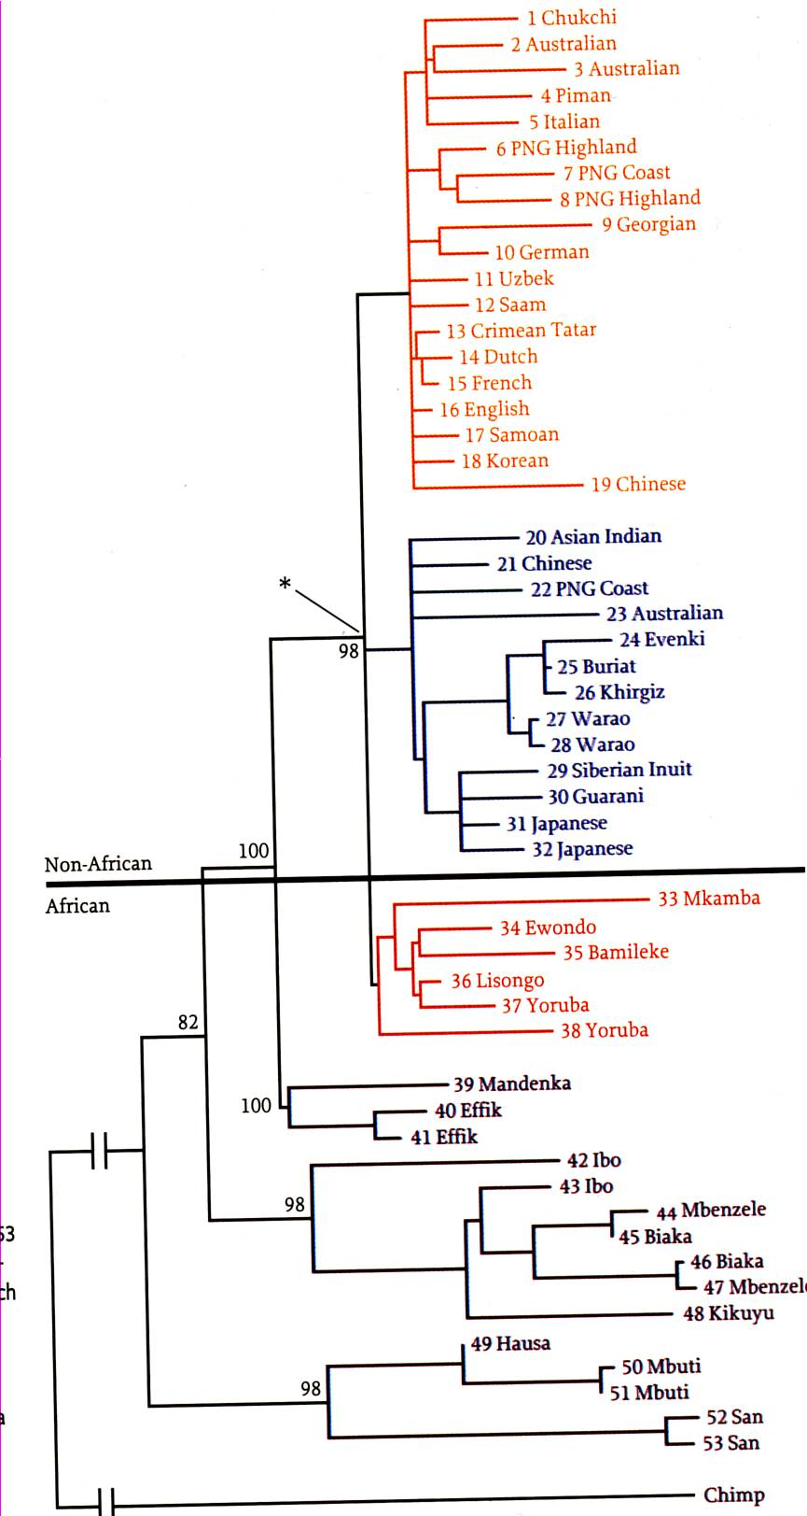
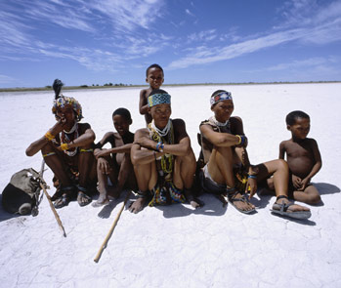
Africa consistently shows the greater diversity and the ‘deepest’ branch (mtDNA left). This is found in the San of the Kalahari desert populations, closely followed by the Mbuti forest populations

Slide 14
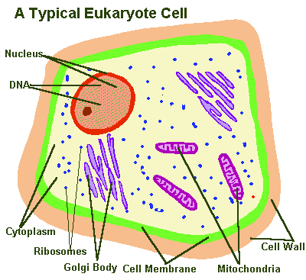

Slide 15
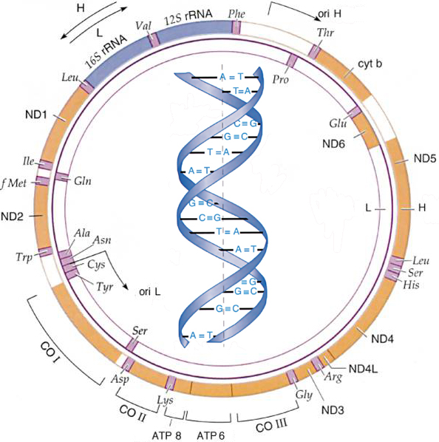
Complete mtDNA, used as a genetic marker of closeness when compared across populations, the mtDNA mutates, and these changes are compared. Similar results are seen with other biological indices (chromosomes, proteins, amino acids etc.).

Slide 16
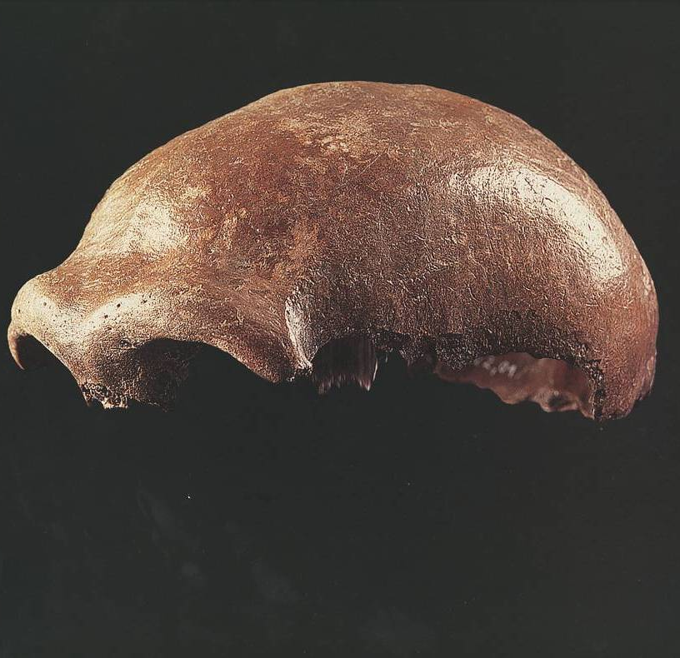
Briggs, A.W. et al., 2009
Dalton, R. 2006
Green, R. L. et al. 2006 and 2010
Krings, et al. 1997
Ovchinnokov 2000
The Neanderthal from the Neander Valley, the first to have usable DNA extracted.

Slide 17
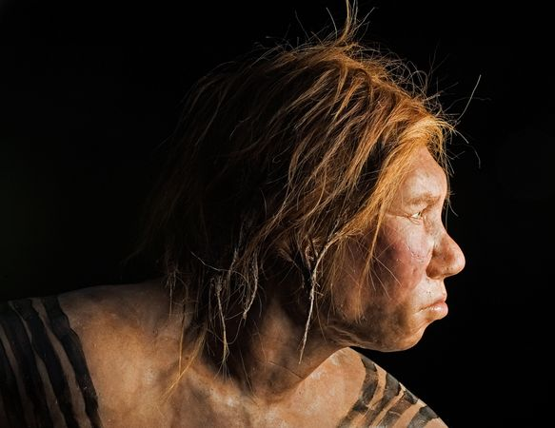
Neanderthal genomes
(What is a genome?)
Three female Neanderthals from Vindija Cave, Croatia.
Test group of modern people, including
one San from southern Africa,
one Yoruba from West Africa,
one Papua New Guinean,
one Han Chinese,
one French,
(representing Australasian, Asian and European populations today)
Green, R. L. et al. 2010 A Draft Sequence of the Neandertal Genome Science 328, 710

Slide 18
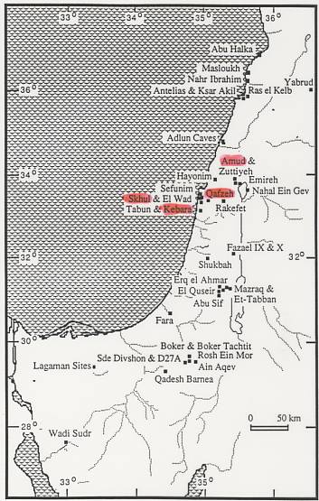
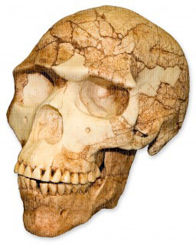
Is this where they did it?
Amud, left, and Schul 5 both from the Levant,

Slide 19
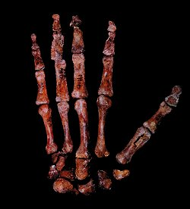
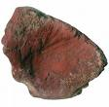
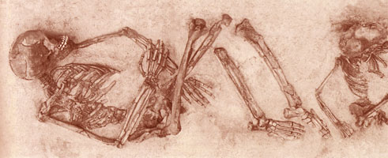
Ochre stained anatomically modern bones and rock from Qafzeh Cave, Israel. Early at 110,000 kyr.
Such graves still lack the quantity and quality of goods found in the later Upper Palaeolithic but the ’tradition’ starts here

Slide 20
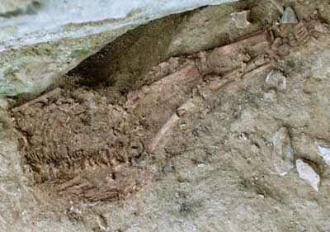
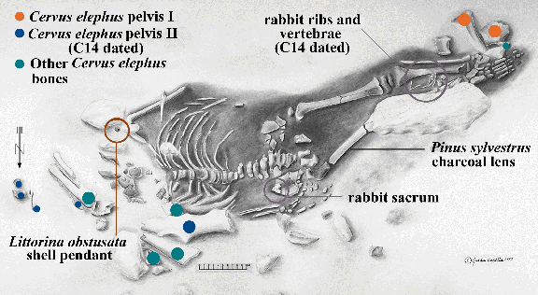
The Lapedo Child burial: Portugal, a possible hybrid or just adapted to the cold?
Notes:
20

Slide 21
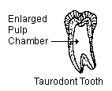
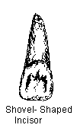
Retention of teeth types in modern populations: Evidence of continuity or adaptation?
Taurodont teeth are found in modern Inuit populations and Neanderthals
Shovel shape incisors in modern Asian populations and Homo erectus, continuity or adaptation?
http://www.uic.edu/classes/orla/orla312/VariationInToothMorphology.htm
Notes:
21

Slide 22
Conclusions:
This is not a new quest,
Each generation uses whatever ‘data’ it has to address the debate
Even if this is the case (e.g. the San are the oldest) what material difference does this or should this knowledge make (to us e.g. to them – are they less likely to be thrown off the reservation?)
What is the relationship of this ‘biological’ origin compared to cultural origins (for example, can we say Chimps have no similar recent genetic affinity with us therefore they cannot be seen to be cultural like us – even though they make stone tools - and reject their material and social culture?)

