Slide 1
An Introduction to the Dead Sea Scrolls
Judaism: Texts and Traditions
Week 6
Dr Jessica Keady
j.keady@uwtsd.ac.uk

Slide 2
The Text of the Hebrew Bible
The Books of the Hebrew Bible date from (very roughly):
1,000 BCE – 164 BCE
They therefore span nearly 1,000 years
Multiple dates, multiple authors, and multiple contexts
There are no original manuscripts, only later copies and translations

Slide 3
The Text of the Hebrew Bible
Before 1947, there were two main sources for the text of the Hebrew Bible:
(1) The Masoretic Text (MT)
Language - Hebrew
Earliest surviving text: 10th and 11th centuries CE
            (2) The Septuagint (LXX)
              Language – Greek
              Earliest surviving text: 4th and 5th centuries CE

Slide 4
The Dead Sea Scrolls
Then 71 year ago, everything changed …
1947 – Discovery of the Dead Sea Scrolls
Some 900 documents
Multiple copies of the biblical texts from ca. 200 BCE to 70 CE
They were around 500 years earlier than the surviving Greek Septuagint copies and over 1000 years earlier than the Hebrew copies

Slide 5
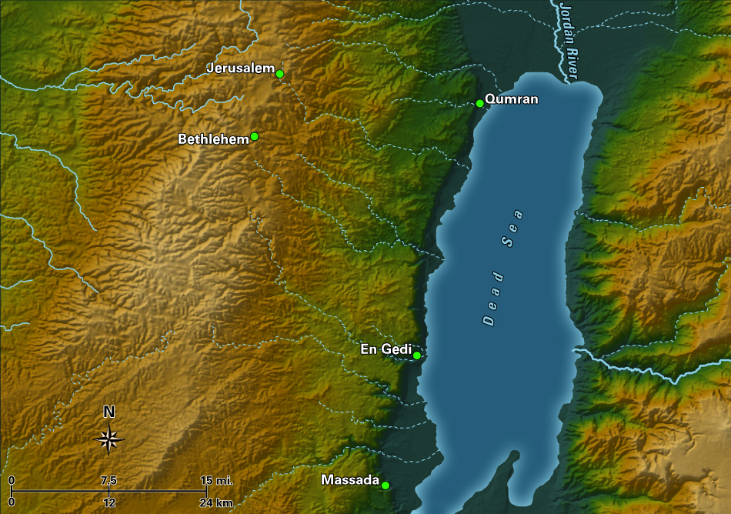
The Discovery of the Scrolls
What are the Dead Sea Scrolls (DSS)?
- 2,000 year old texts found around 70 years ago in 11 Caves near the ruins of Qumran (North-western shore of the DSS)

Slide 6
The Discovery of the Scrolls

Slide 7
NATURAL CAVES
Caves
1, 2, 3, 6, & 11

Slide 8
MANMADE CAVES
Caves
4, 5, 7, 8, 9, & 10

Slide 9
Khirbet Qumran

Slide 11
Pantry

Slide 12
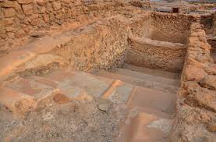
Ritual Purity (mikveh)

Slide 13
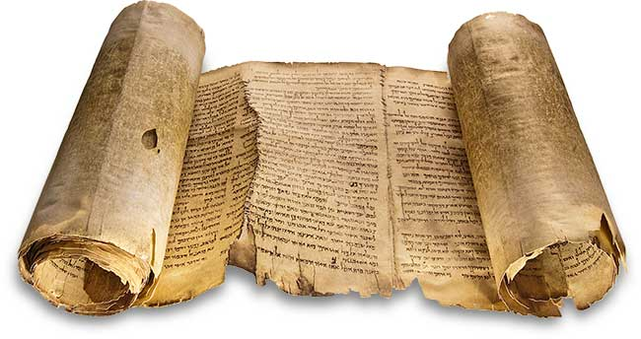
The Great Isaiah Scroll (1QIsa))

Slide 14
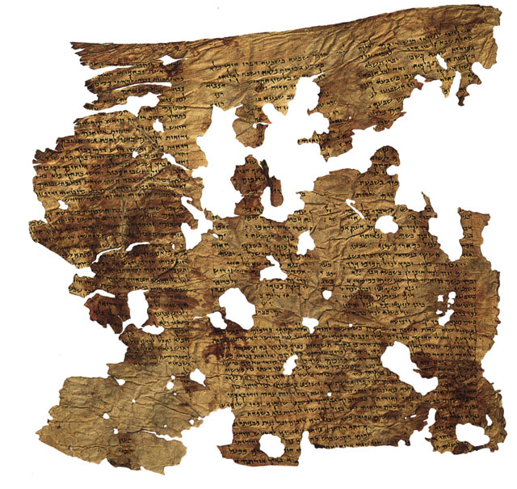
The Enoch Scroll (4Q201)

Slide 15
Diversity in Second Temple Judaism
Diversity is the result of responses to Hellenism and foreign domination.
Josephus mentions four groups:
The Pharisees
The Sadducees
The Essenes
The ‘Fourth Philosophy’

Slide 16
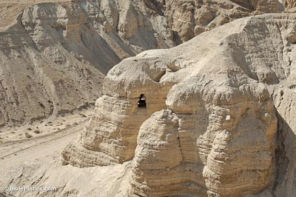
The Essenes and the Dead Sea Scrolls
Emphasis on purity and purification
Sense of separation from communities
Sharing of property
Strict observance of the Sabbath

Slide 17
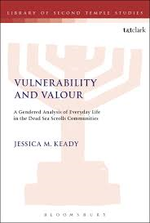

Slide 18
Sectarian Texts
The Community Rule (1QS)

Slide 19
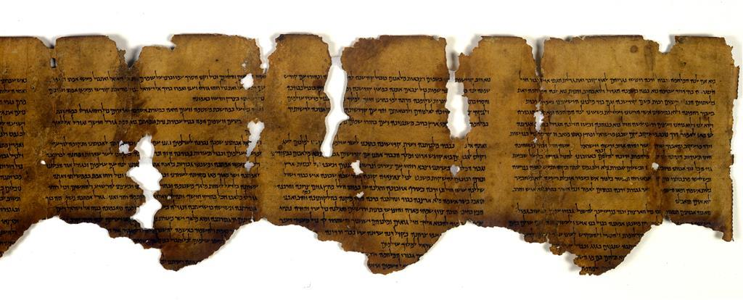
War Texts
The War Scroll (1QM)

Slide 20
Reconstruction and Publication

Slide 21
Fragmentary Damage to the Scrolls

Slide 22
4Q265 frag. 1 lines 11 – 17
‘In the first week [Adam was created but he had no holiness un]til he was brought to the Garden of Eden. And a bone from his bones was taken for the woman, but she had no holiness until she was brought to him in the Garden of Eden after eighty days because the Garden of Eden is holy and every growing thing in its midst is h[oly. Therefore a woman who] bears a male child she shall be unclean for seven days; as at the time of her menstruation she shall be unclean. And she shall remain for thirty-three days in the blood of her purification. And if she bears a female child, then she shall be unclean for two weeks, as in her menstruation; and for sixty-six days she shall remain in the blood of her purification. [No holy thing shall she t]ouch, not come into the sanctuary, until the days of her purification are completed.’

Slide 23
4QMiscellaneous Rules (4Q265)
http://www.deadseascrolls.org.il/explore-the-archive/manuscript/4Q265-1?locale=en_US

Slide 24
4Q274 frag.1 lines 1-9
Let him not begin to present his supplication. He shall lie down on a bed of sorrow, and in a seat of sighing he shall sit. He shall sit apart from all those who are unclean and at a distance of twelve cubits from the purity when he speaks to them … Anyone of the unclean who touches him, shall bathe in water and wash his clothes and then he may eat. For as it says, “Unclean, unclean, shall he cry all the days which he has the affliction” (Lev. 13:45-46). And she who has a flow of blood, for seven days let her not touch the man who has a discharge or any vessel that he touches or that he has lain upon or sat upon. And if she has touched anything, she shall wash her clothes and bathe and then she may eat. She must make every effort not to mingle during her seven days that she might not defile the camps of the holy ones of Israel. Nor may she touch any woman who has had a discharge of blood lasting many days. And the one who is counting (the seven days), whether male or female, may not touch one who has an unclean flow or a menstruating woman during her impurity, unless she was purified from her impurity. For behold, the blood of menstruation is considered as a discharge and that which touches it. And if a man has a flow of semen, contact with him is defiling. A [man who to]uches any one of these unclean people during the seven days of [his] impurity, let him not eat; just as [if he had] been defiled by a human corpse and he shall bathe and wash …

Slide 25
4QTohorot A (4Q274)
http://www.deadseascrolls.org.il/explore-the-archive/manuscript/4Q274-1?locale=en_US

Slide 26
Check In – Essays

