Slide 1
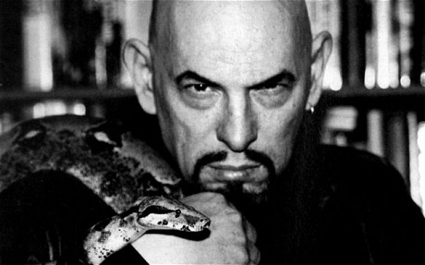
!
Religious Satanism

Slide 2
Religious Satanism
Satanic New Religious Movements (NRMs)
Satan as a principle
Satan as a deity
“Satanism does not have a single well-defined meaning” (Lewis, 2002) and ‘there is … a confusing diversity of different forms of Satanism”.

Slide 3
The Satan of Satanism is pre-Christian and comes “from the Pagan image of power, virility, sexuality, and sensuality” (Lewis, 2002, 641), as a “force of nature, not a living quasi-deity”.
But
Barrett (1998, 167) says that Satanism is “effectively an offshoot of Christianity”

Slide 4
Types of ‘Satanists’
Barrett (1998, 168):
Teenagers inspired by heavy metal bands and occult novels.
Paedophiles who may dress up in a certain way to instil more fear in their victims or to increase the “fun” factor of what they are doing. “Such people are not Satanists, though they might actually practise more genuine evil than those who really are”.
People who are interested in the esoteric and who equate Satanism with the search for knowledge. “But they are not truly Satanists either, in the sense of worshipping the force of evil”.
Those “who proudly and openly take the name of Satanists, and who have created their own Satanist religion”, eg the Church of Satan. LaVey’s aim was “to make carnal desires a proper object of celebration” (Barrett, 168).
Lewis (2002, 641) - “satanic dabblers”, rebellious teenagers or young adults who have created “idiosyncratic religious syncreticism…”.
Solitary Satanists

Slide 5
How do we Learn about Satanism?
From the media (news and entertainment)
From conservative Christianity
From ‘the abused’

Slide 6
The Media
News media
Entertainment media
Hugh Urban (2015, 191): whereas there aren’t that many people influenced enough by Satanism to make membership of Satanic groups all that significant, ‘… its influence on modern popular culture has been significantly greater’.

Slide 7
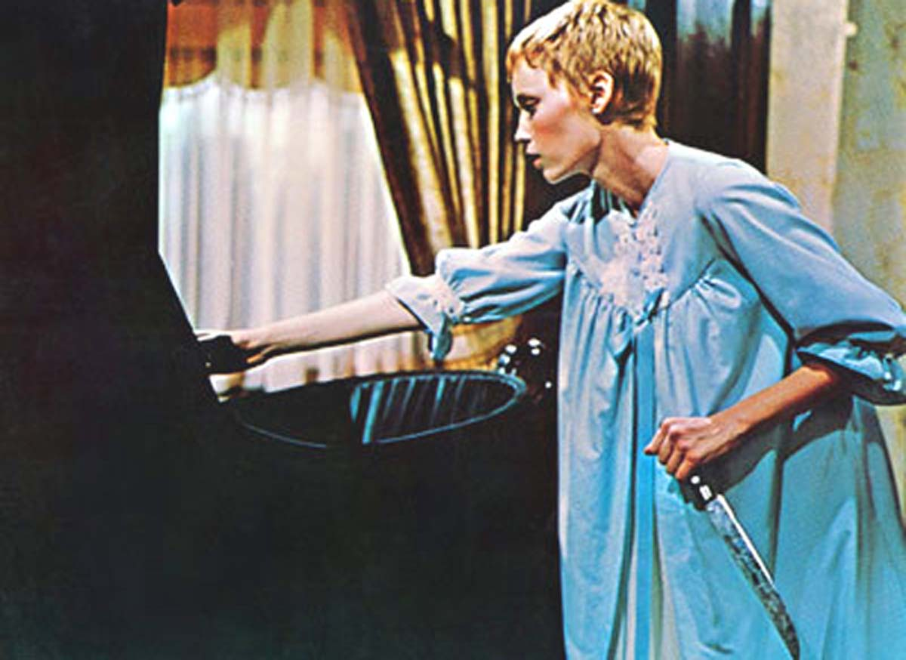
Satan in Hollywood
1915 – The Devil’s Darling
1930s and 1940s - Hammer House of Horror
1968 – The Devil Rides Out
1968 Roman Polansky Rosemary’s Baby
1973 The Exorcist
1976 The Omen
(Urban, 2015, 191)

Slide 8
In Hugh Urban’s book New Age, Neopagan and New Religious Movements his chapter on The Church of Satan and the Temple of Set is subtitled ‘Religious Parody and Satanic Panic’.
Performance, theatrical, organ music
Urban (2015, 186): ‘Clearly, much of this ritual is aimed at an explicit exaggerated, even ridiculous inversion of the Catholic mass. LaVey himself more or less acknowledged as much, suggesting that the early Church of Satan had to use such extreme displays of Christian inversion in order to awaken the American public and make itself known to the world’.

Slide 9

Urban: 30 April 1966 - ‘Anton Szandor LaVey shaved his head and proclaimed the formation of the Church of Satan (CoS). Declaring this “Year One, Anno Satanis” LaVey quickly generated a great deal of media attention by performing the first Satanic wedding in 1967 and then enacting the first modern “black masses” in the basement of his Victorian San Francisco home, called the Black House’.
Rituals, but not ‘to control and subdue followers’ but to empower (Urban, 2015, 185)

Slide 10
Urban (2015, 179) ‘LaVey often walked a fine line between serious religion and comical satire, exploiting the power of performance art as much as the power of occult philosophy and magic’.

Slide 11
So, LaVey used the media then the media ran away with Satanism. They:
‘added a new twist to the theme of performance and spectacle that runs through modern Satanism from the late 1960s onwards. While the early Church of Satan had made a point of performing shocking and provocative ritual spectacles such as the black mass, the American media of the 1980s made a spectacle of their own, by sensationalizing and exaggerating the power of Satanism in the modern world’ (Urban, (2015, 197).

Slide 12
“Careless journalists” who lump together paganism, Satanism and others “haven’t done their homework – or, if they have, have decided not to let the facts get in the way of a good story” (Barrett, 1998, 163). He goes on to say that some fundamentalist Christians do the same – if something isn’t of God it must be of the Devil.

Slide 13
Conservative Christianity
Barrett (1998, 168) quotes Melton (1992, 109) stating that almost all we know about Satanism has been told to us by Christians: “Though none had ever seen a Satanist ritual or met a real Satanist, these Christian writers described their practices in great detail. That is to say, the Satanist tradition was created and sustained by generation after generation of anti-Satanist writers”.

Slide 14
‘The Abused’
1980s and 1990s – Satanic Panic
Satanic Ritual Abuse

Slide 15
Why Satan?
Petersen (2005, 424) “Questions abound: Why Satan – is he not an evil fiend? Why give up morality – wouldn’t we just kill each other? What’s the fun of being black-hearted, selfish, cruel, bloodthirsty, and malevolent? My point is that behind the modern-day relativism and rationality of Western society an instinctive morality built on absolute and very Christian elements provoke us into stereotyping Satanism and Satanists as at worst inherently and radically evil or at best shallow and absurd. This popular discourse about Satanism thus propagates specific understandings tied to the underlying Christian frame of reference, with clear-cut boxes delimiting good and evil; it is clear that Satan, Satanists, and Satanism belong to the latter category, whether it is real of just an act”.

Slide 16
And “In fact, most Satanists and Satanic groups I have encountered are not interested in evil, either in essence or action. They doubt that the Christian moral framework that permeates Western society is doing much good; many Satanists actually consider Christianity or even all organized religion the true evil. Most seriously committed modern Satanists are deeply engaged in moral questions, and consider themselves free thinkers probing the boundaries of nature and culture because we as human beings, can and should indulge in our mental, emotional, and physical abilities. They are also very human. As such, Satanic groups are composed of ordinary people interested in religious and philosophical matters, not evil monsters or ignorant simpletons. It is important to bracket the Christian worldview and rid ourselves of the instinctive categorization that underlies the popular understanding of Satanism if we are to understand the people involved” (Petersen, 2005, 424).

Slide 17
Modern Satanism is a “somewhat darker manifestation of the aspirations of modernity, to be sure, but not inherently evil”. Petersen (2005, 433) says that Satanism “repeatedly reorients itself along a scale of respectability and outrage, thus continually emphasizing the nonconformist attitude that is at odds with Western society while basically affirming a secular, scientific, and even capitalist ethos of rationality”.

Slide 18
Religious Satanism – principle or deity
It’s not about worshipping what Christianity deems evil, but it is a form of “humanistic atheism”, with Satan symbolising “rebellion against unjust and corrupt authority”. Differs from other forms of atheism as it believes in forces and in magick (Lewis, 2002, 214).

Slide 19
Characteristics of modern Satanism (Petersen, 2005, 424):
Rational Satanists: The meeting between modern rationality and Western esotericism, so a cousin to New Age and the Human Potential Movement.

Slide 20
“Satanism is a combination of positive religious and philosophical aspirations centered on the individual with negative and critical anti-authoritarian convictions” (Petersen, 425).
So, ‘rational Satanism’ is a “…defiance against common norms and rigid dogma” (Petersen, 2005, 425).

Slide 21
Influences from Psychology on the Self-religions
SIGMUND FREUD
The tripartite mind:
Conscious – that of which we are aware
Preconscious – what we can bring into our conscious
Unconscious – the repressed. Influences us negatively
Maturity - integration of the contents of the unconscious mind into the conscious mind.
KARL JUNG
The conscious - the “persona” or “mask”; that which is presented to society.
The personal unconscious - “the shadow”.
When the unconscious and conscious minds are integrated, we achieve “individuation”.
WILHELM REICH
Repression of emotional and sexual instincts could lead to ‘blockages’ resulting in what he termed ‘character armour’ and ‘body armour’. These could lead to illness.
The aim was to break through and break down each type of armour.
Psychological, biological, social, political.
GEORGE GURDJIEFF
Two main states of consciousness: awake and asleep, but most people exist in the middle, even in their awakened state, and are free only to carry out orders. ‘Objective consciousness' - 'enlightened state' - 'real and unchanging ''I'' - to ''act'' not 'react'.
‘hierarchy of needs’.

Slide 22
Esoteric Satanists
Satan as a deity
Mystical
Magick
Ritual
Ancient writings

Slide 23
Phases of Religious Satanism
Petersen (2005)
1966-1975, organized Satanism emerging out of the occult subculture. Time of the counterculture. CoS founded in 1966. Media attention, theatrical, responded with dramatic actions including a Satanic wedding and baptism, “carnivalesque showmanship of LaVey” (Petersen, 428). Membership grew. Published The Satanic Bible, “the most influential Satanic manifesto to date…” (Petersen, 428). Countercultural success. But internal conflict and routinization from 1970-1975. LaVey did not like the structure and wanted to create local grottoes so that different groups could have more freedom.
1975-1995: Schism – Temple of Set – Michael Aquino. Temple of Set wanted theism not atheism. Satanic Panic.
1995: internet. Sharing of ideas but also allowed individual satanists to recruit to their particular way. More groups calling themselves Satanists. Virtual Satanism. 1997 LaVey died. Brief internal problems then leadership stabilised.

Slide 24
Satanic Traditions
Two main traditions:
The Church of Satan – LaVeyan
The Temple of Set – Setian

Slide 25
The Church of Satan as an NRM
1960s counterculture (1966)
California
Charismatic leader - Anton Szandor LaVey (Howard Levy) (1930-1999)
The Satanic Bible
Upper-middle class converts
Routinization, rebellion, tension, schisms, controversy, anti-cult movement
World rejecting but not as Roy Wallis meant it – world affirming / world-embracing
Atheistic, humanistic, self religion

Slide 26
Church of Satan
Urban (2015, 181): ‘Like the biographies of other new religious leaders, LaVey’s life stody is a complex misture of history, embellishment, and sometimes fantastic elaboration’.
And
‘LaVey’s Satanic worldview is founded on a complete rejection of all existing religious and moral systems, which are in his view bankrupt, hypocritical, and irrelevant. His own new crewed is based on the fundamental acceptance that all religions are human creations, that all moral codes are relative, and that we may as well create a new religion that we can enjoy rather than feel guilty about’.

Slide 27
‘LaVey’s philosophy is perhaps best described as a kind of radical materialism and hedonistic individualism that celebrates the human body, ego, and sensual pleasure’ (Urban, 2015, 183).
And
‘The main point for LaVey is that Satanism does not mean the worship of some actual deity named Satan who is the opposite of some imagined God. Rather, it is the rejection of all gods altogether and the worship of one’s own individual self. Here Satan – literally “the adversary” – is merely the symbol of the individual human ego, with all its desires and passions, which should be embraced, not repressed’.

Slide 28
Lewis (2005)
Satan in his original pre-Christian form is respected, usually as a principle rather than as a deity
Major emphasis is paced on the power and authority of the individual satanist, rather than on a god of goddess.
The accept that “no redeemer liveth” – that each person is his [sic] own redeemer, fully responsible for his [sic] own life.
Satanism respects and exalts life. Children and animals are thus not abused or killed.
Those satanists who believe in Satan or Set as a living entity do not worship or demonstrate their faith in him (as, for example, Christians worship and pray to God).
Religious satanists believe that one should live out her [sic] lusts and desires and enthusiastically explore the “seven deadly sins” with consenting adults.
They follow many beliefs, practices, and rules of behavior which are in conflict with traditional Christianity, and essentially with all other religions
Uniqueness and creativity are encouraged

Slide 29
Satanism contains “…some very attractive attributes. For example, because traditional Christianity has been so anti-sensual, Satan became associated with sex. The Christian tradition has also condemned pride, vengefulness, and avarice and, when allied with the status quo, has promoted conformity and obedience”. And “LeVeyan Satanism celebrates such ‘vices’ as virtues and identifies them as the core of what Satanism is really about” (Lewis, 2005, 107).

Slide 30
Urban notes (2015, 179) that more movements emerged out of the CoS and ‘moved in a more radical direction, usually called the “Left Hand path” – he names these as the Temple of Set (ToS) and the Setian Liberation Movement

Slide 31
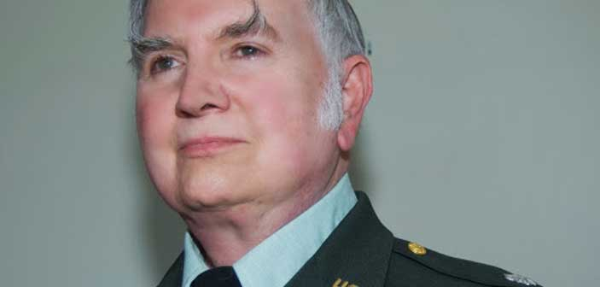
Temple of Set
Michael Aquino 1975
Deity – Set – Egyptian god
Set is seen “as the dispenser of a higher, nonnatural intelligence which is available to selected individuals” (Lewis, 2002, 721).
LaVey – Anno Satanis
Aquino – Aeon of Set.

Slide 32
Webb, (1996, 1) states: “The Aeon of Set is created by the Word “Xeper”. Xeper is an Egyptian verb meaning “I have Come Into Being”. Xeper is the experience of an individual psyche becoming aware of its own existence and deciding to expand the evolve that existence through its own actions. Xeper has been experienced by anyone who has decided to seek personal development’.
‘The Left-hand Path is a quest to become an immortal, potent, and powerful Essence’ (Webb, 1996, 3) and ‘…meaning can only come from the individual’ (Webb, 1996, 5).

Slide 33

Other Satanic NRMs
Zeena LaVey - baptised into the Church of Satan as a child and high priestess from 1985-1990.
In 1990, she and her husband Nikolas Schreck left the Church ‘and began to explore other, more radical forms of Satanism’ (Urban, 2015, 188)

Slide 34
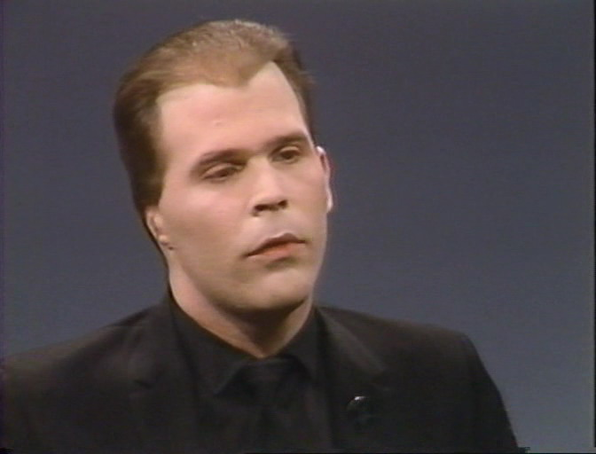
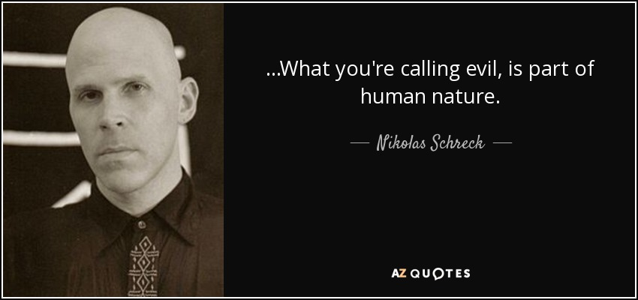
The Werewolf Order – werewolves and vampires – the next step in human evolution. Superhuman existence. ‘Werewolf uprising’ (Urban, 2015, 188)
Schreck controversial, not least for his support for ‘some of history’s greatest villains’, including Charles Manson (Urban, 2015, 190)
Sethian Liberation Movement (SLM) (Zeena LaVey and Nikolas Schreck) developing Temple of Set into more of a sexual focus – shock, breaking boundaries.

Slide 35
Bibliography
Barker, Eileen (1992) New Religious Movements: A Practical Introduction, London: HMSO.
Barrett, David, Sects, ‘Cults’ and Alternative Religions (London: Blandford, 1998).
Barrett, David V (2001) The New Believers: a survey of sects, cults, and alternative religions, London: Cassell.
LaVey, Anton Szandor The Satanic Bible, (New York: Avon, 1969).
Lewis, James R ed, Encyclopedia of Cults, Sects, and New Religions, (New York: Prometheus Books, 2002)
Lewis, James R., Legitimating New Religions (New Jersey: Rutgers University Press, 2003). http://www.religiousstudiesproject.com/podcast/who-joins-new-religious-movements-james-r-lewis-on-the-need-of-new-quantitative-data-on-nrms/
Melton, Gordon J Encyclopedic Handbook of Cults in America, Garland, 1992, p109, in Barrett, David, Sects, ‘Cults’ and Alternative Religions (London: Blandford, 1998).

Slide 36
Petersen, Jesper Aagaard, “Modern Satanism: Dark Doctrines and Black Flames”, in Lewis, James R and Jesper Aagaard Petersen eds, Controversial New Religions, (New York: Oxford University Press, 2005)
Petersen, J.A., (ed), Contemporary Religious Satanism: A Critical Anthology (Controversial New Religions Series. London: Ashgate, 2009)
Urban, Hugh B (2015) New Age, Neopagan, and New Religious Movements: Alternative Spirituality in Contemporary America: California: University of California Press. E-book.
Webb, Don The Eternal Word of Set, 1996, https://ia600204.us.archive.org/23/items/xeper-the-eternal-word-of-set/Xeper_-_The_Eternal_Word_of_Set.pdf

