Slide 1
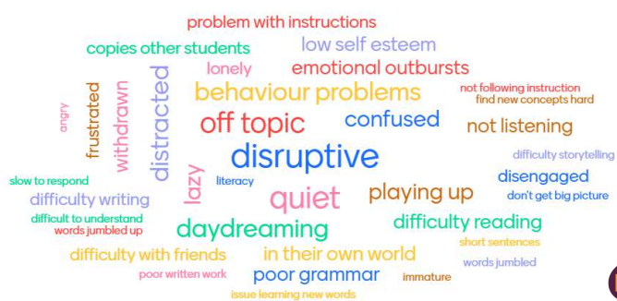
Speech, language and communication needs in early years and developmental language disorder
Speech, language, and communication needs is an umbrella term covering a range of challenges children might experience in their communication. This presentation will mainly focus on developmental language disorder and the challenges children and practitioners might experience (Public Health England, 2020).
Developmental language Disorder (DLD) and Diagnosis
Developmental language disorder (DLD) is a long-term language difficulty where a child might struggle with expressing and understanding language. It is a neurodevelopmental disorder like autism, and like autism, it is not a condition that a child will ‘grow out’ of DLD often co-occurs with other neurodevelopmental disorders, including ADHD, developmental coordination and speech sound disorders (NHS, 2024; Kirby and Clayton, 2018; Bishop et al. 2017).
Signs of DLD can be challenging to observe in early childhood as language is still developing and children develop at different rates; some children might use more gestures than verbal utterances, and some children may camouflage communication difficulties (Hobson and Lee, 2023). Due to limited expressive and receptive language skills, children with DLD might misinterpret social cues or struggle to negotiate with peers. (Speech and language, 2023).
Speech therapists can find Diagnosis in the early year’s problematic, and DLD is rarely diagnosed before the age of five as some communication difficulties present similarly to DLD (RADLD, 2019; NIDCD, 2022; The DLD Project, No date). Initially, a SENCO might suggest carrying out didactic and anecdotal observations and a baseline assessment or speech screening test for a child for practitioners with concerns (DfE, 2024a). Family and multi-agency partnerships are vital in gaining a holistic understanding of a child and their needs. The statutory progress check at 2 years may highlight developmental delays, and parents may raise concerns. This accumulative information supports a graduated response (Powell et al., 2021; Torbay Family Hub, No date).
Although SENCOs may not have the clinical expertise to diagnose specific communication needs, the graduated response enables them to review practice, enable the learning environments and provide evidence for referral if required (Speech and language, 2023. Torbay family hub, No date). Speech therapists can then carry out their assessments and collaborate with families and settings to improve a child’s communication skills, whether speech, language or combination (NAHT, 2020).
Source: Speech and language (2023)

Slide 2
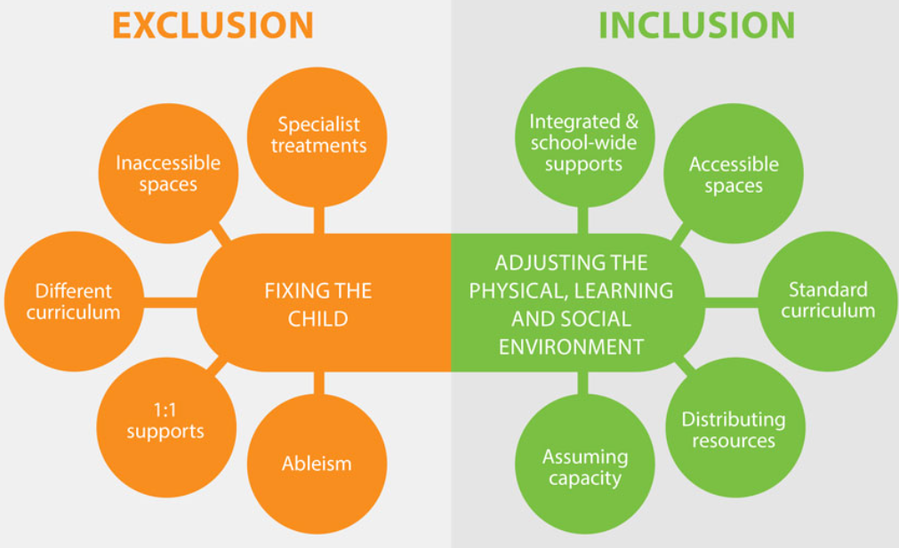
Challenges
The models of disability are often used to highlight different opinions of disability and can be a barrier when assessing support. The social model of disability examines how society organises itself to remove barriers and enable equity by changing attitudes towards disability and supporting choice and autonomy. In contrast, the medical model of disability emphasises how medical practice might ‘fix’ a disability, creating a deficit view and perpetuating low expectations (Hogan, 2019; Haegele and Hodge, 2016). McGregor (2020) found that when speech therapists suggested therapy based on needs rather than a medical model, they faced opposition from settings and parents favouring formal assessment. Practitioners must strike a balance between the models when supporting needs while simultaneously promoting inclusion and acknowledging the unique child (DfE, 2024a; NEU, 2022).
Communication is a barrier for children with DLD as they can struggle with social communication and interactions, impacting their learning, social development and well-being (NAHT, 2020). From a safeguarding perspective, children with communication needs may be more vulnerable to abuse or neglect than their peers because they are unable to communicate or understand what has or is happening to them; stresses on families of children with SEND can include poor mental health, stigma and prejudice, practitioners need to be alert to these risks too (Safeguarding network, 2024).
Strategy
Cunningham et al. (2023) suggests a blended approach to supporting language, for example, using scaffolding strategies during play. Bishop (2019) shares this opinion, stating that practitioners should take a more naturalistic approach when embedding interventions to support language difficulties.
A simple and effective strategy is modelling language in a child’s play; practitioners can model self-talk, parallel talk and expanding comments (DfE, 2021; NCSE, 2020). Vygotsky’s Zone of proximal development demonstrates this link between social interactions and gaps in a child’s knowledge and learning potential, demonstrated when modelling language in play (Pound, 2014). Narrating play supports a language-rich environment where children can learn new vocabulary in context but needs to be undertaken sensitively to avoid overwhelm; a guiding rule is four comments to one question (DfE,2021; McCandless, 2023; HSE Ireland, 2024).
This ‘bottom-up’ approach consolidates foundational skills of developing language through listening and attention (NHS, 2022). Like Maslow’s Hierarchy of Needs, if these foundation needs are not met a child will fail to flourish (Pound, 2014).
Source: Reasonable adjustments in schools (No date).

Slide 3
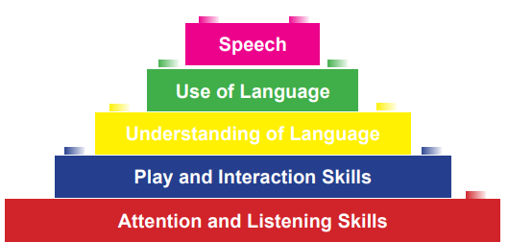
Inclusion
Bronfenbrenner ecological systems theory, as cited in Asmussen et al. (2016), can have many applications, including identifying risk factors such as poverty’s impact on the ecological cycles. As a result, Bronfenbrenner’s theory and academic research have influenced multiple early childhood intervention strategies. Guralnick (2019) posits that developments in professional training, legislation and policy initiatives have also come together with the hope of benefiting children and families. However, some interventions can seclude rather than include children (Reasonable adjustments in schools, No date).
Powell et al. (2021) assert that settings need to have regard to their legal duties, particularly SENCOs. Special Educational Needs and Disability guidance are covered by Section 19 of the Children and Families Act (2014) and Chapter 6 of the SEND Code of Practice (2015) and is enshrined within the Equality Act (2010), particularly Section 20. The SEND Code of Practice categorises pupils by four primary areas of need, one of which is communication and interaction; with this in mind, practitioners are both accountable and responsible for the progress and development of all children in their cohort, including how children access support (DfE, 2024b).
Conclusion
Increasingly, settings are facing challenges, accessing specialist support and funding constraints, and approximately 50% of children from areas of high deprivation will start settings with communication needs (UK Parliament, 2023: RCSLT, 2024). RCSLT (2024) posits that demand for services outstrips capacity 4 times over in some parts of the UK. Furthermore, a recent study comparing data from pre-pandemic infants and those born during the COVID-19 pandemic found that the pandemic had negatively impacted language development with long-term effects for some children (Pejovic et al. 2024).
Norbury et al. (2016) warn that if communication needs are not identified and supported in early childhood, there are possible long-term ramifications, including low educational attainment and cycles of risk, such as antisocial behaviour, impacting them and future generations (EIF, No date).
These statics and possible lifelong implications are a stark reminder of why supporting all children in early childhood is vital for their future outcomes.
Pandora Oates (2317746)
Module No: ECEY6006_BIRM
Word Count (1095)
Date: 11/05/25
Source: NHS (2022) Building Blocks of Communication Development

