Slide 1

Component 2: Practical:Individual Presentation
Student Name: Alin Florin Carare
Student Number:2246440
International Bussines Communication
Module Code LCBB 6001
Module Lecturer: Samson Oladejo

Slide 2
Outline of the Presentation
It presents the cross-cultural negotiation situation between Dyson Ltd and Haier Group.
This presentation explains and defines culture and its applicability in global business environments..
It uses an intercultural communication theory that examines the rules of cultural interactions.
It indicates the big cultural contrasts between Chinese and UK business activities.
It presents strategies for negotiating and the importance of ensuring cultural awareness.
Notes:
This section will define the purpose of the presentation, which will be to discuss the issues and tactics of negotiating across cultures between a UK and Chinese company. The sections develop cumulatively to the approach a business should take with regard to culture.

Slide 3
Defining Culture and Its Elements
Culture is a set of combined values which consists of values, beliefs, language and behaviours through which social interaction occurs.
It has a direct impact on the way people communicate, the positions of authority, and how people prefer to negotiate (Gunia et al, 2016).
The implications of high-context (China) culture relative to low-context (UK) message interpretation. High-context culture(China) vs. low-context culture(UK)
The orientations toward time are also not the same; China is polychronic and relationship-oriented; the UK is monochronic and task-based
Power distance and uncertainty avoidance are cultural dimensions that determine business expectations.
Notes:
The section provides how culture defines communication and negotiation. The section will emphasise the impact of the differences in various cultural aspects, such as time perception, authority structures in business transactions between the British and the Chinese organisations (Fengfan, 2015).

Slide 4


Relevance of Culture in Business Communication
Cultural differences need to be understood to ensure the avoidance of miscommunication and conflict in global business.
In different countries, business etiquette, tone, hierarchy and ways of reaching decisions vary remarkably.
Directness in the UK can be deemed as professional, whereas in China, it may be seen as disrespectful.
Chinese culture emphasises non-expediency and the development of relationships over time as opposed to expediency dealings and transactions (Hofstede et al, 2019).
Lacking cultural sensitivity, Dyson can create an issue of mistrust and undermine the possible collaboration with Haier.
Notes:
The section will give a justification for why culture must be addressed as a strategic issue in international business. The negotiations might fail when not considering Chinese culture or business expectations, and doing so might influence the image and success of Dyson in the Asian market.

Slide 5
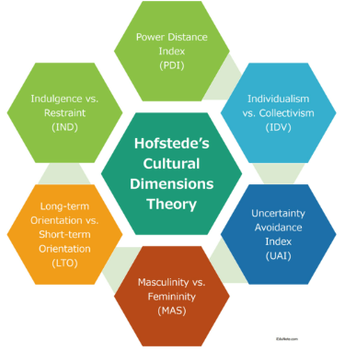
Intercultural Communication Theory – Hofstede’s Dimensions
The Cultural Dimensions Theory developed by Hofstede offers a framework for analysing the effects of national cultures on behaviours at work, which are in relation to leadership, communicative behaviours and preferred negotiation styles among others (Hou et al, 2023). It assists foreign companies such as Dyson to realise and adjust cultural expectations.
Power distance is one of the key dimensions. China ranks high on this, and it implies that there is a lot of respect for the authority and hierarchy. The seniors usually make decisions and respect to rank is within the norm. By contrast, the UK is less of a score, and a flatter organisational structure and informal organisation are preferred (Gunia et al, 2016). This implies that we have to deal with the Chinese partners officially and be given respect for our position and titles.
The dimension, individualism vs collectivism, indicates that the UK believes in independence and expressing oneself, whereas China focuses on group harmony, loyalty and concurrence (Fengfan, 2015). The British teams could be more aggressive in negotiations and emphasise the responsibility on an individual level, whereas the Chinese ones would be interested in the group impact and the group integrity of the decisions.
Notes:
This part presents a theory formulated by Hofstede as a scope of the national cultural comparison. This section will elucidate how Dyson will need to change its communication and planning style to be in tune with those of Haier by pointing out the differences between the UK and China in their hierarchy, decision-making, risk tolerance, and time focus. This mutual understanding makes the likelihood of respect and agreement in the negotiation process high.

Slide 6
Cultural Elements to Overcome in Chinese Business Negotiations
Respect for hierarchy in the Chinese business environment is critical; establishments are usually spearheaded by senior executives, and the junior members of the team give priority to their seniors when making decisions.
The Chinese prefer an indirect method of communication; partners might as well use hints, silence, gestures, or other means instead of using the word no; the representatives of the UK in business situations can be quite straightforward (Warter and Warter, 2015).
Chinese businesses are built on the concept of guanxi, personal relationships and trust developed; a formal meeting will usually follow an informal social meeting, like banquets or tea sessions.
Face is the notion of dignity and reputation of a person; direct criticism, contradiction or embarrassment can make one party lose face, and the relationship cannot be trusted further.
There is a more relaxed attitude towards time; UK firms might anticipate efficiency and quick decisions, whereas Chinese firms might deliberate longer and follow the long-term view and a sense of desiring to be patient (Gunia et al, 2016).
Notes:
The section will also highlight the importance of the need to respect the hierarchy and indirect communication, which strongly contradicts the British values of informality and direct communication. Guanxi is important- otherwise, nothing can move forward without trust. Maintaining of face is not confrontational, and slowness of lines cannot denote disengagement (Harkiolakis and Halkias, 2016). Being aware of these cultural norms also means that Dyson will not do anything to inadvertently endanger its relationship with Haier.

Slide 7
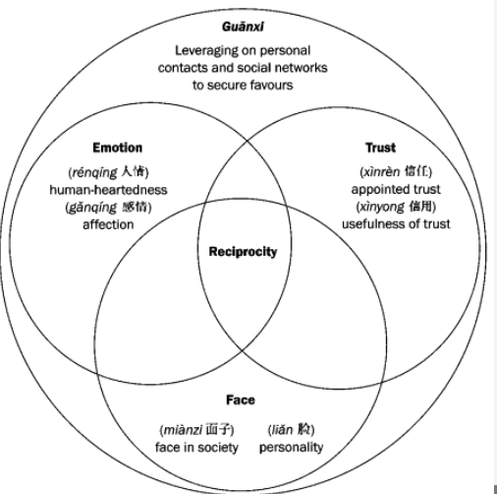
Additional Cultural Considerations
Chinese business culture dictates that gifts should be taken as a form of goodwill, but should not be in the form of fanciness, or it will be interpreted wrongly, though the gifts should be simple and within the cultural context of the other party.
Non-verbal language is as important as verbal one: tone, silence, gestures, and eye contact are very important; sometimes a non-verbal message is much weightier than words.
Under Chinese circumstances, a prolonged or too intensive eye contact can be taken as an invasion or an arrogant act, whereas in the UK, this is frequently a sign of self-assurance (Nosratabadi et al., 2020).
Cultural context alters meaning even in the English language; what is technically understood may sound different based on tone and the situation, as it depends on the intentions.
There are differences in every region in China, and Haier might have its own business activities that are not the same across the country.
Notes:
British directness can make such a mistake when ignoring Chinese manners. For instance, stating no directly or being humorous too freely can be unpleasant. Modesty and humility might serve well in the process of Chinese negotiation ( Harkiolakis and Halkias, 2016). Even the English language skills will not lead to the same interpretation. When negotiating with Haier, Dyson is supposed to be aware of regional and corporate differences.

Slide 8


Strategies for a Successful Negotiation
Dyson needs to include cultural education for all the teams before official meetings, such as etiquette, values, business structure, and Chinese negotiation practices, to prevent making any mistakes.
The relationship-building process should start with informal communication like eating together, visiting factories, or introducing each other, as a prerequisite for long-term collaboration.
Dyson, instead of emphasising short-term profit or deliverables alone, must propose a short-term common strategic plan that entails hassle-free mutual objectives and instead of longevity and loyalty, which is the focus of Haier.
The bargaining team must involve Chinese-speaking or culturally knowledgeable assistants to minimise mistranslation and demonstrate a desire to collaborate with other cultures (Holý and Evan, 2022).
Dyson is required to use a cooperative tone, which does not involve confrontation and displays tolerance to delays and the possibility of several meetings until an agreement is found.
Notes:
The speaker emphasises the following aspects of preparation and building relationships. Haier not only seek short-term profits but also invests in a long-term partnership. Inviting Chinese advisors is a sign of grave intentions. Through patience and cooperation, Dyson will earn more credibility and opportunities to succeed in terms of negotiations.

Slide 9


Importance of Cultural Awareness and Adaptability
Cultural awareness enables the leaders to foresee conflict and understand the behaviour properly, as well as being able to interact in a meaningful way.
It creates trust and empathy, prevents miscommunication and minimises unconscious bias in diverse working environments.
Flexibility enables the professional to react quickly to foreign conventions, cultural communication and values.
Dyson wants an international reputation, to minimise risk, and to make itself more ready to conduct business around the world.
Cultural competence has a direct influence on the long-term success of partnerships such as the one with Haier.
Notes:
This section has pointed out that cultural awareness is not a course on soft skills, but a basic strategic skill. It allows avoiding expensive errors and enhances a business relationship across the globe. Flexibility means that Dyson is in a position to modify its approach to negotiations without losing values.

Slide 10
Conclusion
To make cross-cultural negotiations successful, preparation, recognition of cultural differences and a long-term focused approach are necessary.
The dimensions presented by Hofstede reveal the main differences between the values of the UK and Chinese businesses.
Hierarchy, indirect communication and guanxi are important issues that Dyson needs to deal with to fit Haier's expectations.
An acceptable, long-term partnership approach will be patient, respectful, and cooperative.
Cultural intelligence enables Dyson to establish long-lasting relations and not merely strike deals.
Notes:
This presentation concludes by reiterating the point that such negotiation is not merely a business exercise; this is a journey of building a relationship. Cultural intelligence is the only key to Dyson in the future success in Asia. Such collaboration has the potential to become a global model when handled well.

Slide 11
References
Fengfan, M., 2015, November. Managing Cultural Differences in International Business Negotiations. In Proceedings of the 12Th International Conference on Innovation and (pp. 175-179).
Gunia, B.C., Brett, J.M. and Gelfand, M.J., 2016. The science of culture and negotiation. Current Opinion in Psychology, 8, pp.78-83.
Harkiolakis, N. and Halkias, D., 2016. E-negotiations: Networking and cross-cultural business transactions. Routledge.
Hou, M., 2023. Face and identity in intercultural conflict management. Journal of Intercultural Communication, 23(2), pp.88-96.
Holý, V. and Evan, T., 2022. The role of a nation’s culture in the country’s governance: Stochastic frontier analysis. Central European Journal of Operations Research, 30(2), pp.507-520.
Hofstede, G.J., Jonker, C.M., Verwaart, T. and Yorke-Smith, N., 2019. The lemon car game across cultures: evidence of relational rationality. Group Decision and Negotiation, 28, pp.849-877.
Nosratabadi, S., Bahrami, P., Palouzian, K. and Mosavi, A., 2020. Leader cultural intelligence and organisational performance. Cogent Business & Management, 7(1), p.1809310.
Warter, I.U.L.I.A.N. and Warter, L.I.V.I.U., 2015. Intercultural negotiation in mergers and acquisitions. The integration of the cultural dimension into the negotiation domain. Buletinul Institutului Politehnic din Iaşi, LXI, pp.73-86.

