Slide 1
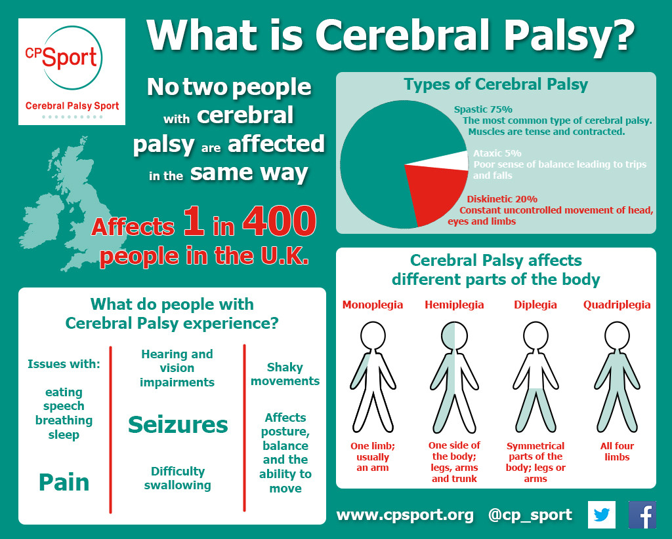
Cerebral Palsy:
advantages and disadvantages of Social and Medical Models
‘Cerebral Palsy (CP) is defined as motor impairment that limits activity, and is attributed to non-progressive disturbances during brain development in foetuses or infants. The motor disorders of Cerebral palsy are frequently accompanied by impaired cognition, communication, and sensory perception, behavioural abnormalities, seizure disorders, or a combination of these features (Aisen et al., 2011).’ The causes for CP are, infection in pregnancy, starvation of oxygen in the brain during birth, meningitis, bleed to the brain and if the baby's brain does not develop normally (NHS, 2017).
1
2
CP is long-life illness and affects 1 in 400 people in the UK (Cpsport, 2019)
The Medical Model fixes or treats the impairment
The Social Model listens to the person with the disability
(Cameron, 2014)
(Cameron, 2014)
Advantages of Medical Model
Advantages of Social Model
(Haegele and Hodge, 2016)
(Haegele and Hodge, 2016)
Disadvantages of Medical Model
Disadvantages of Social Model
(Haegele and Hodge, 2016)
(Haegele and Hodge, 2016)
LEGISLATION TO PROTECT PEOPLE FROM DISCRIMINATION
Section 20 Children and Families Act 2014
The Equality Act 2010 Protects People who have a disability
Special Educational Needs and Disability Code of Practice
(Equality Act 2010; Children and Families Act 2014; Nasen, 2014)

Slide 2
Reference List
Aisen, M. et al. (2011) "Cerebral palsy: clinical care and neurological rehabilitation", The Lancet Neurology, 10(9), pp. 844-852. doi: 10.1016/s1474-4422(11)70176-4.
Cameron, C. (2014) Disability Studies. 1st edn. London: SAGE Publications LTD, pp. 98-143.
Cpsport (2019) What is Cerebral Palsy? – Cerebral Palsy Sport, Cpsport.org. Available at: http://www.cpsport.org/resources/cerebral-palsy-key-facts-and-statistics/what-is-cerebral-palsy/ (Accessed: 12 May 2019).
Disability Rights UK (2012) The Equality Act and disabled people | Disability Rights UK, Disabilityrightsuk.org. Available at: https://www.disabilityrightsuk.org/equality-act-and-disabled-people (Accessed: 13 May 2019).
Haegele, J. and Hodge, S. (2016) Disability Discourse: Overview and Critiques of the Medical and Social Models, Taylor & Francis. Available at: https://www.tandfonline.com/doi/full/10.1080/00336297.2016.1143849?casa_token=sA2BGiqBvNMAAAAA:q5s6KDqP-Um-QJ-LnUKKWD6TOsOMtuHmTVdFfbKanA5idRM1BtCXXLG48FlygfcjvcRk_Jhdkp-n (Accessed: 13 May 2019).
Nasen (2014) The SEND Code of Practice: 0 to 25 years. Available at:
file:///C:/Users/GEO/AppData/Local/Packages/Microsoft.MicrosoftEdge_8wekyb3d8bbwe/TempState/Downloads/the_send_code_of_practice_0_to_25_years_-_mini_guide%20(1).pdf
(Accessed: 12May 2019)
NHS (2017) Cerebral palsy, nhs.uk. Available at: https://www.nhs.uk/conditions/cerebral-palsy/ (Accessed: 12 May 2019).
Children and Families Act 2014, C.20. Available at: http://www.legislation.gov.uk/ukpga/2014/6/section/20/enacted (Accessed 12 May 2019)
Image reference
Image 1 & 2
Cpsport (2019) What is Cerebral Palsy? – Cerebral Palsy Sport, Cpsport.org. Available at: http://www.cpsport.org/resources/cerebral-palsy-key-facts-and-statistics/what-is-cerebral-palsy/ (Accessed: 12 May 2019).

