Slide 1
Academic Skills
Main purposes, products and service offerings of Sainsburys PLC
Ion Alexe
Andrei Dragomir
Ana- Maria Popescu
Stefan Alexandru Dinca

Slide 2
Code of conduct
Integrity
We will act with integrity and avoid conflicts of interest.
Objectivity
We will ensure the timely and understandable disclosure of relevant information that is accurate, complete and objective.
Professionalism
We will act in a manner that demonstrates admirable professional conduct. We will work to improve the quality of our services and raise the professional standards in our project.
Confidentiality
We will not use confidential information acquired in the course of our work to our personal advantage.

Slide 3
Introduction
Founded in 1829 by John James and Mary Ann Sainsbury
Second-largest supermarket chain in UK
Conducts operation in more than 1400 locations in the UK
More than 117,000 employees are employed
Operates in Scotland, Ireland, Belfast, United States other than UK
Key offerings includes food items, general merchandise, clothing and financial services
Notes:
Notes
In the food retail commercial sectors, Sainsburys is considered as one of the big players that ranks second in the UK supermarket sectors. Through taking strategic and tactical actions, it has been able to expand its businesses and customers base in a significant way. Along with operating domestically, it conducts operation in the world market such as Scotland, Ireland, Unites States etc. The competitive offerings in different sectors such as food, general merchandise, clothing as well as banking are developed by Sainsburys to reach the customers through 117,000 employees (Sainsburys, 2022).

Slide 4
Industry Analysis
PESTEL Analysis
Forces | Impacts
Political | Brexit issues, Trade barriers
Economic | Rising in costs of fuel, salaries, fierce competition
Social and Cultural | Healthy eating and Fairtrade movement
Technological | New analytics and online shopping
Environmental | Carbon footprint and plastic waste
Legal | Equity law, consumers rights and social pressure group
Notes:
Notes
The macro-environmental factors affect any kind of organization in a significant way. Sainsburys is also affected by the macro-environmental forces such as political, economic, social and cultural, technological issues, environmental as well as legal issues which are uncontrollable. Sainsburys has been affected in a significant way by this factors in a several ways. Among the political factors, the Brexit issue is one of the major factors that affected the business because of changing trade barriers (Roheim, Gardiner, and Asch, 2017). The tax policies, tariff and non-tariff barriers etc affect the organization in a significant way. Several economic factors that affect the organization is rising costs of the materials, fuels, employee management costs, inflation rates. The Covid-19 pandemic has affected the spending power of the people which has also affected the organization. Among the socio cultural forces, the most dominant factor that affect the organization is the trends and demand of health conscious food as well as online shopping (Booth et al., 2011). Perhaps technology is affecting the organization as a result of expanding online operation and customers data management. The environmental factor also play a crucial role in terms of reducing damage to the environment. Legal issue also affect the organization.

Slide 5
Industry Analysis
Five Forces Model
Factors | Impact | Description
Suppliers Power | Low | Large number of suppliers for selecting -It is easy to bargain for Sainsburys as it has large scope as well as scale of operation
Customers Power | High | -Low Switching costs for customers and large numbers of options to buy products for customers -Sophisticated knowledge as well as price transparency
Threats from substitutes | High | -Large number of convenience, supermarkets and small stores pose a threat by offering products and low costs of doing business online
Threat of new entry | Low | -High entry barriers -The market is dominated by some large food service companies
Rivalry | High | Competition takes place over price, products as well as promotions -Saturated nature of market -Globalization and commoditization
Notes:
Notes
It is crucial to analyze the competitive spheres in an industry to sustain and gain sustainable competitive advantage. The Porters five force model assist to analyze the environment of the organization and identify the attractiveness of the industry (Samnani, 2014). Sainsburys operate in the retail food sector in which the suppliers power is considered low as large number of suppliers are available. Customers power is high as there are low switching costs and customers sophisticated knowledge increase brand switch (Hassan, and Parves, 2013). The threats from the substitutes are high as large number of new competitors are entering with new and improved products. The rivalry is high because of commoditization, globalization and low costs.

Slide 6
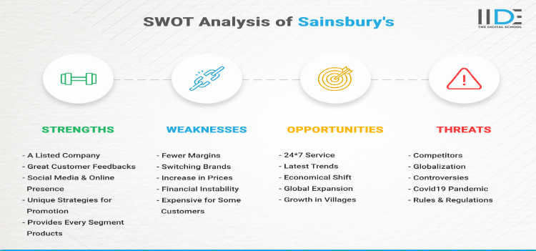
SWOT analysis of Sainsburys

Slide 7
Market analysis of Sainsburys
Segmentation
Dividing the markets in homogeneous groups based on similar characteristics
Segmentation variables used by Sainsburys are
Demographic (age, family lifecycle, income)
Psychographic
Geographic
Notes:
Notes
Segmentation, Targeting as well as Positioning is considered as the core strategy of marketing that help to identify the appropriate customer base to which the companies offers the products and services. Sainsburys also segments it the total market into some homogenous groups based on some characteristics such as demographic, psychographic as well as geographic variables to better identify to whom the products and services are marketed (IIDE. 2022).

Slide 8
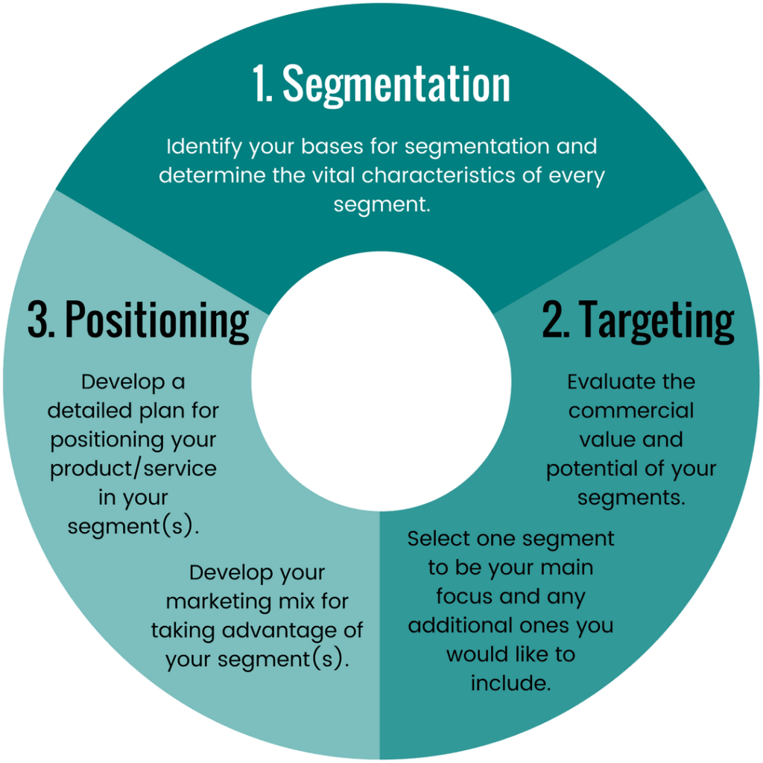
Market analysis of Sainsburys
Targeting and Positioning
Middle class people
Family unit especially women
Young people
Positioned based on quality convenience and value

Slide 9
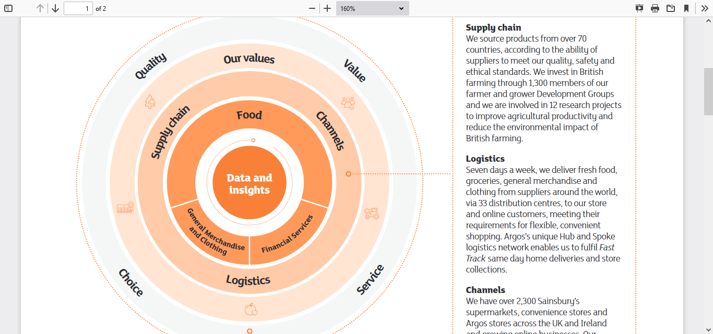
Business model and purposes of Sainsburys
Business model
A business model is an outline of how a company plans to make money with its product and customer base in a specific market
Notes:
Notes
A business model is a crucial map or blueprint of the activities and purposes which are needed to be accomplished in order to survive and make profit. Sainsburys has developed its business model based on some key factors such as quality, values, services, choices, channel, logistics, supply chain management.

Slide 10
Business model and purposes of Sainsburys
Quality
Value
Choice
Services
Supply chain & channel
Logistics
Maintain Ecellent Quality in productions and products epecially food products
Provides more vale for less prices
Wider varities of products to choice for customers
Employed more than 178,000 employees for serving customers
Ensure supply chain efficieny and focuses on innovate new channels to serve the customers
Logistics activities includes using advanced technologies

Slide 11
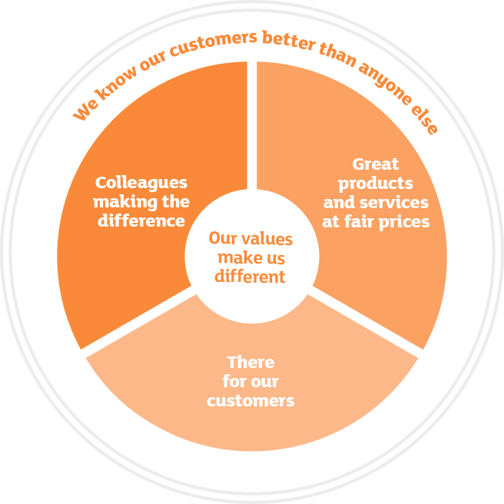
Business Strategies of Sainsburys
Five Pillars of business strategy are
1. Knowledge about customers
2. Great products and services at fair prices
3.There for our customers
4. Colleagues making difference
5. Organizational Values

Slide 12
Business Strategies of Sainsburys
Five Major Priorities
Priority 1
Priority 2
Priority 3
Priority 4
Priority 5
Differenciate food as well as grocery by increasing quality, value along with services
Growing the general merchandise as well as clothing items
Providing easy access to the financial services
Focusing on generate efficiency for investing digital business
Improving the balance sheet

Slide 13
Value proposition of Sainsburys for Customers
Customers Engagement
Grocery app offering searching, browsing, ordering and cancelling
Customers Loyalty
Nectar Card
Offer flexibility for customer
Sales promotions
Discounts

Slide 14
Value proposition of Sainsburys for Customers
Differentiation
Offering of new and improved product lines for customers such as gluten-free bakery products
Shopper mission and innovative channel
Adapt with the changing consumer trends
Capturing market share by increasing large customer base
Adapt with the trends of top-up shopping among young generation
New channel introduction
Quality products at low pieces for less affluent customers

Slide 15
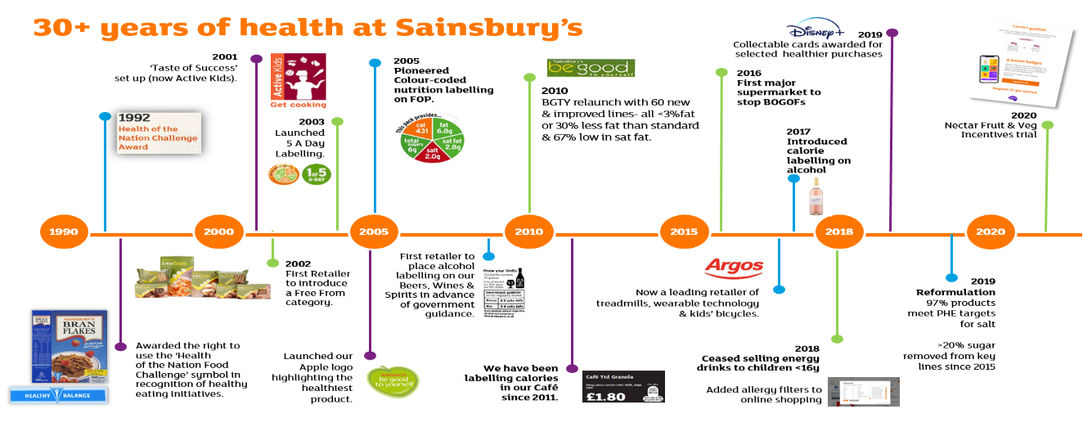
Analysis key strategies and market offerings of Sainsburys
Product mix Strategy
Notes:
Notes
Sainsburys has built its reputation through selling the quality products that attract the health conscious customers. Argos is considered as one of the pioneering brand for Sainsburys for selling the quality products. The journey of the company from 1990-2020 has been remarkable in terms of providing excellent food quality along with the digital services.

Slide 16
Analysis key strategies and market offerings of Sainsburys
Product mix strategy (Food and Non-food items)
Categories | Products
Fruits/vegetables | Fresh salad as well as vegetables along with fruits, Carb alternatives, frozen fruits along with the vegetables, different kinds of organic foods, prepared vegetables as well as foods, fresh materials along with the herbs etc.
Fish/meat | Pudding, items of just cooks, venison as well as duck, turkey, beef as well as lamb, seafood, fishes, bacon as well as chicken
Chiled | Halal and Kosher, desserts items, fruit juices, soup, sauces, pasties, garlic bread along with the pizza etc.
Dairy | Dough as well as pasty, custard, cream, cheese, eggs and milk etc.
Bakery | Cakes, naans, buns, breakfast bakery, bagels as well as rolls, bread etc.
Beer, wine as well as spirits | Sparkling wine as well as Champagne
Non-food items | Clothing, Financial services, electronics, beauty and health care, baby products etc

Slide 17
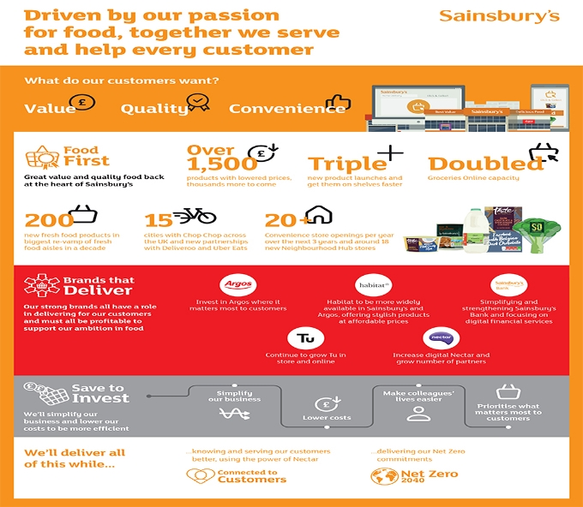
Analysis key strategies and market offerings of Sainsburys
Product mix strategy
New products and brands
Quality Control
HACCP (Hazard Analysis Critical Control Point)
Argos offer more than 60,000 products
Habit offers more than 4500 products operating 600 stores
Tu operates 400 stores offering 3000+ products
Sainsburys Bank offers financial services and has more than 1370 ATMs
Review and monitor the production process
Training and guidelines for employees

Slide 18
Analysis key strategies and market offerings of Sainsburys
Pricing mix strategy
Adapting the competitive prices pressures
Practice the policy of price discrimination
Set different prices for different markets
Offer low prices and quality products for customer retention
Follows the competitive pricing strategy

Slide 19
Analysis key strategies and market offerings of Sainsburys
Distribution strategy
Operates more than 2300 supermarkets and convenience stores including Argos
Operates more than 33 distribution centers
Use the hub and logistics systems of Argos
Sourcing from more than 70 countries
Investing in more than 1300 farming centers to source fresh ingredients

Slide 20
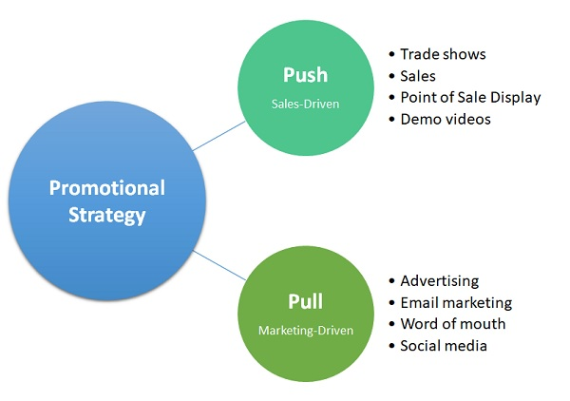
Analysis key strategies and market offerings of Sainsburys
Promotion strategy
Use of push and pull media
Use of ATL (Above the line) and BTL (Below the line) advertising strategy
Use of traditional and digital media channel such as Television, newspaper, radio, online advertising, PPC (pay per click) advertising, social media etc
Nectar Reward Card

Slide 21
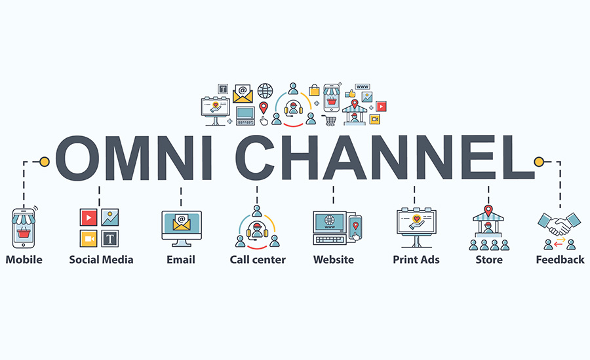
Digital operation and customers service management of Sainsburys
Omni channel
Sainsburys provides seamless customer experience through the omni-channel operation. Online and offline channel are integrated
Nectar App
Provides easy access to the rewards and sales promotion and increase customers experiences

Slide 22
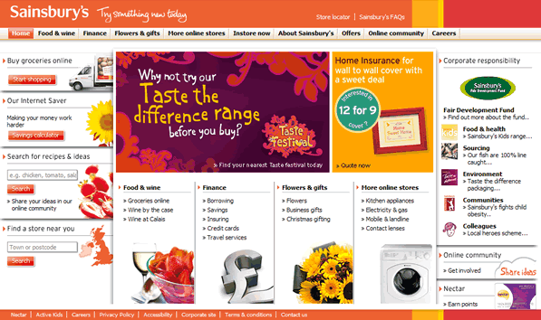
Digital operation and customers service management of Sainsburys
E-commerce website
User friend-and easy
Web browsing experiences
Details of the products
Quality contents
Multiband digital transformation
Usage of customers insights
One stop and single customers experiences
Integrated team of the Habitat, TU and Argos

Slide 23
Operation in Covid-19 pandemic
Closing down the Argos stores and shifting to online operation
1
Impacts of Covid-19 on Sainsburys
2
Increased costs and reduced profits at the bgaining of the pandemic
Changing the slogan from ‘ Live well for Less’ to ‘Helping everyone eat better’
3
4
Significant grwoth in online operation and invest in new technology

Slide 24
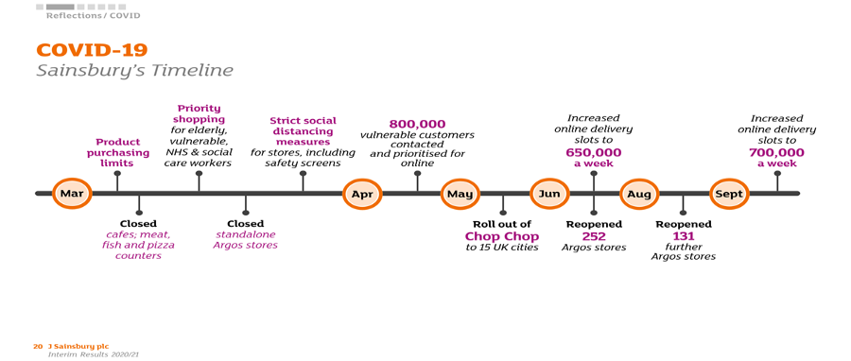
Operation in Covid-19 pandemic

Slide 25
Recommendation
For Improving the products and services of Sainsburys, some strategies can be followed such as
Continuously monitoring the changes in customers preferences and choices
Scanning the micro and macro environment to identify, anticipate and satisfy customers
Continuous value innovation in products to fit specific consumption situation should be monitored
Continues investment in technology

Slide 26
Conclusion
Technological innovation provides the sustainable competitive advantage
Customers should be the centrality of all activities of an organization
Continues products and service innovation bring success for food retailers
Notes:
Notes
For being successful in todays marketplace three key issues are needed to be incorporated in the business such as continuous value innovation to identify and serve the new needs of the customers (Goswami, and Chouhan, 2021). Customer focus is the major key for the success as power and sophisticated knowledge of the customers are increasing day by day. And lastly, the continuous innovation requires more investment in technology which can being sustainable competitive advantage for the companies.

Slide 27
References
Sharma, R., Majumdar, S., Khattri, T., Singh, R. and Gehlot, A., 2018. Save the Real Nectar: Water Distribution System in Multi-storied Apartments. In Intelligent Communication, Control and Devices (pp. 653-659). Springer, Singapore.
Samnani, A., 2014. Macro-environmental factors effecting fast food industry. Food Science and quality management, 31(1), pp.37-40.
Sainsburys, 2022. Update on the impact of COVID-19 and Preliminary Results for the 52 weeks to 7 March 2020. [online] About.sainsburys.co.uk. Available at: <https://www.about.sainsburys.co.uk/news/latest-news/2020/30-04-2020-prelims> [Accessed 24 June 2022].
Sainsburys, 2022. [online] About.sainsburys.co.uk. Available at: <https://www.about.sainsburys.co.uk/~/media/Files/S/Sainsburys/documents/reports-and-presentations/2019/ar-docs/sainsburys-ar2019-businessmodel-strategy.pdf> [Accessed 24 June 2022].
Sainsburys, 2022. [online] About.sainsburys.co.uk. Available at: <https://www.about.sainsburys.co.uk/~/media/Files/S/Sainsburys/documents/reports-and-presentations/2019/ar-docs/sainsbur
Booth, S.L., Sallis, J.F., Ritenbaugh, C., Hill, J.O., Birch, L.L., Frank, L.D., Glanz, K., Himmelgreen, D.A., Mudd, M., Popkin, B.M. and Rickard, K.A., 2011ys-ar2019-businessmodel-strategy.pdf> [Accessed 24 June 2022]. Environmental and societal factors affect food choice and physical activity: rationale, influences, and leverage points. Nutrition reviews, 59(3), pp.S21-S36.
BBC, 2022. Sainsbury's: Cost of Covid has been high. [online] BBC News. Available at: <https://www.bbc.co.uk/news/business-56912064> [Accessed 24 June 2022].
Goswami, S. and Chouhan, V., 2021. Impact of change in consumer behaviour and need prioritisation on retail industry in Rajasthan during COVID-19 pandemic. Materials Today: Proceedings, 46, pp.10262-10267.
IIDE. 2022. In-Depth SWOT Analysis of Sainsbury’s - 2022 | IIDE. [online] Available at: <https://iide.co/case-studies/swot-analysis-of-sainsburys/> [Accessed 24 June 2022].
Hassan, A. and Parves, M., 2013. A Comparative Case Study Investigating the Adoption of Customer Relationship Management (CRM) The Case of Tesco and Sainsbury's. International Journal of Managing Value and Supply Chains, 4(1), p.1.
Roheim, C.A., Gardiner, L. and Asche, F., 2017. Value of brands and other attributes: Hedonic analysis of retail frozen fish in the UK. Marine Resource Economics, 22(3), pp.239-253.

