Slide 1
LCBB6022
Leadership and management, theory and practice
WEEK 4
Session 1:
The contingency and situational
Theory (Continue)

Slide 2
Contingency Theories of Leadership: Path-goal theory (1 of 6)
Path-goal theory:
  Contingency model of leadership that extracts key elements from the Ohio State leadership research on initiating structure and consideration and the expectancy theory of motivation.
  Derived from belief that effective leaders clarify the path to help followers achieve work goals.
Notes:
The term “path-goal” is derived from the belief that effective leaders clarify the path to help their followers achieve their work goals. According to path-goal theory, whether a leader should be directive or supportive or should demonstrate some other behavior depends on complex analysis of the situation. The theory predicts the following: directive leadership yields greater satisfaction when tasks are ambiguous or stressful than when they are highly structured and well laid out, while supportive leadership results in high performance and satisfaction when employees are performing structured tasks. Directive leadership is likely to be perceived as redundant among employees with high ability or considerable experience.

Slide 3
Contingency Theories of Leadership: Path-goal theory (2 of 6)
Leadership Responsibilities:
According to the path goal theory, if a leader want their people to achieve their goals, they need to help, support, and motivate them.
Leaders can do this in three ways:
Helping them identify and achieve their goals.
Clearing away obstacles, thereby improving performance.
Offering appropriate rewards along the way.

Slide 4
Contingency Theories of Leadership: Path-goal theory (3 of 6)
To do this, you can use four different types of leadership:
Supportive leadership
Directive leadership
Participative leadership
Achievement-oriented leadership

Slide 5
Supportive leadership (4 of 6)
Supportive leadership focus on relationships.
The leader show sensitivity to individual team members' needs and consider the team members' best interests.
This leadership style is best when tasks are repetitive or stressful.

Slide 6
Directive leadership (5 of 6)
Directive leadership focus on communicating goals and expectations and assigning clear tasks.
This style works best when tasks or projects are unstructured, or when tasks are complex and team members are inexperienced.

Slide 7
Participative leadership (6 of 6)
Participative leadership focus on mutual participation. The leaders consult with your group and consider their ideas and expertise before making decisions.
This approach works best when the subordinates are skilled and experienced.
It is the appropriate style when the tasks are complex and challenging, and when the team members want to give their input.

Slide 8
Different Ways Situations Affect Leaders
Situation Directly Influences Leader Behavior.
Situation Moderates Effects of Leader Behavior.
Situation Directly Affects Outcomes or Mediators.

Slide 9
Activity 1
Critically assess the various theories we’ve seen so far.
Which do you find most relevant and why?
Support your answers with examples of leaders.

Slide 10
Guidelines for Flexible, Adaptive Leadership, to different situations
Understand your leadership situation and try to make it more favorable.
Learn how to use a wide range of relevant behaviors.
Identify effective behaviors for your objectives and situation.
Use more planning for a long, complex task.
Provide more direction to people with interdependent roles.
Monitor a critical task or unreliable person more closely.
Provide more instruction and coaching to an inexperienced subordinate.
Be more supportive to someone with a highly stressful task.

Slide 11
Guidelines for Coping with Demands and Constraints
Learn the reasons for demands and constraints
Expand the range of available choices
Determine what you want to accomplish
Manage external relationships
Analyze how you use your time
Plan daily and weekly activities
Avoid unnecessary activities
Conquer procrastination
Take advantage of reactive activities
Make time for reflective analysis and planning
Plan for extreme events

Slide 12
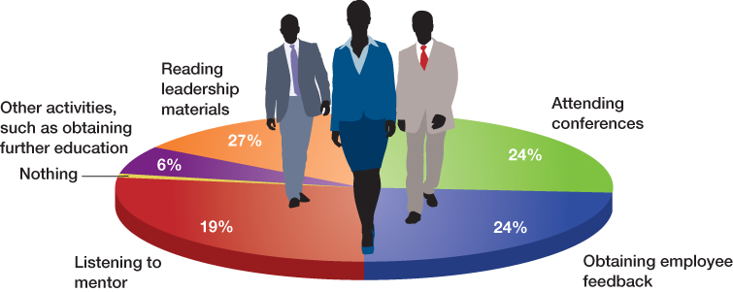
Contrast Contingency Theories of Leadership
OB POLL How Are You Developing Your Leadership Skills
Note: Survey of 700 respondents.
Source: Based on J. Brox, “The Results Are In: How Do You Ensure You’re Constantly Developing as a Leader?” May 14, 2013, http://www.refreshleadership.com/index.php/2013/05/results-ensure-youre-constantly-developing-leader/#more-4732.
Notes:
Consider the OB Poll … and your own quest for leadership skills.

Slide 13

Think and discuss
How would you develop your leadership skills?

Slide 14
Guidelines for Inspirational Leadership
Articulate a clear and appealing vision
Explain how the vision can be attained
Act confident and optimistic
Express confidence in followers
Use dramatic, symbolic actions to emphasize key values
Lead by example

Slide 15
References
Crawford, J. (2023) Leadership: Advancing Great Leaders and Leadership. IntechOpen. Available at: https://doi.org/10.5772/intechopen.104266.
Yukl, G.A. and Gardner, W.L. (2020) Leadership in organizations. Ninth edition. Harlow: Pearson Education Limited.

