Slide 1
Module BMPF7081
Module BMPF4001
Continuing Professional Development/Preparing for Work-based Learning
Day 1

Slide 2

Our Vision
Our intention for this presentation:
welcome you to the university
introduce everyone
overview of first module
Hwb support
academic writing and plagiarism
library services
start module

Slide 3
Our Vision
Meet the team...
Dr Louise Emanuel– Cyfarwyddwr Academaidd/ Academic Director l.emanuel@uwtsd.ac.uk
Ann Beaumont – Swyddog Gweinyddol/ Administrative Officer a.beaumont@ydds.ac.uk
Julie Crossman – Uwch Darlithydd/Senior Lecturer julie.crossman@uwtsd.ac.uk
Lowri Harris – Uwch Darlithydd/Senior Lecturer L.M.Harris@uwtsd.ac.uk

Slide 4
Our Vision
Guidance and support...

Slide 5

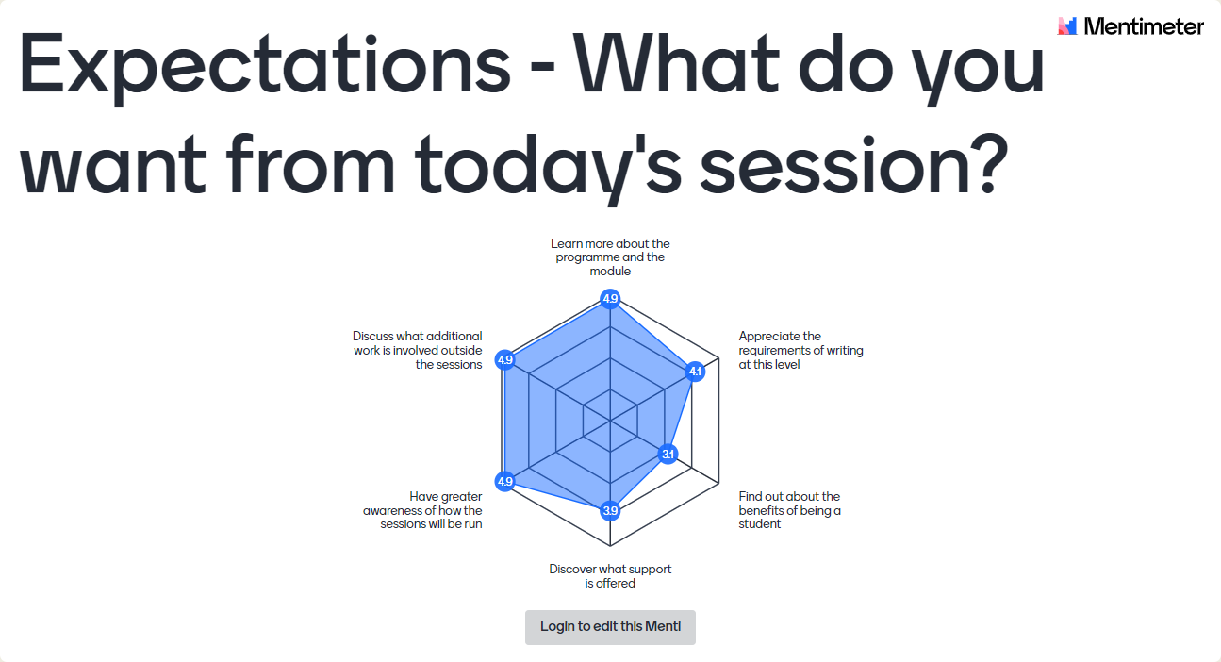

Mentimeter Activity
Expectations
and
Concerns

Slide 6

Module Requirements and Support
20 Credit Module
Consists of:
  Induction included within 3
  full day sessions
  Module Material
  Individual tutorials
  Access to our Virtual
  Learning Environment (VLE)
  Access to our library resources
  Support from your tutors and UWTSD
Notes:
Steve

Slide 7


Our Vision

Slide 8
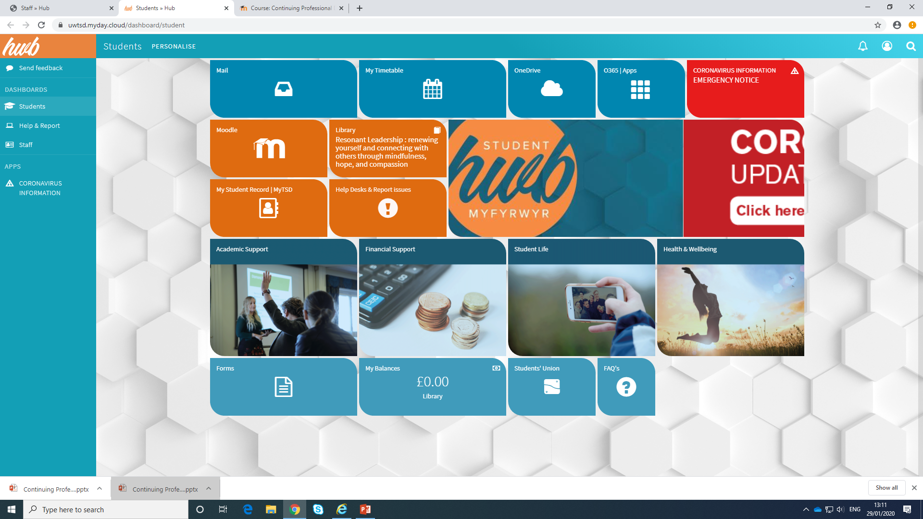
Students » Hub (myday.cloud)
Notes:
Julie

Slide 9
C.V.
Notes:
File

Slide 10

Discuss in groups:
Define a CV
What elements should be included in a professional CV?

Slide 11
      Elements:
Personal details
Academic Qualifications
Personal/extra-curricular Achievements
Awards / Honours
Publications
Membership of official bodies
Work / work experience and other commitments
Activities / Hobbies
Skills
Courses / conferences attended
Chronological – date

Slide 12
Other considerations
Language use:
  Using active, positive words
  Concise Verbs
  No adjectives
  Grammar and Spelling
Accuracy:
  Information

Slide 13

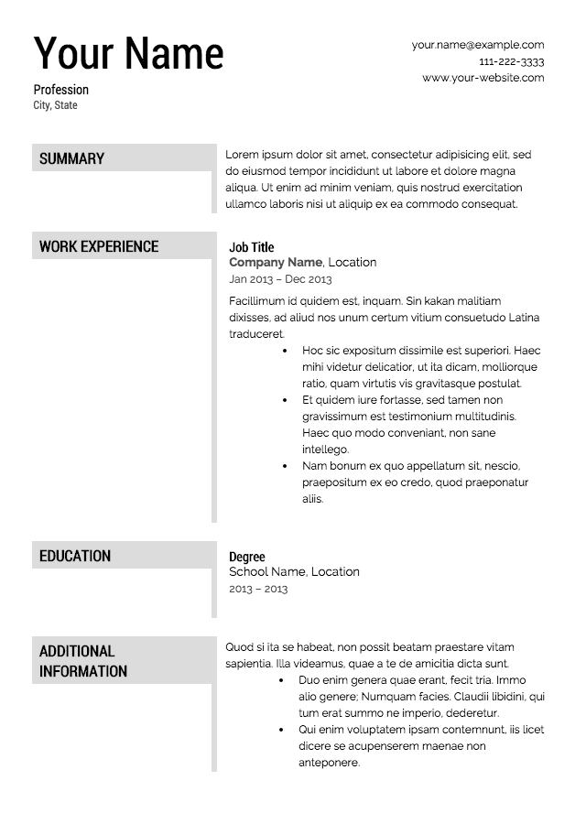

Slide 14

Activity: Job competencies
Using the Job Competencies list, identify:
Those that relate to you
Those you may need to develop

Slide 15


Slide 16
The use of job descriptions
Clarification of role, duties, and responsibilities
Job evaluation
Recruitment
Identification of development needs

Slide 17
Consider your own job description
how suitable is it for conducting a gap analysis?
does it cover everything you do?
does it include the skills, knowledge, qualifications
and experience needed within the job?
is it up to date?

Slide 18

Activity: SWOT Analysis

Slide 19
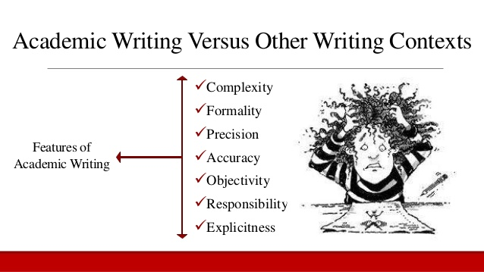

Academic writing
Critical thinking, reading and writing booklet:
  (Adapted from Stella Cottrell’s book)
  See Module
  Handbook

Slide 20
Llên-ladrad a Chyfeirnodi
Plagiarism and Referencing

Slide 21
Diffiniad o Lên ladrad
Plagiarism defined
“…uses words, ideas or work products, attributable to an identifiable person or source, without attributing the work to the source from which it was obtained, in a situation in which there was a legitimate expectation of original authorship, in order to obtain benefit, credit or gain".
Fishman, 2010

Slide 22
Sut ddylid cyfeirnodi?
So how should I cite this?
Fishman, T. (2010) dyfynwyd yn / cited in Fearn, H. ‘Is it plagiarism? Well it is rather difficult to say.’ [Ar lein / Online], Available: http://www.timeshighereducation.co.uk/412292.article [29 Ebrill 2013 / 29 April 2013]

Slide 23
Sbectrwm Llên-ladrad
A spectrum of plagiarism
Twyll bwriadol – bwriad i dwyllo / Deliberate cheating – intent to deceive
Gwybod y rheolau a gwenud camgymeriad. / Knows the rules and makes a mistake
Camymddygiad / Misconduct
Ddim yn gwybod y rheolau a’u torri. / Doesn’t know the rules and breaks them
Camddefnydd / Misuse
Camddealltwlriaeth / Misunderstanding

Slide 24
Harvard Referencing Examples
I don’t like referencing,
not et al

Slide 25


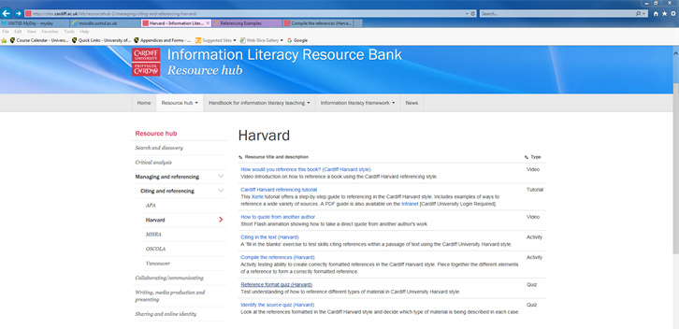
http://sites.cardiff.ac.uk/ilrb/resourcehub-2/managing/citing-and-referencing/harvard/
Activities: Compile the references (Harvard)
Reference format quiz (Harvard)

Slide 26
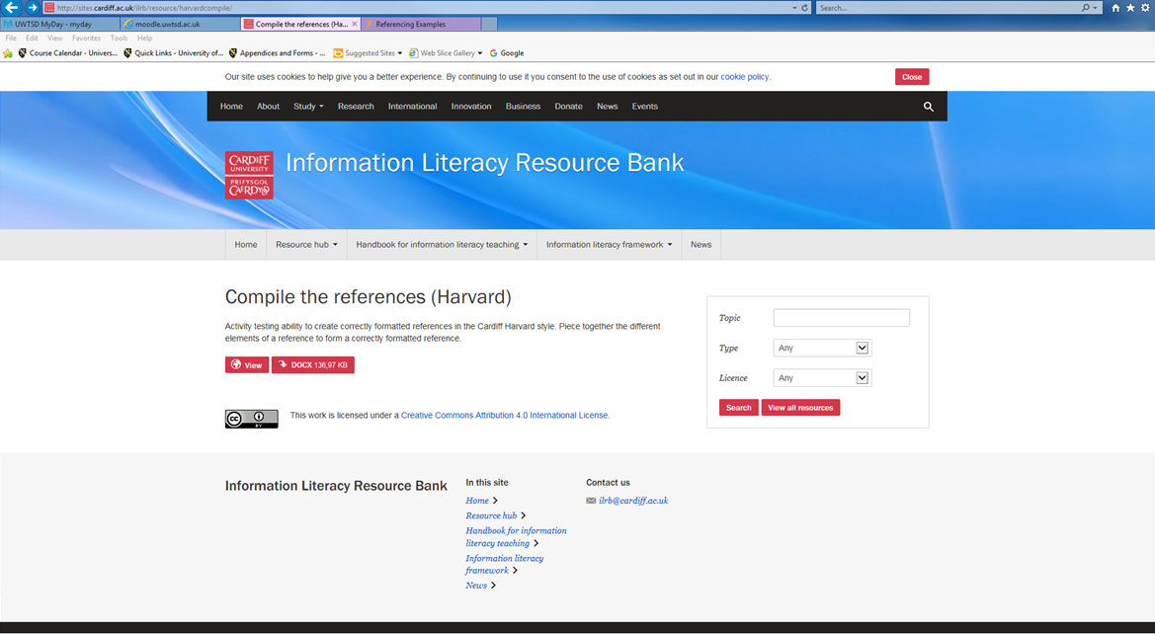
Activity – Harvard Referencing
http://sites.cardiff.ac.uk/ilrb/resource/harvardcompile/
Click “View”

Slide 27
RHAI ENGHREIFFTIAU
Copïo heb ddangos mai copi yw e.
Talu rhywun arall i wneud drosoch.
Dim danogs eich ffynonellau (gair neu weithred) yn ddigon clir.
Gweithio gydag eraill a dim cydnabod rhannu’r gwaith
Some examples
Copying without showing it is a copy
Paying someone to do it for you
Not showing your sources (words and work) transparently enough
Working closely with others and not acknowledging the shared work

Slide 28
Cyfeirnodi Harvard 7 Cwestiwn
Mae cyfeirnod yn gyflwan pan fyddwn yn gwybod:
Pwy ysgrifennodd / olygodd y gwaith?
Pryd y cyhoeddwyd ef?
Beth yw ei enw?
Beth yw’r ffynhonnell (llyfr, erthygl, gwefan)?
Ble cyhoeddwyd ef?
Pwy gyhoeddodd ef?
Ar ba dudalen mae’r deunydd y cyfeiriwyd ato?
Harvard Referencing
7 questions
A reference is complete when we know:
Who wrote it or edited it?
When was it published?
What’s it called?
What kind of a source is it (book, article, website)?
Where was it published?
Who published it?
What page is the relevant material on?

Slide 29

Cwestiynau Grwp
Group Questions
Have we:
answered your questions?
alleviated your concerns?

Slide 30

Camau Nesaf
Next Steps
Annotated CV and JD
Read handout on reflection

Slide 31

Gwerthusiad – Plws / Delta
Evaluation – Plus / Delta

Slide 32
References
Coffield, F., Moseley, D., Hall, E. and Ecclestone, K. (2004 ) Learning Styles and Pedagogy in Post-16 Learning: a systematic and critical review. London: Learning and Skills Research Centre/University of Newcastle upon Tyne.
Entwistle, N. (2000) Scoring Key for the Approaches and Study Skills Inventory for Students (ASSIST) [Online], Available: http://www.etl.tla.ed.ac.uk/questionnaires/ASSIST.pdf [17 April 2013].
Kolb, A.Y. and Kolb, D.A. (2005) The Kolb Learning Style Inventory – version 3.1, 2005 Technical Specifications. Boston, MA: Hay Resource Direct, [Online], Available: http://www.whitewater-rescue.com/support/pagepics/lsitechmanual.pdf [17 April 2013]

