Slide 1
Interpreting A screenplay
BA Set Design
AD4013

Slide 2
Interpreting A screenplay
How screenplays work
Breaking down a screenplay – the basics

Slide 3
Assignment
Creating your portfolio
Research aspects of the story
Communicate and illustrate your ideas
Reflecting on the process

Slide 4
How screenplays work
Myth
Character
Conflict

Slide 5
Myth & ritual in storytelling
Stories are metaphors for life
Stories are rituals
Stories use symbols and metaphor
Stories dramatise change and transformation

Slide 6
Myth & ritual in storytelling
Unity of time, place and action
A story with magnitude
Beginning, middle and end
Causal relationships between each step

Slide 7
Myth & ritual in storytelling
Joseph Campbell studied myth and folklore across cultures
Identified a monomyth
Satisfy basic human needs

Slide 8
Joseph Campbell’s monomyth
Ordinary world
Extraordinary world
Face challenges
Receive a gift
Return to ordinary world, transformed

Slide 9
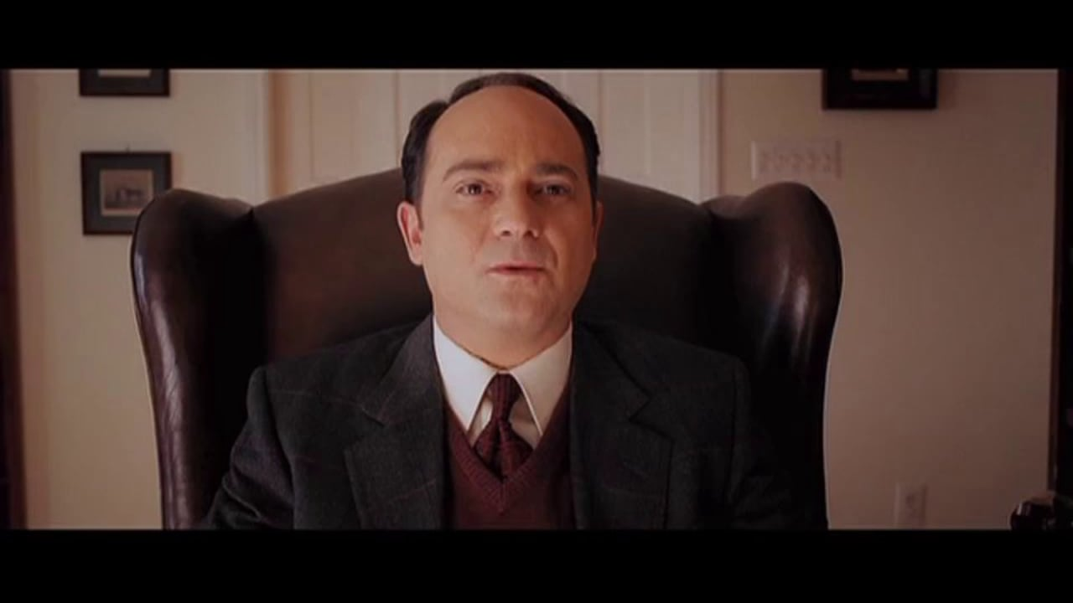
Our Time Is Up (2005)
Notes:
https://www.youtube.com/watch?v=vso9iPIpeu8

Slide 10
Analysis: Our Time Is Up (2005)
What is the Ordinary world?
What is the Extraordinary world?
What challenges does Dr Stone face?
What gifts does Dr Stone receive?
What are the challenges/gifts for his patients?
How does he return to ordinary world, transformed?
Magnitude? Metaphor? What is the story about?

Slide 11
Conflict
Protagonist struggles
Has goal(s) to achieve
Opposed by forces of antagonism
Without struggle, achievement lacks merit
Notes:
In a classical screen story, the protagonist is struggling to do something, they have a goal. Stopping them from achieving this goal are the forces of antagonism, often another person, the antagonist. Without this struggle, any achievement of the character lacks real merit (and real interest for a mainstream audience, it is argued).

Slide 12
Obstacles
Characters struggle against obstacles
Obstacles can be external or internal
Obstacles increase in magnitude
Notes:
Characters struggle against obstacles. The most immediate are physical ones that put the life of the character at risk; if they are killed they cannot achieve their goal. Because there is so much at stake, genres that have this form of conflict are always popular, although they can quickly lapse into cliché.

Slide 13
External conflict
Outside the character
Physical (such as, threat to survival)
Other people (such as threat to survival/rivals/barriers)
Notes:
Physical obstacles are an example of external conflict and can be used for comic and other purposes as well as for action/suspense.
Other people can embody different concepts, to help add meaning to conflct

Slide 14
Internal conflict
Entirely within a character
Self doubt
Moral dilemma
Madness
Notes:
By contrast, internal conflict is entirely within a character. It is self doubt, a moral dilemma, madness. The internal conflict of the screen story will often carry the underlying themes of the story, the film's argument, which we'll come back to in a bit.
In many successful mainstream stories, the main character deals with both an external and internal conflict. In Titanic (1997), Rose DeWitt Bukater is facing the external conflict of surviving the iceberg-scuppered ship and the attentions of her mother, her fiance, Cal, and her new beau, Jack. She is also facing the internal conflict of whether to do her duty and marry Cal or follow her heart and choose Jack. When the internal and external conflicts climax at the same time, it can be a powerful story design. And a cheap sexual innuendo.

Slide 15
Meaning in conflict
Conflict is symbolic/metaphorical to the audience
Conflict is about something
Conflict can represent a moral argument
Conflict is designed around mutually incompatible goals
Notes:
Conflict is about something, it is symbolic or metaphorical to the audience. In Titanic, this is represented by Rose's internal dilemma, is about class and gender divides, and about the opportunity to
transcend these offered by new world of liberty, the USA, in contrast to the old world, Europe. It can help to think about this aspect of conflict as a moral argument, the protagonist and antagonist representing different sides. This can apply to any genre of narrative film.

Slide 16
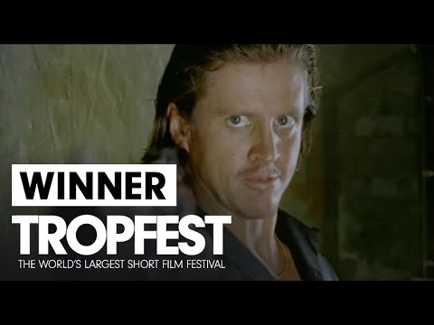
The Money (2004)
Notes:
https://www.youtube.com/watch?v=disj0pQdcuI

Slide 17
The Money (2004)
How is conflict used in The Money?
What are the mutually incompatible goals?
What internal conflict is there?
What is the conflict a symbolic of?

Slide 18
Character
Artificial construction
Serve function(s) in screen story
Notes:
A character, even one based closely on a real person, is an artificial creation, constructed to serve a function or functions in a screen story. There are a number of ways of approaching character, these different techniques and analyses will prove useful in your own work. But be warned, character is a thorny issue and as with other story elements, there’s a lot of give and take between character, conflict, structure and metaphor/symbol in the creation and development of a story. Today, we’ll look at some terms and concepts that will help you understand character and the story form and give you some basic tools to start exploring this.

Slide 19
Character
Goal – symbolic struggle
Goal can represent an outlook on the world
Divergent wants and needs (perceived goal versus actual goal)
Conflicting conscious & unconscious desires
Notes:
In addition to the attributes that McKee and Field outline, a main character in a mainstream film will have a clear goal, and their struggle for that goal not only drives the film but symbolises what it is about.
Other characters can personify concepts that the main character (and their goal) are in conflict with – when creating stories considering how characters might represent conflicting ideas can be a very useful tool.
Main characters will often have divergent wants and needs, the conflicting conscious and unconscious desires.

Slide 20
Breaking down a screenplay
Select a screenplay
Analyse the opening 10 pages
Breakdown according to different requirements

Slide 21
Breaking down a screenplay
Locations
Props/dressing
Graphics
Animals
Vehicles
Construction/builds
SFX

Slide 22
Breaking down a screenplay
Organise with columns for:
  Slugline (INT.LOCATION.TIME)
  Scene numbers
  Day/Night
  Pages
  Characters
  Props & other elements
  Notes

Slide 23
Screenplays
Alfie
Valkyire
Amour
Little Miss Sunshine
Stalag 17
The Iron Lady
The Omen II
My Week With Marilyn
Notes:
Choose one that you have not seen! Avoid seeing the film or researching its look.

