Slide 1


The First 1000 Days

Slide 2
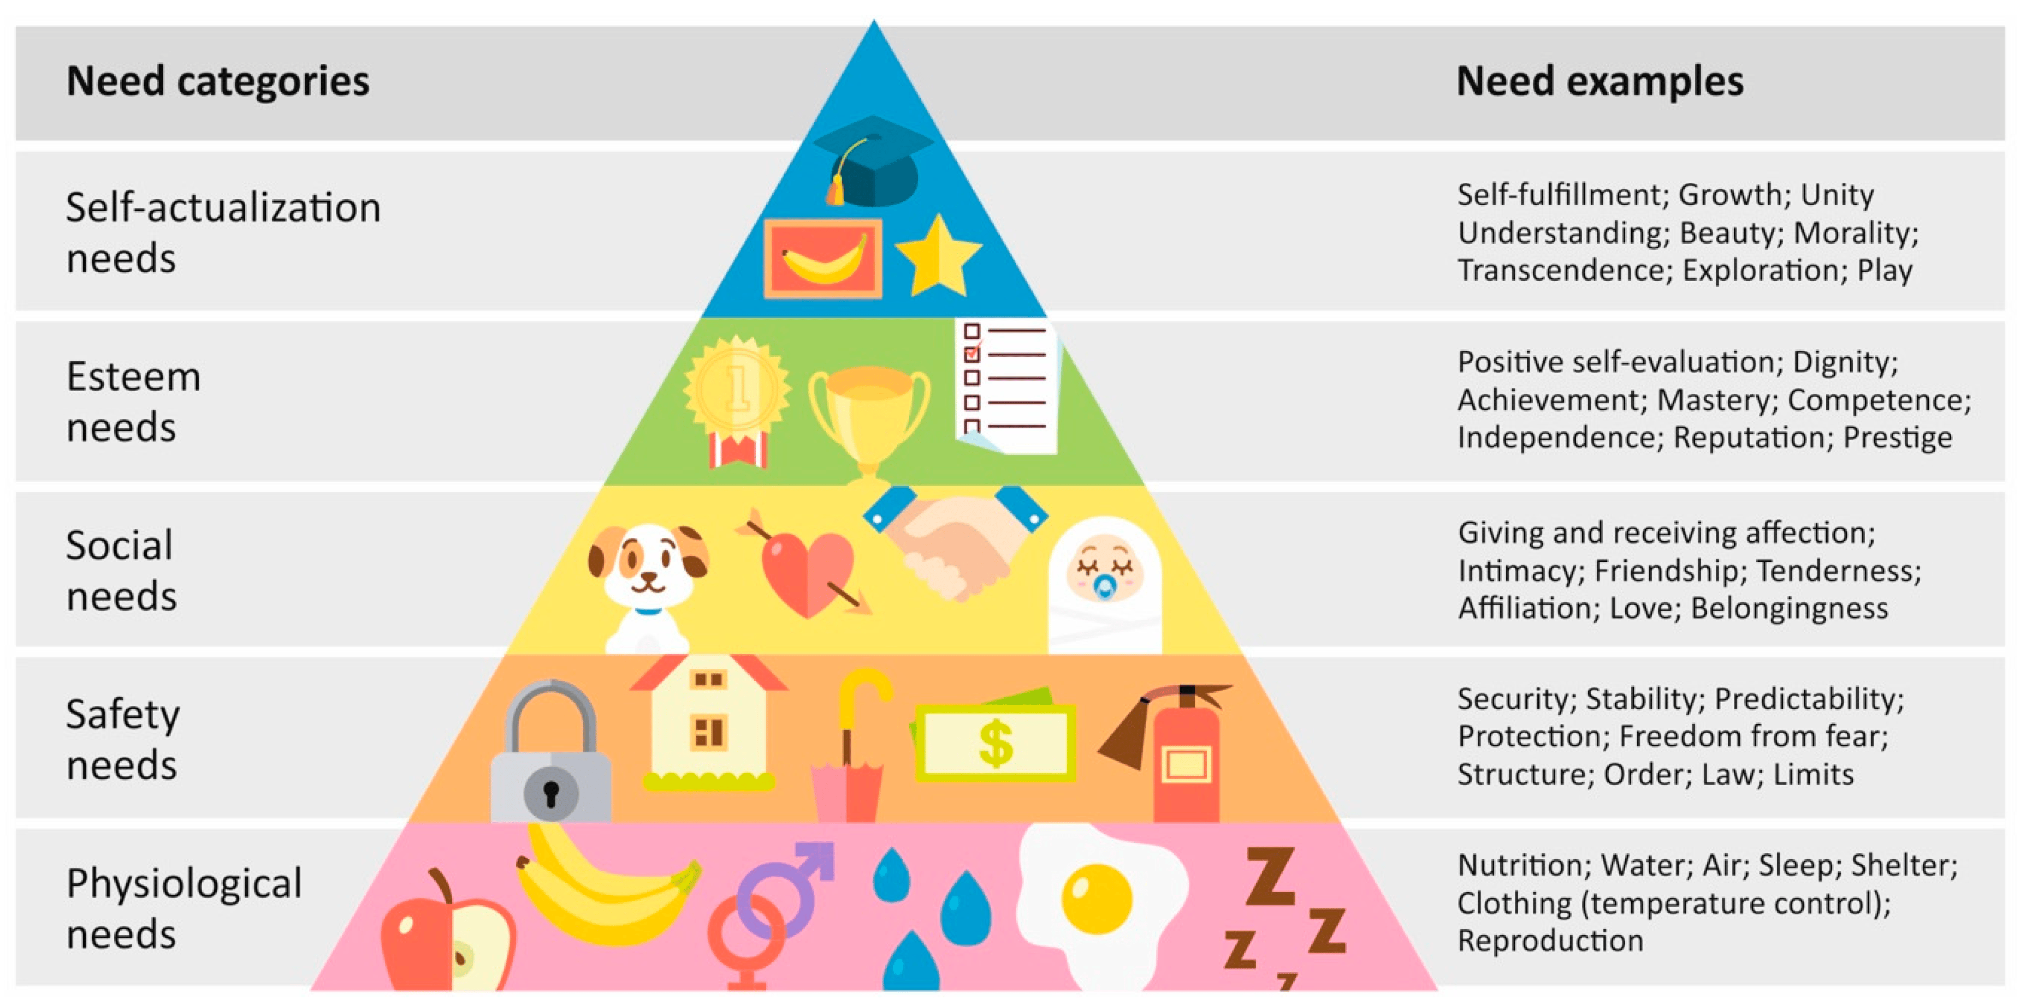
What is the First 1000 Days?
The initial 1,000 days, from conception to age 2, are crucial for a child's brain, body, and immune system development (House of Commons, 2019). Factors during pregnancy and after birth, including health, nutrition, and relationships, profoundly influence a baby's future (UNICEF, 2013).
In this period, babies require nutritious food, nurturing relationships, safety, playtime, and a wholesome environment to thrive (UNICEF UK, 2016), aligning with the first three stages of Maslow's Hierarchy of Needs. Holistic well-being during these critical days yields benefits, fostering secure attachments for healthy social and emotional development and contributing to optimal brain development with neural pathways supporting cognitive abilities, learning, and memory (1000 days.org, 2019).
Why is the First 1000 Days Important?
During this crucial stage, a baby's brain undergoes rapid development, surpassing all other life stages, significantly shaping their future. Ensuring a nutritious diet throughout the mother's pregnancy and early childhood is vital for proper learning abilities, physical skills, and emotional development. Insufficient nutrition in the first 1,000 days may lead to adverse outcomes like stunted growth, impaired cognitive development, compromised immune function, and increased susceptibility to illnesses (Likhar and Patil, 2022).
Experiencing hunger, stress, or abuse during this period can leave lasting impacts on a child's development. An unsafe or unhealthy environment within the first 1,000 days may affect a child's physical health in later stages (Australia, 2022). Elevated stress hormones, like cortisol, due to prolonged tension, can impact the fetus, leading to miscarriage, fetal growth retardation, premature birth, and postnatal delays.
(Davis and Sandman, 2006).

Slide 3
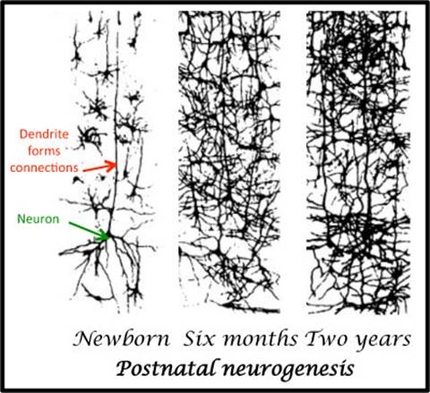
What Does the Research Say?
Recent neuroscience findings reveal that 80% of a child's brain development occurs within the initial 1000 days of life, profoundly impacting long-term health, learning abilities, and executive function (Itasca Project, 2021). Prioritizing enabling environments and inclusive practices during this period is crucial for children and families' well-being (HighScope, 2018). Dr. Heckman's research emphasizes that early interventions in health, nutrition, and education during the first 1000 days yield high returns in improved educational outcomes, better health, and increased productivity later in life (Heckman, 2013). While not focused on the first 1000 days, Urie Bronfenbrenner's Ecological Systems Theory underscores the immediate environment's importance, including family and community, in influencing a child's development during this critical period.
https://www.youtube.com/watch?v=J4OQQYyA--E (Kayla Goodson, 2017)
The provided image illustrates the increase in synapses within the brain during the initial two years of life. Synapses play a crucial role in information processing within the brain. The early stages of brain development serve as the basis for adaptability and resilience. Experiences hold significant potential to impact this development, with children being particularly susceptible to enduring negative influences during this phase.
As a result, these early years present a unique opportunity for parents, caregivers, and communities. Positive early experiences wield a profound influence on children's prospects for achievement, success, and happiness, and as such this period serves as a crucial window of opportunity to shape positive outcomes for the developing brain (Public Health, 2017) .

Slide 4

Professional Partnerships
Urie Bronfenbrenner's ecological systems theory highlights the interconnectedness of various systems influencing a child's development. Effective partnerships during the first 1000 days align with this theory by emphasizing the importance of positive interactions within the microsystem, coordinated efforts in the mesosystem, external support in the exosystem, and influencing cultural and societal values in the macrosystem (The Early Years & Childcare Service, 2021). By understanding and applying Bronfenbrenner's ecological systems perspective, practitioners can enhance their approach to creating a comprehensive and supportive environment for children during this critical developmental period.
These professionals play a central role in fostering holistic child development and addressing physical, cognitive, emotional, and social aspects. Early intervention is key, as practitioners promptly identify and address developmental delays. To this end Early years practitioners play a pivotal role in establishing and fostering professional partnerships during the first 1000 days of a child's life. These partnerships are essential for providing comprehensive support to children and their families (Choo et al., 2019). Below are some professional collaborations that early years practitioners may help develop:
Social Workers and Family Support Services
Collaborating with social workers and family support services is pivotal for early years practitioners, as it establishes a comprehensive and integrated framework for supporting the holistic development and well-being of children and families. These partnerships offer a range of benefits that contribute to a more inclusive and supportive environment (Welsh Government, 2017). Social workers bring expertise in understanding and addressing complex social and emotional challenges within families. By collaborating with these professionals, early years practitioners gain insights that enable them to identify and address social and emotional needs of children effectively.
Social workers often work closely with vulnerable or at-risk families facing various challenges. Partnering with social workers allows early years practitioners to extend their support to families dealing with issues such as poverty, domestic violence, or housing instability. This collaboration helps create a more inclusive environment where every child has the opportunity to thrive (Department Of Education, 2023).
Health Visitors
Collaborating with health visitors and doctors ensures that children receive regular health check-ups, vaccinations, and timely medical interventions if needed. Health visitors often have established relationships with families, built on trust and confidence (Doi, Jepson and Hardie, 2017). Early years practitioners, by partnering with health visitors, can leverage these existing relationships to create a seamless and supportive experience for families as they navigate both health and developmental aspects. This partnership contributes to monitoring and promoting the overall health and well-being of the child (Welsh Government, 2017b).

Slide 5
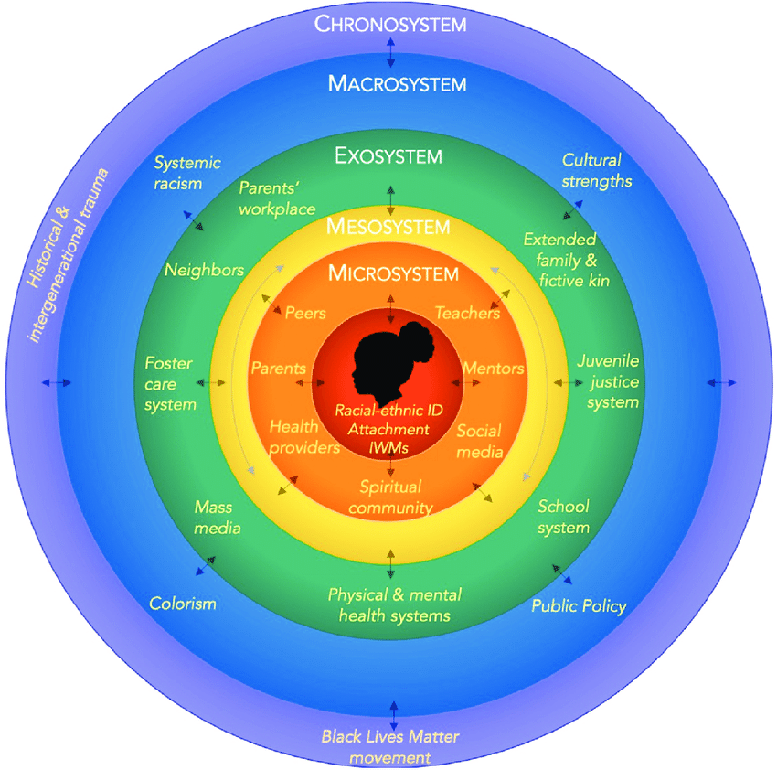
Partnerships with Parents
Building a positive relationship between early years practitioners and parents is crucial for holistic child development, aligning with Vygotsky, Bowlby, and Bronfenbrenner's theories. This collaborative partnership, thriving in an enabling environment, fosters inclusive practices (Professional Association for Childcare and Early Years, 2016). It allows valuable information exchange, creating a sociocultural learning environment and supporting secure attachments, as highlighted by Bowlby, within Bronfenbrenner's ecological systems theory. Integrating enabling environments ensures comprehensive addressing of a child's strengths, challenges, and individual needs. Maternal factors significantly shape a child's development, from physical health to environmental conditions. Recognizing and addressing these factors, especially maternal health, are vital for effective support and optimal child development (Ahmad et al., 2021). Supporting maternal mental health is equally crucial, considering its profound impact on the child's emotional environment. Offering mental health services, counseling, and resources is imperative, along with creating awareness and fostering an open dialogue to destigmatize postpartum mental health issues (Chauhan and Potdar, 2022; NSPCC, 2019; NHS England, 2022). Collaborative partnerships among professionals and support services streamline information sharing, coordinate interventions, and create a seamless, personalized support system empowering mothers and fostering children's well-being during their critical early years.

Slide 6
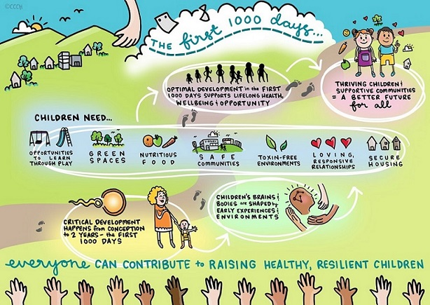
What is Exceptional Care?
Providing exceptional care within the first 1000 days is an all-encompassing endeavor, covering prenatal care, early childhood healthcare, nutrition, stimulation, safety, and emotional support. It is imperative that governments, healthcare providers, and communities prioritize initiatives during these formative years. The cornerstone of this care is comprehensive prenatal care, ensuring expectant mothers receive not only proper medical attention but also crucial nutritional support, setting the stage for a healthy start in life (Public Health Wales, 2011).
After birth, maintaining a dedicated focus on healthcare is paramount. Regular check-ups, vaccinations, and monitoring of developmental milestones form integral components of this proactive approach, facilitating early identification and intervention to minimize long-term impacts and promote overall well-being. Adequate nutrition, addressing both maternal needs during pregnancy and the nutritional requirements of the child during infancy and early childhood, is pivotal for optimal growth and development, influencing physical health, cognitive abilities, and immune function.
Beyond physical health, exceptional care extends to fostering positive interactions and providing stimulation for comprehensive cognitive, social, and emotional development. Creating a safe environment is equally crucial, not only to minimize physical risks but also to address emotional needs. This contributes to the establishment of secure attachments and positive mental health throughout the child's life.
Dr. Pikler's philosophy underscores the importance of cultivating an environment grounded in respectful care. In the context of the Pikler Triangle, caregivers encourage autonomy and refrain from undue interference, fostering an atmosphere conducive to respectful play (Marlen, n.d.; Nursery World, 2017). The Pikler Triangle itself, with its wooden frames and triangular facets equipped with climbing rungs, becomes a conduit for achieving crucial childhood milestones. Through purposeful climbing activities, children engage in the enhancement of gross motor skills, spatial awareness, and overall balance. Integrated into the educational landscape, it becomes a catalyst for the cultivation of confidence and independence in young learners.
https://www.youtube.com/watch?v=LL3sSKtBVZY

Slide 7
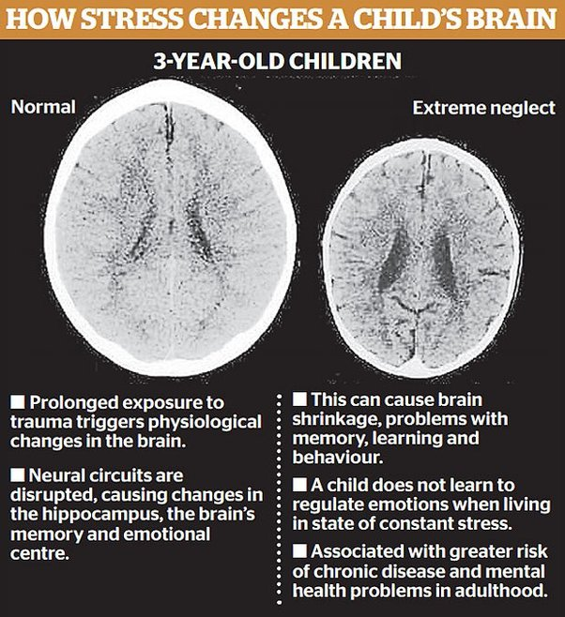
What Happens When Children Do Not Receive Exceptional Care?
Inadequate care during the first 1000 days, from prenatal to early childhood, can have lasting consequences. Insufficient nutrition, limited stimulation, and a lack of responsive caregiving may lead to impaired cognitive and physical development, increased susceptibility to infections, and delayed social-emotional growth. These early challenges can contribute to behavioral and mental health issues, educational difficulties, and an elevated risk of chronic health conditions. Research underscores a crucial finding: prolonged neglect, marked by persistent disruption or substantial caregiver unresponsiveness, can cause more enduring harm to a child's development than overt physical abuse. The consequences extend to cognitive delays, impairments in executive functioning, and disruptions in the stress response system. Recognizing the impact of neglect on a child's well-being emphasizes the need for heightened awareness and preventive measures in caregiving practices.(Harvard University, 2013).
https://developingchild.harvard.edu/resources/inbrief-the-science-of-neglect-video/
What Does The Research Say?
The concept of "serve and return" interactions aligns with Bronfenbrenner's emphasis on the reciprocal relationships between children and their immediate social environment. In the microsystem, the quality of interactions between caregivers and children is crucial for healthy development. Positive and responsive exchanges contribute to the child's emotional, social, and cognitive well-being, creating a supportive environment within their immediate social circle (Virtual Lab School.org, n.d.).
https://www.youtube.com/watch?v=m_5u8-QSh6A&t=21s
This aligns with Vygotsky's emphasis on the social nature of learning, which suggests that serve and return interactions contribute to a child's cognitive development by providing a scaffold for their learning (Gowrie NSW, 2022). John Bowlby and Mary Ainsworth's attachment theory, with its emphasis on the importance of secure emotional bonds, also aligns closely with the principles of serve and return interactions. Both underscore the significance of responsive and reciprocal caregiving practices in promoting optimal development and building the foundation for healthy relationships throughout life (Flaherty and Sadler, 2011).
Although these theorists may not explicitly use the term "serve and return," their work collectively supports the idea that responsive interactions and relationships between caregivers and babies are crucial for optimal early childhood development.

Slide 8

What are the Challenges and Limitations that May Hinder Exceptional care in the First 1000 Days?
Several additional challenges could pose significant problems in providing exceptional care during the first 1000 days. These challenges may vary depending on cultural, economic, and geographic factors
Covid 19
The COVID-19 pandemic led to a notable disruption in healthcare services, hindering timely access to prenatal care, routine check-ups, and essential vaccinations. The consequences of such delays may manifest in long-term health implications for both mothers and infants. Economically, the fallout from the pandemic has exacerbated financial strains on families. Job losses and economic insecurity translate into financial barriers to accessing quality healthcare services, nutrition, and a conducive environment for a child's development. Moreover, the mental health implications of the pandemic cannot be overstated. Parents, grappling with increased stress, anxiety, and depression, face challenges in providing consistent and nurturing care, whilst cut off from their support network and unable to socialize their children through play dates and organised baby toddler groups, increasing their feelings of isolation. The emotional toll on parents may subsequently impact the child's emotional development and overall well-being (Unicef, 2016).
(Unicef Jamacia , 2020)

Slide 9
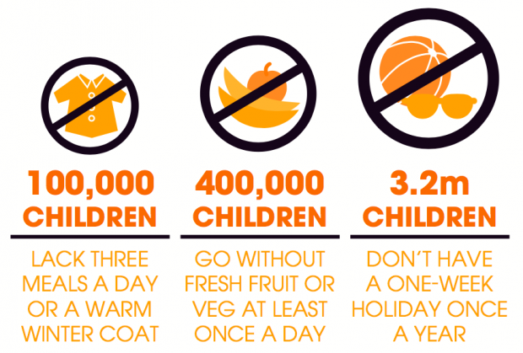
Current Financial Climate
Financially strained families may struggle to afford enriching early childhood experiences crucial for cognitive development. Educational resources like toys, books, and extracurricular activities become unattainable for those facing economic hardships (JRF.org, 2013). Housing insecurity adds to these challenges, impacting a child's health and overall well-being (Hock et al., 2023). The current financial climate may push parents to work long hours soon after having a baby, affecting their ability to dedicate time to their child during the crucial first 1000 days. Limited affordable childcare options further challenge parents, especially those balancing work responsibilities, highlighting the need for adequate childcare support to ensure consistent and attentive care.
Under-funding of non-maintained Charities
Limited funding for charities poses challenges during the first 1000 days, impacting support and services. Charities, crucial for bridging gaps in healthcare and support systems, face constraints affecting families, especially in vulnerable situations. This includes reduced access to vital services, diminished outreach, and limited capacity for support programs like mental health services. Funding limitations may also hinder contributions to research, advocacy, and addressing disparities among vulnerable populations (Jemal et al., 2022).
Parents' Mental Health
Parents' mental health significantly influences the care quality during the first 1000 days. Those facing mental health challenges may struggle with positive interactions, emotional support, and consistent caregiving. These crucial aspects of nurturing care may be compromised, impacting the child's development. Mothers, especially, face an elevated risk of postpartum depression, hindering secure attachment formation with infants and potentially affecting socio-emotional development.(Royal College of Midwives, 2019).

Slide 10
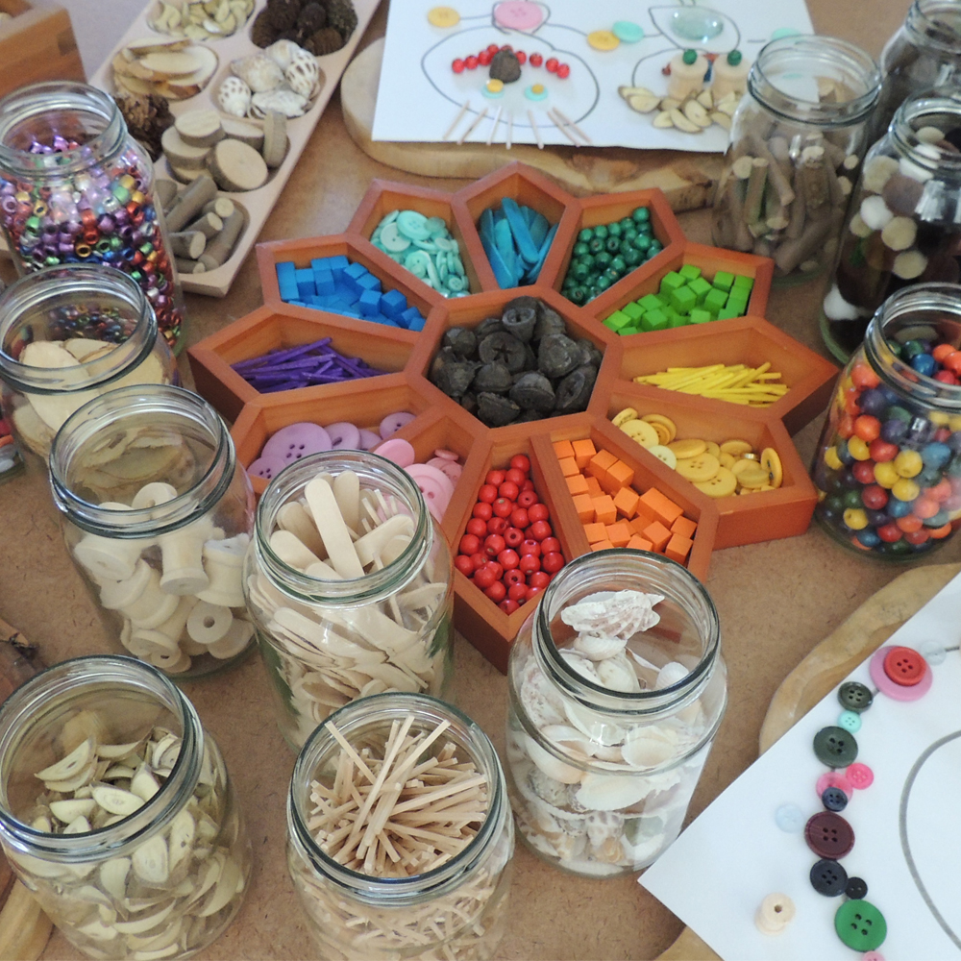
Activities
The first 1000 days of a child's life are pivotal for development. Diverse activities during this period lay a crucial foundation for a child's holistic development, influencing a lifetime of learning and success.
LOOSE PARTS
Loose Parts Play revolves around providing children with aesthetically pleasing resources, often of a natural origin, that lack a predetermined purpose. These items are intended to be explored with creativity, freedom, and imagination. Examples of Loose Parts may encompass pinecones, sticks, buttons, shells, and wooden shapes. Offering open-ended loose parts resources comes with numerous advantages. By doing so, you create an environment that empowers children, filled with captivating items fostering creativity and innovation. The limitless possibilities ensure ongoing interest among children, while the capacity to freely adjust, modify, or shape play and materials accommodates individual needs, making the resources suitable for all ages and developmental stages (Creative Star Learning LTD, 2017). Similarly, using loose parts wrong is impossible therefore eliminating any sense of failure for children. On the contrary, children can derive a profound sense of personal accomplishment by attaining their play goals, coupled with the excitement and fulfillment of making new discoveries through experimentation (https://www.pacey.org.uk/, 2019).
Montessori and Loose Parts Play are similar in their child-centric, exploration-focused approach, emphasizing creativity, natural materials, and self-directed learning. Both prioritize an enabling environment for holistic development. The open-ended materials in Loose Parts Play align with Montessori's real-world emphasis. Both approaches contribute to inclusive practices, accommodating diverse learning styles and fostering autonomy. Integrating Loose Parts Play into Montessori settings enhances the learning experience, offering opportunities for exploration, imaginative play, and collaborative engagement. This enriches the educational journey for every child, promoting a comprehensive and inclusive foundation for early childhood development (PACEY, 2019).

Slide 11
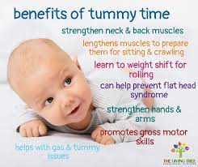
Tummy Time
Encouraging tummy time is an excellent method to enhance your baby's upper body strength. Commencing this practice from birth involves placing your baby on your chest. Incrementally extend the duration of these sessions each day. As your baby becomes more comfortable, transition to tummy time on the floor. This beneficial activity not only strengthens the back, neck, and shoulders but also provides them with a unique perspective on the world around them (NHS, 2023).
Tummy time serves as a catalyst for muscle development in the neck, shoulders, and upper body, essential for acquiring motor skills such as crawling and standing. It also mitigates the risk of flat head syndrome by offering repositioning opportunities.
Placing the baby on their tummy encourages the development of visual skills and hand-eye coordination. The active engagement during tummy time prompts the baby to push up on their arms, lift their head, and roll over, fostering gross motor skills and overall coordination (National Institutes of Health.gov, n.d.). Tummy time contributes to core strength, vital for stability and balance. It enhances spatial awareness and helps prevent conditions like torticollis, where neck muscles tighten, limiting movement.
Beyond physical benefits, tummy time exposes the baby to diverse sensory stimuli, fostering sensory development. It also encourages independent exploration, providing a safe environment for the child to engage with their surroundings autonomously.
In addition to these developmental advantages, tummy time may aid in relieving gas and promoting digestion. The gentle pressure on the baby's abdomen during these sessions can alleviate discomfort associated with gas buildup (Appelquist, 2018).

Slide 12

Baby Massage
Baby massage in the first 1000 days is a vital component of a child's developmental journey, acting as a proximal and nurturing interaction within the microsystem. This practice not only fosters secure attachments but also significantly influences emotional and social development. Additionally, baby massage plays a pivotal role in the exosystem by promoting a supportive caregiving environment. Caregivers, through regular engagement in massage, develop a profound understanding of the infant's cues and needs, establishing a responsive and empathetic environment. This aligns with Bronfenbrenner's ecological systems theory, emphasizing the reciprocal influences within systems (Cherry, 2023).
Furthermore, baby massage directly aligns with Maslow's hierarchy of needs by addressing physiological needs through comfort and warmth. Simultaneously, it fulfills the need for safety by fostering a secure attachment and promotes emotional connections, addressing the infant's need for love and belongingness. This holistic approach contributes to positive self-image and esteem, laying a robust foundation for healthy psychological development.
In line with Bowlby's theory, baby massage establishes the caregiver as a reliable source of comfort, functioning as a safe haven for the infant during moments of distress. The physical closeness during massage contributes to the caregiver being perceived as a secure base, supporting the child's exploratory behaviors with confidence (Sullivan et al., 2011).
These positive experiences during baby massage contribute to the development of positive internal working models—the mental representations of the self, others, and relationships. These models influence the child's expectations and beliefs about relationships and emotional interactions, aligning with Bowlby's notion of how early attachment experiences shape future social and emotional development.
https://www.youtube.com/watch?v=qcVQmznxWM4

Slide 13

Play Dates
Play dates within the first 1000 days play a pivotal role, intricately shaping fundamental aspects of a child's development. These interactions forge essential social skills, laying the groundwork for the formation of healthy relationships (Lacey, Banerjee, and Lester, 2022). As children engage in dialogue during these play dates, they are exposed to diverse communication styles, providing a fertile ground for the flourishing of language development. Moreover, the dynamic environment of play stimulates cognitive growth, encouraging exploration and problem-solving.
Emotional regulation, a crucial facet of early development, is honed through shared experiences of joy and frustration during play. This unique context teaches children to navigate their feelings in a social setting, fostering emotional resilience. Physical development, too, reaps benefits from the array of activities involved in play, refining both fine and gross motor skills. Observational learning during play dates enhances adaptive behaviors, contributing to a child's overall behavioral repertoire.
In the framework of Urie Bronfenbrenner's ecological systems theory, play dates are indispensable for the development of social skills, language, and cognition. The collaborative aspects of sharing and peer engagement take center stage in this microenvironment. Simultaneously, play dates align with Bronfenbrenner's macroecological perspective by introducing diversity and cultural elements naturally. These early social engagements, characterized by collaboration, sharing, and the forging of friendships, significantly contribute to a well-rounded developmental journey throughout the critical first 1000 days (Child Focus, 2023).

Slide 14
Reference list
1000 days.org (2019). Homepage - 1,000 Days. [online] 1,000 Days. Available at: https://thousanddays.org/ [Accessed 13 Jan. 2024].
Ahmad, K., Kabir, E., Keramat, S.A. and Khanam, R. (2021). Maternal health and health-related behaviours and their associations with child health: Evidence from an Australian birth cohort. PLOS ONE, 16(9), p.e0257188. doi: https://doi.org/10.1371/journal.pone.0257188 [Accessed 09 Jan. 2024].
Appelquist, J. (2018). 10 Reasons For Tummy Time. [online] Pump Station & Nurtury. Available at: https://www.pumpstation.com/blogs/news/top-10-reasons-for-tummy-time [Accessed 13 Jan. 2024].
Australia, H. (2022). The first 2 years of a baby’s life can impact their health and wellbeing later on. Here’s what you can do to give your child the best possible start. [online] www.pregnancybirthbaby.org.au. Available at: https://www.pregnancybirthbaby.org.au/the-first-1000-days#:~:text=1%2C000%20days [Accessed 02 Jan. 2024].
Brexpatshov (2023). Child-Led Play in the Pikler Philosophy: A Guide for Parents and Caregivers - Brexpatshov. [online] Parenting and Montessori for Kids. Available at: https://www.brexpatshov.com/child-led-play-in-the-pikler-philosophy/ [Accessed 20 Jan. 2024].
Chauhan, A. and Potdar, J. (2022). Maternal Mental Health During Pregnancy: A Critical Review. Cureus, [online] 14(10). doi: https://doi.org/10.7759/cureus.30656 [Accessed 03 Jan. 2024].
Cherry, K. (2023). A Comprehensive Guide to the Bronfenbrenner Ecological Model. [online] Verywell Mind. Available at: https://www.verywellmind.com/bronfenbrenner-ecological-model-7643403 [Accessed 13 Jan. 2024].
Child Focus (2023). Playdates: Benefits for Child and Parent | Child Focus. [online] www.child-focus.org. Available at: https://www.child-focus.org/news/playdates-benefits-for-child-and-parent/#:~:text=Playdates%20are%20crucial%20in%20addressing [Accessed 21 Jan. 2024].
Choo, Y.Y., Agarwal, P., How, C.H. and Yeleswarapu, S.P. (2019). Developmental delay: identification and management at primary care level. Singapore Medical Journal, [online] 60(3), pp.119–123. doi: https://doi.org/10.11622/smedj.2019025 [Accessed 13 Jan. 2024].
Creative Star Learning LTD (2017). Simon Nicholson and The Theory of Loose Parts – 1 Million Thanks. [online] Creative STAR Learning | I’m a teacher, get me OUTSIDE here! Available at: https://creativestarlearning.co.uk/early-years-outdoors/simon-nicholson-and-the-theory-of-loose-parts-1-million-thanks/ [Accessed 07 Jan. 2024].
Davis, E.P. and Sandman, C.A. (2006). Prenatal Exposure to Stress and Stress Hormones Influences Child Development. Infants & Young Children, 19(3), pp.246–259. doi: https://doi.org/10.1097/00001163-200607000-00008 [Accessed 16 Jan. 2024].

Slide 15
Department Of Education (2023). Stable Homes, Built on Love: Implementation Strategy and Consultation Children’s Social Care Reform 2023. [online] Available at: https://assets.publishing.service.gov.uk/media/642460653d885d000fdade73/Children_s_social_care_stable_homes_consultation_February_2023.pdf [Accessed 19 Jan. 2024].
Doi, L., Jepson, R. and Hardie, S. (2017). Realist evaluation of an enhanced health visiting programme. PLOS ONE, [online] 12(7), p.e0180569. doi:https://doi.org/10.1371/journal.pone.0180569 [Accessed 03 Jan. 2024].
Flaherty, S.C. and Sadler, L.S. (2011). A Review of Attachment Theory in the Context of Adolescent Parenting. Journal of Pediatric Health Care, [online] 25(2), pp.114–121. doi: https://doi.org/10.1016/j.pedhc.2010.02.005 [Accessed 19 Jan. 2024].
Gowrie NSW (2022). Lev Vygotsky’s Theory of Child Development - Gowrie NSW. [online] www.gowriensw.com.au. Available at: https://www.gowriensw.com.au/thought-leadership/vygotsky-theory#:~:text=Vygotsky [Accessed 08 Jan. 2024].
Harvard University (2013). How Child Neglect Harms Brain Development in Children. [online] Center on the Developing Child at Harvard University. Available at: https://developingchild.harvard.edu/resources/inbrief-the-science-of-neglect-video/ [Accessed 13 Jan. 2024].
Heckman, J. (2013). Invest in Early Childhood Development: Reduce Deficits, Strengthen the Economy - The Heckman Equation. [online] The Heckman Equation. Available at: https://heckmanequation.org/resource/invest-in-early-childhood-development-reduce-deficits-strengthen-the-economy/ [Accessed 13 Jan. 2024].
HighScope (2018). Perry Preschool Project - HighScope. [online] HighScope. Available at: https://highscope.org/perry-preschool-project/. [Accessed11 Jan. 2024].
Hock, E., Blank, L., Fairbrother, H., Clowes, M., Cuevas, D.C., Booth, A. and Goyder, E. (2023). Background. [online] www.ncbi.nlm.nih.gov. Available at: https://www.ncbi.nlm.nih.gov/books/NBK598813/ [Accessed 20 Jan. 2024].
House of Commons (2019). First 1000 days of life Thirteenth Report of Session 2017-19 Report, together with formal minutes relating to the report. [online] Available at: https://publications.parliament.uk/pa/cm201719/cmselect/cmhealth/1496/1496.pdf.[Accessed 20 Jan. 2024].
https://www.pacey.org.uk/ (2019). Getting to grips with loose parts play. [online] Pacey.org.uk. Available at: https://www.pacey.org.uk/news-and-views/pacey-blog/2019/march-2019/getting-to-grips-with-loose-parts-play/#:~:text=What%20is%20the%20theory%20behind. [Accessed 20 Jan. 2024].

Slide 16
Itasca Project (2021). Itasca Project First 1,000 Days Report: When it Matters Most. [online] Available at: https://itascaproject.org/wp-content/uploads/Itasca_Project_First_1000_Days_Full_Report.pdf. [Accessed 20 Jan. 2024].
Jemal, J., Larkham, J., King, D., Mainard-Sardon, J., Dang Nguyen, H., Rossiter, W., Sykes, N. and Wakefield, D. (2022). Breaching the Dam. [online] Available at: https://www.probonoeconomics.com/Handlers/Download.ashx?IDMF=a7a2f20d-2ec0-4d6e-8d58-db005c6651fa. [Accessed 11 Jan. 2024].
JRF.org (2013). Does money affect children’s outcomes? | Joseph Rowntree Foundation. [online] www.jrf.org.uk. Available at: https://www.jrf.org.uk/care/does-money-affect-childrens-outcomes. [Accessed 15 Jan. 2024].
Kayla Goodson (2017). Urie Bronfenbrenner Ecological Systems Theory. YouTube. Available at: https://www.youtube.com/watch?v=J4OQQYyA--E. [Accessed 20 Jan. 2024].
Lacey, A.J., Banerjee, R.A. and Lester, K.J. (2022). ‘Are They Going to Play Nicely?’ Parents’ Evaluations of Young Children’s Play Dates. Journal of Child and Family Studies. doi: https://doi.org/10.1007/s10826-022-02499-4. [Accessed 11 Jan. 2024].
Likhar, A. and Patil, M.S. (2022). Importance of Maternal Nutrition in the First 1,000 Days of Life and Its Effects on Child Development: A Narrative Review. Cureus, [online] 14(10). doi: https://doi.org/10.7759/cureus.30083. [Accessed 18 Jan. 2024].
Marlen, D. (n.d.). The Pikler Approach: Part 1 | Under 2’s. [online] Teach Early Years. Available at: https://www.teachearlyyears.com/under-2s/view/the-pikler-approach-part-1.[Accessed 17 Jan. 2024].
National Institutes of Health.gov (n.d.). Benefits of Tummy Time | Safe to Sleep®. [online] https://safetosleep.nichd.nih.gov/. Available at: https://safetosleep.nichd.nih.gov/reduce-risk/tummy-time#:~:text=Supervised%20tummy%20time%20is%20important.[Accessed 18 Jan. 2024].
NHS (2023). NHS. [online] NHS. Available at: https://www.nhs.uk/. [Accessed 19 Jan. 2024].
NHS England (2022). NHS England» Bringing awareness to maternal mental health. [online] www.england.nhs.uk. Available at: https://www.england.nhs.uk/blog/bringing-awareness-to-maternal-mental-health/.[Accessed 17 Jan. 2024].
Nicholson, S. (1971). Imagination Playground Theory of Loose Parts Simon Nicholson. [online] Available at: https://media.kaboom.org/docs/documents/pdf/ip/Imagination-Playground-Theory-of-Loose-Parts-Simon-Nicholson.pdf.[Accessed 11 Jan. 2024].

Slide 17
NSPCC (2019). Parental mental health problems | NSPCC Learning. [online] NSPCC Learning. Available at: https://learning.nspcc.org.uk/children-and-families-at-risk/parental-mental-health-problems/.[Accessed 11 Jan. 2024].
Nursery World (2017). EYFS Best Practice: All about…Pikler. [online] Nursery World. Available at: https://www.nurseryworld.co.uk/features/article/eyfs-best-practice-all-about-pikler.[Accessed 20 Jan. 2024].
PACEY (2019). Getting to grips with loose parts play. [online] Pacey.org.uk. Available at: https://www.pacey.org.uk/news-and-views/pacey-blog/2019/march-2019/getting-to-grips-with-loose-parts-play/.[Accessed 19 Jan. 2024].
Professional Association for Childcare and Early Years (2016). Supporting Members to Provide the Highest Standards of Care and Learning for Children. [online] p.7. Available at: https://www.pacey.org.uk/Pacey/media/Website-files/PACEY%20member%20practice%20guides%20(PDFs)/PG28-Theories-of-child-development.pdf.[Accessed 19 Jan. 2024].
Public Health Wales (2011). The First 1000 Days: Foundations for life Annual Report of the. [online] Available at: https://phw.nhs.wales/services-and-teams/local-public-health1/cwm-taf-morgannwg-public-health-team/cwm-taf-morgannwg-public-health-documents/cwm-taf-annual-report-of-the-director-of-public-health-2011-first-1000-days-foundations-for-life/.[Accessed 19 Jan. 2024].
Public Health, C. (2017). Foundations of Life -First 1000 Days. [online] Available at: https://www.calderdale.gov.uk/ords//nweb/COUNCIL.minutes_pkg.view_doc?p_Type=AR&p_ID=50004.[Accessed 20 Jan. 2024].
Royal College of Midwives (2019). Parental Emotional Wellbeing and Infant Development. [online] Available at: https://www.rcm.org.uk/media/4645/parental-emotional-wellbeing-guide.pdf.[Accessed 19 Jan. 2024].
Sullivan, R., Perry, R., Sloan, A., Kleinhaus, K. and Burtchen, N. (2011). Infant Bonding and Attachment to the Caregiver: Insights from Basic and Clinical Science. Clinics in Perinatology, [online] 38(4), pp.643–655. doi: https://doi.org/10.1016/j.clp.2011.08.011. [Accessed 14 Jan. 2024].
The Early Years & Childcare Service (2021). Exploring Pedagogy - Introducing Urie Bronfenbrenner. [online] The Education People. Available at: https://www.theeducationpeople.org/blog/exploring-pedagogy-introducing-urie-bronfenbrenner/.[Accessed 14 Jan. 2024].

Slide 18
UNICEF (2013). The first 1,000 days of life: The brain’s window of opportunity. [online] UNICEF-IRC. Available at: https://www.unicef-irc.org/article/958-the-first-1000-days-of-life-the-brains-window-of-opportunity.html.[Accessed 13 Jan. 2024].
Unicef (2016). Unicef UK. [online] Unicef UK. Available at: https://www.unicef.org.uk/. [Accessed 19 Jan. 2024].
Unicef Jamacia (2020). Marley family releases reimagined One Love single worldwide in support of UNICEF. [online] www.unicef.org. Available at: https://www.unicef.org/jamaica/press-releases/marley-family-releases-reimagined-one-love-single-worldwide-support-unicef [Accessed 20 Jan. 2024].
UNICEF UK (2016). About Baby Friendly - Unicef UK. [online] Baby Friendly Initiative. Available at: https://www.unicef.org.uk/babyfriendly/about/.[Accessed 19 Jan. 2024].
Virtual lab school.org (n.d.). Promoting Social-Emotional Development: High Quality Environments | Virtual Lab School. [online] www.virtuallabschool.org. Available at: https://www.virtuallabschool.org/infant-toddler/social-and-emotional-development/lesson-3.[Accessed 20 Jan. 2024].
Welsh Government (2017a). Families First Programme Guidance. [online] Available at: https://www.gov.wales/sites/default/files/publications/2019-07/families-first-guidance-for-local-authorities_0.pdf.[Accessed 19 Jan. 2024].
Welsh Government (2017b). Flying Start Health Programme Guidance. [online] Available at: https://www.gov.wales/sites/default/files/publications/2019-07/flying-start-health-programme-guidance_0.pdf.[Accessed 21 Jan. 2024].
World Health Organization (2019). Why is the environment important for early childhood development? [online] Available at: https://cdn.who.int/media/docs/default-source/mca-documents/child/early-child-development/clean-safe-and-secure-environments-to-support-ecd.pdf?sfvrsn=d09abfca_1&download=true.[Accessed 21 Jan. 2024].
Yogman, M., Garner, A., Hutchinson, J., Hirsh-Pasek, K. and Golinkoff, R.M. (2018). The power of play: A pediatric role in enhancing development in young children. Pediatrics, [online] 142(3). doi: https://doi.org/10.1542/peds.2018-2058. [Accessed 21 Jan. 2024].

