Slide 1
Strategy – An Overview
Glenn Behenna

Slide 2
Vocabulary of Strategy
Vision.
Mission.
Goal.
Objectives.
Strategic capability.
Strategies.
Business model.
Control.

Slide 3
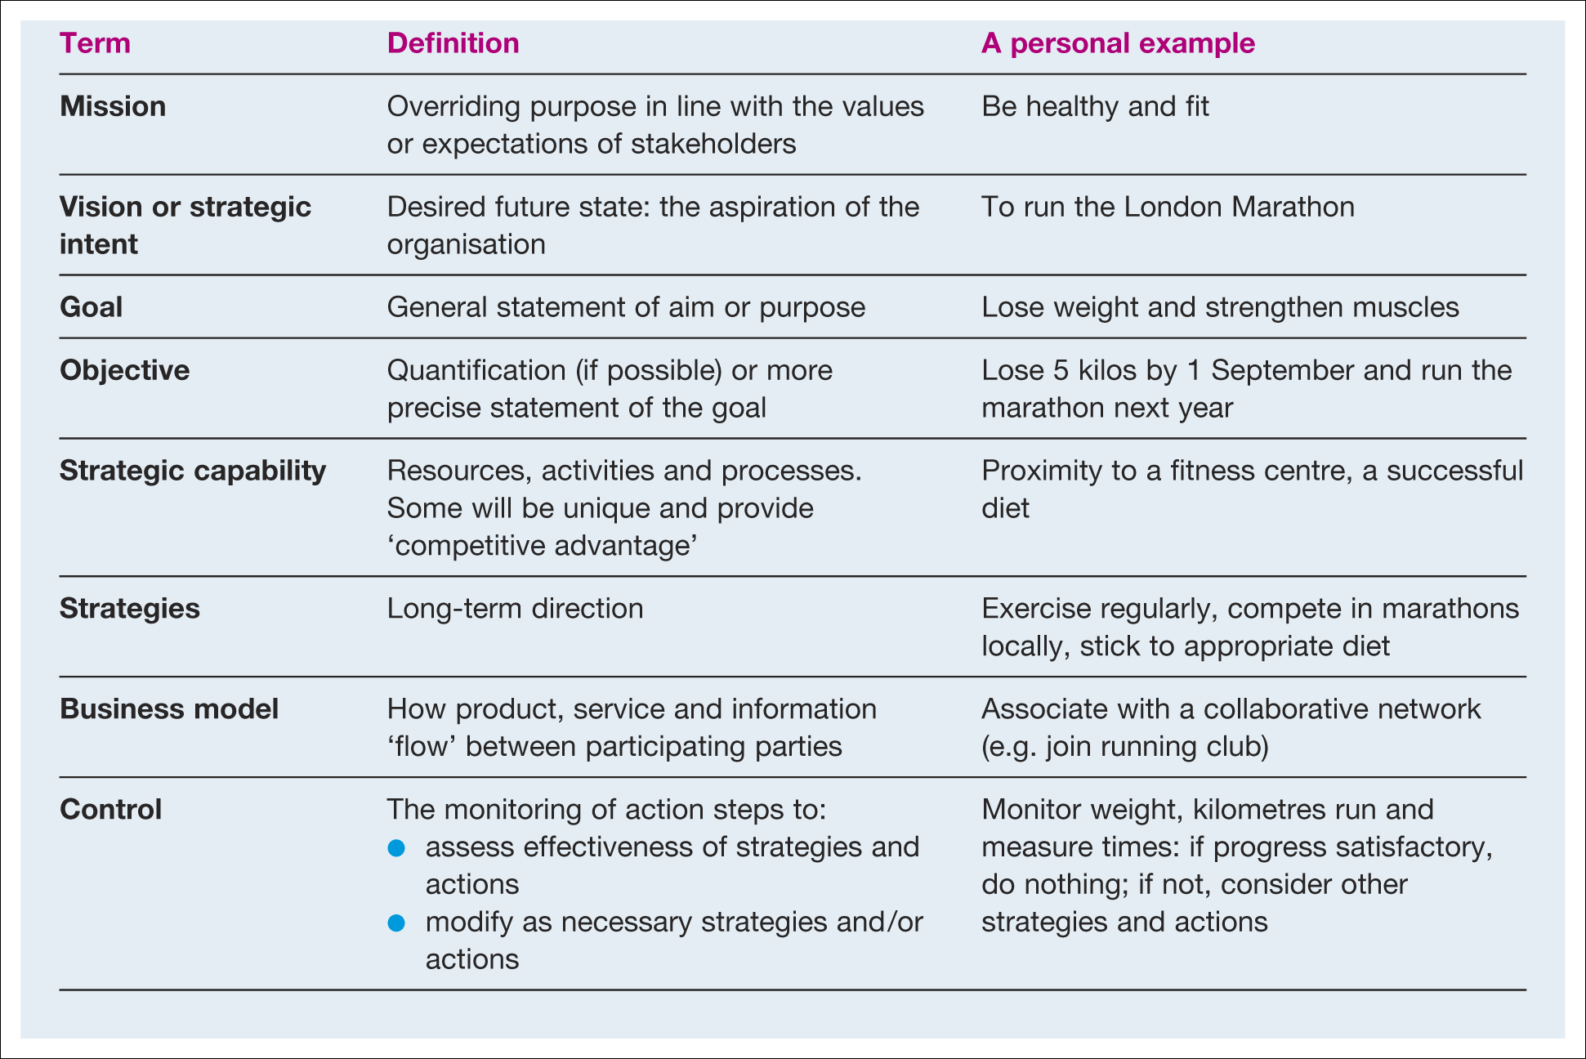
Vocabulary of Strategy

Slide 4
Vocabulary of Strategy:
Kingston University
Mission
  To promote participation in higher education, which it regards as a democratic entitlement; to strive for excellence in learning, teaching, and research; to realise the creative potential and fire the imagination of all its members; and to equip its students to make effective contributions to society and the economy.

Slide 5
What is Strategy?
Strategy is the direction and scope of an organisation over the long term, which achieves advantage in a changing environment through its configuration of resources and competences with the aim of fulfilling stakeholder expectations (Johnson et al 2011).

Slide 6
What is Strategic Management?
Strategic management includes understanding the strategic position of an organisation, making strategic choices for the future, and managing strategy in action (Johnson et al 2011).

Slide 7
What is Strategic Position?
Strategic position is concerned with the impact on strategy of the external environment, an organisation’s strategic capability and the expectations and influence of stakeholders (Johnson et al 2011).

Slide 8
What are Strategic Choices?
Strategic choices involve understanding the underlying bases for future strategy at both the business unit and corporate levels and the options for developing strategy in terms of both the directions and methods of development (Johnson et al 2011).

Slide 9
What is Strategy in Action?
Strategy in action is concerned with ensuring that strategies are working in practice (Johnson et al 2011).

Slide 10
Three Core Areas of Strategy
Strategic analysis
  Environment
  Resources
  Vision, mission and objectives
Strategic development
  Options
  Rational selection between options
  Finding the strategic route forward
Strategy implementation
  Resource allocation
  Strategic planning and control
  People issues and strategic change

Slide 11
Influences on
Strategy Making & Planning
EXTERNAL
INFLUENCES
Societal values
Demographics
Pressure groups
Government/legislation
NATURE OF
THE BUSINESS
Markets & competition
Products/services
Technology
Capital investment
PROCESS &
OBJECTIVES
ORGANISATIONAL
CULTURE
History and age
Leadership and
management style
Structure and systems
INDIVIDUALS
AND GROUPS
Expectations of stakeholders and
coalitions
Adapted from Johnson and Scholes 2004

Slide 12
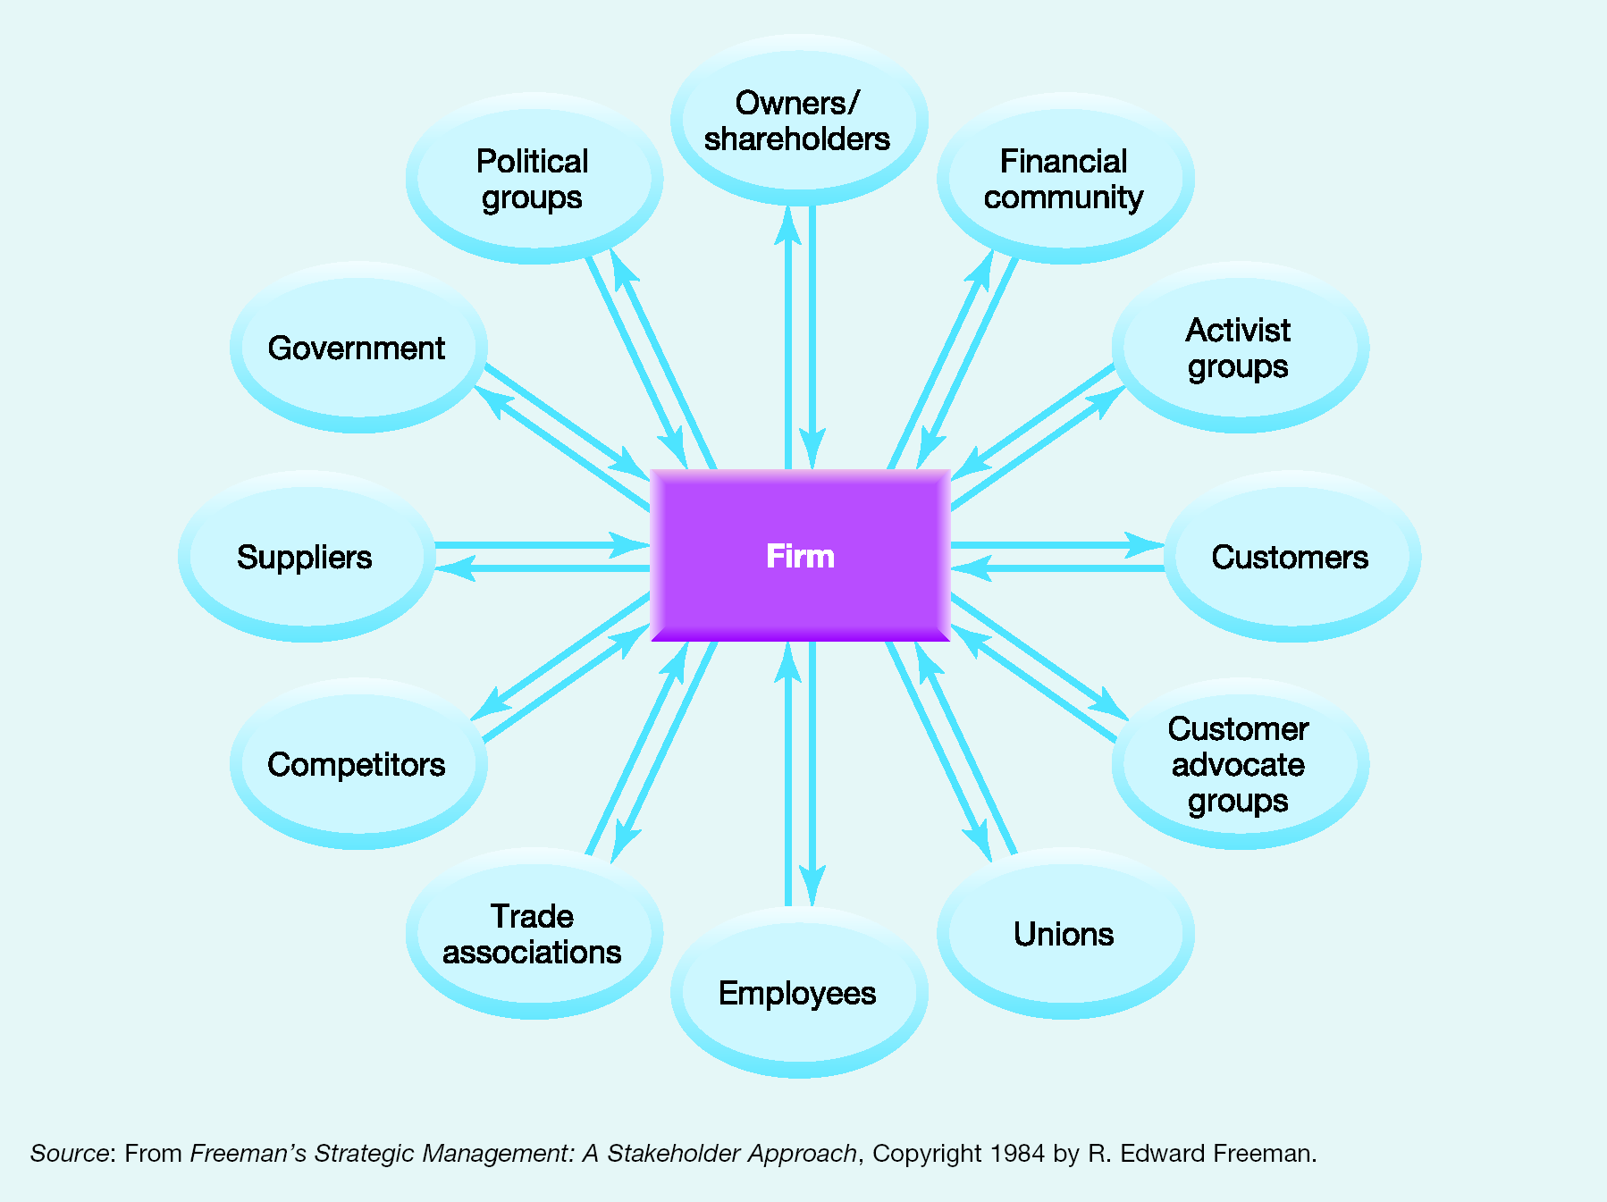
Stakeholders of Large Organisations

Slide 13
Discussion Questions
Identify examples of organisations, with which you are familiar, in different sectors. For each organisation please provide the following information:
Who are the key stakeholder groups? What is the key motive of each group? Which has greatest power?
How might this influence the organisation and its choice of values, direction and strategy?
What problems or conflicts might this cause in the organisation?

Slide 14
Reference List
Johnson, G and Scholes, K (2004) Exploring Corporate Strategy, London: Prentice Hall
Johnson, G, Scholes, K and Whittington, R (2011) Exploring Corporate Strategy: Text and Cases, London: Prentice Hall

Slide 15
Extended Knowledge
For a more extensive discussion and a fuller explanation of organisational purposes: values, mission, vision and objectives see Johnson et al 2008, Chapter 4, pp 131-171.

