Slide 1

Christian-Muslim Relations
Dr Angus M Slater

Slide 2
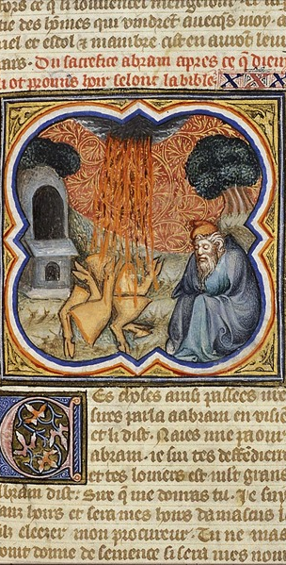
Revision
In the last section, we introduced the explosive expansion of the Muslim community and its caliphate during and after the lifetime of Muhammad.
We also looked at the various ways in which the changing circumstances posed by this expansion had an impact on the Muslim community and its interaction with Christian and Jewish communities.
This interaction flows both ways, as we saw in the exploration of Christian responses to the coming of Islam and the changing themes which emerged in this area – from fitting Islam into Old Testament prophecies (Sebeos), Islam as a form of divine judgement (Michael of Syria), and Islam as a form of Christian heresy (John of Damascus).

Slide 3
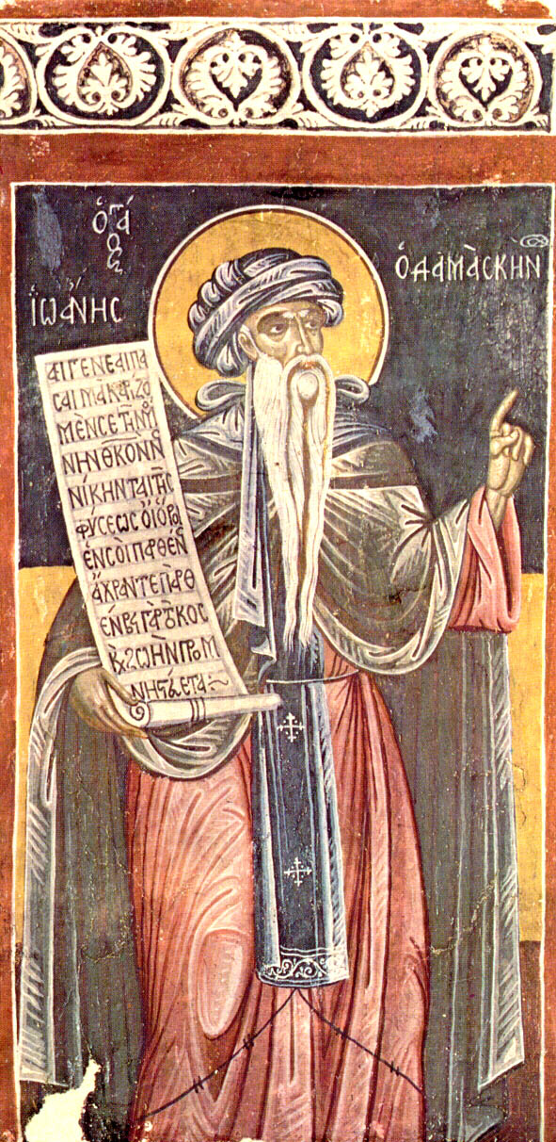
Revision
You had five readings to complete for the last section, which varied between primary sources and secondary literature.
The primary literature from John of Damascus and the Covenant of ‘Umar will give you a good grounding in the basic concepts and understandings circulating at this time in the relationship between Christianity and Islam.
The secondary literature from Stroumsa and Penn flesh this out further, with a deeper background to Syriac responses to Muslim conquest and a great description of the tri-partite relationality between Judaism, Christianity, and Islam.
The last chapter from Stroumsa offers up an argument that connects initial contact between Christians and Muslims and later developments.
Make sure that you take the time to discuss the readings in the appropriate Moodle section.

Slide 4
The Medieval Period – Crusades, Knowledge, and Transmission

Slide 5
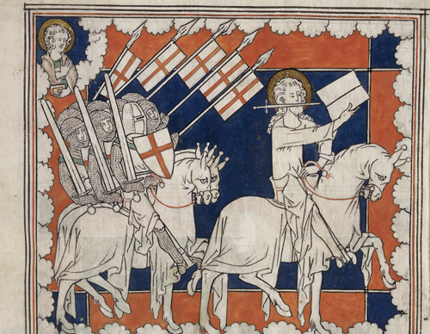
The Medieval Period – Crusades, Knowledge, and Transmission
In this section, we turn to the next stage of relation between Christian and Islamic traditions.
We have focused so far largely on Eastern Christian responses and experiences of Islam, for historical and geographical reasons. In this section, we will move somewhat further West in order to broaden our exploration of the historical context of Christian-Muslim relations. Remember, however, that the relationship between Christianity and Islam continues in the East – it is often easy to forget!
We also move forward in history a little (750AD onwards) in this section in order to include a vitally important part of the historical story, the Crusades – one which continues to have relevance and rhetorical power today.
It is often tempting to view the Crusades as emblematic of the tenor of Christian-Muslim relations during this historical period, but as we will see, there were a great number of geographical and situational variations present.

Slide 6
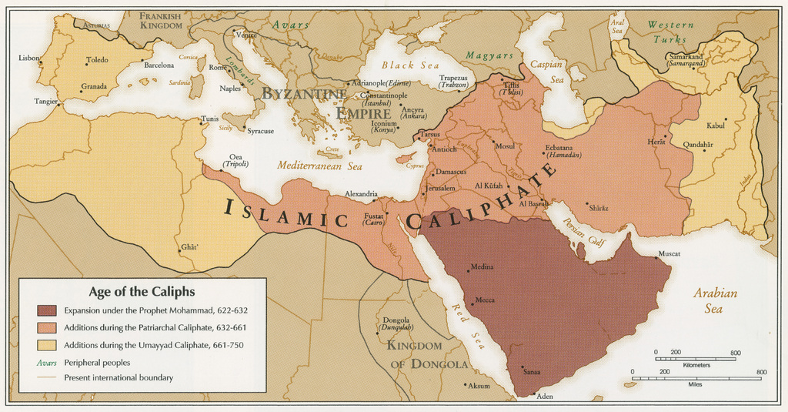

Slide 7
Western Christian Reactions to the Coming of Islam

Slide 8
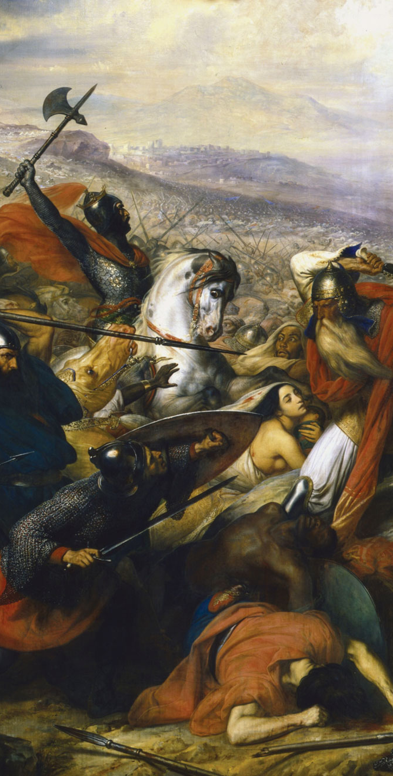
Western Christian Reactions to the Coming of Islam
As we have in earlier sections, increasingly the Christian communities in the East and West of the old Roman Empire had grown apart, with differing theological emphases and political systems of influence.
While Eastern Christians had had contact with the Muslim community from before the foundation of Islam, the Church in the West had not really had to grapple much with the coming of Islam until significantly later – 711AD with the invasion of the Spanish Visigothic kingdom, until 732AD when Muslim raiders were defeated by a Frankish army lead by Charles Martel at the Battle of Tours (125km from Paris) – but when doing so, the perceived threat very quickly became apparent.

Slide 9
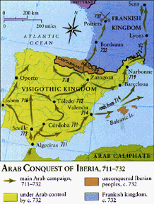

Slide 10
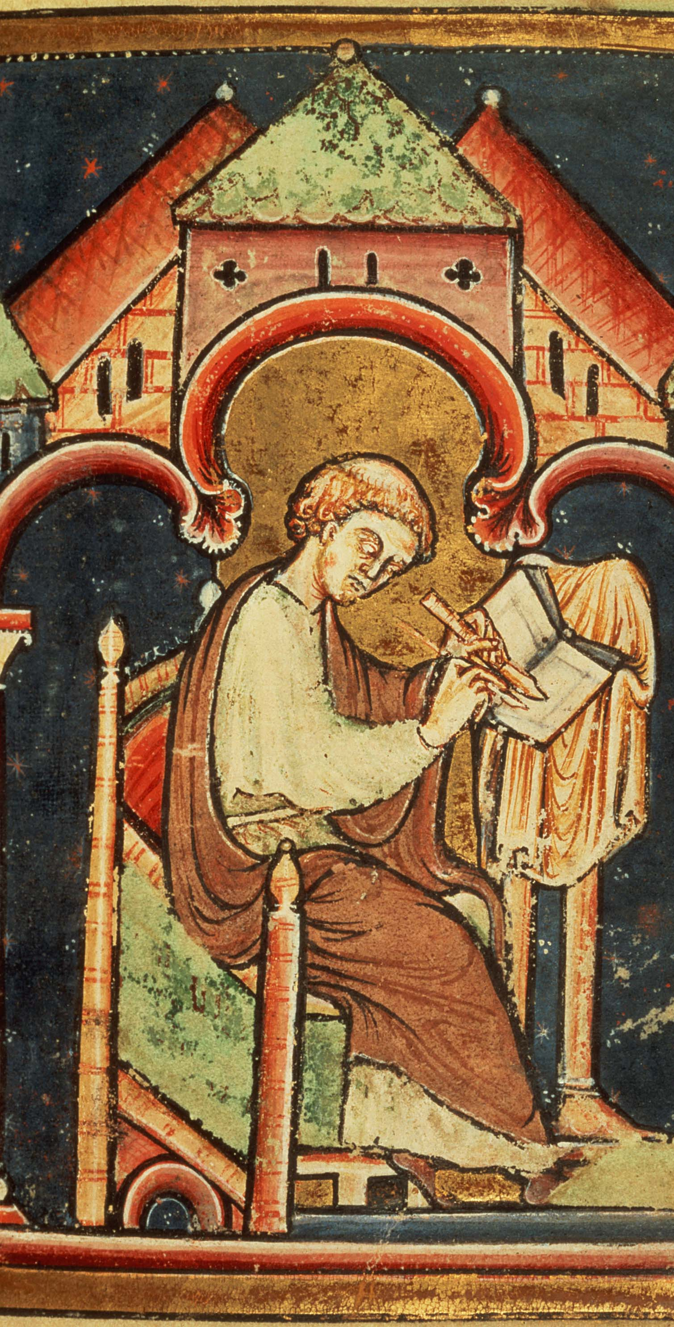
Western Christian Reactions to the Coming of Islam
This initial contact between the raiding tendrils of the Islamic caliphate and the Frankish kingdom in France caused a great deal of worry and speculation on the part of Western Christians at the time – the forming centralisation of the Church and secular power at this time allowed the news to travel quickly across Christian Europe, even reaching the Venerable Bede in Jarrow, England, who wrote:
‘In the year of our Lord 729, two comets appeared around the sun, striking terror into all who saw them. One comet rose early and preceded the sun, while the other followed the setting sun at evening, seeming to portend awful calamity to east and west alike. One comet was the precursor of day, and the other of night, to indicate that mankind was menaced by evils at both times. They appeared in the month of January, and remained visible for about a fortnight, bearing their fiery trails northward as though to set the welkin aflame. At this time, a swarm of Saracens ravaged Gaul wit horrible slaughter, but after a brief interval in that country, they paid the penalty of their wickedness’
Bede’s view of the coming of Islam took the same form as early Eastern Christian approaches, interpreting them as the descendants of Ishmael from the Old Testament and their raids as similar to those of the Vikings – difficult, but by no means existential.

Slide 11
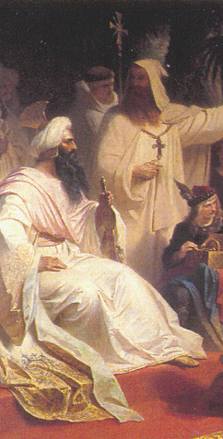
Western Christian Reactions to the Coming of Islam
This early form of reaction from Western Christians swiftly changed as the nature of the relationship between Christian and Islamic communities changed, particularly in Andalusia, where the Umayyad Caliphate had fled to, following their overthrow by the Abbasids.
This split in the Muslim community promoted increasing interchanges between rulers – for example the exchange of diplomats and gifts between Harun Al-Rashid, the Abbasid Caliph made famous in the West by his association with the tales of the Arabian Nights, and Charlemagne, the Emperor of the Carolingian Empire.
However, this split is also the location in Andalusia, of the first experience of Western Christians living under Muslim rule – a situation in which arose the first sustained western interpretation of Islam, one which was to continue to have significance to this day.

Slide 12
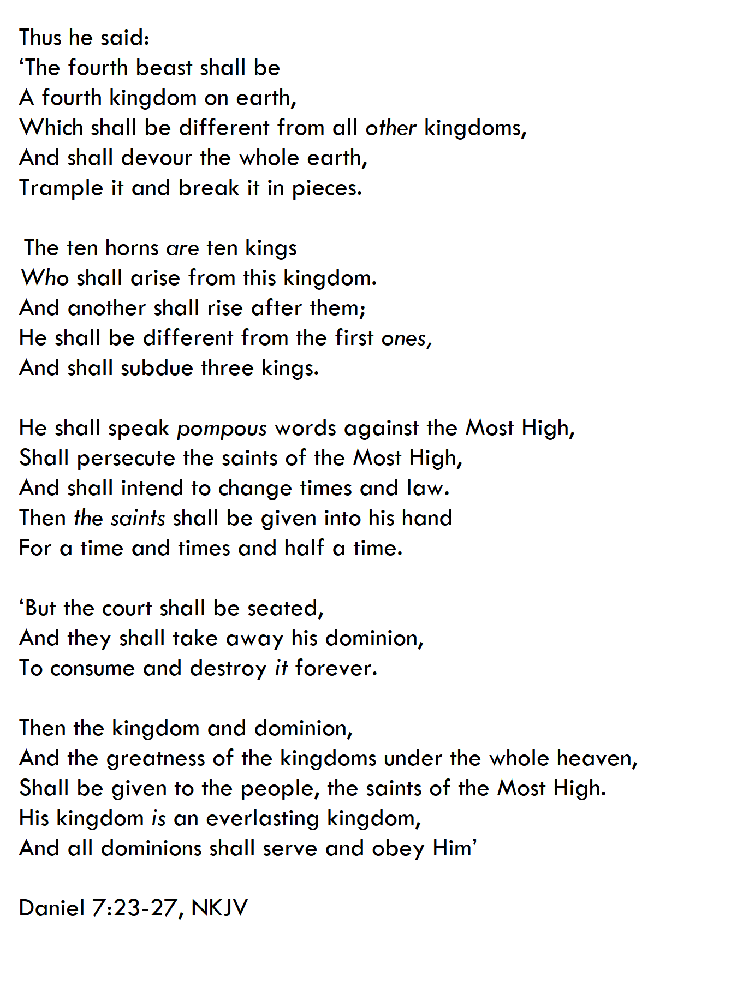
Spanish Martyrs Movement – 850-860AD
This first specifically western Christian response to Islam arose in the city of Cordoba, the capital of the Umayyad caliphate in Spain, from among the Christian population living under Muslim rule.
Two Christians, a priest Eulogius and a layman Paul Alvarus, experiencing the rise of Islamic rule sought, as others had done before, to interpret and understand the meaning of this historical occurrence through the lens of scripture. Unlike previous attempts, and in reaction to their experiences, they focused their interpretation on the apocalyptic passages of the Old Testament such as Daniel 7 – where four beasts are described; a lion, a bear, a leopard, and a fourth terrible beast – all of which represent kings and kingdoms.
Previously these beasts had been associated with the empires of the past; Babylon, Persia, Greece, and Rome. However, the experiences of Paul and Eulogios drove them to re-envision the applicability of this chapter to their own times – identifying their experiences under Muslim rule with the apocalyptic imagery present here and elsewhere in the scriptures (Mark 13, Revelation 13, etc), they were convinced that the establishment of Muslim rule was a stepping stone to the end times, and that Muslims played the role of the scripturally described Anti-Christ in this theological / historical drama.

Slide 13
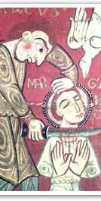
Spanish Martyrs Movement – 850-860AD
This association of Islam with the Antichrist proved to be a significantly new and powerful, theological trope of interpretation, which continues to have relevance today.
The impact on the Christian community of Cordoba was significant, with a flourishing of religious fervor leading to public denouncements of Muhammad and successful calls on Muslims to convert being made. This broke the expected norms of behaviour for Christians under Muslim rule and led to a number of executions and martyrdoms in the Christian community.
While the movement in Cordoba itself was suppressed by about 860AD, the trope of Islam as associated with the Antichrist and the End Times spread swiftly through the increasingly interconnected Christian kingdoms and proved a major turning point in the understanding of the role of Islam for the Western Church.
Islam had shifted – from the somewhat everyday raiders of Bede, to an existential and theological threat to the foundation of religious and secular power in the West.

Slide 14
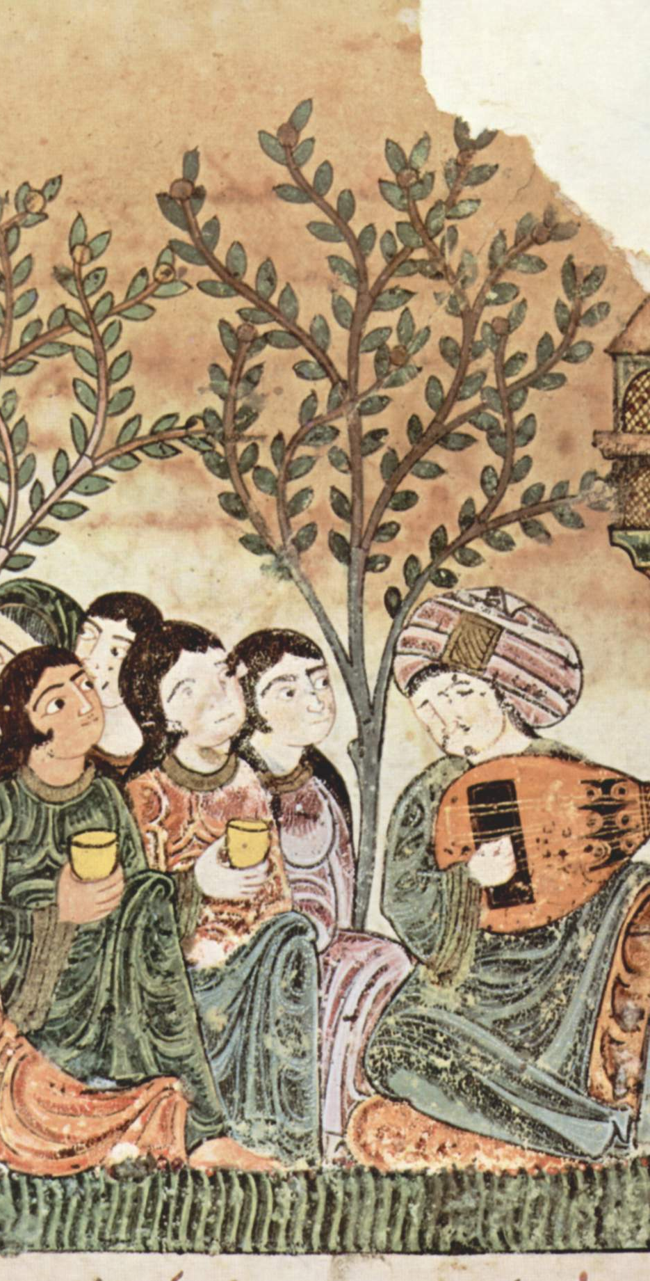
Western Christian Reactions to the Coming of Islam
This example of the Spanish Martyrs is a useful one, as it illuminates the changing role that Islam came to play between the initial contact with the West in 700AD and the period of the Crusades from 1095AD onwards.
The trends and themes in the conceptualisation of the other, both Christianity of Islam and Islam of Christianity, do not emerge out of nowhere – they have specific and particular resonances which continue to influence our conceptions of the other today.
Western Christian responses to Islam became significant different to Eastern Christian responses because of their differences of situation, with an increasingly hostile and threatening attitude emerging between communities on both sides of the religious divide.
We move now to another of these crucial turning points in the relationship between Christianity and Islam – the period of the Crusades.

Slide 15
The Crusades – 1095AD-1291AD

Slide 16
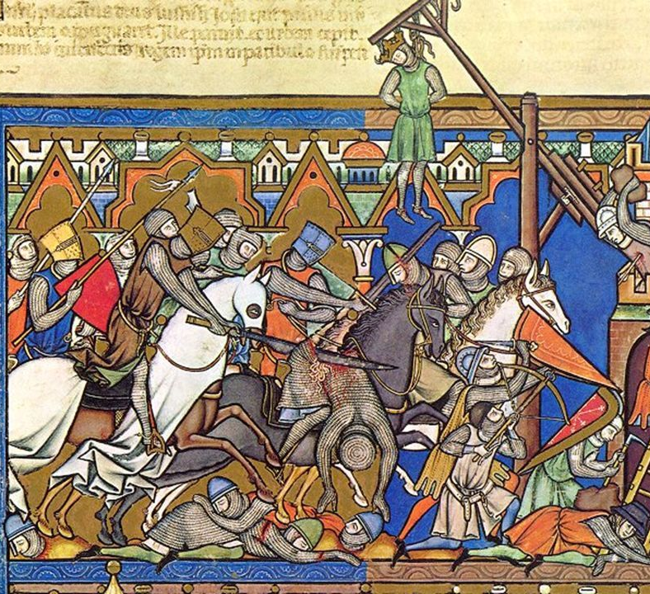
The Crusades – 1095AD-1291AD
The period of the Crusades, stemming from the stunning successes of the First Crusade (1096-1099AD), through the supporting Second (1147-1149AD) and Third (1189-1192AD) crusades, the misdirection of the Fourth crusade (1202-1204AD), and ending with the ignominious failures of the Fifth Crusade 1228AD-) onwards, have a significant effect on the development of the relationship between Christian and Islamic communities, both within their societies and in the borderlands between them.
It is not my aim in this section to develop and lead you through the history of the Crusades in great detail – there are plenty of excellent sources for that like Tyerman’s ‘God’s War’ or Runciman’s ‘A History of the Crusades’ – but rather to examine the way in which this period of contact changed the tenor of the relationship which had been built up between the two communities in the preceding centuries.
Take the time to familiarize yourself with the rough historical outline of the period – there is too much to cover well in this short section!

Slide 17
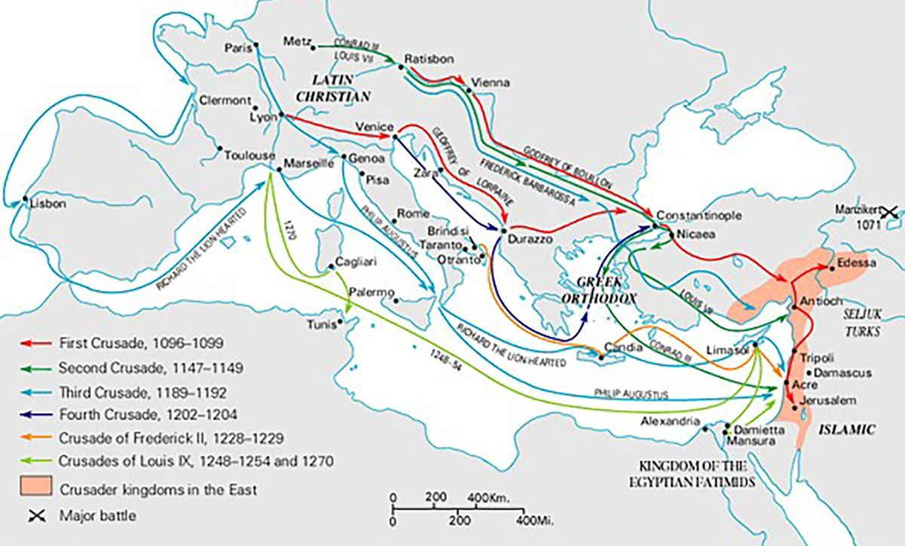

Slide 18
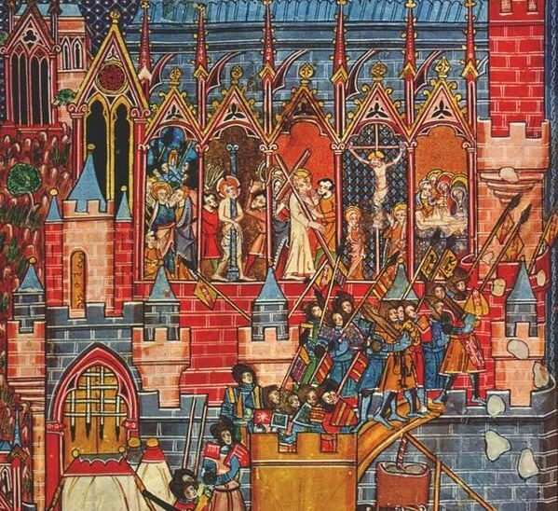
The Crusades – 1095AD-1291AD
Initially, Muslim reactions to the Crusades were of a part with ongoing expectations and relations between the Muslim states in Syria and the Near East and the Byzantine Empire, which still controlled most of Anatolia.
The Byzantines had employed significant quantities of Frankish and Rus mercenaries for decades, and the appearance of more of these troops in the area initially seemed to be nothing out of the ordinary.
However, with the sack of Jerusalem and the massacre of its inhabitants in 1099AD, perceptions of the Frankish crusaders shifted, with a reputation for barbarism and fanaticism becoming more prevalent among Muslim communities in the nearby area.
This reputation for barbarism did not only extend to aspects of warfare and fighting, such as the slaughter of civilian populations, but can also be seen in contemporary accounts of Muslim reactions to Frankish notions of medicine and justice.

Slide 19
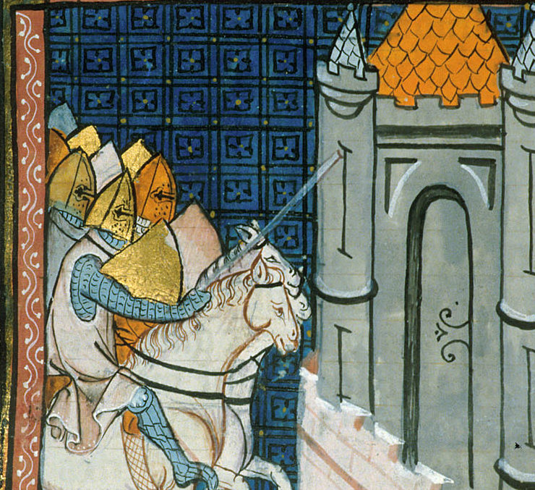
The Crusades – 1095AD-1291AD
The account of Usama ibn Munqidh (1095-1188AD) is particularly useful in this regard – in the context of medicine he describes his astonishment at the attempted cure of a leg abscess with an axe, which unsurprisingly results in the death of the patient, and the trepanning of a mentally ill woman resulting in her death as well.
In the field of justice, ibn Munqidh relates two anecdotes that further this impression of barbarism – the first is the settling of a legal dispute through a duel, which appears deeply unjust to him, and the second is the use of ‘ordeal by water’ in order to ascertain guilt, where the accused is thrown into a barrel of blessed water – the guilty to float as the water repels them, the innocent to sink.
Beyond this general impression, scholars (Watt, 2000) suggest six major changes in the way that Muslim and Christian communities envisioned each other resulting from the period of interaction of the Crusades.

Slide 20
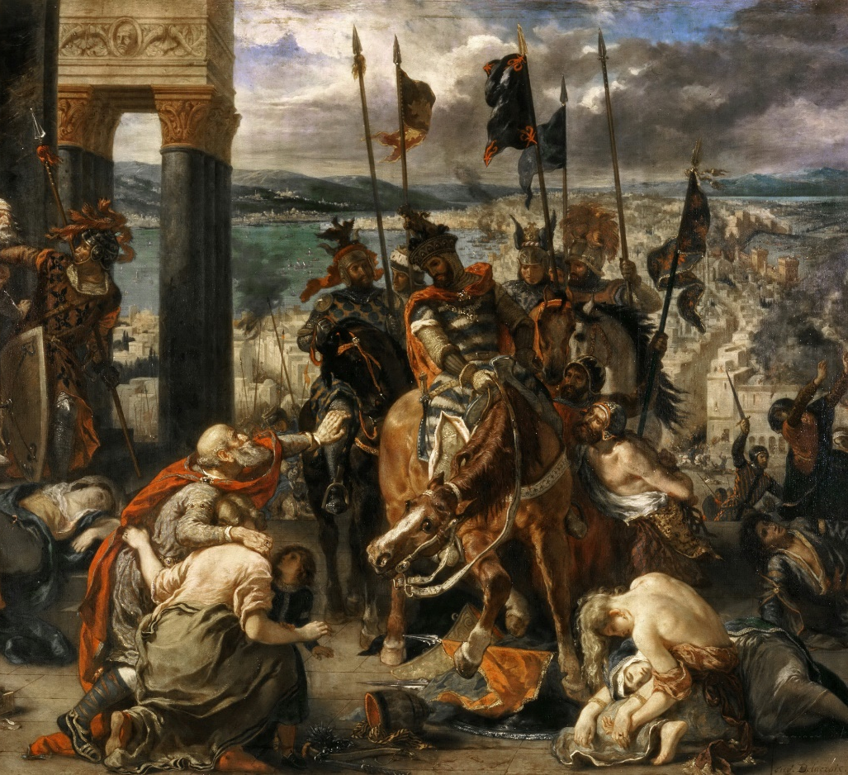
The Crusades – 1095AD-1291AD
These are:
1 – A lasting suspicion of Western Christians among Muslim communities
2 – A revival of Muslim expansion and consolidation
3 – A solidification of Muslim attitudes and veneration of Jerusalem as religiously important
4 – A increased suspicion and repression of Christian communities in Muslim lands
5 – A increased role for the Western Church in Christian communities in the Near East
6 – A lasting increase in the level of intellectual interchange and exchange between Near Eastern Muslim communities and Western European Christian communities
To these, I would add – a weakening of the Byzantine Empire and its importance in the workings of Eastern Christianity, a solidification of the international connections of ‘Christendom’ in Western Europe, and an acceleration of the identification of the other with aspects of religious threat.

Slide 21
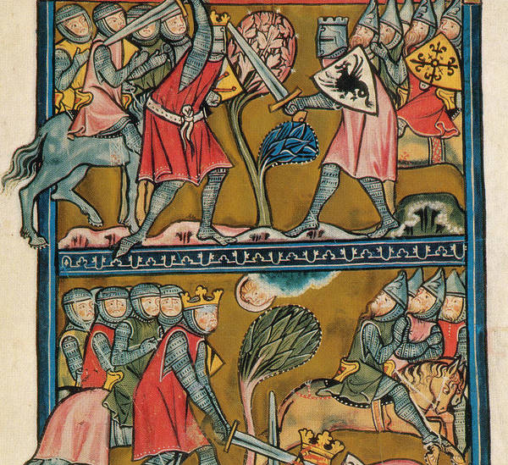
The Crusades – 1095AD-1291AD
The swirl of completing conceptions of Islam within Western Christendom had some impact on the impetus of crusading, yet when looking at later sources, it is difficult to support the idea that Christians in the West had much idea about what exactly Islam was, even at this stage.
What had filtered through tended to be heavily distorted, either by simple chance or by political motivations on the part of writers – for example, in the period after the Spanish Martyrs, we see descriptions of Islam as demonic, sexually licentious, and magical, as well as Muhammad as claiming divinity and deliberately fulfilling aspects of apocalyptic prophecy.
We can see this in the famous work The Song of Roland, one of the earliest of the chivalric writings in the West, which describes Charles Martel’s victory over the Saracens at Tours. In it, the Saracens worship three Gods – Muhammad, Apollyon, and Termagent – who are obviously the product more of Western imagination than actual experience or knowledge, a blend of pagan historical gods and heard snatches of actual Muslim practice.

Slide 22
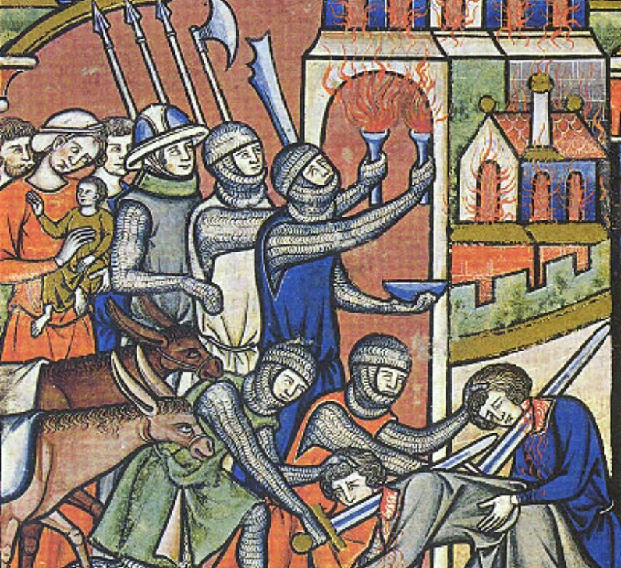
The Crusades – 1095AD-1291AD
It is tempting, sometimes, to view the period of the Crusades as a purely negative encounter in the long relationship between Christianity and Islam.
In many ways, this is correct – the impressions given of each community to the other were often largely negative, filtered through brutal combat and tit-for-tat massacres. We also see the acceleration of the type of concepts used to produce demonic, apocalyptic, and theological threatening visions of the other and their increased influence on popular culture on both sides.
Yet, in many other ways the Crusades represent the first great expansion of relation between Western Christianity and Islam, with increased knowledge and exchange occurring throughout the period. In addition to the new experiences felt by those who travelled on Crusade or on pilgrimage to the Holy Land, the return of crusaders to western Europe transformed significant social and cultural aspects of those societies – in ways that continue to shape our contemporary societies as well.

Slide 23
Perception and Transmission of Knowledge

Slide 24
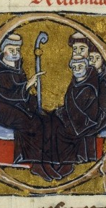
Perception and Transmission of Knowledge
One of the best examples of the fruits of this increased interaction between the Muslim and Western Christian worlds, is through the work of Peter the Venerable (1092-1156AD), the abbot of the great monastery at Cluny.
While Bernard of Clairvaux was preaching the crusade, Peter understood the challenge of Islam in a different way, investing in understanding its core beliefs and practices – this involved a sustained attempt at translating the key texts of Islam and seeking to understand the formation of Islam through its own sources.
Largely completed in Spain, Peter’s efforts at encouraging the translation of Islamic texts resulted in the first translation of the Qur’an by Robert of Ketton in 1143AD, the translation of accounts of the life of Muhammad, a translation of al-Kindi’s Apology from ~900-100AD, and various other documents.
This is the first instance we have of a sustained attempt at translating the sources of the Muslim tradition into forms familiar to Western Christianity – for the first time, Islam could be studied seriously and on its own terms.

Slide 25
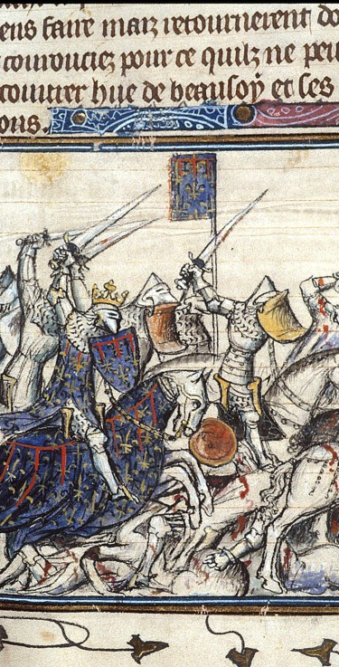
Perception and Transmission of Knowledge
In Peter’s own works, the Summa totius heresis Saracenorum ( The Summary of the Entire Heresy of the Saracens) and the Liber contra sectam sive heresim Saracenorum (The Refutation of the Sect or Heresy of the Saracens), he extends and expands the knowledge gained through this process of translation, attempting in the Summa to encapsulate the beliefs of the Muslim tradition and in the Liber to refute the key aspects of Muslim beliefs from the Christian perspective.
As you can tell from the titles, Peter was originally most concerned with providing a clear outline of the principles of Muslim beliefs, but, as with John of Damascus earlier, saw these beliefs as stemming from a heretical form of Christianity.
In contrast to earlier versions of this approach, the tone taken by Peter is one of a call to return to true belief, issued out of Christian love. He writes:
‘It seems strange, and perhaps it really is, that I, a man so very distant from you I place, speaking a different language, having a state of life separate from yours, a stranger to your customs and life, write from the far parts of the West to men who inhabit the lands of the East and South, and that I attack, by my utterance, those whom I have never seen, whom I shall perhaps never see. But I do not attack you, as some of us often do, by arms, but by words, not by force, but by reason; not in hatred, but in love’

Slide 26
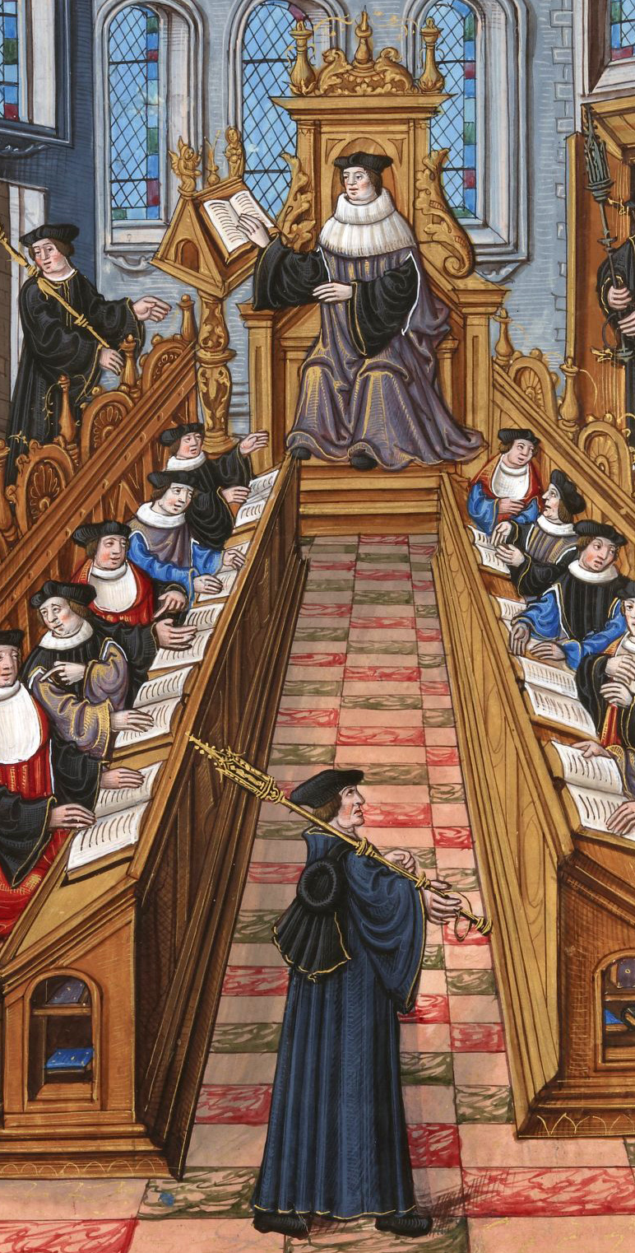
Perception and Transmission of Knowledge
During the time period of the Crusades, the equivalent availability of knowledge in Muslim and western Christian communities was deeply unequal – Muslim societies had access to much more ancient Greek philosophical, medical, and engineering treatises, had significant state-endowed patronages of the arts and scholarship, and were located within a transnational system of knowledge exchange which prioritised the celebration of learning.
In almost every way, western Christian communities were backward intellectually at this point, politically weak and de-centralised, and economically primitive when compared with their Muslim neighbours.
Yet, over the period from about 1000AD-1400AD, this severe imbalance begins to change with the increased centralisation and internationalisation of the West – this promotes not only a significant new focus on scholarship and learning in the west (e.g. the setting up of the first universities, aping similar Muslim institutions), but also increases the transmission of intellectual thought between Muslim and Christian communities, focused largely on the translation of classic Greek texts.

Slide 27
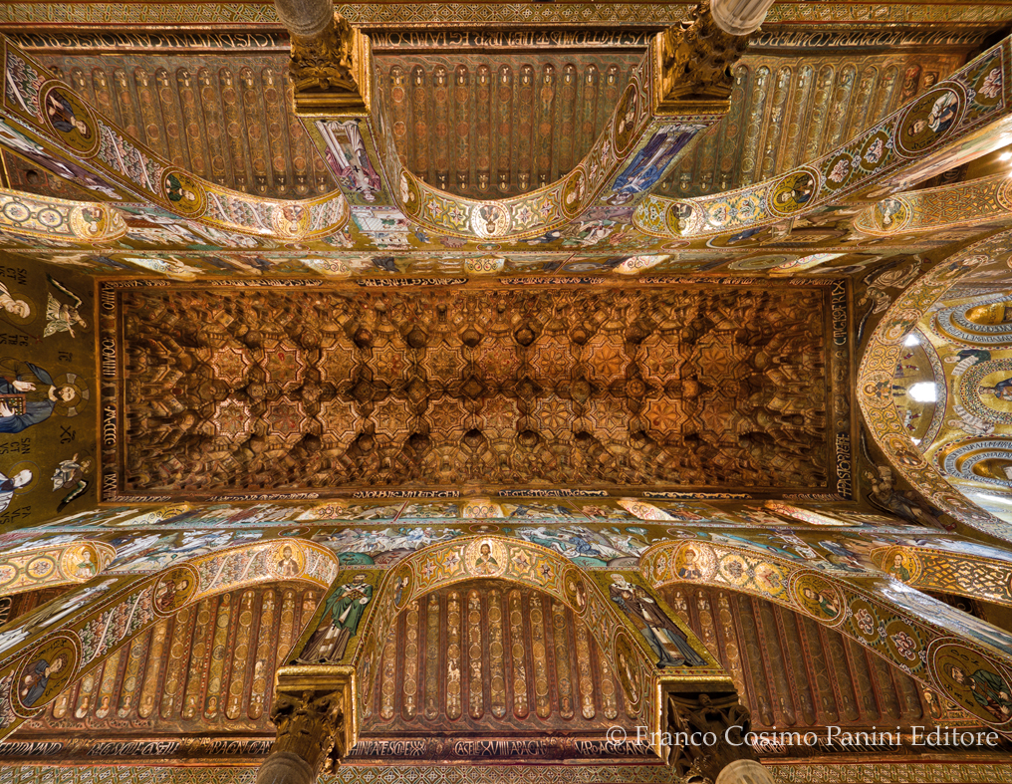
Perception and Transmission of Knowledge
Two particular geographic areas played a prominent role in this growth of cultural exchange between Muslim and Christian communities – both places where co-religionists lived in close proximity – the Norman conquest of Sicily (1030-1090AD) and their subsequent rule over large Muslim populations, and the Hispanic Peninsula, split between Christian kingdoms and the powerful Muslim Almohads, and the subsequent mixing of Christian and Muslim communities.
In each of these situations, populations of both Christian and Muslims lived under rule by the other, with cultural, religious, and social interchange becoming a common facet of their societies.
In both cases, we see tension between the communities, but also a flourishing of intellectual and spiritual pursuits, including a mixing of artistic styles – like the church roof from Palermo, opposite.

Slide 28
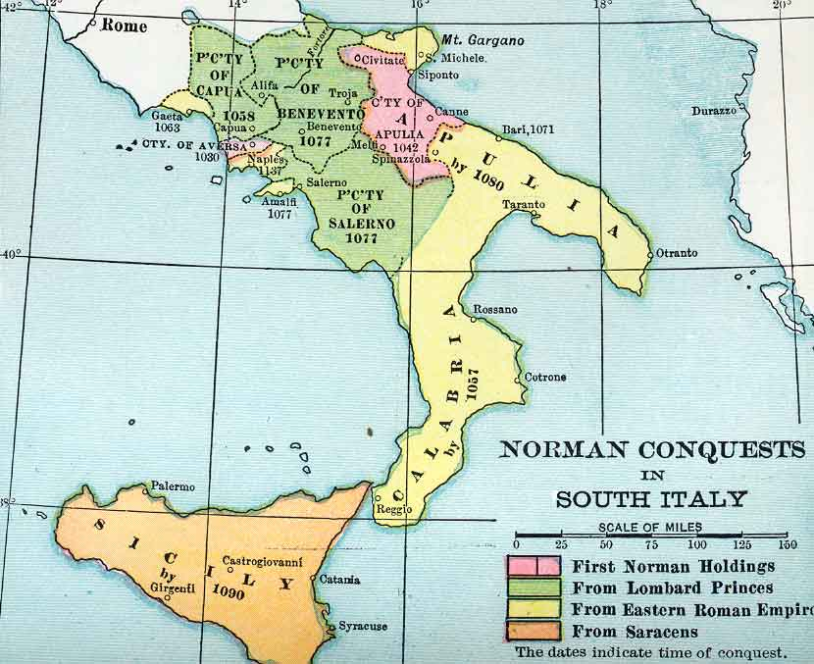

Slide 29
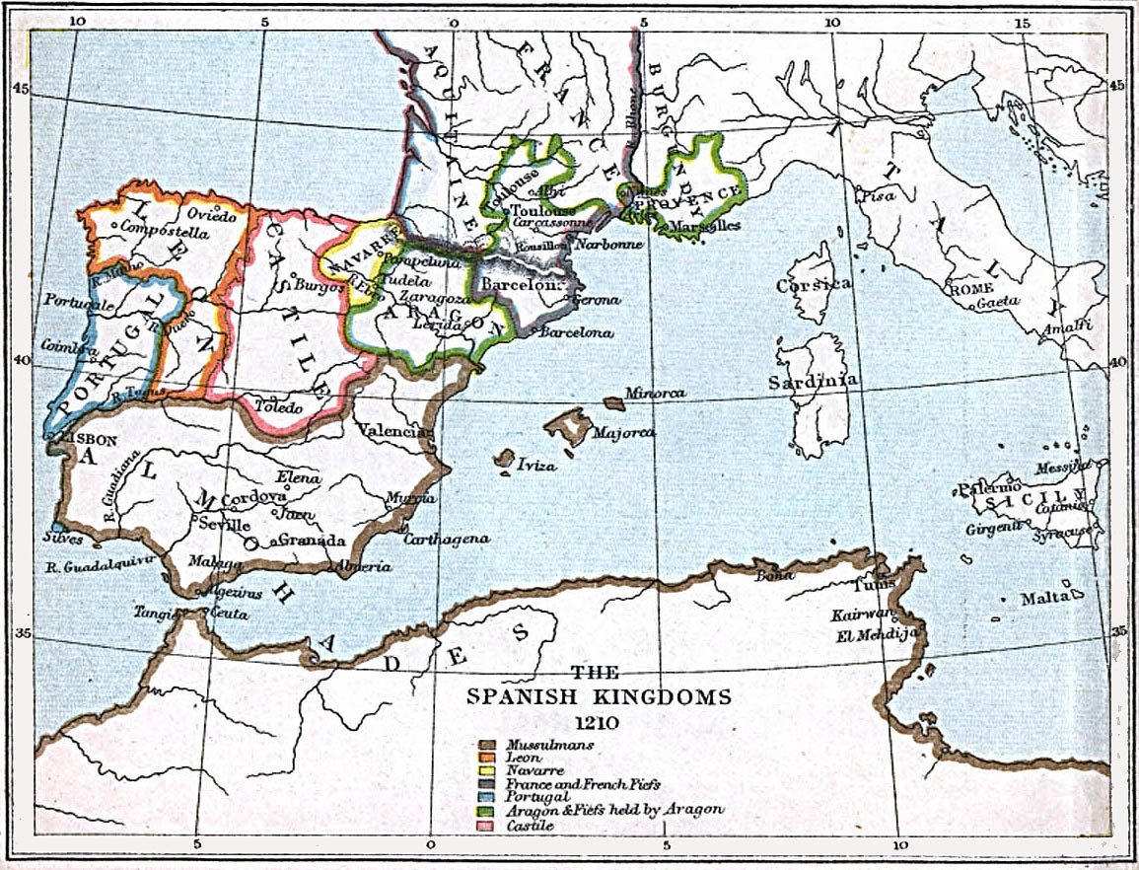

Slide 30
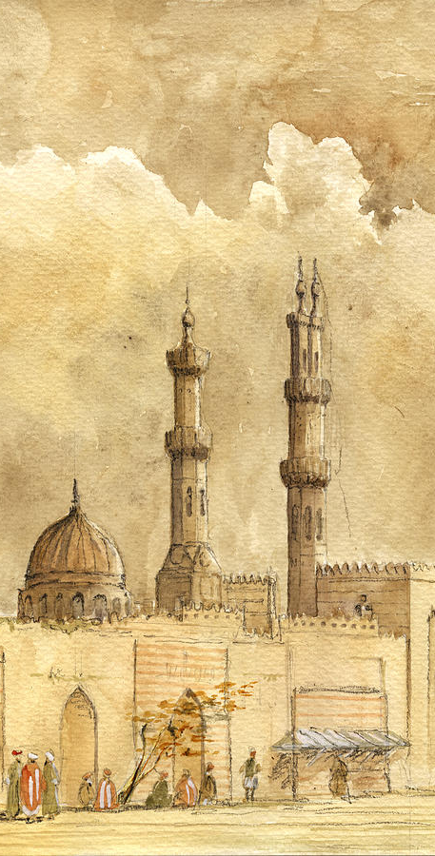
Perception and Transmission of Knowledge
Beyond these geographical overlaps, we also see two large cultural influence of the Muslim community emerge in western Europe.
The first is the establishment of learning communities modelled on Islamic centres of learning in the Near East such as al-Ahzar (969AD), the first western universities. Almost all of the earliest institutions in the West are founded in the immediate period during / after the Crusades in places like Bologna, Oxford, Salamanca, etc.
Even today, many of the forms and rituals of university life can be traced back to this Islamic foundation (Makdisi, 1981), such as the wearing of academic robes, the holding of a ‘chair’, teaching ‘circles’, th endowment of ‘degrees’, and the mixed faculty model of education.
When you graduate, remember this!

Slide 31
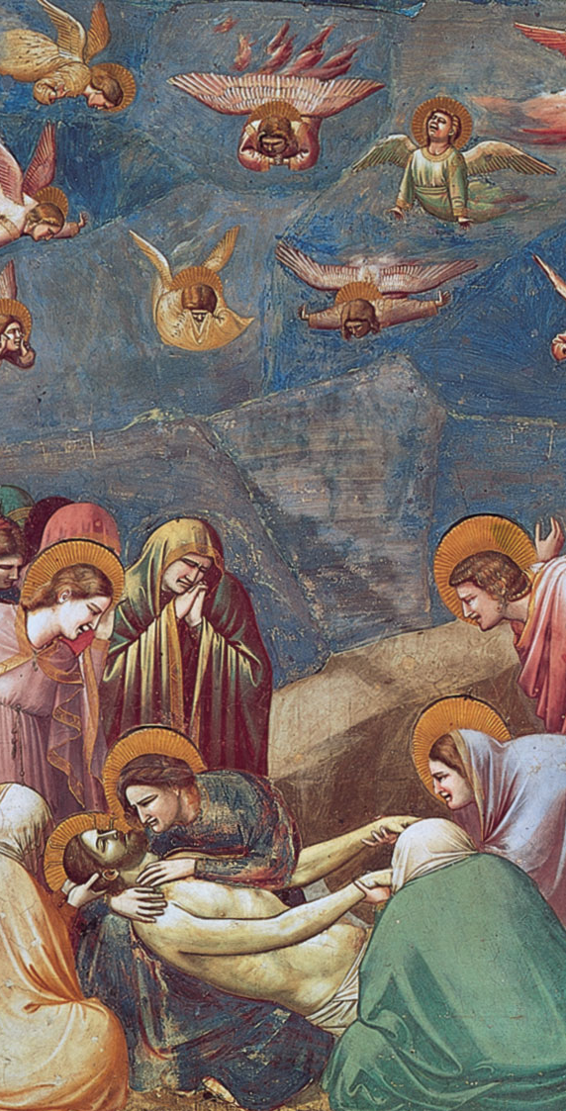
Perception and Transmission of Knowledge
The second example of this increased period of interchange is to be found in the foundations of the later western European period of the Renaissance, extending from the 12th century.
In this period, many more works of literature, philosophy, medicine, engineering, poetry, and theological matters were translated between Greek, Arabic, and Latin promoting further cultural, artistic, and philosophical interchange. Figures such as Avicenna (Ibn Sina), Averroes (Ibn Rushd), and Moses Maimonides became well known among the intelligentsia of the western Christian community as did the translation of ancient Greek texts by Plato, Aristotle, Socrates, and others.
An example of this milieu is the case of Averroes and Aquinas. Averroes, the Muslim philosopher Ibn Rushd lived in Spain from 1126 AD, and was profoundly influenced by, and supportive of, Aristotelian concepts of like the eternality of the world. In addition he supported the equal place of reason with scripture in determining the truth of reality.
He was opposed, directly and indirectly, in his interpretation and support of Aristotle by the great Christian medieval theologian, Aquinas (1225-1274AD), who argued for the Christian and Muslim beliefs of creation ex nihilo, and for the primacy of scripture.

Slide 32
Readings

Slide 33
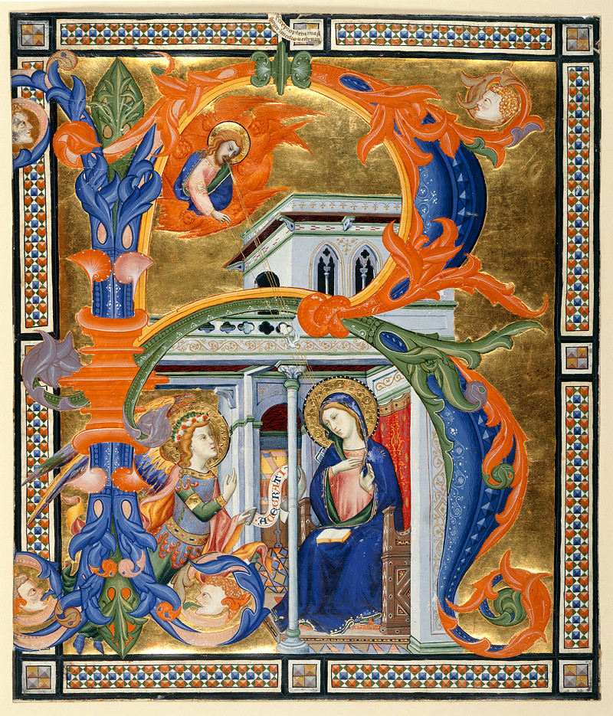
Readings
The readings for this section are, by necessity, broad in scope with two primary sources (Al-Kindi and ibn-Mundiqh) and two other sources being offered.
Each reading will give you an insight into a small area of this vast period of history – if you an interested in a differing area then let the module tutor know and they can advise on further reading.

Slide 34
Readings
Usamah ibn-Munqidh – “Chapter 8: An Appreciation of the Frankish Character” in Kitāb al-Iʻtibār (trans P. Hitti, 2000)
Peter the Venerable - Summa totius heresis Saracenorum, p. 34-51 (trans. I. Resnick, 2016)
Two primary sources from differing time periods – ibn-Mundiqh offers a first-hand account of the cultural and social differences between Muslim communities and Christian crusaders, while Peter the Venerable provides a readable account of early Christian conceptions of Islam.
Abd al-Masih ibn Ishaq al-Kindi – The Apology of Al-Kindi – p. 90-107 (trans. W. Muir, 1887)
I have also included a PDF copy of Al-Kindi’s much earlier, but influential, Apology should you wish to engage in further reading.
Mourad, S., & Lindsay, J. (2012-08-01). Ibn ‘Asakir and the Intensification and Reorientation of Sunni Jihad Ideology in Crusader-Era Syria. In Just Wars, Holy Wars, and Jihads: Christian, Jewish, and Muslim Encounters and Exchanges. : Oxford University Press.
Davis, G. (2012-08-01). Angles of Influence: Jihad and Just War in Early Modern Spain. In Just Wars, Holy Wars, and Jihads: Christian, Jewish, and Muslim Encounters and Exchanges. : Oxford University Press.
Two further sources that explore in more detail the changing way in which the interaction between Muslim and Christian communities had an impact on the other.

