Slide 1
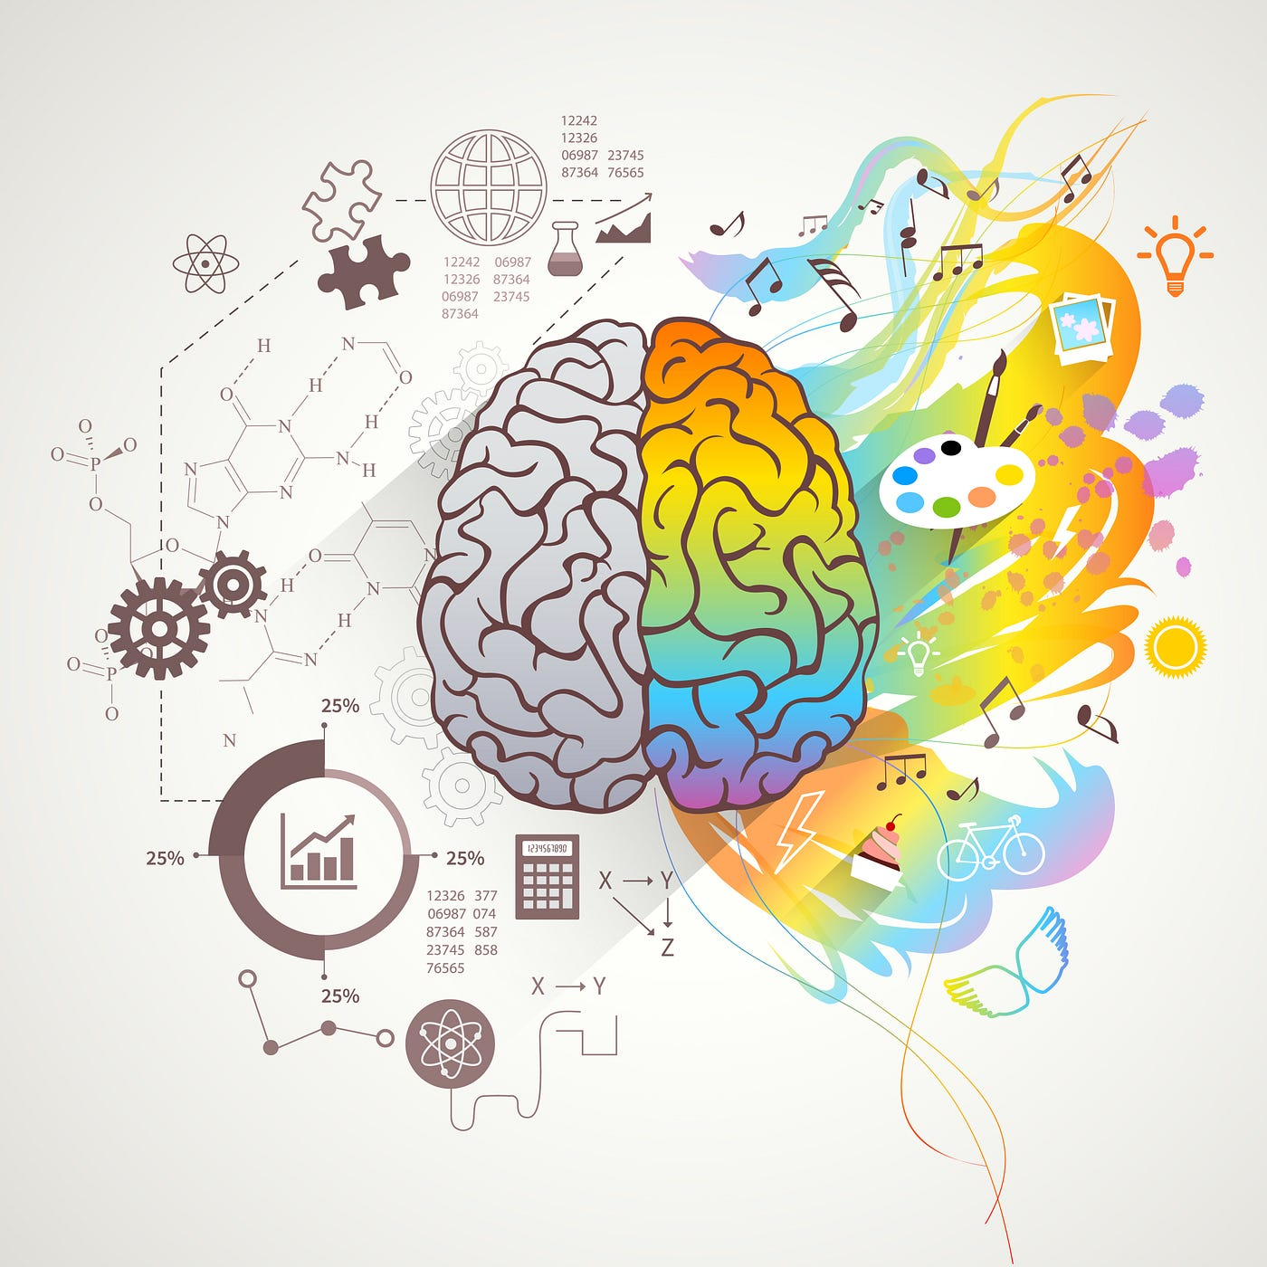

Understanding My Emotions: Developing Emotional Intelligence as a Student
Module: Developing Emotional Intelligence Skills (LCLM5006)
HANDLING EMOTIONS
EMPATHY
Empathy and social awareness can be improved through active listening and understanding different perspectives (Bradberry and Greaves, 2009).
Social awareness
SELF-AWARENESS
MOTIVATION
Q1:
Emotional intelligence can be developed as an ability through reflection, learning and continuous practice (Mayer and Salovey, 1997).
Self-awareness enables individuals to recognise emotional triggers and understand how emotions influence thoughts and behaviours (Goleman, 1995).
Developing emotional regulation supports thoughtful responses rather than impulsive reactions in challenging situations (Gross, 2015).
Mindfulness enhances emotional intelligence by increasing awareness of emotions in the present moment (Brown and Ryan, 2003).
How can emotional intelligence be developed?
Name | Raluca Mihaela Popa Student ID |2332370
Lecturer: Abdallah Naser
Controlling emotions
As a student, during assessment periods, I often experience stress and anxiety. Increased emotional awareness has helped me pause, reflect and manage pressure more effectively.
Developing mindfulness
Mindfulness techniques, such as breathing and short reflection, have helped me stay focused and reduce feelings of overwhelm during academic challenges.
Q2:
Reflection: Emotions, Mindfulness
and Academic Life
INTRODUCTION
Emotional intelligence involves recognising and managing one’s own emotions and responding effectively to others (Goleman, 1995). In higher education, emotional intelligence is essential for managing stress, academic pressure and feedback. This poster explores how developing emotional intelligence and mindfulness can support emotional control and academic success.
METHOD
Review of academic literature on emotional intelligence and employability
Use of peer-reviewed journal articles and academic textbooks
Focus on EI in education and workplace contexts
Reflective approach based on my experience as a student
CONCLUSION
Developing emotional intelligence and mindfulness has improved my ability to manage academic stress and emotional challenges. These skills support resilience, motivation and academic performance, while also preparing students for future professional environments.
ACADEMIC SUCCESS: FACTORS & ACTIONS
This poster is based on a review of academic literature on emotional intelligence and mindfulness, combined with reflective practice to link theory to my experience as a university student.
KEY FACTORS
Emotional awareness
Resilience
Time management
Motivation
REFERENCES
ACTIONS
Reflecting on feedback constructively
Seeking academic support
Managing emotions proactively
Setting realistic goals
Bradberry, T. and Greaves, J. (2009) Emotional Intelligence 2.0.
Brown, K.W. and Ryan, R.M. (2003) Journal of Personality and Social Psychology.
Goleman, D. (1995) Emotional Intelligence.
Gross, J.J. (2015) Psychological Inquiry.
Mayer, J.D. and Salovey, P. (1997) Emotional Development and Emotional Intelligence.
Parker, J.D.A. et al. (2006) Personality and Individual Differences.

