Slide 1

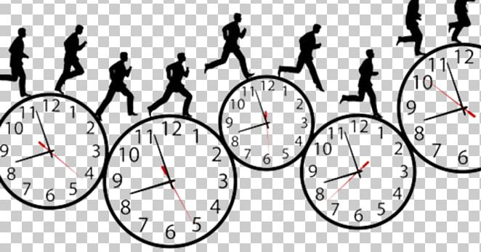

Time management

Slide 2

time management is essential for success in almost anything in life especially in school, college and university. The students who prefer manage their own time well planning the assignments having time for their self, they enjoy and perform better in studies.
dd

Slide 3
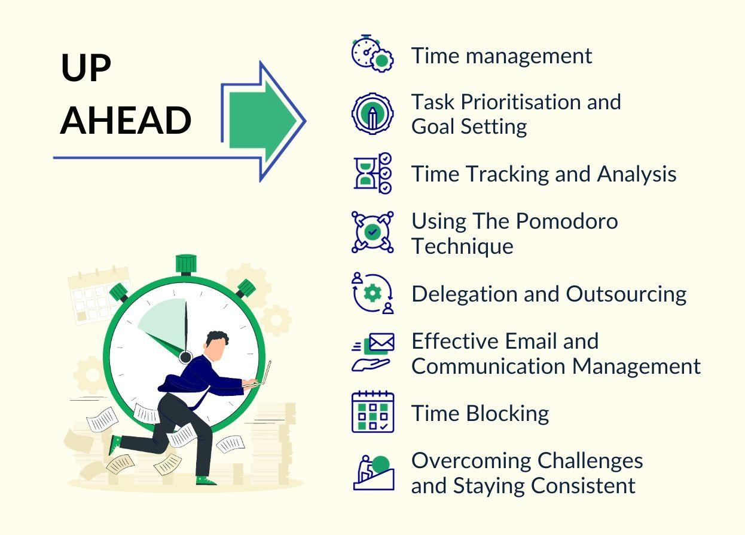
What skills you need for manage your time?
Long hours are not a substitute for efficiency. Tasks not worth doing at all are not worth doing well (Margulis, A. 2007).
(Margulis, A. 2007). The road to success: A carer manual- how to advance to the top. Academic press

Slide 4

Why do I need to manage my time?
Better focus
Work life balance
Reduce stress
Improve qualities

Slide 5


Slide 6
References
(University of derby 2023). Time management techiques-techniques self-direction and planing at university.
(Bisbee.D.2019). Time management and academic success. Hardvard extension school.
(Fu, Y. Wang, Q. wang,X. Zhong,h. Xhen, j. fei, H. Yao Y. Li, N. 2025). Unlocking academic success- the impact oftime management on college students study engagement BMC psychology.
(Jackson,V.P. 2009). Time management- a realistic approach: jurnal of the amreican college of radiology.
(Flanagan,H. 2020). How time management techniques and a sense of awe can increase our well being.

