Slide 1
My Career Aspiration – Adult Social Worker
Zara Khan
2422667
Professional Development within Health and Social Care
LCHS4009

Slide 2
My Chosen Career -Adult Social Worker
I would like to become an adult social worker because I enjoy helping people and want to support adults to feel safe, improve their wellbeing and live more independently. My interest in this career comes from working in supported accommodation, where I help tenants with budgeting, housing applications, appointments and everyday living skills.
Through this work, I have seen how one difficulty can lead to another. For example, money worries can affect someone’s mental wellbeing and make it harder for them to manage daily responsibilities. I enjoy listening to people, getting to know their circumstances and working with them to find practical ways forward. I also think it is important to respect their choices and involve them in decisions about their support.
My current role has given me useful experience, but I know there is still a lot to learn. To become a social worker, I will need the right qualifications and a better understanding of legislation, safeguarding and assessments.
(National Careers Service, n.d.)

Slide 3
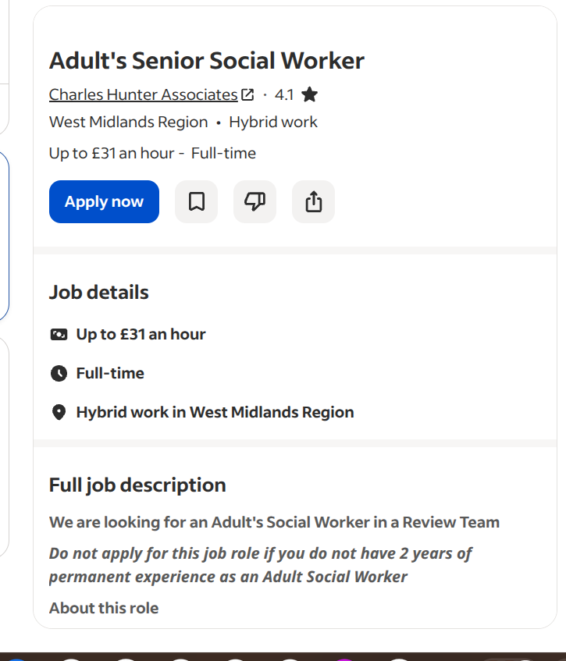
Job Advert and Requirements.
I found a job on Indeed for an Adult’s Senior Social Worker in a Review Team, advertised by Charles Hunter Associates. It is a full-time role in the West Midlands, offering hybrid working and pay of up to £31 an hour.
The team supports adults with disabilities, long-term health conditions, dementia, and difficulties with drugs or alcohol. The work includes assessing people’s needs, involving them in decisions about their support and responding to safeguarding concerns.
Some parts of this relate to what I do now in supported accommodation. I speak with tenants about the difficulties they are facing and help them work towards goals, such as managing their money or becoming more independent. When we review their support needs, I listen to what they feel is going well and where they still need help. This gives me relevant experience to build on, although a social worker has different responsibilities.
The advert asks for a recognised social work qualification, at least two years of experience after qualifying, and experience working with adults with disabilities. A UK driving licence and a vehicle are also required. I see this as a future goal, once I have qualified and gained more experience.
(Charles Hunter Associates, n.d.)

Slide 4
Strengths
I feel one of my main strengths is making time to listen. In my current job, tenants sometimes need someone to talk things through with before they feel ready to accept help. I try to be approachable and give them space to explain what is happening, rather than assuming I know what they need.
I am also patient and able to explain things clearly. For example, when helping a tenant with a housing application, I work through it with them and explain any questions they find confusing. I encourage them to complete what they can themselves, while being there if they need support. This helps them practise skills they can use again.
Another strength is noticing what people are doing well. During support reviews, I talk with tenants about their progress, whathey feel confident managing and where they would like more help. This links to the job advert’s strengths-based approach, as the support builds on their abilities and involves them in deciding the next steps.
These are skills I could bring to social work and continue developing through training and feedback. (Charles Hunter Associates, n.d.) Social Work England’s standards also emphasise listening to people and recognising their strengths. I practise both when supporting tenants (Social Work England, 2019).”

Slide 5
Skills I can Improve on - Weaknesses
Something I need to improve is my confidence when speaking in groups. I am comfortable speaking to tenants individually in my support worker role, but I get nervous when presenting to several people. As a social worker, I would need to explain my views clearly in meetings with other professionals. I can build on the communication skills I already use by contributing more in team discussions and practising speaking in smaller groups.
I also need to learn more about the laws social workers follow and how they assess people’s needs. In my current job, I talk with tenants about the support they need and review how they are getting on. The advertised role involves more detailed assessments and responding to concerns about someone’s safety. I would need further training in these areas, and I could use examples from my current work to help me understand what I am learning.
Finally, although supported accommodation has given me experience of working with adults, I do not yet have the social work qualification or the two years of experience after qualifying that the advert asks for. I would need to qualify and gain relevant experience in adult social work before progressing to this senior role.
(Charles Hunter Associates, n.d.)

Slide 6
Opportunities
Working in supported accommodation gives me the chance to learn from my manager and colleagues. When I am unsure about something, I can talk it through with them and use their advice to improve. I am comfortable asking questions and listening, which helps me learn from others.
I could also attend training on safeguarding, mental health and supporting adults with disabilities. These are relevant to the social worker job I found and would also help me in my current role. Using examples from my work with tenants would make the training easier to understand.
Another step I can take is to look into approved social work courses and check what I need to apply. My experience of supporting tenants would give me examples to use in my application and help me understand what I’m learning by relating it to things I’ve seen at work.
The advert mentions regular supervision and working with different cases. Once I am qualified, this would give me the chance to discuss difficult situations, get advice and build the experience needed for a senior role.
(National Careers Service, n.d.; Charles Hunter Associates, n.d.)

Slide 7
Threats
One challenge for me could be fitting studying around work and my other responsibilities. Coursework and placements would take time, so I would need to plan ahead. In my current job, I organise appointments with tenants and keep track of tasks. I could use those same skills to plan my week and make time for studying.
The cost of studying could also be a challenge. I would need to look into course fees, travel expenses and what help might be available before deciding how to manage financially. Making a budget would help me work out what I could afford and whether I would need to adjust my working hours.
The emotional side of social work is something I would also need to manage. In supported accommodation, I listen to people who have been through difficult situations. The advertised job also involves safeguarding concerns, which could be challenging. I would talk things through in supervision, ask for advice and make sure I take time to rest outside work. Being willing to ask for help would be important as I take on more responsibility.
(Charles Hunter Associates, n.d.)

Slide 8
Action Plan and Conclusion
My next step is to find out which social work courses I could apply for, what qualifications I need and how I would manage the costs. Over the next three months, I will also speak to my manager about training in safeguarding and supporting adults with disabilities.
I want to become more confident speaking in groups, so I will start by speaking up more in team discussions and practising presentations with someone I feel comfortable with. Asking for feedback will help me know what to work on.
My current job has helped me realise that I enjoy supporting adults and helping them become more independent. I have experience to build on, but I know I still need further training and qualifications. My goal is to qualify as a social worker, gain experience in adult services and eventually work towards a senior role like the one I found.

Slide 9
References-
1)National Careers Service (n.d.) Social worker. Available at: https://nationalcareers.service.gov.uk/job-profiles/social-worker (Accessed: 18 October 2026).
2)Charles Hunter Associates (n.d.) Adult’s Senior Social Worker. Indeed. Available at: https://uk.indeed.com/viewjob?jk=c8a20fb3edde7404 (Accessed: 18 October 2026).
3)Social Work England (2019) Professional standards. Available at: https://www.socialworkengland.org.uk/standards/professional-standards/ (Accessed: 18 October 2026).

