Slide 1
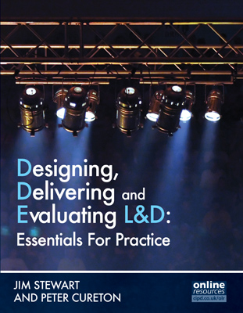
CHAPTER 2
Individual and Collective Learning

Slide 2
Learning Outcomes
At the end of this session you will be able to:
  explain and critically evaluate a range of learning theories
  demonstrate understanding of the relevance and application of learning theories in instructional design
  analyse and assess the principles deriving from learning theories to support effective practice in design and delivery of learning and development interventions
  assess and evaluate the contribution of non-HR professionals and managers to ensure effective learning and development interventions

Slide 3
Overview
Introduction
  - Defining learning
Individual learning theory
  - Behaviourism; cognitive approach, cybernetics and constructivism; social learning theory
  - Andragogy; experiential learning; learning styles
Collective learning theory
  - Team learning theory; group learning theory
  - Organisational learning theory; learning organisation
Workplace learning theory
  - Spaces and types, technology, and models of workplace learning

Slide 4
Definitions of Learning (1)
‘the action of receiving instruction or acquiring knowledge’
(OED, 2013)
‘a process based on experience that results in a relatively permanent change in behaviour or behavioural potential’
(APA, 2013)
‘a relatively permanent change in behaviour that occurs as a result of practice or experience’ (Bass and Vaughan, 1976)

Slide 5
Definitions of Learning (2)
‘a change in attitudes, knowledge or skill. The change can be physical and overt, or it can be intellectual or attitudinal’
(Reynolds et al.,1997)
Learning as an action/a process/a behaviour change or experience?

Slide 6
Traditional Individual Learning
  Behaviourism: an attempt to explain and understand learning through observing behaviour (and ignoring mental processes).
  Cognitive approaches, cybernetics & constructivism: an attempt to explain and understand learning through the internal (information processing) workings of the mind.
  Social learning: an attempt to explain and understand learning as an activity situated in (and shaped by) social institutions, social groups and social class.

Slide 7
Contemporary Individual Learning
  Andragogy: a set of core adult learning principles that apply to all adult learning situations
  Experiential learning: views learning as a cycle whereby the learner is proactively involved in ‘constructive learning’
  Learning styles: attempts to classify learners into learning style categories through various instruments

Slide 8
Collective Learning
..a term used to ‘distinguish the learning that takes place at the supra-individual (ie above the individual) level… [It] can encompass dyads, teams, communities, networks, organizations and even whole societies’
(Sadler-Smith, 2006)

Slide 9
Group versus Team Learning
Group learning is a term used to include all forms of groups including formal, informal, virtual, planned, emergent, primary and secondary.
Sadler-Smith (2006)
Team learning links performance, vision, goals and learning.
Pearn (1998)

Slide 10
OL v LO (1)
 | Organisational learning (OL) | Learning organisation (LO)
Definition | ‘…means the process of improving actions through better knowledge and understanding’ (Fiol and Lyles 1985, p803). | ‘…one where people continually expand their capacity to create the results they truly desire, where new and expansive patterns of thinking are nurtured, where collective aspiration is set free, and where people are continually learning together’ (Senge 1990, p3).
Nature of field | OL is an academic field of research focusing on how learning processes occur at and within organisational settings (Easterby-Smith 1997; Tsang 1997). | LO is a practitioner/consultancy-based ‘toolkit’ that seeks to create an ideal type of organisation (Easterby-Smith 1997; Tsang 1997).
Contri-butors | Contributors are typically academic researchers (Easterby-Smith and Araujo 1999). | Contributors may be highly experienced (or lesser experienced) professionals, management consultants or ‘gurus’.

Slide 11
OL v LO (2)
 | Organisational learning (OL) | Learning organisation (LO)
Key theory and models | Describes a process, be it a process of improving actions, change or knowledge acquisition (Sun 2003).Models are descriptive and scientifically driven. | Prescribes a toolkit/intervention for working towards an ultimate organisational vision. Models are prescriptive, idealistic and intuitive, but can be insightful.
Dissemination | Research is usually disseminated via peer-reviewed academic journals, conferences and lectures. | Usually disseminated through paid consultancy, ‘self-help’ books, personal or consultancy blogs/ websites, etc.
Impact on DDEL | Less impact but design of learning interventions can take account of organisational learning processes to enhance those. | More impact through prescriptions and recommendations for interventions to promote and achieve learning organisation state.

Slide 12
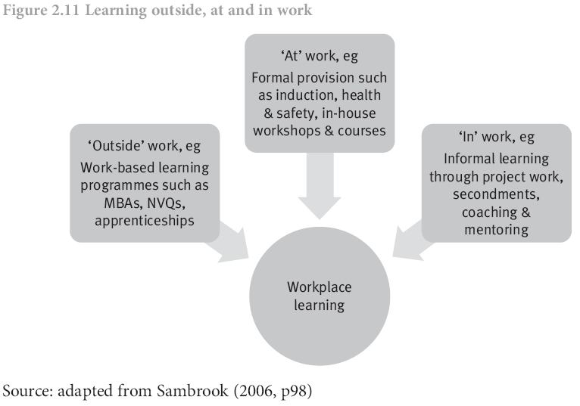
Workplace Learning (WPL)

Slide 13
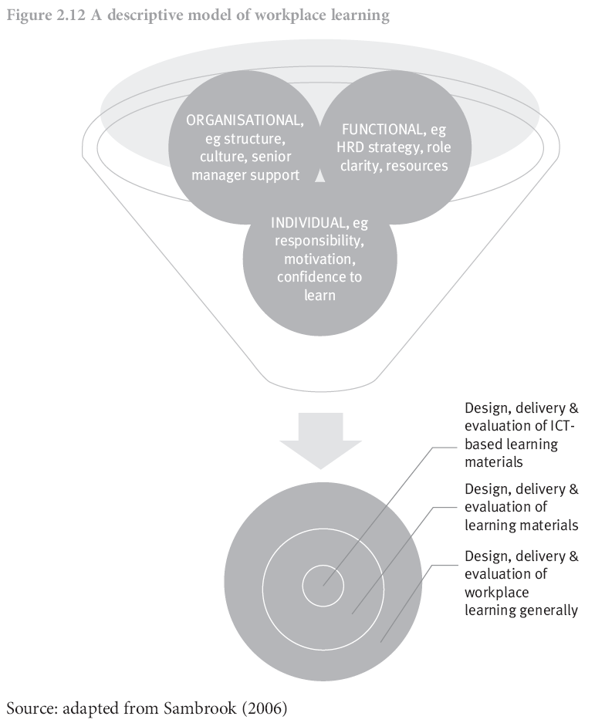
Technology & WPL

Slide 14
Prescriptive Models of WPL (1)
WPL is aligned with or reflects the (desired) workplace culture
the strategic directions of the business and the nature of its challenges and opportunities are reflected in the aims and processes of workplace learning
learning is adequately resourced with the right people and the right tools
the organisation is committed to everyone’s learning

Slide 15
Prescriptive Models of WPL (2)
there is sufficient time for learning to be meaningful
innovation and thoughtful risk taking are encouraged
opportunities to learn are part of everyday work (not add-ons)
formal and informal learning are integrated
learning is recognised
talent is identified and nourished.
(Vaughan 2008)

Slide 16
Conclusion (1)
There are various theories that seek to explain and understand learning at varying levels: the individual, the group and the organisation.
While there is no single right or correct theory of learning at any level, there is enough agreement and similarity to enable some general principles to be applied in designing, delivering and evaluating learning and development.
Learning and development interventions have to take account of each and every level if they are to be fully effective and involve and maximise the contribution of various roles in organisations; including individual employees, line managers, HRD professionals and HR staff.

Slide 17
Conclusion (2)
Learning is not yet well enough understood for HRD professionals to guarantee the outcomes of learning and development interventions and so to be able to say that learning interventions will always directly contribute to achieving desired or set organisational objectives.
However, learning is well enough understood for HRD professionals to take account of and apply learning theory when designing and delivering learning and development interventions.

Slide 18
Further Reading
HISLOP, D. (2013) Knowledge management in organizations: a critical introduction. 3rd ed. New York: Oxford University Press.
HONEY, P. and MUMFORD, A. (2006) The learning styles questionnaire, 80-item version. Maidenhead: Peter Honey Publications.
ILLERIS, K. (2011) The fundamentals of workplace learning: understanding how people learning in working life. London: Routledge.
KNOWLES, M.S., HOLTON III, E.F. and SWANSON, R.A. (2011) The adult learner. 7th ed. London: Elsevier.
SADLER-SMITH, E. (2006) Learning and development for managers: perspectives from research and practice. London: Blackwell Publishing.
STEWART, J. and RIGG, C. (2011) Learning and talent development. London: CIPD.

Slide 19
References (1)
APA (2013) American Psychological Association. http://www.apa.org/ [Accessed 1 October 2013]
BASS, B.M. and VAUGHAN, J.S. (1976) Training in industry: the management of learning. London: Tavistock Publications.
EASTERBY-SMITH, M. (1997) Disciplines of organizational learning: contributions and critiques. Human Relations. Vol 50, No 9. pp1083–1113.
EASTERBY-SMITH, M. and ARAUJO, L. (1999) Organisational learning: the literatures. In: EASTERBY-SMITH, M., BURGOYNE, J. and ARAUJO, L. (eds) Organizational learning and the learning organization: developments in theory and practice. London: Sage.
FIOL, C.M. and LYLES, M.A. (1985) Organizational learning. Academy of Management Review. Vol 10, No 4. pp803–813.

Slide 20
References (2)
OED (2013) Oxford English Dictionary [online]. Oxford: Oxford University Press. Available at: http://www.oed.com/
PEARN, M. (1998) Empowering team learning: enabling ordinary people to do extraordinary things. London: CIPD.
REYNOLDS, A., SAMBROOK, S. and STEWART, J. (1997) Dictionary of HRD. Aldershot: Gower.
SADLER-SMITH, E. (2006) Learning and development for managers: perspectives from research and practice. London: Blackwell Publishing.
SAMBROOK, S. (2006) Developing a model of factors influencing work-related learning: Findings from two research projects. In: STREUMER, J. (ed.) Work-related learning. Dordrecht, The Netherlands: Springer. pp95–125.

Slide 21
References (3)
SENGE, P. (1990) The fifth discipline: the art and practice of the learning organisation. New York: Century Business.
SUN, H. (2003) Conceptual clarifications for organizational learning, learning organization and a learning organisation. Human Resource Development International. Vol 6, No 2. pp153–166.
TSANG, E.W.K. (1997) Organizational learning and the learning organization: a dichotomy between descriptive and prescriptive research. Human Relations. Vol 50, No 1. pp73–89.
VAUGHAN, K. (2008) Workplace learning: a literature review. A report prepared for Competenz, New Zealand Council for Educational Research. Available at: www.competenz.org.nz [Accessed 1 October 2013]

