Slide 1
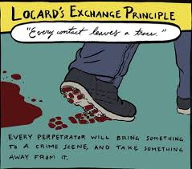
Forensic Recovery & Examination
Workshop 3

Slide 2
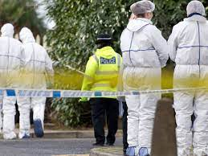
Recap Workshop 1 & 2:
The Principle of Exchange (Locard)
Cross contamination
Role of a CSI
Forensic capabilities
Sources of forensic evidence (triangle)
Types of evidence
Arriving at scene
Investigative mind-set
Golden Hour Principles
Initial risk assessments (Dynamic)
Scene control
Preserving the scene
The 4 R’s

Slide 3
Today’s aims and learning outcomes…
To understand the definition of ‘Material’ (CPIA, 1996)
To critically analyze each stage of managing scenes:
-Identifying
-Securing
-Preserving
-Searching & examining
-Releasing
To understand the importance of The Forensic Strategy.
To understand policing powers in relation to entry, searching and seizing at a premises.

Slide 4

Today’s aims and learning outcomes continued…
To critically analyse the requirements of the police and crime scene investigators at different scenes
To understand the importance of the chain of evidence
To understand the importance of suspect considerations
To understand the the main stages of the Investigative and Evidential Evaluation Cycle

Slide 5
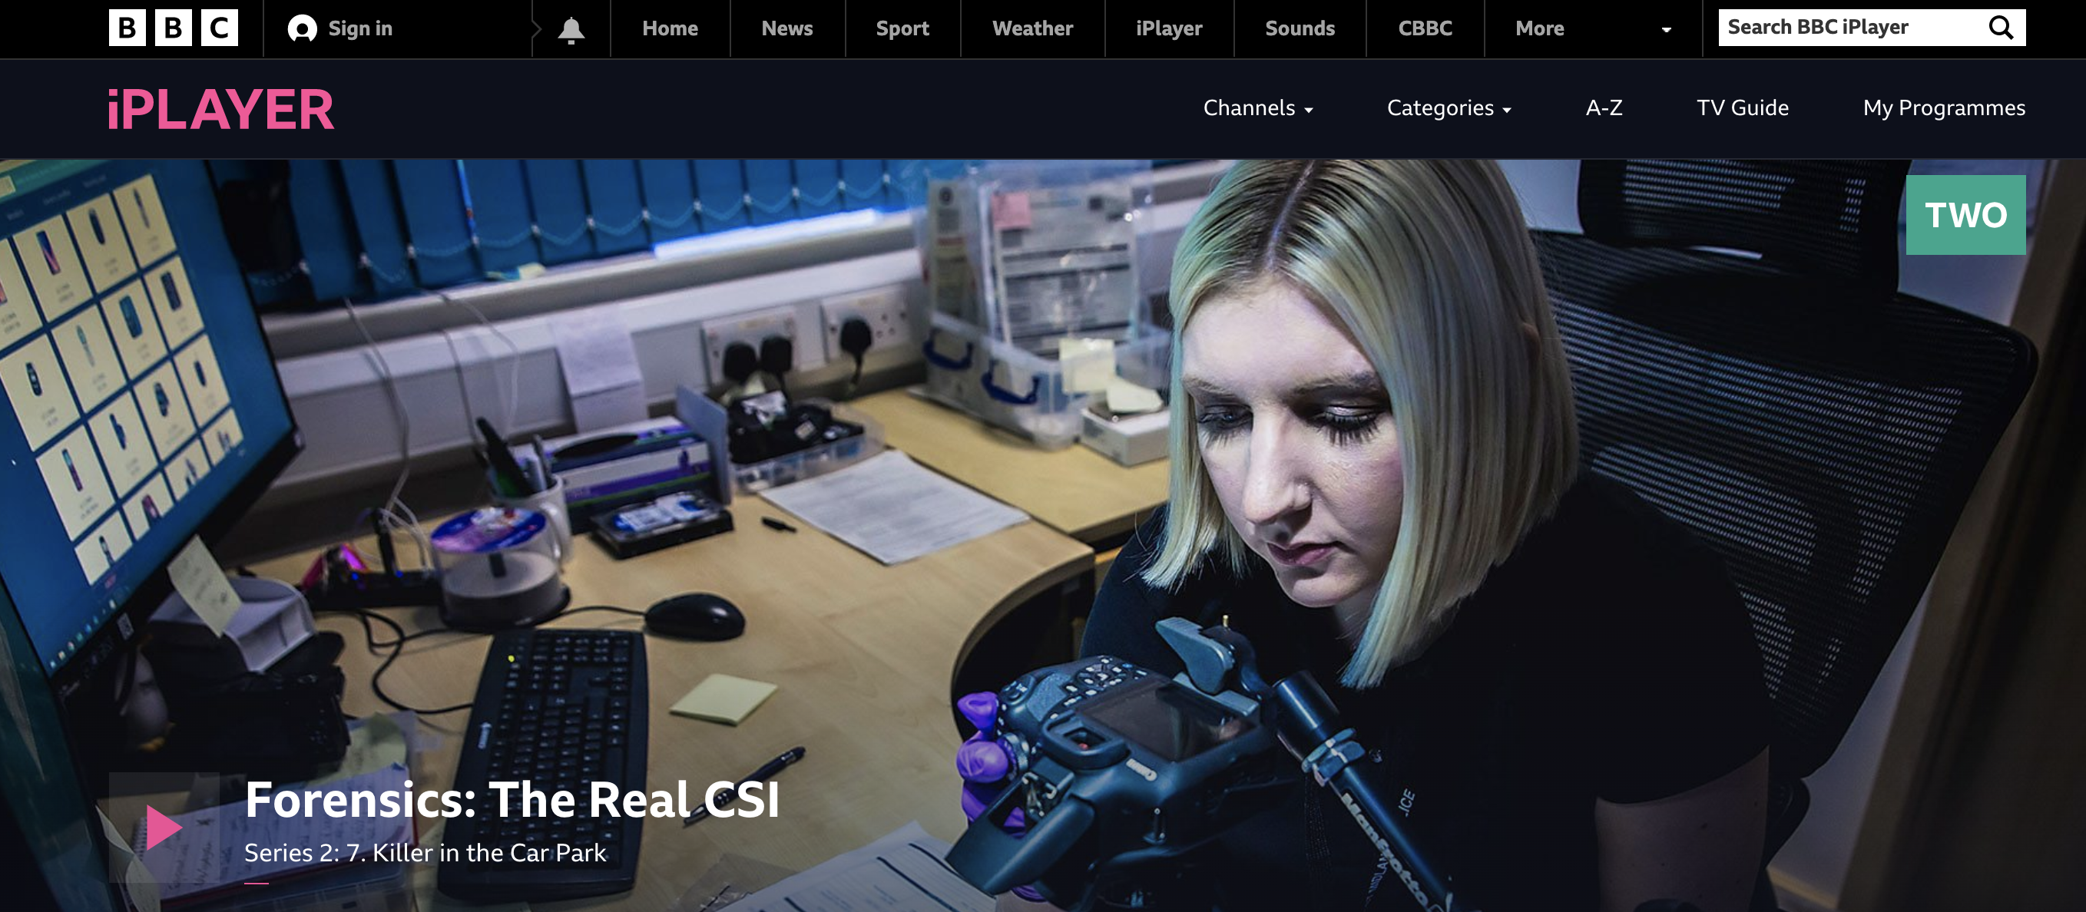
Task: Watch and Identify...
Task:
Watch the documentary:
identify where you believe forensic recovery and/or examination take place
identify where you believe policing powers are being executed (i.e, search powers)
Documentary: Forensics: The Real CSI
Series: 2
Episode: 7 ‘Killing in the Car Park’
Clicks here to play the documentary
Notes:
Link to documentary: https://www.bbc.co.uk/iplayer/episode/m00129qq/forensics-the-real-csi-series-2-7-killer-in-the-car-park

Slide 6
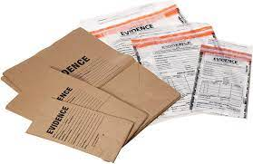
‘Material’
(Criminal Procedure and Investigations Act 1996)
Material is defined as:
‘material of any kind, including information and objects, which is obtained in the course of a criminal investigation, and which may be relevant to the investigation.’
Relevant if:
appears that it has some bearing on any offence under investigation, or
on the surrounding circumstances of the case, unless it is incapable of having any impact on the case.
Notes:
Common formats of material include:
statements
documents
reports
physical exhibits
fingerprints
images
audio or video recordings

Slide 7

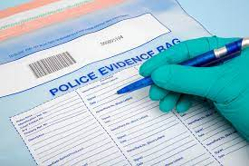
Evidence in Investigations
Physical evidence- documents, objects, etc.
Forensic evidence- fingerprints, DNA, etc.
Digital evidence- computer records, CCTV etc.
Expert witness evidence
Intelligence
…..and many more!
All Material
Notes:
Question- Where will we obtain evidence from?
All provide assistance within an investigation

Slide 8
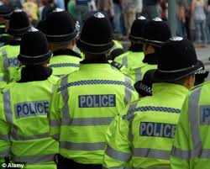
Leads to …
I suspect...
I believe...
KNOW
BELIEVE
SUSPECT
I know....

Slide 9

Managing Scenes
Identifying scenes
1
Securing scenes
2
Preserving scenes
3
Searching and examining scenes
4
Releasing scenes
5

Slide 10
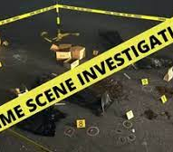
Identifying Scenes…
Examples:
Victims, witnesses & suspects
Routes to and from the scene
Weapons
Suspect’s home address or other premises associated with the suspect or the commission of the offence
Vehicles
Deposition or dump sites

Slide 11
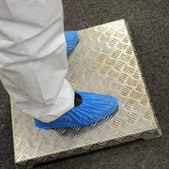
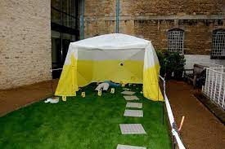
Police - Control of the scene
CAP
Common
Approach
Path

Slide 12
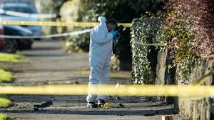
Importance of securing the scene?
Maintain the integrity and provenance of any material which may be recovered from it.
Reduces the opportunities for the material to become contaminated or inadvertently cross-contaminated.
Tape
Scene guard
Vehicles
Road blocks / diversions
Temporary fencing
Suitable PPE
Scene log
The 4 R’s

Slide 13
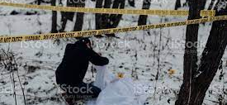
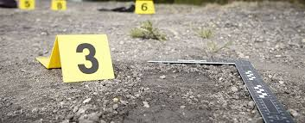
Preserving the scene
Damage being caused by exposure to the elements
Animal disturbance
Disturbance by material being moved from its original position
Microbiological activity causing decay to material
Disturbance by items being taken into it
Disturbance by material being removed from it
Cross-contamination by transference between scenes.
…Try to prevent!!

Slide 14
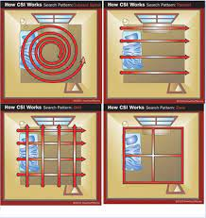
Searching & Examining the scene
It may be necessary to search the scene before examination takes place.
Thorough! One Chance!
Remember: Protection of life always takes primacy over the preservation and recovery of forensic material.

Slide 15
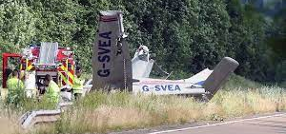
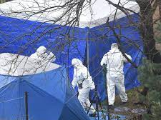
Releasing the scene
Do not release a scene until satisfied all expert advice has been considered (i.e, PolSA)
Once areas which have been covered by crime scene tents and stepping plates have been searched, the scene can be cleaned and released.
Considerations - environmental health department or the local health authority, eg, where chemicals or biological substances may have been found.

Slide 16
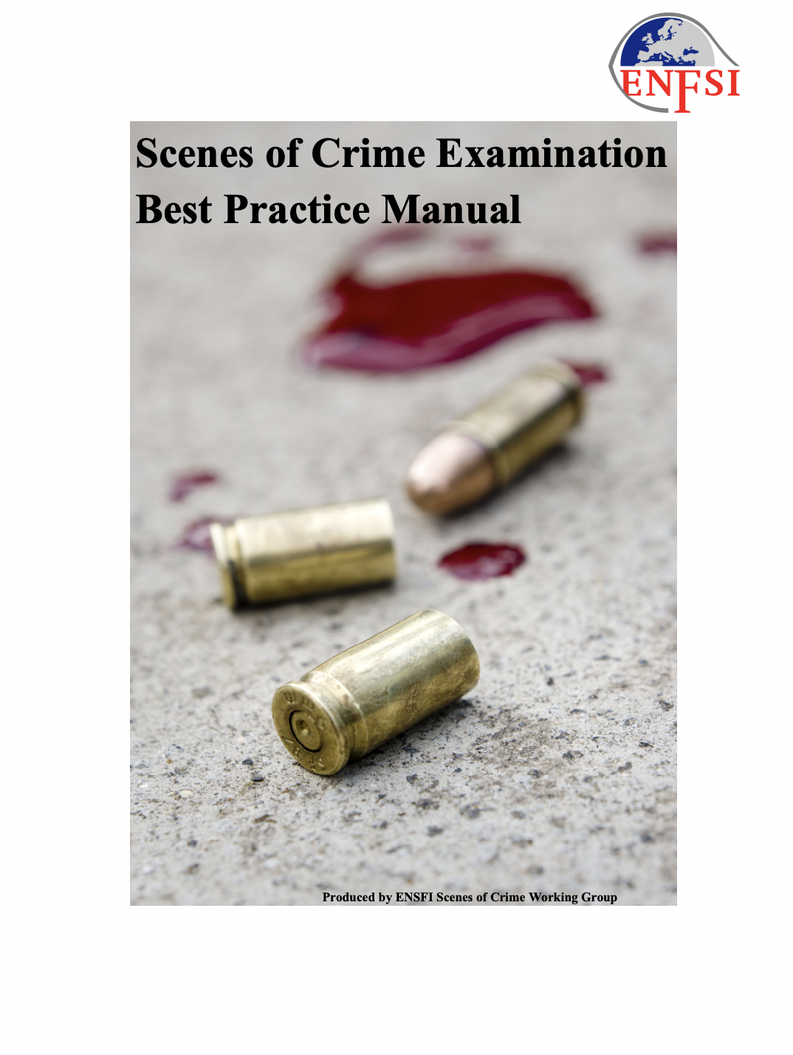
Group Task:
Analyse the directed part of the manual and report the key findings back to the whole group.
Group 1: Case assessment/Information requirements (Page 7 onwards)
Group 2: Health and Safety / Assessment at the scene (Page 9 onwards)
Group 3: Undertaking the scene examination / Scene preservation
(Page 11 onwards)
Group 4: Searching the crime scene / Recording the crime scene
(Page 13 onwards)
Group 5: Recovery of forensic evidence from the crime scene / Preservation and packaging (Page 15 onwards)
Group 6: Labelling and documentation / Transport (Page 16 onwards)
Group 7: Review scene findings and order further examinations/ Report findings (Page 19 onwards)
Click here

Slide 17
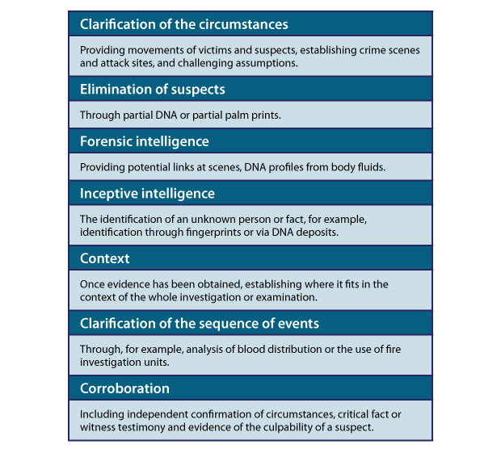

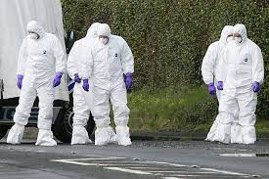
The Forensic Strategy
Enables the potential of material recovered during crime scene examination to be maximised, and can help with:
Notes:
Collecting all relevant material will assist with the following areas;
Discuss each area with the students
Provide the students with a handout.

Slide 18
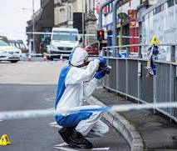
Specialist Support
Criminal Investigation Department
Financial Crime
Surveillance Unit
Hi-tech Crime
Medical experts
Open source experts
Collision Investigation Unit

Slide 19
Crime Scene Investigation
The specific circumstances that a crime scene investigator (CSI) encounters at a crime scene dictate the approach required.
The forensic approach to a volume crime scene varies from that of a major crime scene.
However, similar processes are implemented…
Serious or major cases –
a formal strategy for the forensic response is compiled by a forensic manager in consultation with, and agreed by, the senior investigating officer.
The strategy includes identifying:
Health, safety and security issues and establishing the dimensions of the scene
Coordinating and communicating with relevant personnel
An initial walk-through of the scene identifying key areas of interest
Documenting and recording the scene at all stages of the examination process
Recovering and recording material of interest using appropriate specialists and techniques
A secondary walk-through of the scene and a review.
(College of Policing, 2021)

Slide 20
Policing Perspective: Conducting Investigations
Information obtained from initial call
Information from police systems
Information from officer attending
Information provided by 1st witness
Info provided by victim (1st account)
Evidence collected at scene (exhibits)
Evidence from CSI in attendance
Suspect information & intelligence
Plan to locate & manage suspect
Complete crime report
Consider multi-agency approach
Consider future action- ie searches, interview, file prep

Slide 21
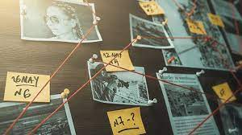
Investigative Strategies
Investigative Strategies
Identifying a line of enquiry to pursue
Determining the objective of pursuing a particular line of enquiry
Identifying the investigative action(s) necessary to efficiently achieve that objective taking into account resources, priorities & proportionality
Conducting the investigative action & gathering the maximum amount of material which may generate further lines of enquiry

Slide 22
Chain of Evidence
You need to be able to show how the evidence was seized including:
Where it was found
Where it was seized
The time of seizure
The date of seizure
Whom it was seized by & what was done with it after seizure

Slide 23
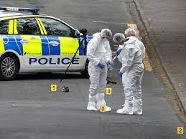
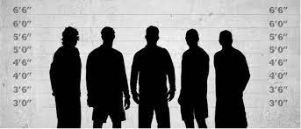
Suspect considerations…what are you thinking?
Suspect present
Identification of suspects
Arrest – yes or no
Managing the scene & a suspect
Cross contamination
Suspect not present
Identification of suspects
Risk assessment
Circulate details
Cross contamination

Slide 24
Investigative and Evidential Evaluation Cycle
Establish current position
Analyse
Identify actions
Take action
Examine existing material
Analyse sufficiency
Identify actions
Take action
Repeat the process

Slide 25
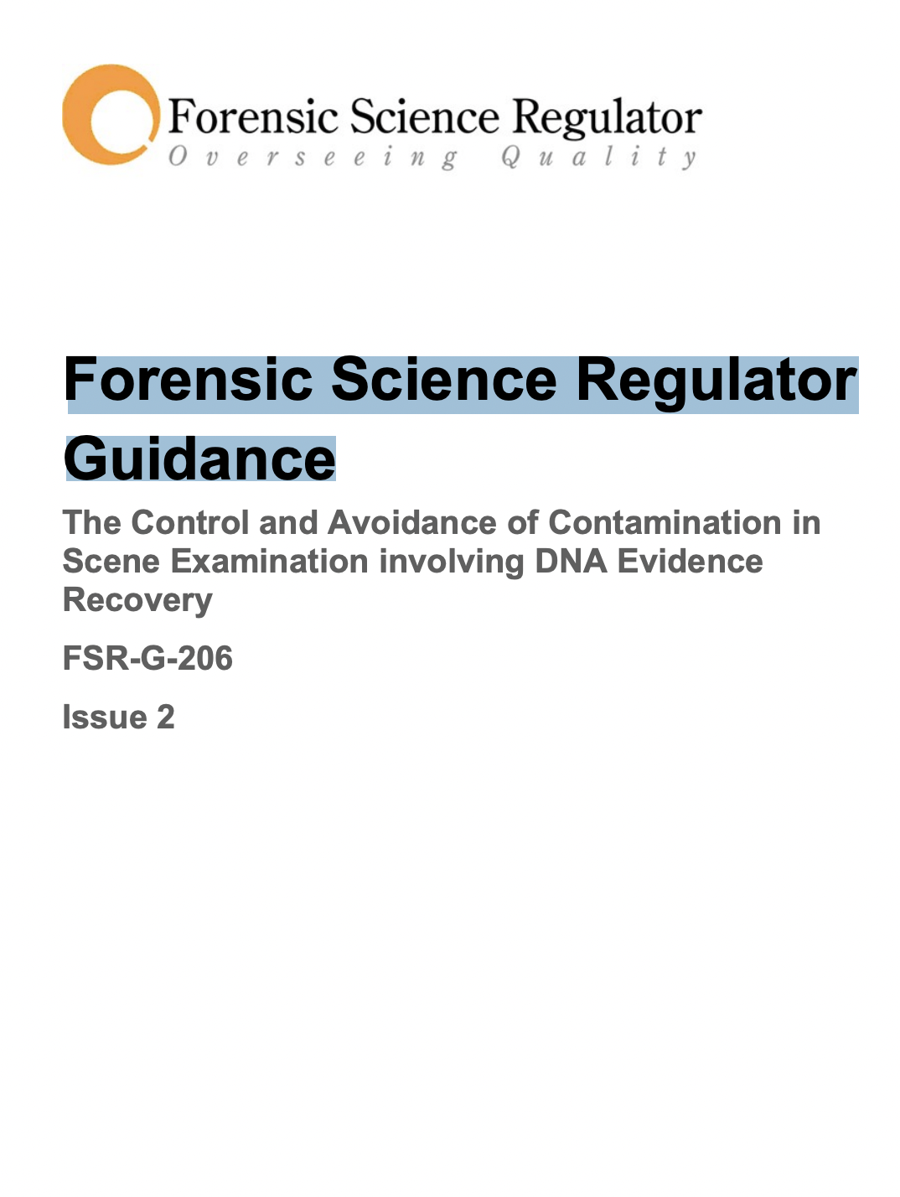
Independent Reading
Click here

Slide 26
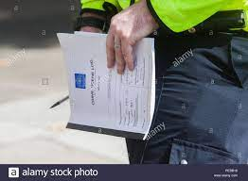
Scene Log
Commence upon arrival
Time/ Date
Who? When? Where? What?
Name
Time entered scene
Time left
Who the log is handed to
Signature

Slide 27

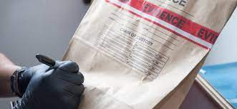
List All Exhibits
MG12 Exhibit list
Exhibit Labels
Remember continuity
Remember unused material
Storage (it may need to be produced in court or for forensic exam later)
Return or destruction at the end of the case

Slide 28
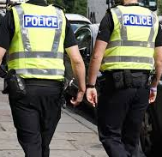
Legal Powers
Investigators have access to a range of legal powers that enable them to conduct effective investigations…
Criminal Procedure and Investigations Act 1996
Regulation of Investigatory Powers 2000 (RIPA)
Police and Criminal Evidence Act 1984 (PACE)
Human Rights Act 1998 (HRA)
Equality Act 2010
Youth Justice and Criminal Evidence Act 1999 (YJCEA).
Notes:
Under certain conditions, these powers allow investigators to deprive individuals of their liberty, use reasonable physical force, enter their homes or other private premises, gain access to private information and to deploy intrusive surveillance techniques.
Investigators have a high level of discretion in how they choose to use these powers.

Slide 29

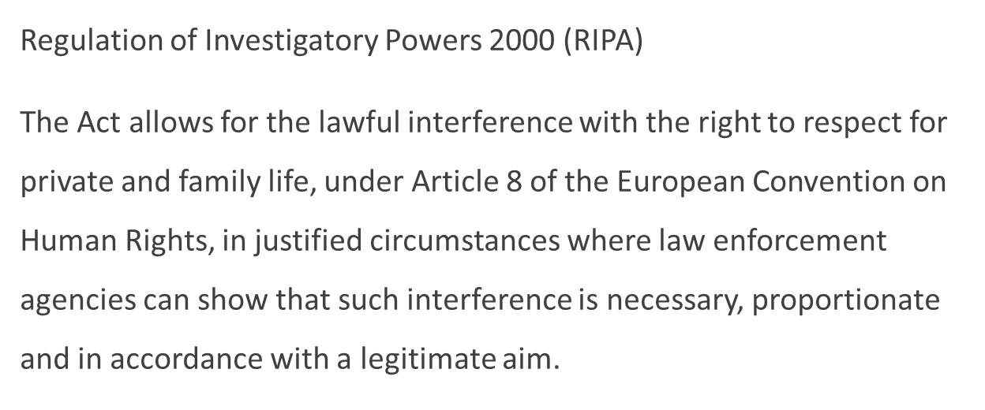

Legal Powers

Slide 30
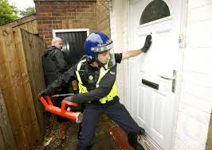

Powers of Search and Seizure

Slide 31
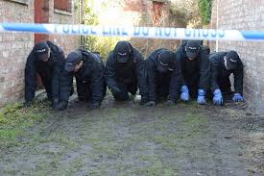
What is a Search?

Slide 32
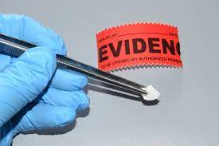
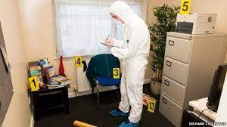
Searching a Premises
Premises must not be entered or searched nor property seized unless authorised by law and then only...
When it is necessary and a proportionate response in the circumstances

Slide 33

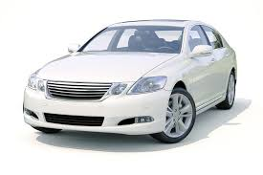
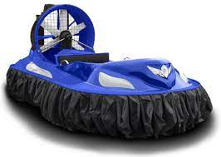
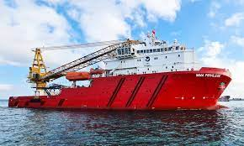


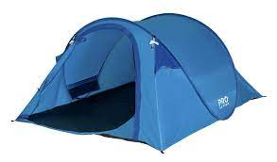
HAVVROT
What is a ‘PREMISES’?
Section 23 PACE 1984:
H
A
V
V
R
O
T

Slide 34
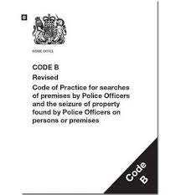
Powers of Entry, Search & Seizure without Warrant
PACE Section 17
Entry for purpose of arrest/recapture/Saving life & limb
PACE Section 32
Search of premises where arrested person is/has recently come from
PACE Section 18
Entry & search after arrest (triable either way or indictable only)

Slide 35
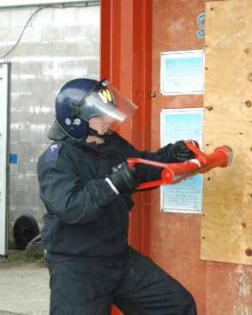
Section 17 P.A.C.E. (1984)
“reasonable grounds to believe”
Notes:
Section 17 Police and Criminal Evidence Act 1984
In order to exercise this power of entry under any of the circumstances, (stated below) you must have reasonable grounds to believe that the person whom you will arrest or recapture is on the premises that you want to enter.

Slide 36

Section 17 (1)(a) P.A.C.E (1984)
A Constable may enter & search any premises for the purpose of:
Executing a warrant of arrest or commitment

Slide 37

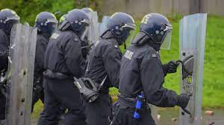
Section 17 P.A.C.E (1984)
Arresting a person for:
An Indictable Offence
An offence under S1 POA 1936

Slide 38

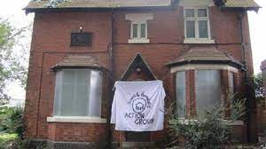
Section 17 P.A.C.E (1984)
S.4 Public Order Act 1986
S.6 to 8 or 10 of the Criminal Law Act 1967
S.76 Criminal Justice & Public Order Act 1994

Slide 39
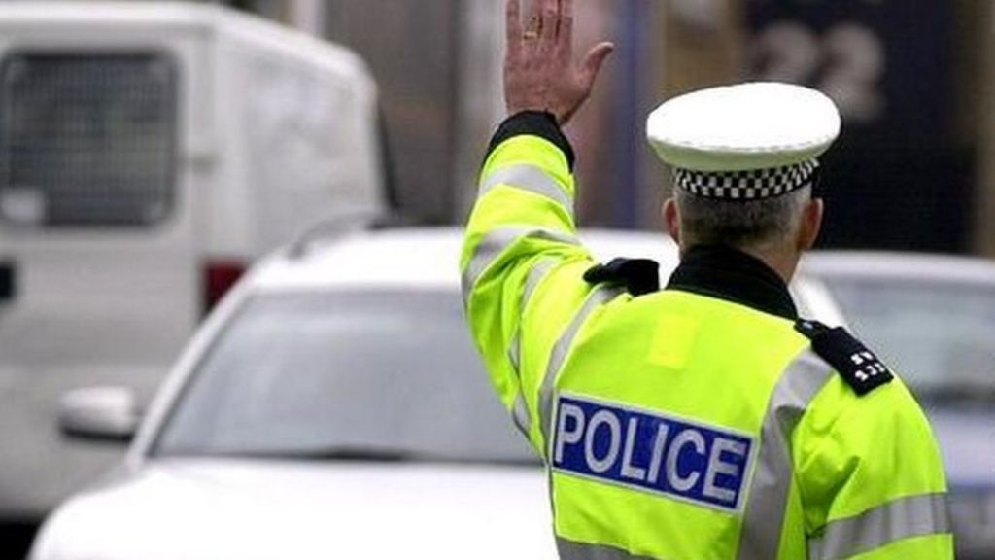
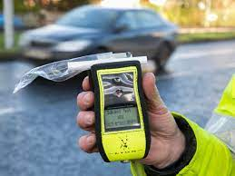
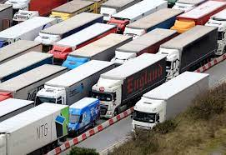
Section 17 P.A.C.E (1984)
S.163 Road Traffic Act 1988
163…STOP for me!!
S.4 Road Traffic Act 1988
S.27 Transport & Works Act 1992
Notes:
Section 163 of the Road Traffic Act 1988 relates to failure to stop when required to do so by a constable in uniform
Section 4 Road Traffic Act 1988 relates to driving under the influence of drink or drugs.
“To arrest a person who was driving, attempting to drive or in charge of a mechanically propelled vehicle on a road or public place, if the person is reasonably suspected to have been unfit through drink or drugs.”
Section 27 Transport & Works Act 1992 relates to offences involving drink or drugs in relation to transport system workers

Slide 40

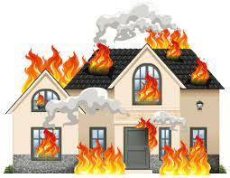
Section 17 P.A.C.E (1984)
Recapturing a person unlawfully at large & whom he is pursuing
Saving life & limb or preventing serious damage to property

Slide 41
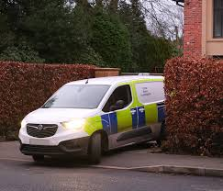
Section 32 P.A.C.E (1984)
“reasonable grounds for believing”

Slide 42
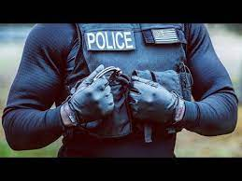
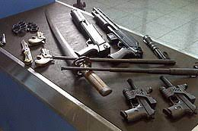
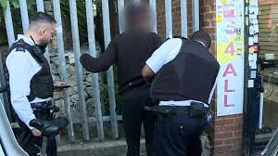
Section 32(1) P.A.C.E (1984)
JOG!!
A Constable may search any person who has been arrested at a place other than a police station
If they have reasonable grounds for believing that the arrested person may present
Danger to himself or others
Implement which he might use to escape
Evidence relating to an offence

Slide 43
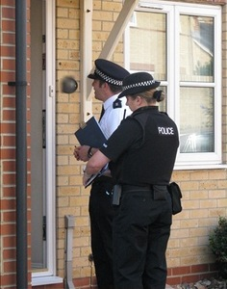
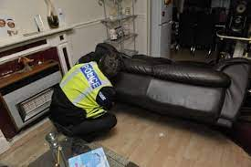
Section 32(2)(b) P.A.C.E (1984)
A Constable may enter & search a premises
In which a person was when arrested or immediately before he was arrested
For evidence relating to the offence for which he was arrested

Slide 44
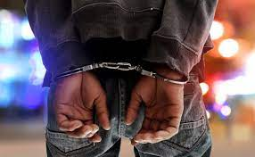


Section 18 P.A.C.E (1984)
“reasonable grounds for suspecting”

Slide 45



Section 18(1) P.A.C.E (1984)
A Constable may enter and search any premises occupied
Or controlled by a person under arrest for an indictable offence

Slide 46



Section 18(1) P.A.C.E (1984)
If he has reasonable grounds for suspecting that there is on the premises evidence relating to that offence
Or another indictable offence which is connected with or similar to that offence

Slide 47
Section 18 P.A.C.E (1984)
An Inspectors authority will be required for all Section 18 searches unless
A constable may conduct a search before taking the person to a police station without obtaining an authorisation from an inspector if the presence of that person at a place is necessary for the effective investigation of the offence (S18(5))
In which situations could this happen?...

Slide 48


Consent
Gaining entry with consent
Premises may be searched (other than under a statutory power) with the written consent of a person entitled to grant entry
Gaining entry without consent
The occupier, or other person entitled to grant access to the premises is entitled to an explanation of the authority under which entry is sought & that occupier should be asked to grant access

Slide 49


Reasonable Force
Necessity to use reasonable force to gain entry if
Refused Entry
Impossible to communicate
Unoccupied
Absent
Frustrate/ Endangerment
Section 117

Slide 50
Planning and Preparing a Search
Common H & S considerations
Do not eat, drink, smoke or touch your face whilst handling exhibits
All body fluid examples should be regarded as potentially infectious
Protect all cuts and grazes with waterproof dressings
Handle all items as little as possible
Considerations before conducting searches?
COMMUNICATION IS KEY!

Slide 51


Section 19 P.A.C.E (1984)
General power to seize and retain property under certain circumstances.

Slide 52


Section 19(2) P.A.C.E (1984)
A Constable who is lawfully on any premises may seize anything which is:
Covered by a warrant
Anything they have reasonable grounds for believing is evidence of an offence
Anything that has been obtained in consequence of the commission of an offence

Slide 53
Section 19 - Seizing
Necessary to seize it to prevent it being:
Concealed
Lost
Altered
Damaged
Destroyed
Section 22 of PACE 1984:
Seized property may be retained for specific reasons only.
Possible reasons for retention are that the property seized is:
For use as evidence in a trial (unless a photograph or copy would suffice)
Forensic examination
Further investigation
Establish the lawful owner.

Slide 54

Criminal Justice and Police Act (2001)
Relates to the seizure of a large quantity of property
Or where it is not reasonably practicable to separate the legally seizable part from the rest, e.g. where the material is in a filing cabinet, and allows officers to sift through it at another place.
Seize and Sift

Slide 55


Record, Package and Store Evidence
Seize
Correctly package
Exhibit label
Exhibit number
Forensic Examination
Continuity signature
Evidence for court
EPNB entry/ statement

Slide 56

Question 1:
Rogers resides in a ground floor flat of a multi-storey house. He is wanted for an offence of burglary and one day officers arrest Rogers while he is leaving his flat. The officers believe that Rogers has stolen property from the burglary and hidden it in the building.
Which, if any, of the following rooms may be searched by the officers, in these circumstances?
A - Roger’s flat
B - The lounge and kitchen used by all the residents
C- Any room in the building
D - None, a warrant must be obtained.

Slide 57
Question 2:
You arrest John at his friend Peter’s house on suspicion of theft. Do you have the power to search Peter’s house before leaving for the police station?
A - Yes, with Peter’s permission
B - Yes, there is a power under Section 32 to search the house as John was in the premises when arrested.
C - No, the property is not owned or controlled by the suspect
D - Yes, if permission is given by an inspector.

Slide 58

Question 3:
Before entering any premises under Section 17 PACE, you must seek the permission of an officer of the rank of inspector or above.
True or False?

Slide 59

Question 6:
You have arrested SMITHERS on suspicion of theft of car stereos and have obtained a Section 18 PACE authority to search his lockup garage.
While conducting the search of the garage, you find five cameras which match the description of those stolen in a burglary two weeks previously.
Do you:
Seize the cameras under Section 19 PACE?
Seek permission from the duty inspector for authorisation to seize the cameras?
Return to the station and obtain a search warrant?
Arrest him on suspicion of burglary and seize the cameras under Section 32 of PACE?

Slide 60

Question 7:
What Power of Entry can you use when recapturing an escaped prisoner whom you are pursuing?
S17 PACE
S18 PACE
S32 PACE
Common Law

Slide 61

Question 9:
Section 32 of the Police and Criminal Evidence Act gives police officers the power to enter and search premises where a person was at the time of their arrest or immediately before if the offence for which he/she was arrested is an indictable offence.
Which of the following statements is true regarding this power?
This power only extends to a search for evidence of the offence for which they were arrested.
This power extends to a search for evidence of any offence.
This power extends to a search for evidence of the offence for which they were arrested as well as anything which they might use to injure themselves/others or assist their escape.
This power extends to a search for evidence of any offence as well as anything which they might use to injure themselves/others or assist their escape.

