Slide 1

MA in Psychotherapeutic Practice
Lesson 1: Welcome, Introductions and Getting Started
Dr Beverly Cole

Slide 2

Welcome and getting started

Slide 3
The aims of this lesson are …
To introduce you to this series of workshops
Get you started, in becoming More research aware, research informed and research active

Slide 4
Each week will consist of:
A Lesson – Asynchronous learning, working through the material for this week on Moodle
A Workshop – Synchronous learning. 9.00 a.m. to 12.00 noon on Tuesday mornings on Teams. See Moodle for draft schedule of work and dates.

Slide 5
Modus operandi for this lesson element of the module…….
My aim is that you end each week better informed (or at least more challenged!) than at the start of the week, and can engage in rich discussion during our workshops and productive independent learning …

Slide 6

Draft schedule of work:
Check this out on the Moodle toggle to get an overview of the module

Slide 7

Synchronous v Asynchronous learning: Can you tell the difference?

Slide 8
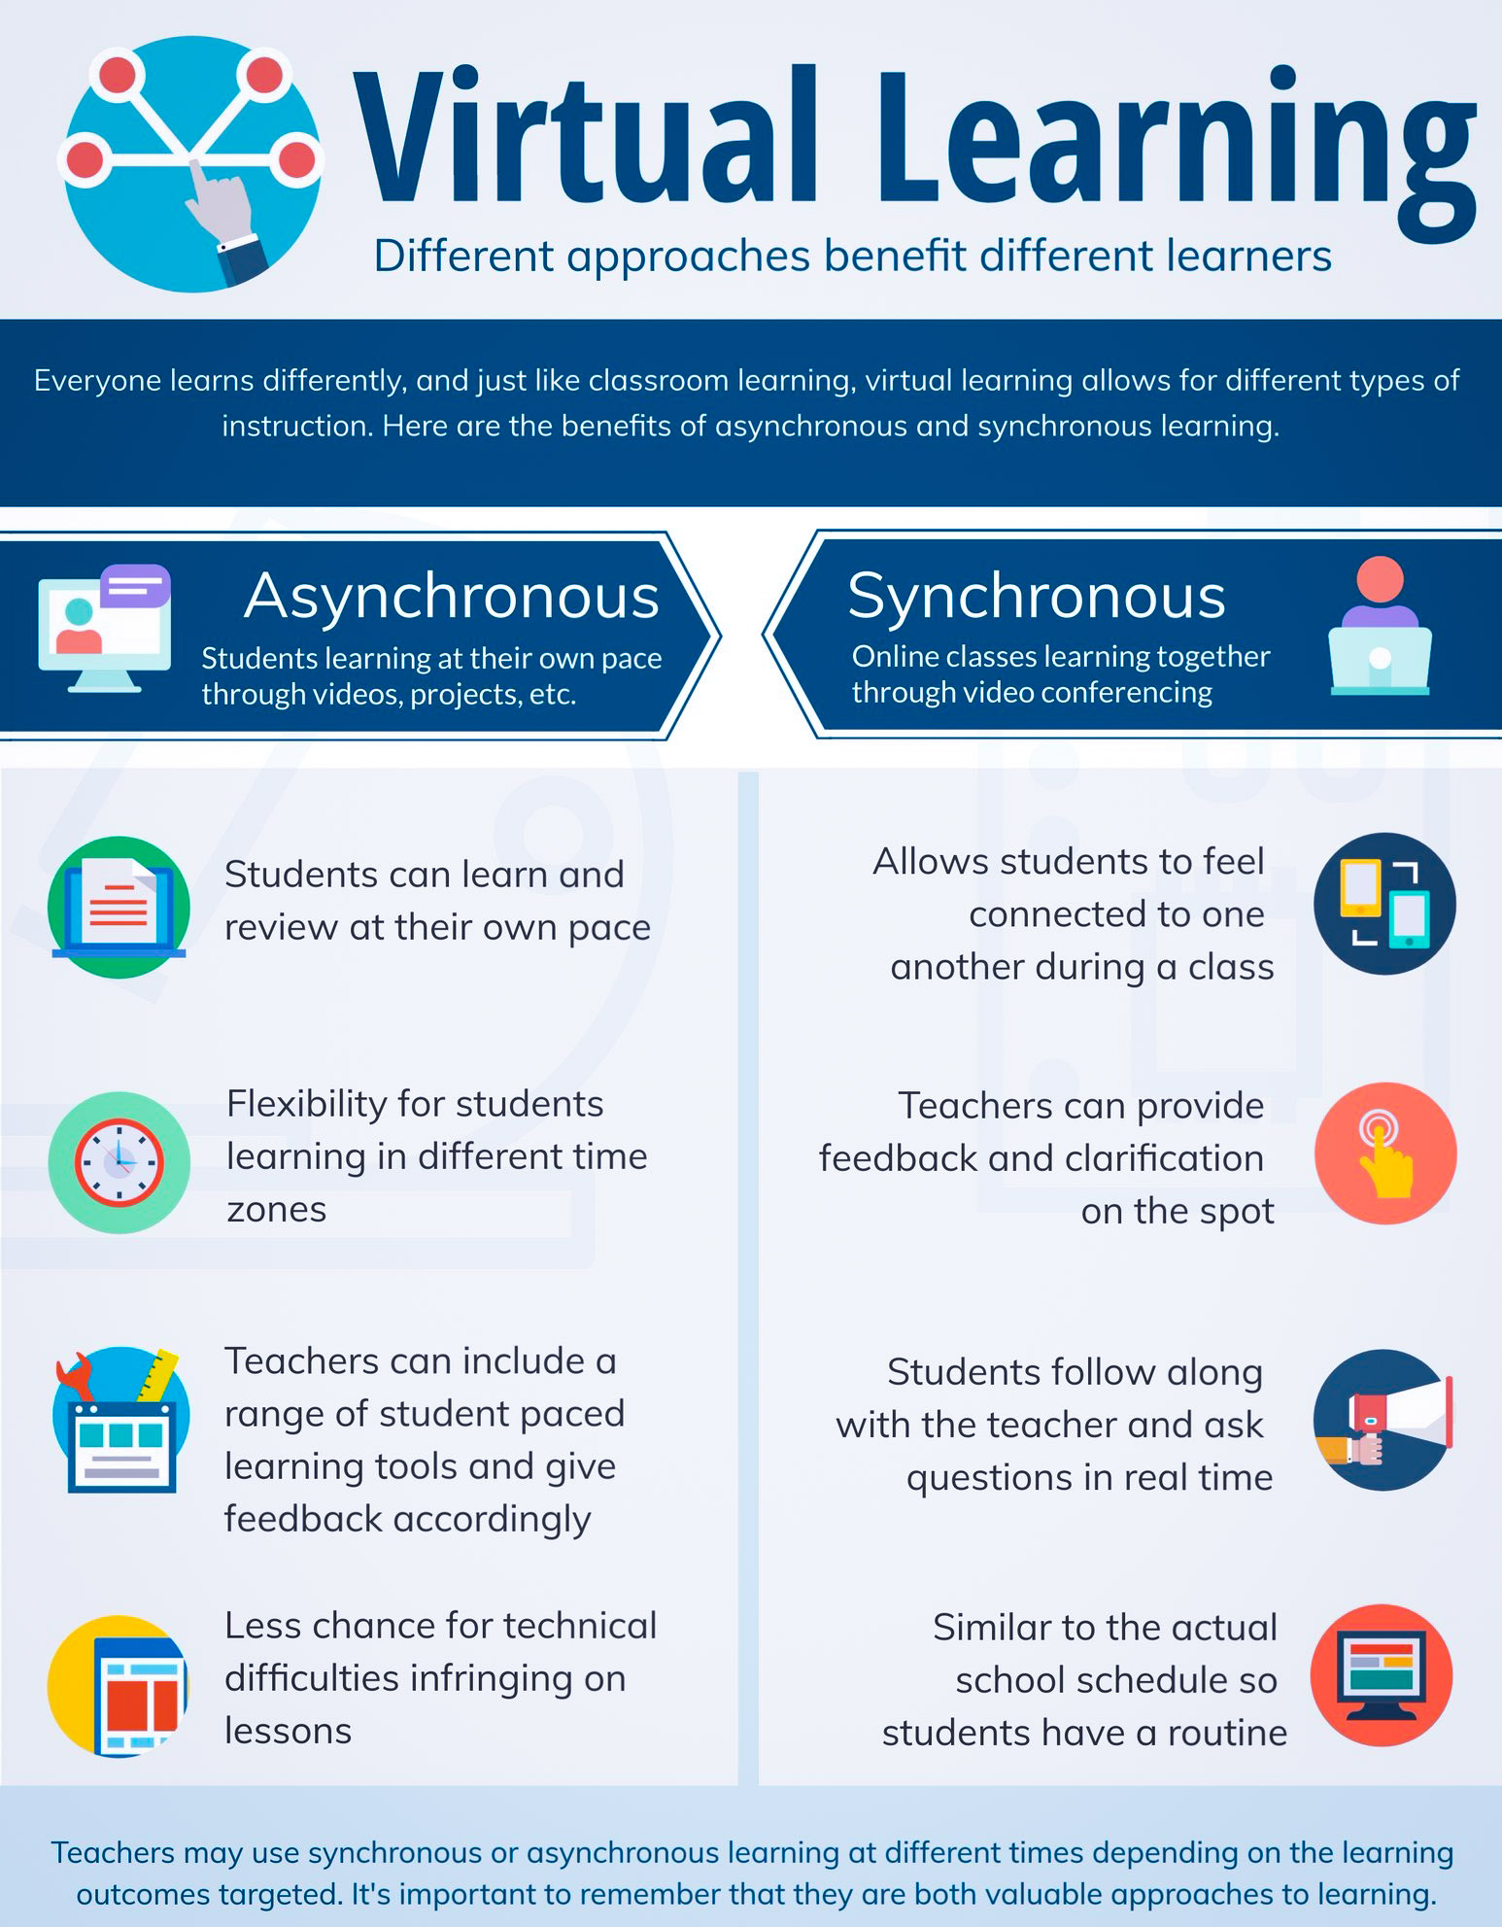

Slide 9
MODULE LEARNING OPPORTUNITIES:
Synchronous Learning
Asynchronous Learning
Pre recorded power points
Interactive
Videos
Online resources
Microsoft Teams
Experiential workshops
Peer writing sessions
Reflective writing exercises
Guest speakers
Directed reading

Slide 10
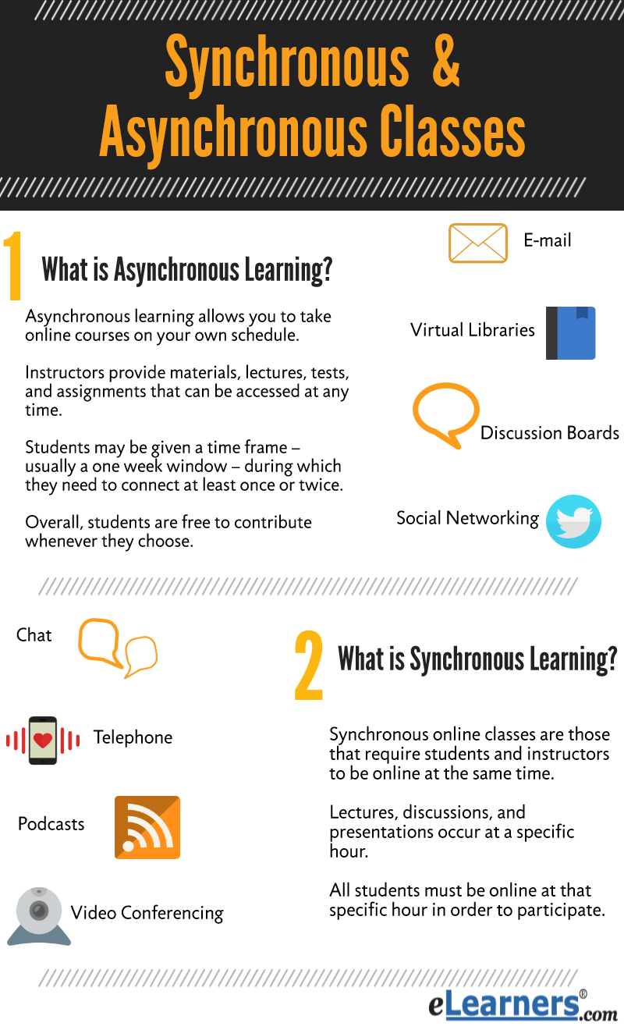
Module Structure … Any questions? Note them down and bring them to our workshop!

Slide 11
Things to consider this week …
The format and structure of the module - what we are going to do and how
Positioning research (and yourself) within the counselling profession
Methodological positioning - Looking through a critical lens – setting the scene for your philosophical paradigms
Reflective, educative and thought provoking exercises

Slide 12

Positioning research (and yourself) within the counselling profession: Start considering this…

Slide 13


Take some time to reflect - Where are you on this scale?
Research aware
Research informed
Research active

Slide 14

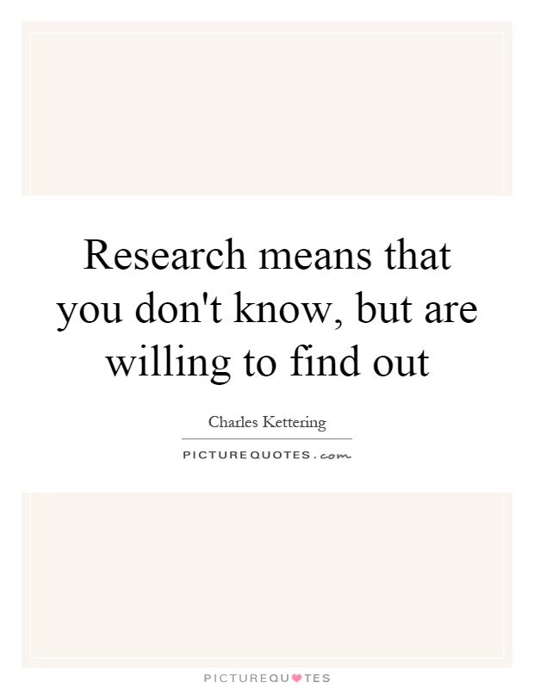
Consider the similarities that this quotation throws up in relation to counselling …

Slide 15
Within these lessons we are considering Qualitative Research …
Consider how engaging in qualitative research can help you personally as a counselling practitioner …

Slide 16

Positioning research [and yourself] within the counselling profession, why is this important?

Slide 17
Positioning research within the counselling profession
For any profession to survive and develop, on-going research is necessary
We have to challenge old concepts and introduce and develop new ideas

Slide 18

Positioning research within the counselling profession:
Published research is informative to the practitioner and can be both informative and supportive in the practice of counselling

Slide 19
Positioning research within the counselling profession
It is important for counsellors to keep up to date with research findings to ensure that client-work is rooted in robust rationale:
This brings and keeps knowledge and skills up to date and gives choice of interventions to apply in an ethical way

Slide 20
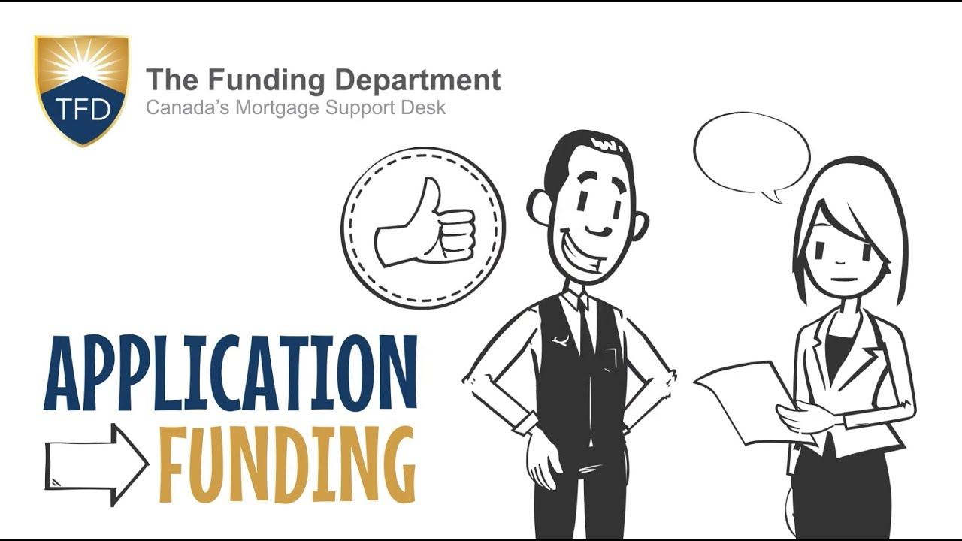
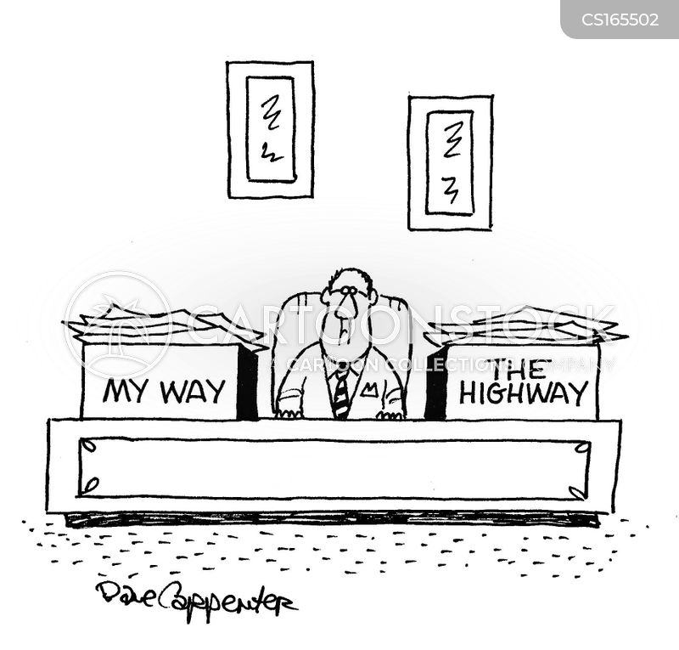
Funding … Research is key to getting [and maintaining] funding for counselling projects …

Slide 21
Research in the counselling profession:
Evidence based
Practice based

Slide 22

Positioning research (and yourself) within the counselling profession
Evidence-based research is seen as vital by the National Health Service in the UK, as supported and encouraged through the work of the National Institute for Health and Care Excellence (NICE).
Outcome measures such as GAD-7 and PHQ-9 are often used to collect quantitative evidence, while tools such as client feedback & exit questionnaires can provide more qualitative information on service effectiveness.

Slide 23
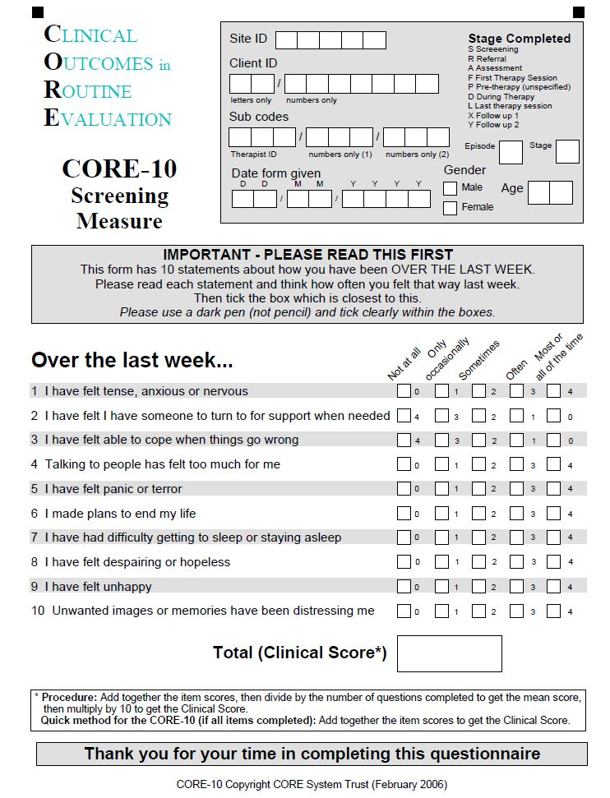
…and what about CORE?
“Clinical Outcomes in Routine Evaluation”.
The CORE system comprises of tools and thinking to support monitoring of change and outcomes in routine therapeutic practice.
Using routine outcomes to give clients feedback on their progress in therapy is helpful to both the client and the practitioner and may improve outcomes
This, in itself, is a form of research.
Notes:
“

Slide 24


We will consider ‘Practice-based‘ research in our workshop – what do you know/think about this?

Slide 25

Positioning research within the counselling profession:
See: An Introduction to Research in Counselling and Psychotherapy (McLeod, 2013)

Slide 26

More about your research journey [9 mins] …..
More about this series of workshops.pptx

Slide 27

Touched on ethics there ….
If you haven’t already done so, now would be a good time to read and consider …

Slide 28
Research Ethics …
UWTSD: Student Regulations
UWTSD: Research Ethics and Integrity Code of Conduct
BACP: Ethical Guidelines for Research in the Counselling Professions
BERA: British Educational Research Association
BERA: Ethical Guidelines
BPS: Code of Ethics and Conduct

Slide 29

Ethics ...
Remember:
ALL research has to have ethical approval
Getting ethical approval is only the START of the ethical process, which will frame the whole of your research project

Slide 30
Positioning research [and yourself] within the counselling profession – what does this have to do with this module?

Slide 31
In preparation for this module it is important to develop an understanding of the ways in which therapy research has grown and developed, the types of methodological approaches that have been employed, and the social, political and cultural factors that have shaped this enterprise.
These themes are addressed in the 2013 version of McLeod’s ‘Introduction to research’ mentioned on a previous slide

Slide 32
As the BACP reminds us, research is important for clients, for practitioners and politically to continue to demonstrate that counselling changes lives
Research provides evidence for the range of issues where therapy can be effective and the positive outcomes for clients can be made visible

Slide 33


Positioning research within the profession Learning from practice and learning from reading:
-
sss
sear

Slide 34
Research matters ….
For clients

Slide 35

The prime importance of research is for client welfare…as counsellors, we have a duty to clients to evidence the benefits of therapy, and also to recognise its potential adverse effects
Research can also support client choice by identifying a range of therapies which may be beneficial for them

Slide 36
Research matters …
For practitioners

Slide 37
Research is also important for practitioners … Research is a vital part of therapeutic practice. The BACP Ethical Framework values research for enhancing our professional knowledge, and providing an evidence-base for practice in ways that benefit our clients
It commits members to 'keeping accurate and appropriate records’ and to ‘monitoring the impact of our work with clients’
Whilst it may feel that incorporating research into routine practice can interfere with the therapeutic process, studies show that therapists who monitor their clients’ progress, using tools such as outcome measures are better able to meet their client’s needs

Slide 38
Research matters …
For commissioners

Slide 39
Research is also important for commissioners
Evidence that counselling is THERAPEUTICALLY and COST effective is essential for commissioning services. The National Institute for Health and Care Excellence (NICE) develops its guidelines based on research…
If no research is available on a particular therapy, or if other research is considered to be of a higher standard, then the therapy may not be recommended, EVEN if there is no evidence that it’s less effective than more widely researched alternatives…
An example of this is the commissioning of IAPT services, where Cognitive Behavioral Therapy (CBT) has the largest body of research and is therefore most often commissioned

Slide 40

What are your thoughts on the lighter view of qualitative research on the following slide (bring these with you to our workshop!] …

Slide 41
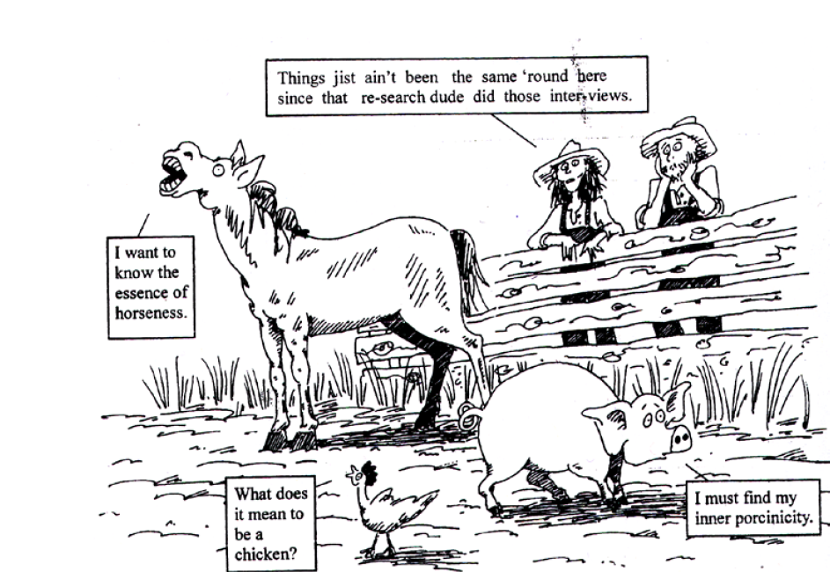

Slide 42
Time for reflection: One of the first things to consider is your philosophical lens ….
How do you view the world and how you live within it?
Consider this now, and again after completing this lesson.

Slide 43
One of the first things to consider is your philosophical lens …
This quick, three minute video provides a simple explanation of ontology, epistemology and research paradigms, so that you can start to form your understanding of these concepts …..

Slide 44
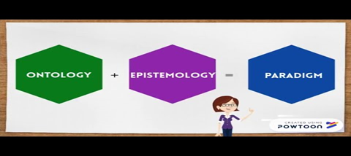
Your philosophical lens [3 mins] ……….
Understanding Ontology and Epistemology

Slide 45

Big words for big concepts …
Ontology and Epistemology

Slide 46

However, these can be easy to understand …
The way we think about the world (ontology) influences: what we think can be known about it (epistemology); how we think it can be investigated (methodology and research techniques); the kinds of theories we think can be constructed about it; and the political and policy stances we are prepared to take …

Slide 47
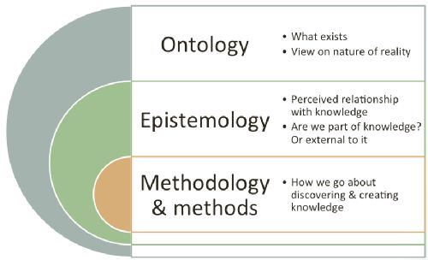
Ontology and Epistemology …

Slide 48
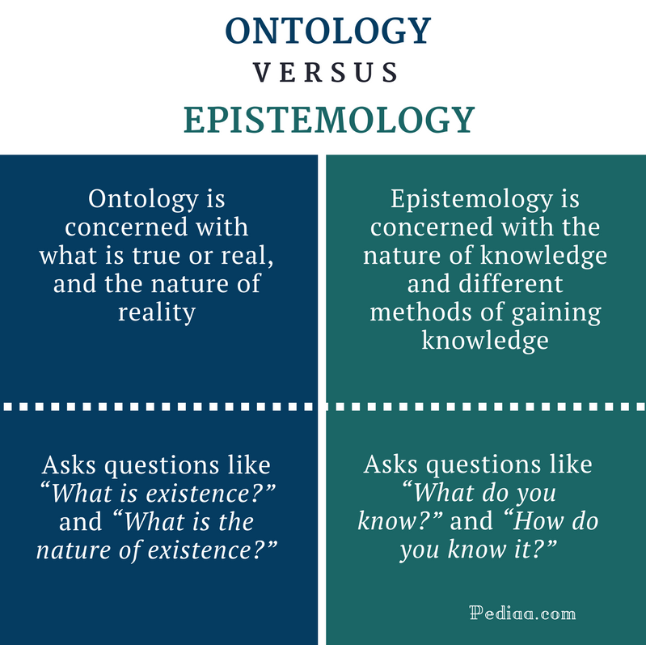

Slide 49
Time for reflection …
Consider:
Ontology
Epistemology
How is our reality created?
Do we create ourselves or are we created by the stories that society tell us?”
Is there one truth, or multiple truths?
How do these concepts relate to your philosophical lens?

Slide 50

Braun and Clarke suggest considering the following analogies when starting to consider the philosophical lens through which we view our research…

Slide 51

Are we archaeologists….digging to find something already there…

Slide 52
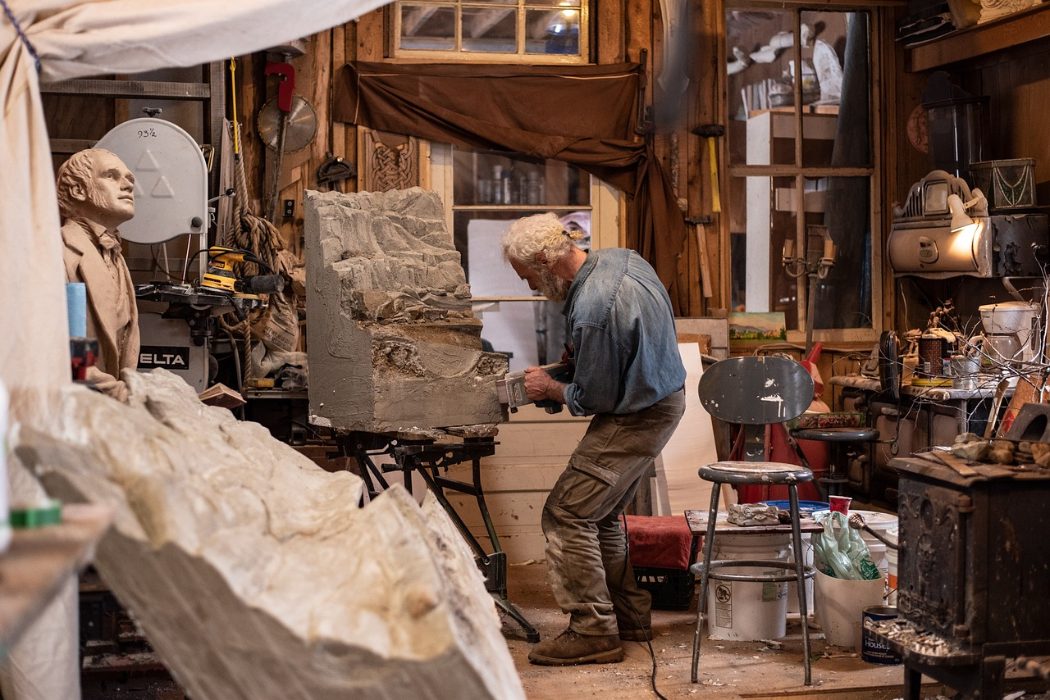
….or sculptors, creating new knowledge?

Slide 53
You can delve deeper into this within:
Braun, V. and Clarke, V., 2013. Successful qualitative research: A practical guide for beginners. London: Sage.
Ontological and epistemological reflexivity: A core skill for therapists [See Moodle]

Slide 54

A lighter look at research paradigms
The research onion

Slide 55
How agile a researcher are you? See next slide for the answer …
A research agility self-assessment:

Slide 56
How agile a researcher are you?
Undertake a research agility self-assessment:
An analytical mind.
A people person.
The ability to stay calm.
Intelligence.
Curiosity.
Quick thinker.
Commitment.
Excellent written and verbal communication skills.
Sympathetic.
Systematic.
Report writing
Data collection
Analysis of information from different sources
Finding information off the internet
Critical thinking
Planning and scheduling
Interviewing
Critical analysis

Slide 57

What do you need?
What do you know, and what do you need to know? Bring your thoughts to our Workshop - Your chance to have an input into future content

Slide 58
QUESTIONS?
Bring them to our workshop!

Slide 59

Top up reading:
Staines, G, M. (2019) Social Sciences Research, Research Writing and Presentation for Students. London: Rowman & Little Publishers. Chapter 1 (online)

Slide 60
Reference list and further ‘top up’ reading
Brinkmann, S. (2018). Philosophies of Qualitative Research (Understanding Qualitative Research. London: Oxford University Press
Cooper, M. (2008) Essential Research Findings in Counselling and Psychotherapy: the facts are friendly. London, Sage.
Cooper, M. Et al (2010) Person-Centred and Experiential Therapies Work: A Review of the Research on Counselling, Psychotherapy and Related Practices. Ross on Wye, PCCS.
Harper, D. (2012) Qualitative research methods in mental health and psychotherapy: a guide for students and practitioners, Oxford: Wiley-Blackwell. Online
McLeod, J. (2011) Qualitative Research in Counselling and Psychotherapy. 2nd Ed. London: Sage
Willig, C. (2008) Introducing Qualitative Research in Psychology. 2nd Ed. Berkshire: Open University Press.

Slide 61
For writing your dissertation:
Andrews, G. (2017) How to write a master's dissertation. Ebook and free on Kindle. This will only take you about an hour to read and gives you the basics of the format and content of a dissertation
Glatthorn, A.A. and Randy, L.J. (2005) Writing the winning thesis or dissertation. Online
Staines, G, M. (2019) Social Sciences Research, Research Writing and Presentation for Students. London: Rowman & Little Publishers. Online

Slide 62
For writing your dissertation:
Andrews, G. (2017) How to write a master's dissertation. Ebook and free on Kindle. This will only take you about an hour to read and gives you the basics of the format and content of a dissertation
Glatthorn, A.A. and Randy, L.J. (2005) Writing the winning thesis or dissertation. Online
Staines, G, M. (2019) Social Sciences Research, Research Writing and Presentation for Students. London: Rowman & Little Publishers. Online
Thomas, G. 2022. How to do your research project: A guide for students. Fourth edition. London: Sage.
Wallace, M. and Wray, A. 2021. Critical reading and writing for postgraduates. London: Sage.

Slide 63
References … … …
Biggam, J. 2018. Succeeding with your Master’s Dissertation. A step by step handbook. Particularly Pages 114 - 172.
Braun, V. and Clarke, V. 2013. Successful qualitative research: A practical guide for beginners. London: Sage.
Fleetwood, S. (2005) ‘Ontology in organization and management studies: a critical realistperspective’, Organization, 12 (2): 197-222.
Guba, E.G. and Lincoln, Y.S (2005) `Paradigmatic controversies, contradictions, and emerging confluences’, in N.K. Denzin and Y.S. Lincoln (eds) The Sage Handbook of Qualitative Research, third edition, Thousand Oaks, California: Sage, pp. 191-215.
Prasad, P. 2005. Crafting Qualitative Research: Working in the Postpositivist Traditions. Routledge. EBook Published 24 February 2015

Slide 64
In this lesson, we have considered:
The format and structure of the module - what we are going to do and how
Positioning research (and yourself) within the counselling profession
Methodological positioning - Looking through a critical lens – setting the scene for your philosophical paradigms
Reflective, educative and thought provoking exercises

Slide 65

Next lesson:
Guest Speaker: PhD Student, Ann Watling Getting the most out of research supervision Research documentation Stopping qualitative research disasters before they start

Slide 66
Next lesson [Asynchronous] … … …
See further information posted on Moodle under the toggle for next week

Slide 67
The aims of this lesson were …
To introduce you to this series of workshops
Get you started, becoming research aware, research informed and research active
Over to you now, to continue the work started during this lesson …

