Slide 1



Sport Organisations for life
Good place to find your self in the next Future

Slide 2

Challenger Sport
Challenger understands that players, coaches, parents and administrators all have different needs and priorities, and by listening to our customers for over 25 years we have created a TOTAL SOCCER company that caters to everyone involved in the game. Challenger Sports is owned and operated by some of the most experienced soccer people in the country and our team of 13 offices and 150 full time now provides a comprehensive range of services and products that include:
International Soccer Camps – Next Level Training – SoccerPlus Camps – GK Icon Camps – Challenger Soccer Academy – TinyTykes – Challenger World Tours – Challenger Tournaments – Challenger Teamwear

Slide 3
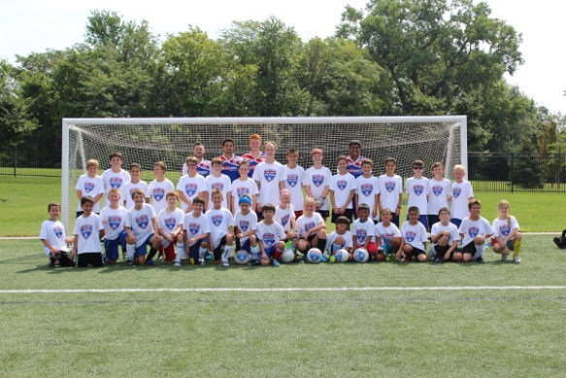
Employment
Challenger provides job opportunities for students on placement and any induvial that have experience in sport coaching.
They are now pleased to be able to enhance this truly global soccer experience by having coaches from a wide range of countries share their knowledge and passion for the game with our 200,000 participants!

Slide 4








Partners:

Slide 5

Camp America
Camp America is one of the biggest Summer camp host in the USA. Camp America was established way back in 1969 and is part of a larger organisation called the American Institute for Foreign Study (AIFS)...

Slide 6
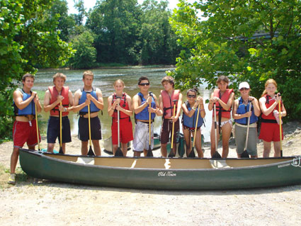
Camps and Employment
Working with hundreds of summer camps located all over the USA, Camp America offers a huge range of work placements to everyone.
Private Camps - Single Gender of campers - Special Need Camp - Jewish Camp - Christian camps

Slide 7
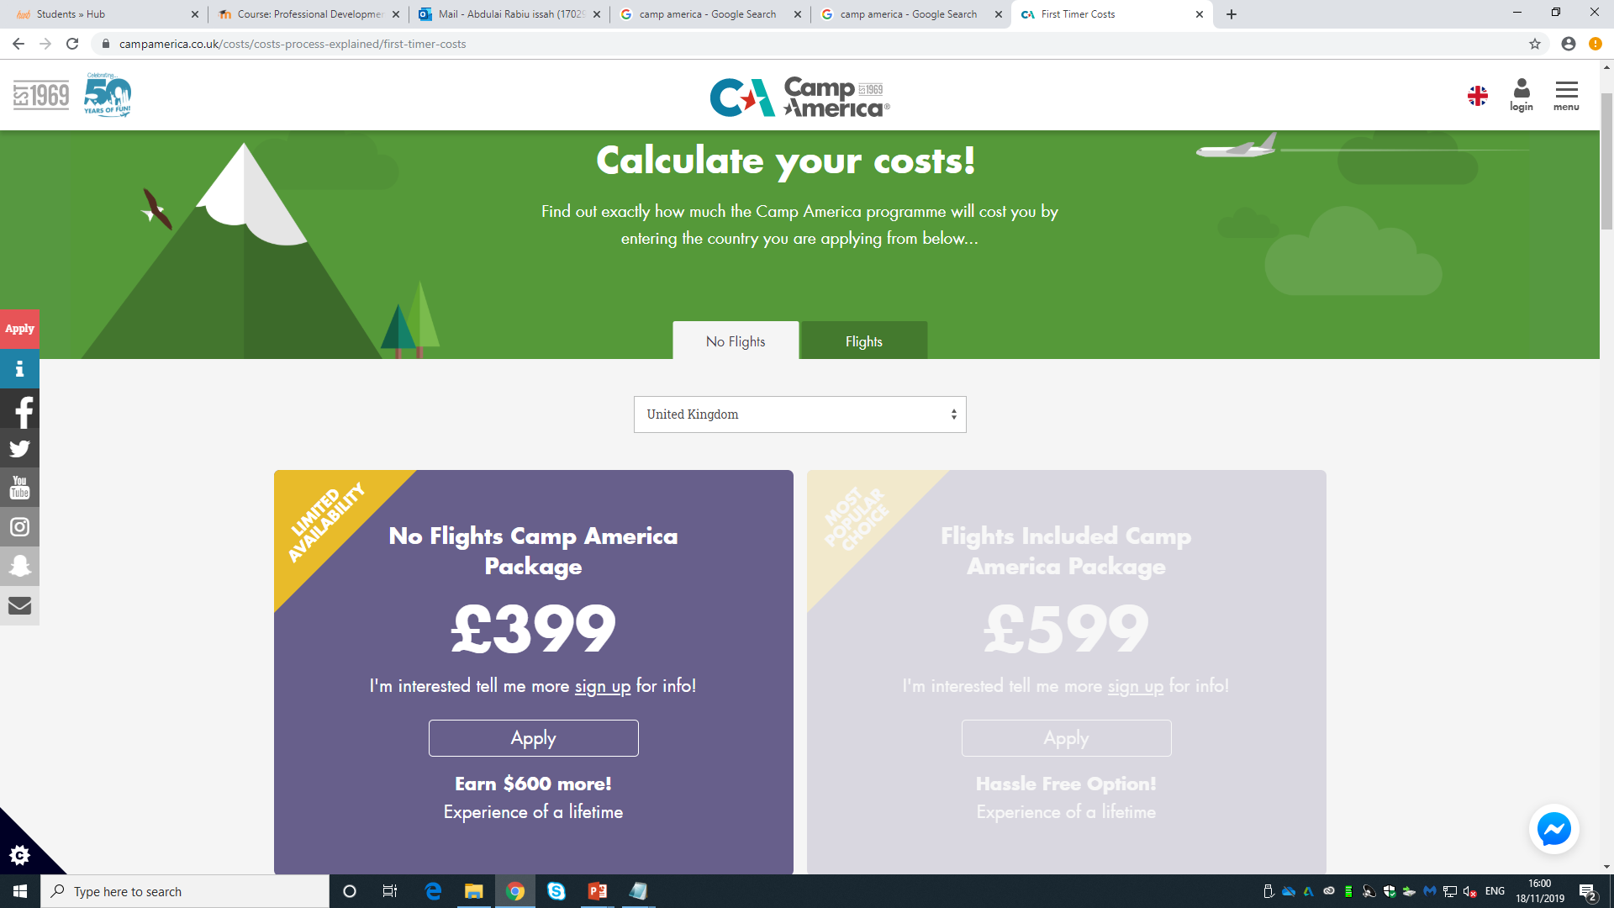
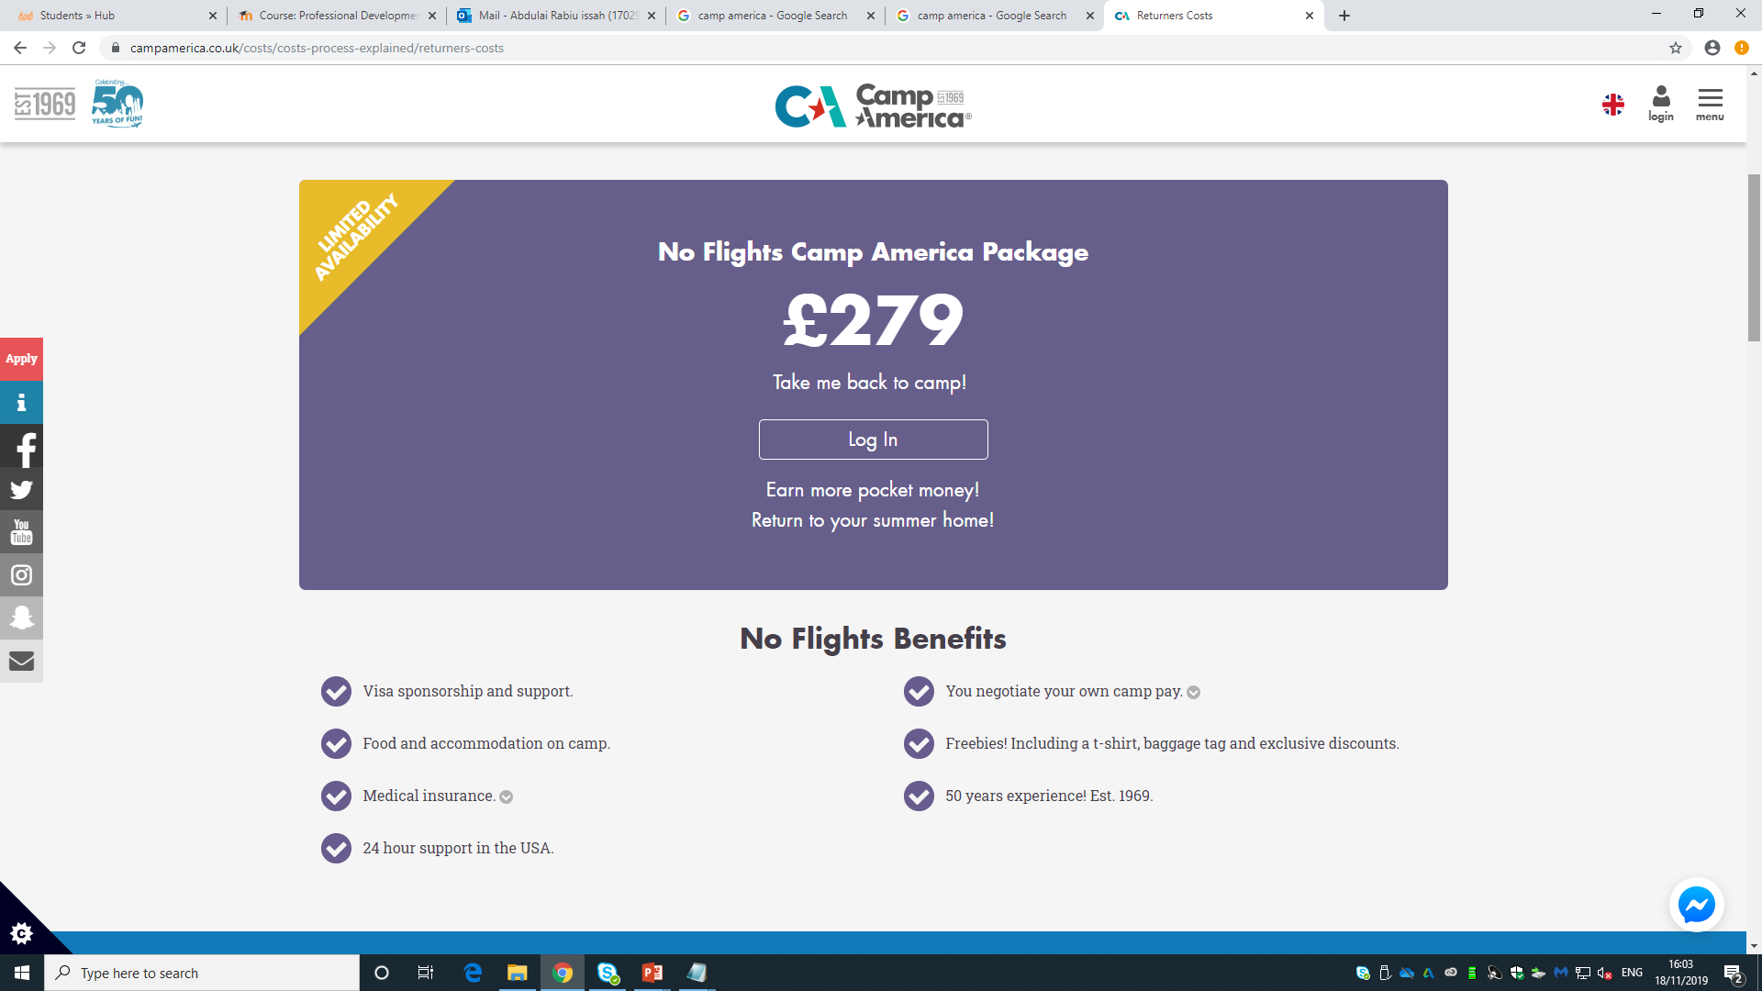
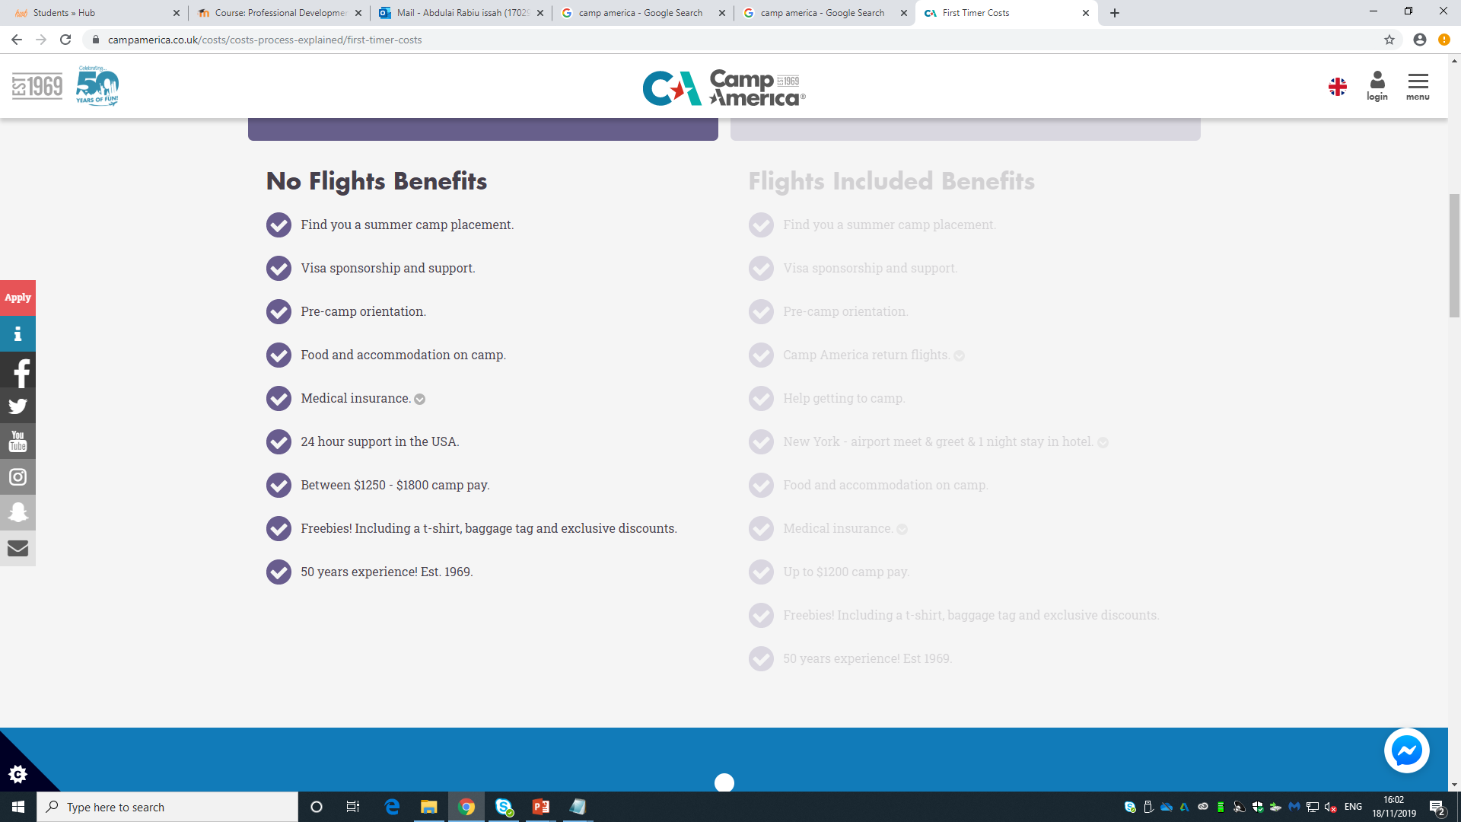
Cost and Application

Slide 8

Why Camp America?
At Camp America we're really proud of the programme we offer. It's a unique opportunity to spend an entire summer away from home, in a safe but exciting environment that's designed with one thing in mind - fun! Here's why there's no experience quite like Camp America...

Slide 9
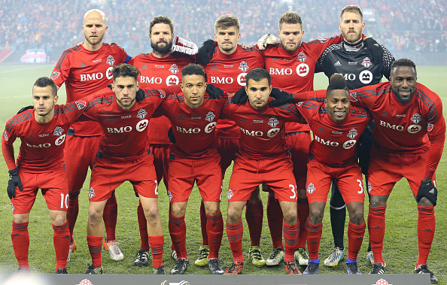
Toronto FC
Toronto Football Club is a Canadian professional soccer club based in Toronto, Ontario. The Club is Founded October 2005;14 years ago.

Slide 10
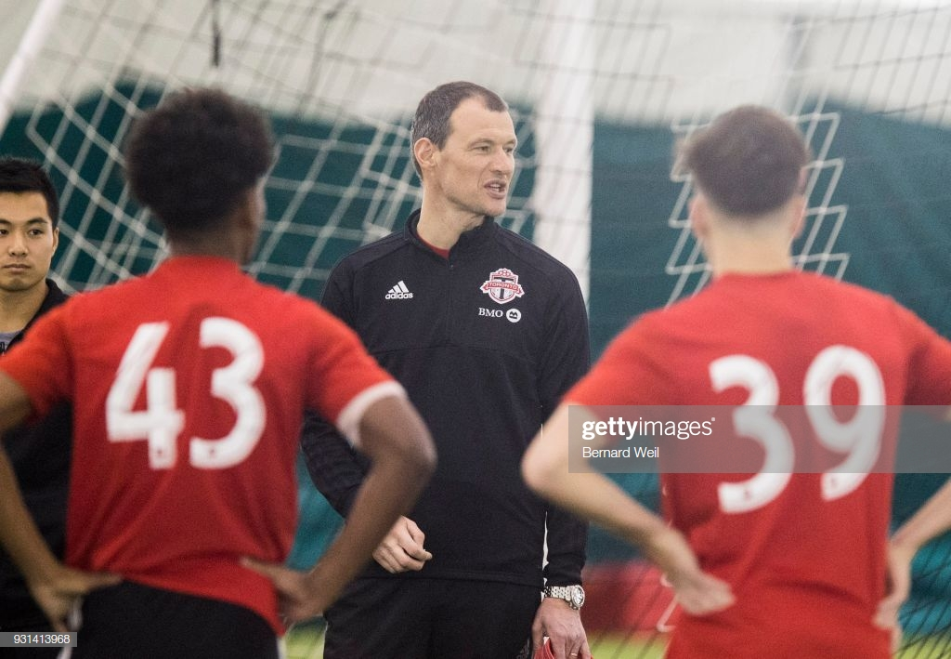
Employment and Experience
Camps
Academy
Stadium
Pro Players Clinics
Management team
Shop

Slide 11
THANK YOU
Challenger Sports (2018) Available at https://www.challengersports.com/about-us/
Accessed on 16/11/2019
Challenger Sports (2018) Available at https://www.challengersports.com/partners/
Accessed on 16/11/2019
Challenger Sports (2018)https://www.challengersports.com/become-a-coach/
Accessed on 16/11/2019
(2019),Camp America,(Online) Available at https://www.campamerica.co.uk/about-us/the-company
Accessed on 16/11/2019
(2019),Camp America,(Online) Available at https://www.campamerica.co.uk/the-experience/types-of-camp
Accessed on 16/11/2019
(2019)Toronto Football Club (Online) Available at https://www.torontofc.ca/community/relations
Accessed on 16/11/2019

