Slide 1
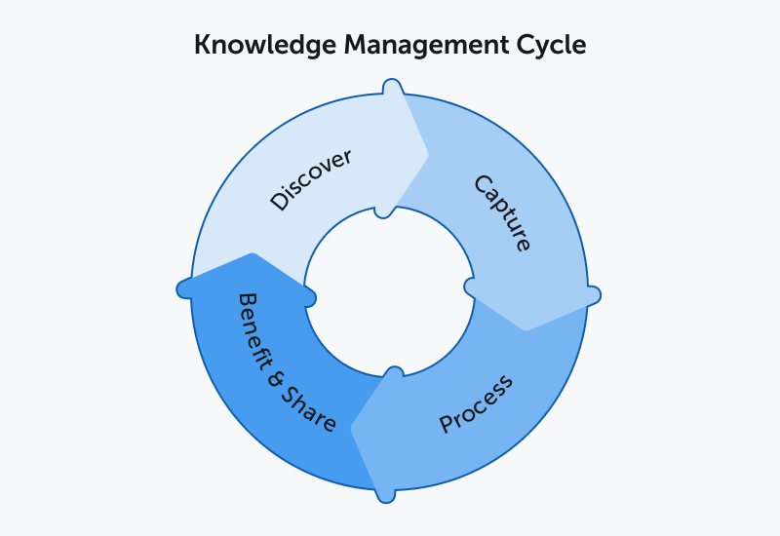
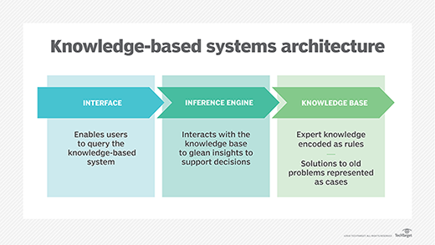
Knowledge and Information Management
Introduction:
An organization's ability to maintain current records, respond to customer inquiries, and control who has access to what information is all improved by the usage of a knowledge management system. It's a useful approach for both established corporations and new ventures. The implementation of a knowledge management system is an essential step in every progressive business. Knowledge management systems are becoming popular because of their ability to facilitate the transfer of institutional knowledge between employees and new hires. Knowledge management's end objective is to pair individuals in need of information with those who have it to share.
Enhancing Value by Knowledge Management for Amazon:
Amazon is universally regarded as one of the most successful online retailers in the world. Amazon has always known that its success will depend on its consumers' ability to have a positive shopping experience, which means being able to simply search for and purchase the products they need.
No extra tabs or interfaces needed. When dealing with Amazon, all transactions are processed via a single hub. It makes no difference whether it's food, technology, literature, or clothes. Full-service convenience. There has been no change to the site or the user's experience. This makes consumers feel at ease as they navigate the web, especially in unfamiliar places. Just picture it: the Amazon Books and Amazon Electronics websites are under separate domains. Imagine if, before you could go shopping, you had to decide which store to visit.
Keeping everything looking the same throughout. Information about the product, such as features and customer ratings, is presented consistently throughout all listings. Outstanding content management is responsible for this, since they consistently assemble new material for users and release it to the public. To top it all off, every single data "nugget" may be recorded and stored for later use.
Content that can be separated into modules. Every page on Amazon is broken down into digestible chunks. There are no complex PDF books to go through. Sometimes they'll provide more information, but it'll be presented as a choice (like "click here") rather than a need (like "read on").
Distributed upstream content creation. Although Amazon seems to have complete control over what is shown, the material is really produced by the goods producers, who have the necessary skills. All of the information seems like it originated from the same location since it follows Amazon's design guidelines, writing styles, and other practices and rules.
About Amazon:
Amazon is unparalleled in size and scope compared to other companies throughout the globe. It dominates the market in both cloud computing and online retail. Amazon's goal, like that of every other business, is to maximize profits. The company is well-known for its demanding work environment, which pushes employees to the brink of their ability. Although such a strategy is standard for large organizations, Amazon's CEO, Jeff Bezos, has his own plans for the company's future. As he sees it, the fate of all humanity hinges on this. He's doing his best to push forward some promising innovations. Bezos envisions a worry-free world where future generations may live in peace and prosperity. For Bezos, the establishment and growth of a space program is a long-term objective. But first, you need to save up enough money and amass enough tools. Amazon, like any other company, is subject to internal and external analyses of its advantages and weaknesses. Amazon's main assets are its leadership and its cash on hand.
Concept of Knowledge Management:
The term "knowledge management" refers to the deliberate effort put into capturing, organizing, storing, and disseminating an organization's accumulated body of know-how.
Institutional knowledge is accumulated by a company as it develops, grows, and defines its business strategy. The firm would not be able to function without this data. Transferring this knowledge to inexperienced workers is critical to keeping the business running smoothly.
Knowledge management's major objective is to help employees find and connect with the individuals who know specific information or have specific institutional knowledge.
Challenges in Knowledge Management for Amazon:
Data storage and sharing might be difficult if everyone isn't on the same page. The adaption phase is challenging in and of itself since people (and especially programmers) are reluctant to change their established routines. It is crucial to the growth and success of your community and productivity that you find ways to encourage your staff to collaborate and share their work and ideas in a common environment.
It seems that the frequency with which new versions of the technology we rely on are released is only increasing. We feel a feeling of pressure to stay up with the times because of the rapid pace at which our most useful technology are evolving. The key thing to keep in mind is that although technological advancements and upgrades might be inconvenient at first, they often lead to better and more useful outcomes.
It's a fact that content moderation is difficult to master. The data your users provide might be quite valuable, but it may need regular maintenance and checks to ensure accuracy. Set up validation reminders for your moderators or the original posters to ensure that all information is up to date.
Conclusion:
Every business has certain requirements that a knowledge management system must fulfill. The aims and objectives of a business, as well as the manner in which the firm serves its customers and clients, are factors that determine whether or not the organization should deploy a knowledge management system. Knowledge management systems are used by a wide variety of organizations and corporations to develop processes that are dependable and trustworthy, which in turn boosts sales and productivity.
Information Architecture:
Effective and long-lasting information organization, structure, and labeling are fundamental concerns in information architecture (IA). The aim is to make it easier for people to locate what they need and do what they need to do. It's impossible to do so without first grasping the system's structure and the interconnections between its constituent parts.
References:
Boell, S.K. (2017) “Information: Fundamental positions and their implications for Information Systems Research, education and Practice,” Information and Organization, 27(1), pp. 1–16. Available at: https://doi.org/10.1016/j.infoandorg.2016.11.002.
Bouakel, M. and Zerbout, A. (2021) “Perspectives of Big Data Analytics' integration in the business strategy of Amazon, Inc..,” Big Data Analytics, pp. 201–220. Available at: https://doi.org/10.1201/9781003129660-20.
Hoehle, H. and Huff, S. (2012) “Advancing Task-Technology Fit Theory: A formative measurement approach to determining task-channel fit for electronic banking channels,” Information Systems Foundations: Theory Building in Information Systems [Preprint]. Available at: https://doi.org/10.22459/isf.10.2012.06.

