Slide 1
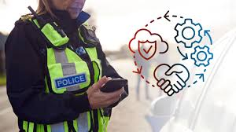

Digital and Operational Policing Assignment 2
Presented by Dan Phillips 2305529

Slide 2
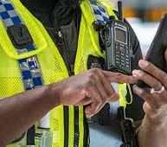
Contents
How does the integration of information and intelligence enhance the effectiveness of both operational and digital policing
Introduction
Point 1 – What is Information and Intelligence?
Point 2 – National Intelligence Model and How is Intelligence Graded?
Point 3 – How does this enhance the effectiveness of both digital and operational policing?
Point 4 – Key Challenges
Summary

Slide 3
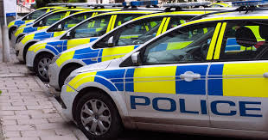
Introduction
Policing in the UK depends on a range of strategies designed to enhance how crime is prevented, detected, and responded to.
One of the most significant developments in recent years has been the growing integration of information and intelligence across policing in the UK.
To address these challenges, the police must adopt approaches that support timely, accurate, and ethical integration of intelligence
This assignment will examine how the integration of information and intelligence enhances the effectiveness of both operational and digital policing, and what this means for modern policing practice.
(Phythian, Kirby and Swan-Keig, 2024), (Hughes and Blockley, 2025).

Slide 4
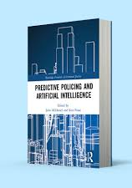
What is Information and Intelligence?
Information refers to the raw facts the police receive such as calls from the public, CCTV footage, incident reports, or digital footprints left online.
Intelligence is what this information becomes once it has been assessed, analysed, and checked for reliability.
The threats and issues that policing faces has become much more complicated in the current digital era.
(College of Policing, 2023), (NPCC, 2024), (Henry, 2024).

Slide 5
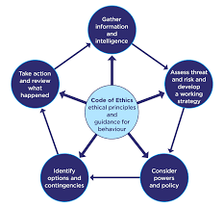
NIM? How is Intelligence Graded?
The National Intelligence Model, often referred to as the NIM, is the main framework used by police forces across the UK.
For information to become intelligence, it must first be assessed using a standard system known as the 3x5x2 intelligence model
(Home Office, 2025), (HMICFRS, 2022), (College Of Policing, 2022)

Slide 6
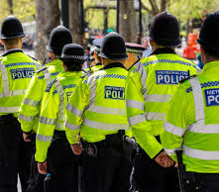
How Integrating Information and Intelligence Enhances Operational and Digital Policing?
The integration of information and intelligence plays a vital role in improving the effectiveness of operational and digital policing in the UK.
For frontline, operational policing, integrated intelligence is particularly valuable. It can help officers identify crime patterns, recognise high-risk areas, and provide an understanding to repeat offending.
Digital policing has also benefited significantly from the integration of information and intelligence by allowing police forces to respond more quickly and effectively to modern forms of crime.
(IJECM, 2021), (Ratcliffe, 2016), (Manning, 2008), (Wilson-Kovacs and Wilcox, 2023)

Slide 7
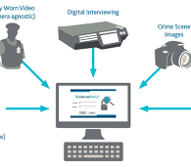
Key Challenges About this Integration
One major issue is information overload. Police forces now collect vast amounts of data from crime reports, CCTV, body-worn cameras, and online sources.
Different police units and partner agencies often use separate systems, which can limit how easily intelligence is shared across departments or regions.
Digital policing also raises concerns around privacy, ethics, and public trust. The use of online monitoring, data analytics, and digital forensics can be seen as intrusive if not used correctly.
(HMICFRS, 2015), (Lyon, 2018), (Wong, 2025)

Slide 8
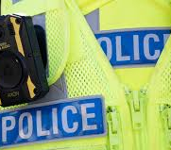
Summary
In conclusion, the integration of information and intelligence is essential to the effectiveness of both operational and digital policing in the UK.
For modern policing practice, integrating information and intelligence is not optional but a fundamental requirement for effective, ethical, and accountable policing.

Slide 9
Timeline Graphic
Main Research – 10/12/25
Writing Introduction – 17/12/25
Main Body – 18/12/25-28/12/25
Conclusion and Editing – 29/12/25

Slide 10
AI Declaration
Basic Acknowledgement format of AI tool use
I acknowledge the use of Grammarly at https://grammarly.com on 29/12/25 to proofread my work. I used the prompt(s):
Please proofread my work
I confirm that I have not presented any AI generated text as my own work. I confirm I have copies of my drafts, notes, and other resources I used before, and after the use of AI tools which I may be asked to provide in evidence.
Signed: Daniel J Phillips 29/12/25

Slide 11
Reference List
College Of Policing (2022). Intelligence Report. Available At: https://www.college.police.uk/app/intelligence-management/intelligence-report. (Accessed on 17/12/25).
College of Policing (2023). Principles. Available At: https://www.college.police.uk/guidance/pnc-and-leds/guidance-code-practice-pnc-and-leds/principles. (Accessed on 15/12/25).
Henry, A. (2024) ‘Digital ritual: Police–public social media encounters and ‘authentic’ interaction’, The British Journal of Criminology, 64(2), pp. 452–467. Available at: https://doi:10.1093/bjc/azad036.
HMICFRS (2022). National Intelligence Model. Available At: https://hmicfrs.justiceinspectorates.gov.uk/glossary/national-intelligence-model/. (Accessed on 17/12/25).
HMICFRS (2015). Real Lives, Real Crimes – A Study of Digital Crime and Policing. Available At: https://assets-hmicfrs.justiceinspectorates.gov.uk/uploads/real-lives-real-crimes-a-study-of-digital-crime-and-policing.pdf. (Accessed on 29/12/25).
Home Office (2025). NIM Code of Practice. National Centre For Policing Excellence. Available At: https://library.college.police.uk/docs/npia/NIM-Code-of-Practice.pdf. (Accessed on 17/12/25).
Hughes, C. and Blockley, T. (2025) Intelligence-led Policing. Routledge.
International Journal of Economics, Commerce and Management (2021). INFORMATION-ANALYTICAL ACTIVITY IN THE POLICE STRUCTURES OF THE MINISTRY OF THE INTERIOR. International Journal of Economics, Commerce and Management, 9(12), pp. 1–15. Available At: https://ijecm.co.uk/wp-content/uploads/2021/12/91219.pdf. (Accessed on 17/12/25).
Lyon, D. (2018) The culture of surveillance: Watching as a way of life. John Wiley & Sons.
Manning, P.K. (2008). The technology of policing: Crime mapping, information technology, and the rationality of crime control (Vol. 4). NYU Press.
National Police Chiefs Council (2024). Artificial Intelligence (AI) Strategy Keeping the public safe from the criminal misuse of AI; deploying ethical, transparent and ambitious AI to improve policing. Available at: https://www.npcc.police.uk/SysSiteAssets/media/downloads/publications/publications-log/science-and-innovation/2025/npcc-ai-strategy.pdf. (Accessed on 15/12/25)
Phythian, R., Kirby, S. and Swan-Keig, L. (2024) ‘Understanding how law enforcement agencies share information in an intelligence-led environment: how operational context influences different approaches’. Available at: https://doi.org/10.1108/pijpsm-06-2023-0073.
Ratcliffe, J.H. (2016) Intelligence-Led Policing. 2nd edn. Abingdon: Routledge.
Wilson-Kovacs, D. and Wilcox, J. (2023) 'Managing policing demand for digital forensics through risk assessment and prioritization in England and Wales'. Policing: a journal of policy and practice, 17, pp. 1–15. https://doi.org/10.1093/police/paac106
Wong, A.T.T. (2024) ‘Opportunities and Challenges of Big Data Analytics in Crime Investigation’, International Annals of Criminology, 62(3–4), pp. 570–584. https://doi:10.1017/cri.2025.3.

