Slide 1
The economic advantages of the Kilvey Hill development.
Today I am arguing in favour of the Kilvey Hill Skyline development, based purely on its economic benefits to Swansea. This argument is not about personal opinion; it is about jobs, investment, and long-term economic growth in a city that needs sustainable opportunities.

Slide 2
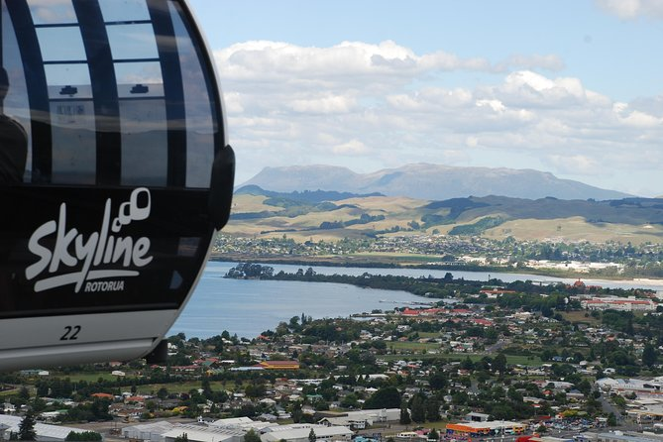
Economic advantages of the Kilvey Hill Skyline Development.
Proposal for a major leisure and tourism attraction on Kilvey Hill
Includes a cable car, outdoor activities, and visitor facilities.
My argument focuses only on economic benefits for Swansea.
Notes:
When we look at the overall economic advantages of the Kilvey Hill Skyline development, the key point is value for money.
Tourism developments typically generate strong economic returns because visitor spending supports multiple sectors at once — hospitality, retail, transport, and services.
This project is expected to generate long-term revenue through visitor numbers, employment, and ongoing business activity. Unlike short-term funding schemes, the Kilvey Hill development creates a self-sustaining economic model that continues to benefit Swansea year after year.
The opposition may focus on short-term costs, but the evidence shows that long-term economic gains outweigh initial investment. From a purely economic standpoint, this development represents a strategic investment rather than a financial risk.

Slide 3
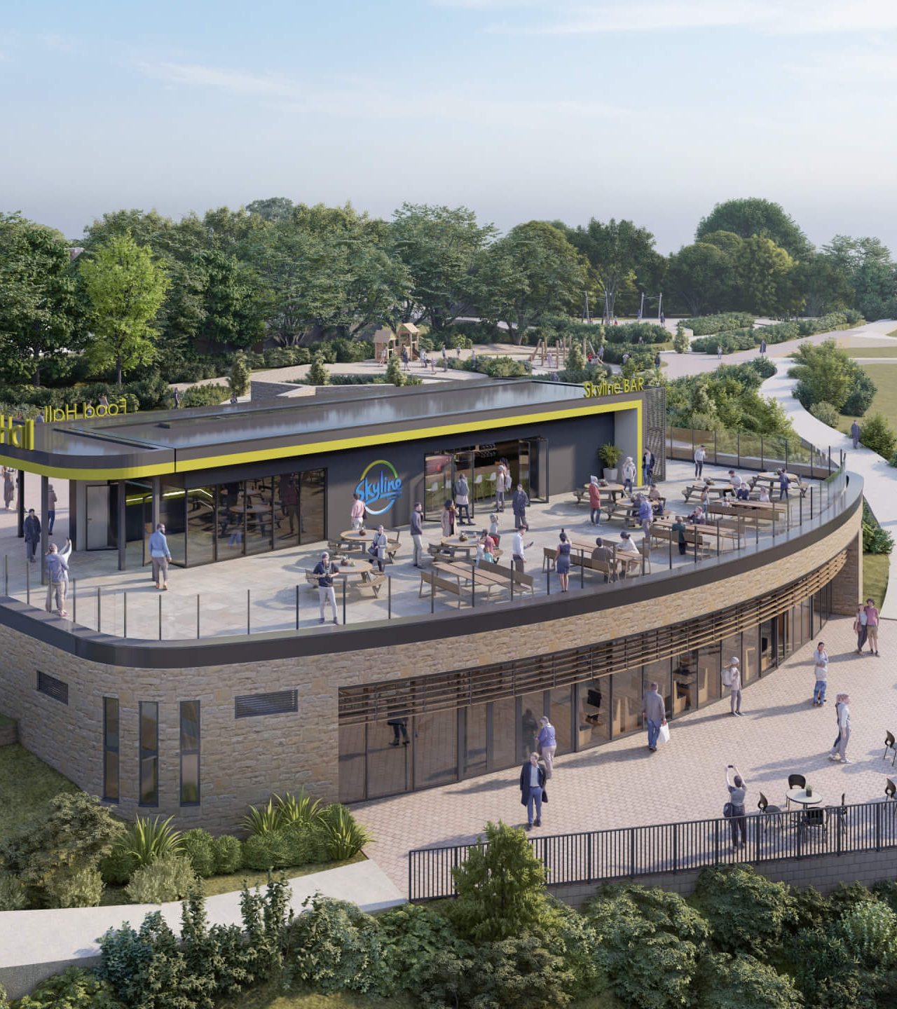
Job Creation – boosting employment in Swansea
Around 478 during construction
Over 100 permanent jobs once open
Jobs in:
Construction, tourism/ hospitality, maintaince/ management
Why this matters?
Helps reduce youth unemployment
Creates local jobs for many including students and graduates
Keeps skilled workers in swansea
Notes:
Let’s start with employment — because jobs are the foundation of any economy.
The Kilvey Hill development is expected to create around 478 construction jobs and over 100 permanent jobs once the site is operational. These are not temporary benefits; they are long-term employment opportunities in tourism, hospitality, and management.
Opponents may argue that development comes with risk, but I would argue that unemployment and lack of opportunity are far greater risks. Swansea already struggles to retain graduates, with many leaving for larger cities due to limited job prospects. This development helps keep people working — and spending — locally.

Slide 4
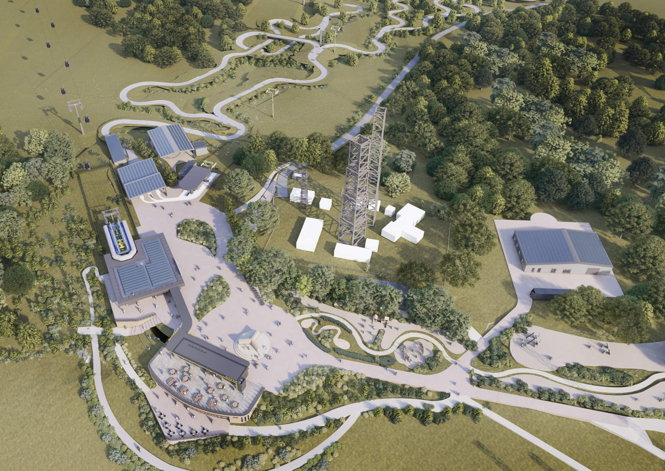
Tourism and visitor spending
Increasing tourism revenue
Estimated up to 450,000 visitors per year
Many visitors expected from outside Swansea and Wales
Visitors spend money on accommodation, restaurants, transport, and shops
The economic impact:
More visitors = more money flowing into the local economy
Supports small and medium sized local bussiness.
Notes:
The economic benefits of tourism do not stop at the attraction itself. Visitors spend money on hotels, restaurants, cafés, transport, and local shops, spreading the economic impact across the city.
This is particularly important for small and medium-sized businesses, which make up a large part of Swansea’s economy. Increased footfall helps these businesses grow, become more resilient, and employ more people.
Opponents may claim the benefits are limited to one site, but the reality is that tourism spending circulates throughout the local economy, creating a multiplier effect that benefits the wider city.

Slide 5
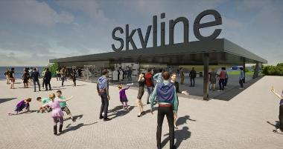
Long term economic growth
Long term financial benefits:
Projected £84 million added to Swansea's economy over 15 years
Measured using gross value added (GVA)
Supported by £4 million Welsh Government Investment
Why this is important:
Shows government confidence in the project
Encourages future private investment in Swansea
Creates lasting economic benefits, not just short-term gains.
Notes:
Short-term thinking is one of the biggest mistakes cities make.
Economic assessments estimate that the Kilvey Hill development could add around £84 million to Swansea’s economy over 15 years. That figure includes wages, visitor spending, and supply-chain activity.
Importantly, the project has received £4 million in Welsh Government funding. Governments do not invest public money without evidence of economic value. This investment signals confidence in the project’s long-term viability and helps attract further private investment.
If this project were economically weak, it would not have received this level of support.

Slide 6
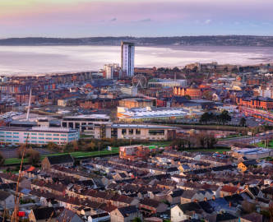
Effcient use of land and infrastructure
Smart economic planning:
Uses existing infrastructure at Landore park and ride
Concentrates development in one area
Reduces the need for costly development/ expansion elsewhere
Economic advantage:
Lower infrastructure costs
Higher economic return from a single attraction site
More efficient use of public mone
Notes:
Another important economic advantage of the Kilvey Hill development is its efficient use of land and existing infrastructure.
Rather than expanding the city outward — which is expensive and inefficient — this project makes use of the Landore Park and Ride, an existing transport hub that is currently underused.
From an economic planning perspective, concentrated development is far more cost-effective than scattered growth. It reduces the need for new roads, new transport links, and additional public services, all of which are expensive for local authorities.
Opponents may argue that development should happen elsewhere, but that ignores the reality that spreading development increases public spending. The Kilvey Hill project focuses investment in one area, ensuring higher economic returns per pound spent and better use of existing resources.

Slide 7
Conclusion.
Why the Kilvey Hill development makes economic sense?
Creates jobs
Attracts visitors and spending
Adds long-term value to Swansea's economy
Increases investment confidence
Economic growth is essential for the future of Swansea so the Kilvey hill development is an opportunity to achieve it.
Notes:
In conclusion, the economic case for the Kilvey Hill development is strong and based on clear evidence. The project would create hundreds of jobs, increase tourism spending across Swansea, and generate long-term economic value. It would also attract government and private investment, helping to strengthen Swansea’s position as a competitive city.
Economic growth does not happen by chance. It happens when cities are willing to invest in new opportunities. Supporting the Kilvey Hill development is not a risk — the real risk is failing to grow. For these reasons, I strongly support the Kilvey Hill Skyline development.

Slide 8
Reference list
Skyline Swansea (2024) Skyline Swansea: Economic impact and job creation. Available at:https://skylineswansea.co.uk/?utm (Accessed: 8 January 2026).
Skyline Swansea (2024) Skyline Swansea would create 100 new permanent jobs. Available at:https://skylineswansea.co.uk/media-releases/skyline-swansea-would-create-100-new-permanent-jobs/?utm (Accessed: 8 January 2026).
Welsh Government (2024) Sky’s the limit for Swansea with new tourism venture. Available at:https://www.gov.wales/skys-limit-swansea-new-tourism-venture?utm (Accessed: 8 January 2026).
News.Wales (2024) Swansea council disposes of land at Kilvey Hill for multi-million-pound leisure attraction. Available at: https://news.wales/south/swansea-council/swansea-council-disposes-of-land-at-kilvey-hill-for-multi-million-pound-leisure-attraction-2025-08-55536.html?utm (Accessed: 8 January 2026).
Swansea Bay News (2025) Council approves plan for Skyline development. Available at:https://swanseabaynews.com/council-approves-plan-for-skyline-development/?utm (Accessed: 8 January 2026).

