Slide 1




Tm Lewin
BMSW 4004
Problem solving and decision making
By Bethay Redmond 2127859

Slide 2
Tm Lewin
Founded in 1898
Founder Thomas Mayes Lewin
Fell into administration for the second time in June 2020
They also supplied the RAF and British Army with uniforms during the first world war

Slide 3
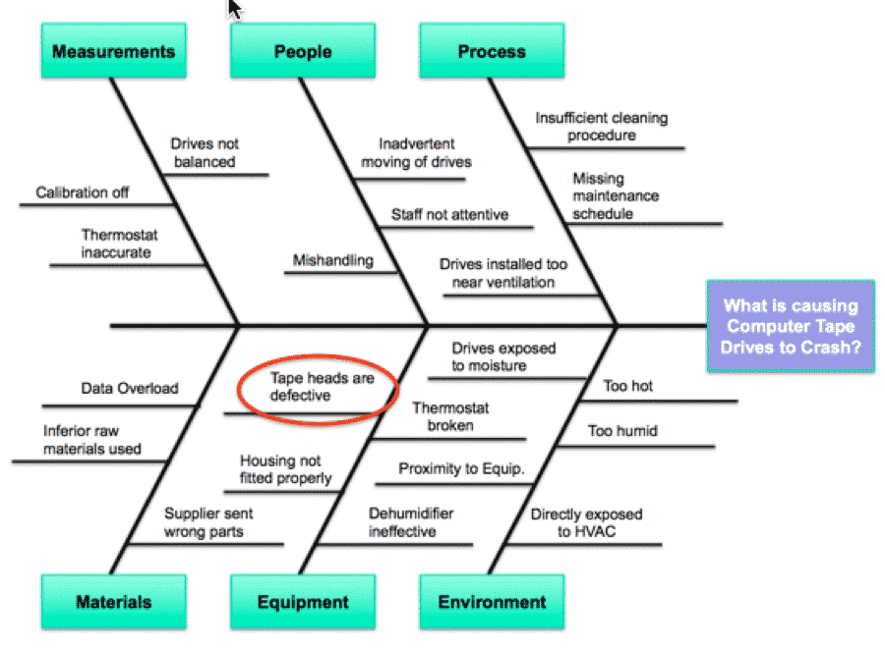
Fishbone
The fishbone diagram identifies segments that contribute partial factors to a overall outcome

Slide 4
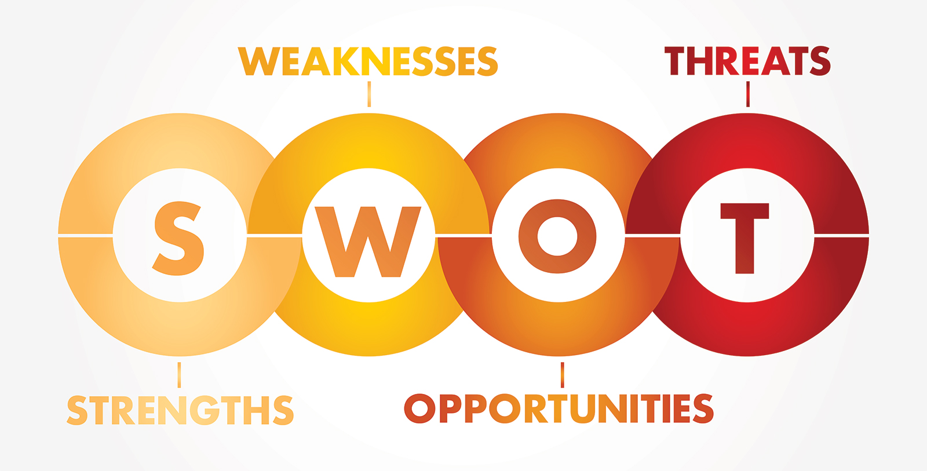
Swot
One of the strengths of TM Lewis is they have been though administration before, so they are aware of the process a weakness is they now only have 50 staff working from home. Opportunities are being able to open stores again and employee more staff however a threat is inflation is prices due to covid and competition.

Slide 5
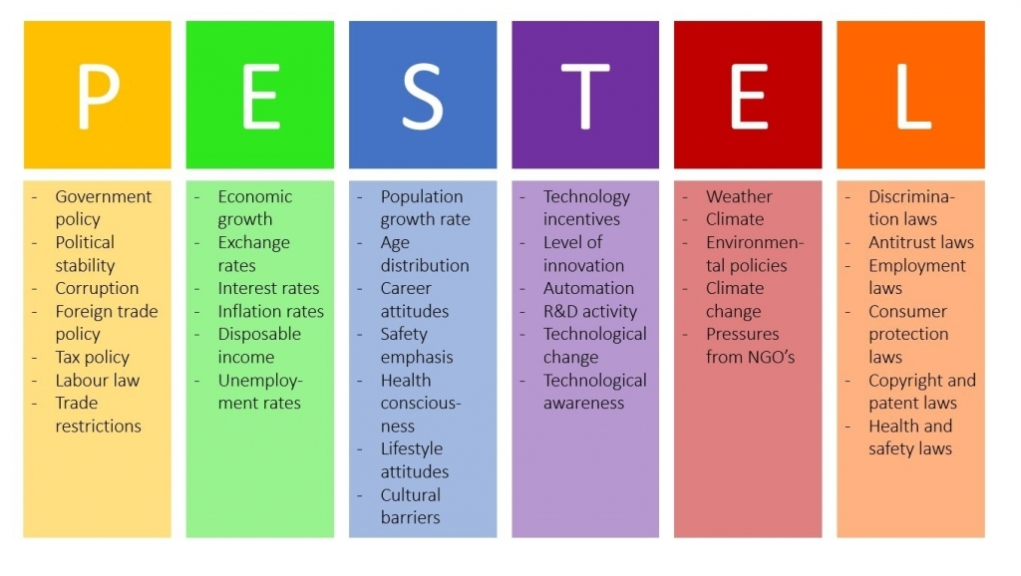
Pestel
Government – due to covid 19 government put the population under lockdown meaning shops had to close their doors to customers
Unemployment rates – number of unemployed raised by 5.8%
Health-conscious – due to lockdown everyone had to stay in their homes to keep other safe
Technological change – due to shops being shut retailers were forced to move there stores online if not already done. This allows retailers to still be able to sell products
Enviromental policies – retailers had rules and regulations to follow regarding covid 19
Health and safety – due to covid 19 shops were shut and 2m distance became a must with mask being a law for this period

Slide 6
Profits and losses
In 2014 the company made £636,000 compared to the year before where the company lost £1.4 million.
Since then, they have launched a brand-new clothing line and made changes to their online store

Slide 7
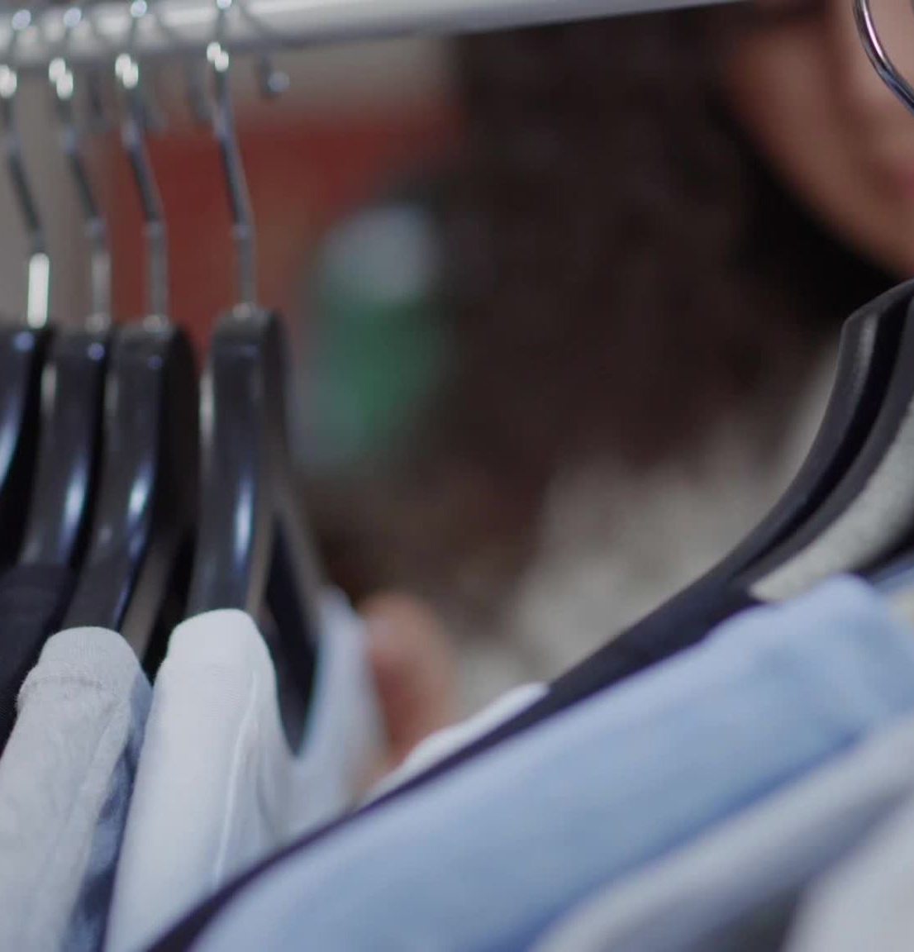
solutions to problems
I think a solution will be to once again open stores especially being men's tailor-made clothing it's hard to judge materials and colors when online shopping also providing a customer service makes people return and gives the company a good name once again.

Slide 8
Competition
With most retailers now making a return to stores after covid-19 I think to be successful you must compare to competitors ensuring you prices are beating other brands where possible this will entice people into the shop as they believe they are getting a deal.

Slide 9



Questions

Slide 10
Referencing
Gov.uk - TM Lewin (shirtmakers) limited
Tm Lewin
Fishbone – google
Pestel - google
Swop - google

