Slide 1



UNIVERSAL STAY AND PLAY
RIFNA BEGUM 1713342
REHANA BIBI 1713117
FULBAN BIBI 1714121
JAMES SAHONTA 1715427
DAVINA THOMAS 1713946
LECTURER: DOREEN NYAH
You’re WELCOME

Slide 2

Executive Summary
With a strong and growing demand for further or higher education, we believe that it is now essential to provide the facilities to meet the needs of our community.
MISSION STATEMENT
We aim to supply to our demands in becoming the leading childcare provider ........
VISION
Maximising and creating professional opportunities for our future

Slide 3

Business Overview
From Two years to Four years of age, this particular stay and play service has been designed to promote access to higher education for parents who wish to return to further studies without the worrying pressures of childcare. The service will run throughout universities who would like to support our system s and aims to become a leading childcare facility.

Slide 4



Products and Services
With several other childcare facilities based locally, our services differ for reasons such as our location. Universal stay and play are specifically based on site of the university campus’s where the parent will take their chosen course of study. With this service open to all students we believe that we are providing accessibility to higher education to all parents. Moreover, our service provides excessive security features.

Slide 5


Target Market
This service is designed particularly targeted towards parents who would like to rebuild or extend on their educational history or experience through university or higher education. We expect that our target market will recognise our values. Research has proven that the demand for childcare facilities is still on the rise. According to our research, our market segment in in demand of supply. This centre aims to teach over 100 learners per year. The particular market segment has been based on geographical factors. We will advertise on an internal basis to keep costs low.

Slide 6

Competitors
Our business has competitors because there are a lot of nurseries in the surrounding areas. Competition in Sparkhill is very high. There are daycares and nurseries around every corner. Here at Universal stay and play we work with parents to suit their schedules by running our services in a particular manner. We are open on a full time basis which allows us to facilitate the academic term during the holidays. Moreover we focus on developing young learners in an academic environment.

Slide 7

Marketing and Sales Plan
RATE
With Value pricing, we have looked into many factors of parenthood and childcare. Moreover the complexities that can be involved when going into further education. We have designed this service to a particular audience based on the demands we have experienced or encountered. We have introduced convenience at low rates. The service is flexible however our academic term is well scheduled meaning that holidays taken within the academic term would need to be authorised well in advance.
PLACE
The service will be run directly from the university campus and is accessible to the community and surrounding areas withing a one mile radius. Plans in place to provide suitable facilities where requirements are not met.
PROMOTION
This tailored and dedicated service is efficient in a variety of ways. Our main feature means that parents and children can attend the same sessions at the same time. We aim to work with communal partners such as other university campuses alongside reputable organisations like Birmingham mind. This will contribute to a mass of our advertising.

Slide 8
Management Team
The Team Roles
Accounts department (responsible for financial control of the business)
Human Resources (manages smooth system with our documentation)
Full time manager (responsible for fulfilling goals and objectives by ensuring all staff workload is complete)
Supervisors ( responsible for productivity and small group actions)
Staff support (assists in a smooth running of daily business operations)

Slide 9
Financial plan
Cash Flow Forecast
Profit and Loss
Start-up Cost: £35,000
Total Income: £409,920
Total Expenses: £335,537
Gross Profit: £74,383
Net Profit: £59,506.40

Slide 10
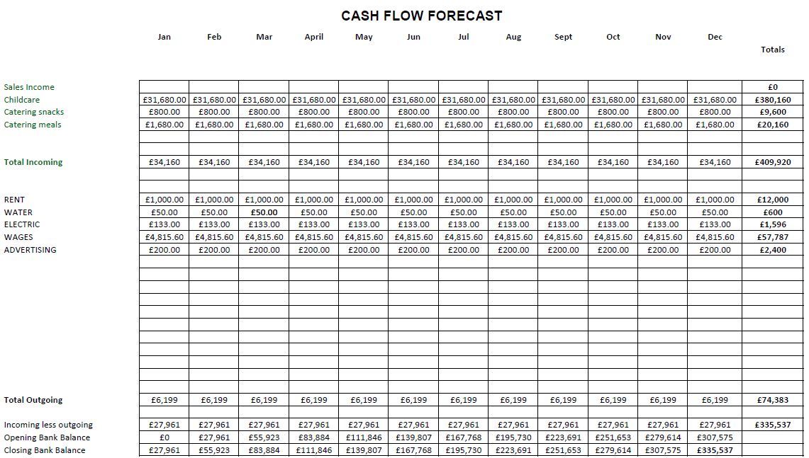
Cash Flow Forecast

Slide 11

SWOT Analysis
STRENGHTS
• Supported learning facility
• Academic environment
• Optional facility
• Qualified team members
• Promotes healthier lifestyle
WEAKNESS
• Children exposed to germs
• Inappropriate behaviour
OPPORTUNITIES
• Early academic opportunities
• Networking
• Company growth
THREATS
• Employees
• Technology
• Young learners
• Audits

Slide 12
PESTLE Analysis
P
Government policies are always changing and for this reason we must run services accordingly. The way information is held to the enrolment of a young learner. To run this type of facility means that all legislation must be fully complied with in order to comply with government policies which are constantly changing. Our database will comply with today's legislation such as relevant staff training
E
‘The British educational suppliers Association (BESA).states that today in the uk, there are an estimated 23,500 day nurseries, 9,600 pre-schools and sessional crèches, 59,500 childminders and 15,000 out- of- school childcare providers. Early education and childcare is booming’ (Hayes, P: 17 may 2016). These statistics show how big the childcare business demand is in the UK.
S
Children who are exposed in their early childhood tend to grow up with strong social skills. This decreases the impact on children struggling with anxiety. Which long term would benefit our future society
T
Schools already carry a major risk in regards to the duty of care provided to the mass number of young learners. Technology adds to the already negative factors we face in today. This factor has raised controversy and needs to be well considered before introducing such systems into an academic setting. For example parental control. Disturbing or illegal viruses are just one of the many that can affect the academic learning database.
L
Besides the many legal aspects involved in business, working with young learners presents many risks. An employer needs to make sure all employees satisfy all policies and procedures accordingly with DBS regulations before offering employment.
E
There are many things to consider when running a business. We believe the environment is important and for this reason, we aim to focus on services that are accessible to the public without having to rely on a car. Moreover, our paper usage will be minimal along with our routine recycling system.

Slide 13
References
REFERENCES DECEMBER 2018
PESTLE
https://rapidbi.com/pestle-analysis-for-schools-and-education/
(B.E.S.A) British Educational suppliers Association. Available at
Https://www.besa.org.uk
Accessed on (23.11.18)
How important are small businesses to local economies
Available at Https://smallbusiness.chron.com
Accessed on (25.11.18
(NACCRRA). The nations network of child care resource and referral.
Available at. https://www.nurseryworld.co.uk/nursery-world/opinion/1157329/early-education-and-childcare-forecast-for-2020-trends
Accessed on (28.11.18)

Slide 14
Lafortune.A. ( 2014 ) What Is the Family Impact on Early Childhood Development. Available at.
https://www.livestrong.com/article/267910-what-is-the-family-impact-on-early-childhood-development/
Accessed on 15/11/2018
Davis. B. (2017) Environmental Factors that Influence Social Development in Children. Available at.
https://www.livestrong.com/article/550087-environmental-factors-for-social-development-in-children/
Accessed on 15/11/2018
HEALTH AND SAFETY AT WORK ACT 1974
https://worksmart.org.uk/health-advice/health-and-safety/employer-duties/what-health-and-safety-work-act
PUBLIC LIMITED
https://smallbusiness.chron.com/ltd-mean-after-business-name-3277.html
ADVERTISING
Birminghammind.org.uk
Uwtsd.ac.uk

